Slide 1
Contents
Introduction
Data Preparation
Exploratory Data Analysis
Prediction and Modeling Techniques
Model Building and Evalution
Analysis and comparison
Conclusion

Slide 2
Introduction
Housing prices are an important reflection of the economy, and housing price ranges are of great interest for both buyers and sellers.
In this project. house prices will be predicted given explanatory variables that cover many aspects of residential houses. As continuous house prices, they will be predicted with various regression techniques including Lasso, Ridge, SVM regression, and Random Forest regression; as individual price ranges, they will be predicted with classification methods including Naive Bayes, logistic regression, SVM classification, and Random Forest classification.
We will also perform PCA to improve the prediction accuracy.
The goal of this project is to create a regression model and a classification model that are able to accurately estimate the price of the house given the features.

Slide 3
Data Preparation
he dataset contains a large number of variables that are involved in determining a house price. We obtained a csv copy of the data from https://www.kaggle.com/prevek18/ames-housing-dataset.
Data Description:The dataset contains 2930 records (rows) and 82 features (columns).

Slide 4
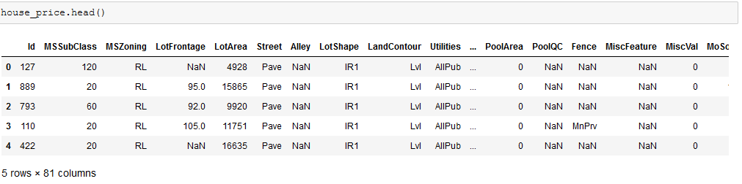
Conti..

Slide 5
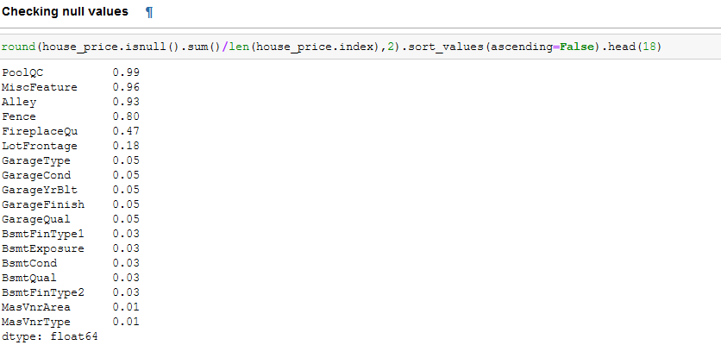
Data cleaning:Dealing with missing values

Slide 6
Outlier Removal
the author states that there are five unusual values and outliers in the dataset, and encourages the removal of these outliars.
Deleting Some Unimportant Columns
We will delete columns that are not useful in our analysis.
dataset.drop(['Order', 'PID'], axis=1, inplace=True)

Slide 7
Exploratory Data Analysis
Target Variable Distribution.
Correlation Between Variables:
We want to see how the dataset variables are correlated with each other and how predictor variables are correlated with the target variable.
fig, ax = plt.subplots(figsize=(12,9)) sns.heatmap(dataset.corr(), ax=ax);

Slide 8
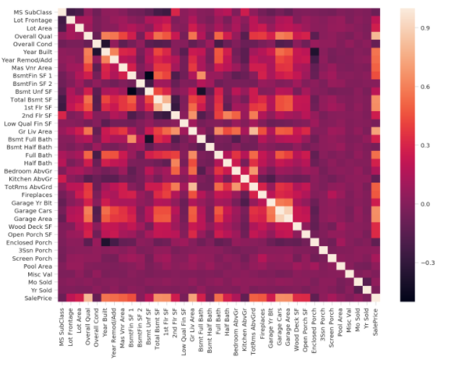
HeatMap

Slide 9
Conti..
Firstly, we want to visualize the relationships between the target variable and the variables that are highly and positively correlated with it, according to what .we saw in the heatmap.
When we plotted the heatmap, we also discovered a significant negative correlation between Bsmt Unf SF and BsmtFin SF 1, and between Bsmt Unf SF and Bsmt Full Bath

Slide 10
Feature Engineering
Creating New Derived Features
Dealing with Ordinal Variables
Encode our categorical features using one-hot encoding technique which transforms the categorical variable into a number of binary variables based on the number of unique categories in the categorical variable; each of the resulting binary variables has only 0 and 1 as its possible values

Slide 11
Prediction Type and Modeling Techniques
we choose the type of machine learning prediction that is suitable to our problem. We want to determine if this is a ragression problem or a classification problem. In this project, we want to predict the price of a house given information about it.
The price we want to predict is a continuous value; it can be any real number. This can be seen by looking at the target vatiable in our dataset SalePrice:
dataset[['SalePrice']].head()

Slide 12
Conti..
The techniques that we will try are:
Linear Regression
Nearest Neighbors
Support Vector Regression
Decision Trees
Neural Networks
Random Forest
Gradient Boosting

Slide 13
Model Building and Evaluation
Feature Scaling
Splitting the Dataset
from sklearn.model_selection import train_test_split X_train, X_test, y_train, y_test = train_test_split( dataset.drop('SalePrice', axis=1), dataset[['SalePrice']], test_size=0.25, random_state=3)

Slide 14
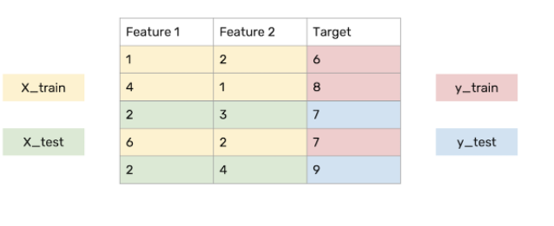
Conti..

Slide 15
Modeling Approach
Choose an algorithm that implements the corresponding technique
Search for an effective parameter combination for the chosen algorithm
Create a model using the found parameters
Train (fit) the model on the training dataset
Test the model on the test dataset and get the results

Slide 16
Modeling
Linear Regression
Ridge Regression
Elastic Net

Slide 17
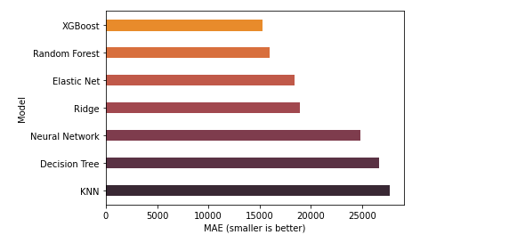
MAE Score

Slide 18
Feature Importances
XGBoost:
Let's discover the most important features as determined by XGBoost model:

Slide 19
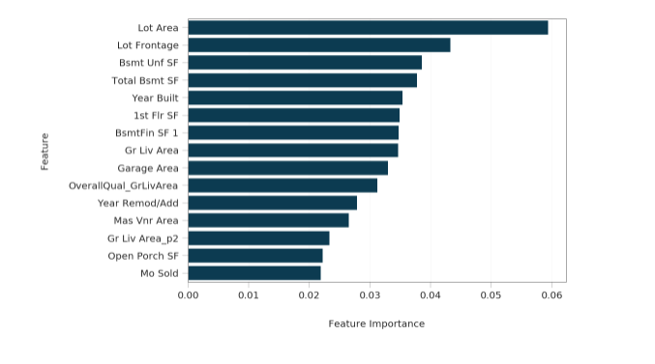
Conti..

Slide 20
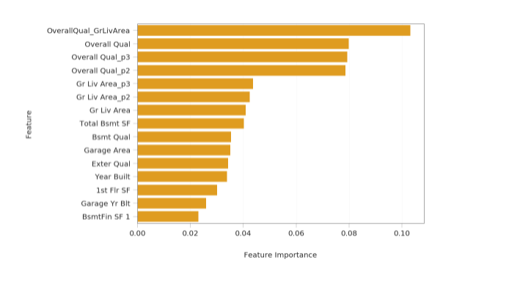
Random Forest

Slide 21
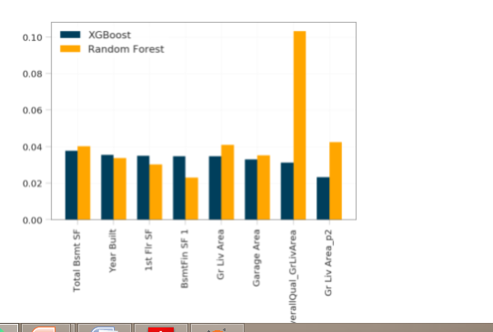
Common Important Features

Slide 22
Conclusion
we built serveral regression models to predict the price of some house given some of the house features. We eveluated and compared each model to determine the one with highest performance.
We also looked at how some models rank the features according to their importance. In this paper, we followed the data science process starting with getting the data, then cleaning and preprocessing the data, followed by exploring the data and building models, then evaluating the results and communicating them with visualizations.

