Slide 1
Contents
Introduction
Data Preparation
Exploratory Data Analysis
Prediction and Modeling Techniques
Model Building and Evalution
Analysis and comparison
Conclusion

Slide 2
Introduction
In micro-lending markets, lack of recorded credit history is a significant impediment to assessing individual borrowers’ creditworthiness and therefore deciding fair interest rates. This research compares various machine learning algorithms on real micro-lending data to test their efficacy at classifying borrowers into various credit categories. We demonstrate that off-the-shelf multi-class classifiers such as random forest algorithms can perform this task very well, using readily available data about customers (such as age, occupation, and location). This presents inexpensive and reliable means to micro-lending institutions around the developing world with which to assess creditworthiness in the absence of credit history or central credit databases.

Slide 3
Conti..
Using a machine learning approach, we can find patterns which cause customer churn and forecast it to obtain a prognosis on which factors impact customer retention. It can help make sense of relationships between data. The models can predict customers with high probability to churn based on analyzing customers personal, demographic and behavioural data to provide personalized and customer-oriented marketing campaigns to gain customer satisfaction.
The goal of this project is to create a regression model and a classification model that are able to accurately estimate the price of the house given the features.

Slide 4
Data Preparation
he dataset contains a large number of variables that are involved in determining a house price. We obtained a csv copy of the The data is collected from the Indian online shoppers.
Data Description:The dataset contains 209593records (rows) and 37 features (columns).

Slide 5
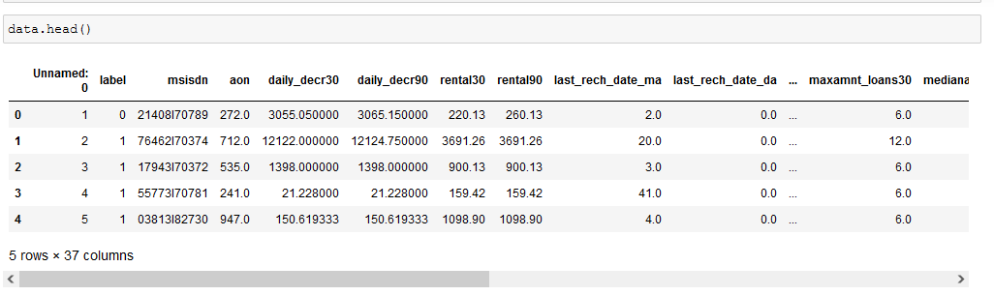
Conti..

Slide 6
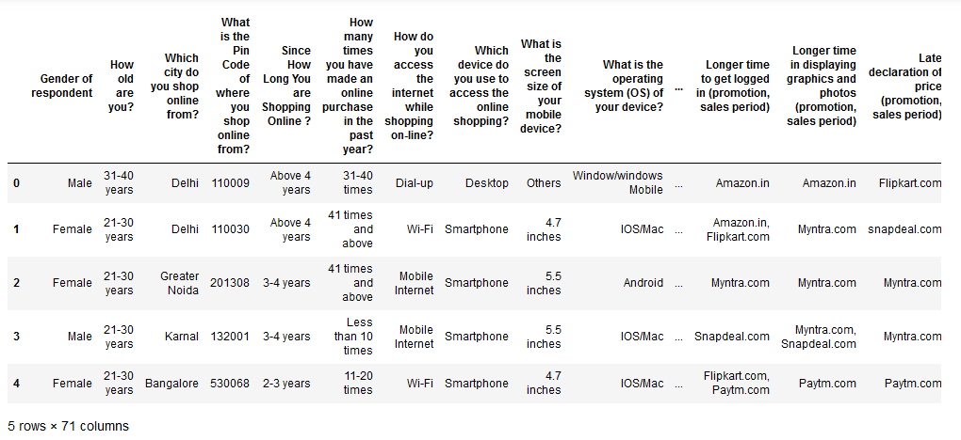
Pre-processing the columns names

Slide 7
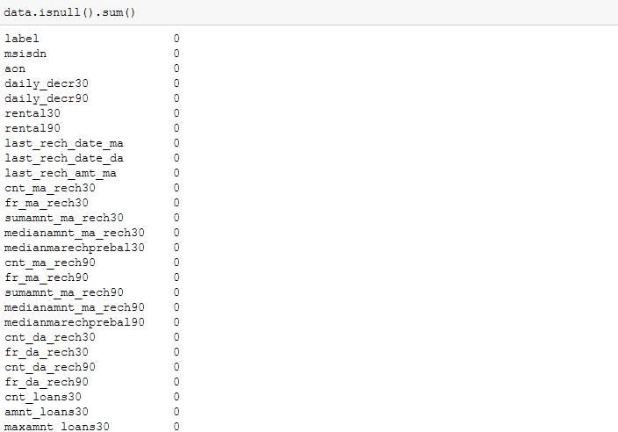
Data cleaning:Dealing with missing values

Slide 8
Exploratory Data Analysis
Target Variable Distribution.
Correlation Between Variables:
We want to see how the dataset variables are correlated with each other and how predictor variables are correlated with the target variable.
The dataset does not have any missing or erroneous data values.
plt.figure(figsize = (8, 5))
plt.title("Correlation between target and features:")
sns.heatmap(data.corr(), annot = True)

Slide 9
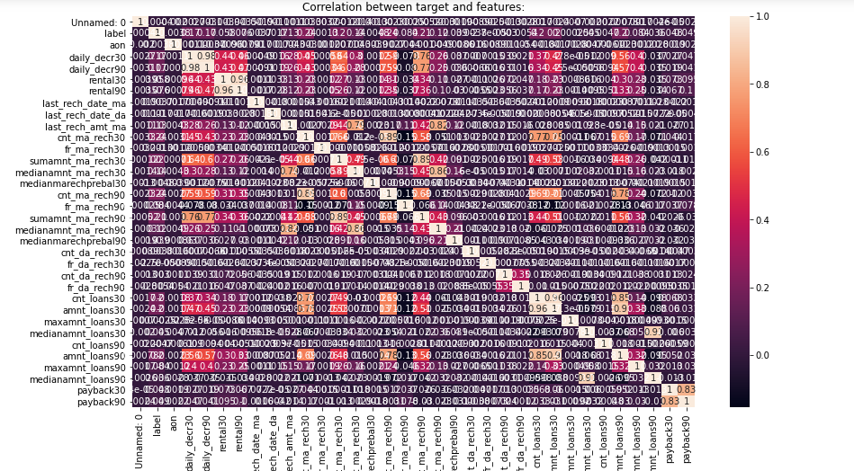
HeatMap

Slide 10
Conti..
Firstly, we want to visualize the relationships between the target variable and the variables that are highly and positively correlated with it, according to what .we saw in the heatmap.

Slide 11
Feature Engineering
Creating New Derived Features
Dealing with Ordinal Variables
Encode our categorical features using one-hot encoding technique which transforms the categorical variable into a number of binary variables based on the number of unique categories in the categorical variable; each of the resulting binary variables has only 0 and 1 as its possible values.

Slide 12
Model Building
Now,the development of a model for predicting if the user will apply for a loan or not will start.
Dummies will be used for converting categorical variables into numerical variables because sklearn models allows only numerical inputs.
The train data set will be divided into two parts,70% of the data will act as training data and the remaining 30% data will be the validation data.

Slide 13
Model Selection
Let’s model each classification algorithm over the training dataset and evaluate their accuracy and standard deviation scores.
LogisticRegression
DecisionTreeClassifier
Random Forest
AdaBoostClassifier

Slide 14
Modeling Approach
Choose an algorithm that implements the corresponding technique
Search for an effective parameter combination for the chosen algorithm
Create a model using the found parameters
Train (fit) the model on the training dataset
Test the model on the test dataset and get the results

Slide 15
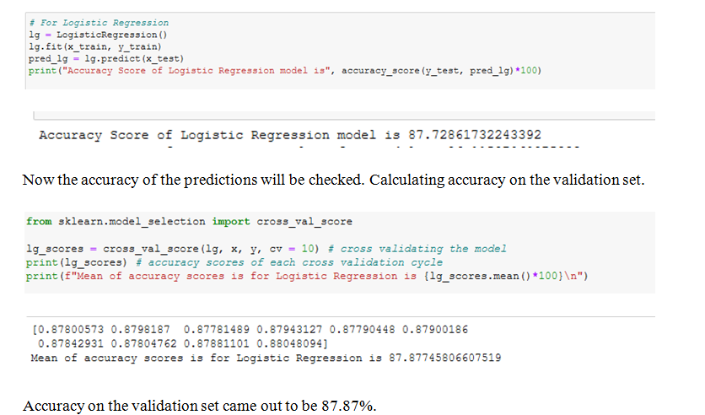
Logistic Regression

Slide 16
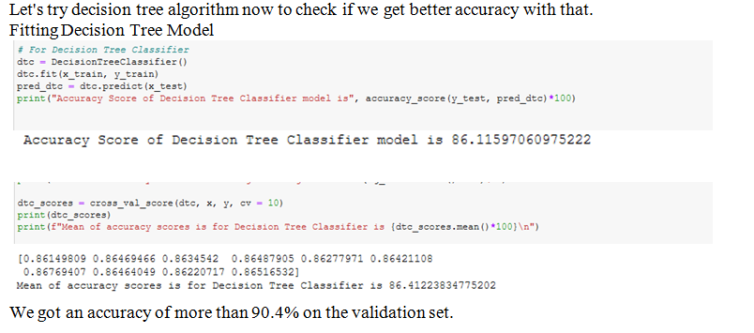
Decision Tree algorithm

Slide 17
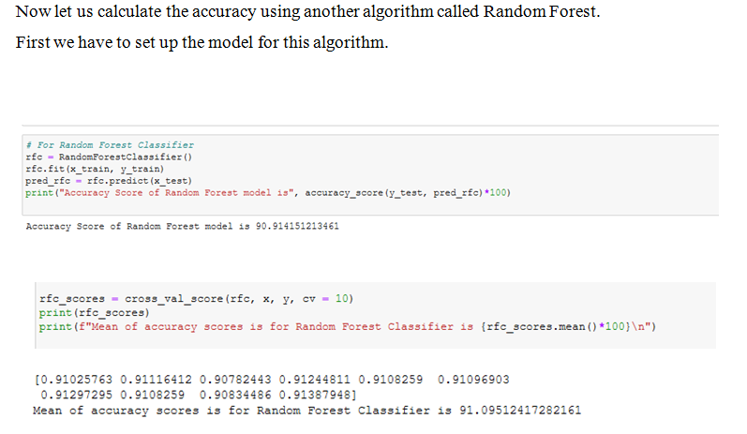
Random Forest Algorithm

Slide 18
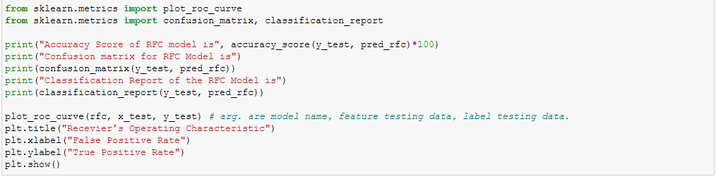
Model Evaluation And Accuracy

Slide 19
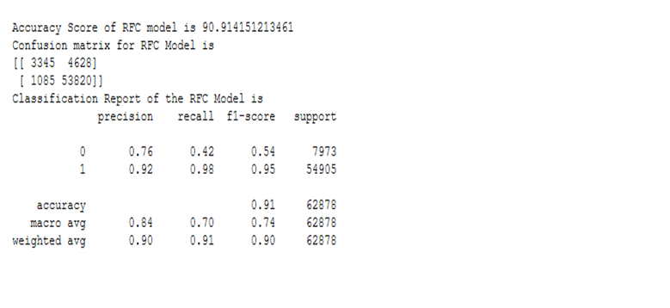
Conti..

Slide 20
Conti..
After the model evaluation , we get the precision and recall for both the target variable as 0.92and 0.98.
Model evaluation gives the results that the prediction is very accurate

Slide 21
Conclusion and Future Work
This study tries to present a benchmark for the most widely used state of the arts for churn classification. The accuracy of the selected models was evaluated on a public dataset of Customer Retention. Based on the findings of this study, ensemble – based learning techniques are recommended as both Random forest and Ad boost models gave the best accuracy.
However, the study can be extended by including hybrid models and deep learning models. Other performance metrics can be used for performance evaluation. Timing measures of the models can also be a major indicator for performance. Models can also evaluate against different datasets from different domains.

