Slide 1
MULTIMODAL SENTIMENT ANALYSIS
Emotion-Aware Multimodal Sentiment
Analysis Using Prototype Memory
Laxmi
Department of Computer Science and Engineering | GLA University, Mathura, India

Slide 2
INTRODUCTION
Why Multimodal Sentiment Analysis?
Human sentiment isn't expressed through words alone — voice tone and facial expression carry signal that text misses.
T
A
V
Text
Audio
Video
Captures semantic content of spoken or written words.
Captures tone, pitch, and speaking style cues.
Captures facial expressions and visual context.
Core challenges: modalities don't contribute equally per sample, and simple concatenation fails to capture cross-modal relationships.
Emotion-Aware Multimodal Sentiment Analysis using Prototype Memory
2

Slide 3
KEY CONTRIBUTION
Emotion Prototype Memory (EPM)
A learnable prototype-based refinement module that sharpens the fused multimodal representation before final sentiment classification.
1
Ranks text, audio & video by learned importance, then fuses them via cascaded cross-attention
2
Compares the fused representation against learnable class prototypes using cosine similarity
3
Refines the representation with retrieved prototype knowledge before the classifier
Result: Test accuracy improves from 55.25% to 60.92%, and weighted F1-score from 55.64% to 61.02% on the MELD dataset.
Emotion-Aware Multimodal Sentiment Analysis using Prototype Memory
3

Slide 4
RELATED WORK
Building on Established Foundations
Pretrained encoders
BERT (text), HuBERT (audio), CLIP ViT-B/32 (video) provide strong single-modality representations.
Attention-based fusion
Transformer self-attention and cross-modal attention model interactions between modalities better than concatenation.
Dynamic modality importance
Not every modality is equally informative for every sample — importance should be estimated per-input.
Prototype-based learning
Comparing representations to learned class prototypes can sharpen class-discriminative features.
Emotion-Aware Multimodal Sentiment Analysis using Prototype Memory
4

Slide 5
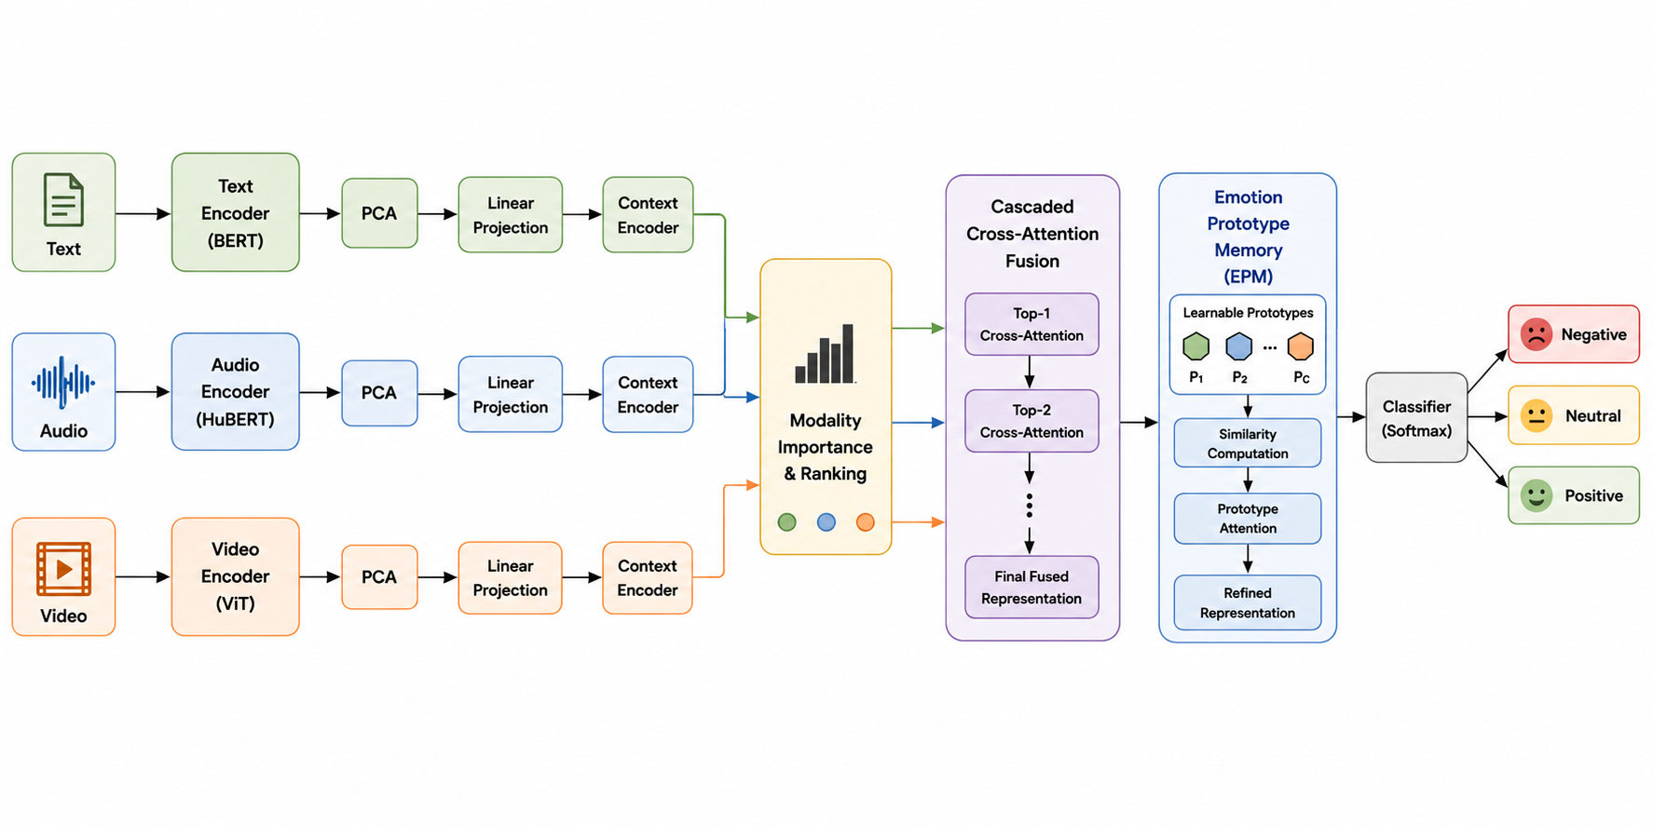
PROPOSED Architecture
Overall Architecture

Slide 6
PROPOSED METHODOLOGY
Overall Framework — Six Stages
Feature
Extraction
→
PCA
Reduction
→
Projection &
Context Encoding
→
Modality
Importance
→
Cross-Attention
Fusion
→
EPM +
Classification
Text, audio & video features are extracted, reduced, projected into a shared space, ranked by importance, fused via cascaded cross-attention, and refined by Emotion Prototype Memory before Softmax classification.
Modalities → PCA → Linear Projection → Transformer Context Encoder → Dynamic Modality Importance (ranking) → Cascaded Cross-Attention → Emotion Prototype Memory → FC + Softmax → Sentiment
Emotion-Aware Multimodal Sentiment Analysis using Prototype Memory
5

Slide 7
PROPOSED METHODOLOGY
Multimodal Feature Extraction
Text
Audio
Video
BERT
HuBERT
CLIP ViT-B/32
768-D
768-D
512-D
[CLS] token embedding used as sentence-level representation of the utterance.
Self-supervised speech model captures acoustic tone, pitch and speaking style.
Image encoder extracts semantic & visual features from a representative frame.
T = BERT(Xt) A = HuBERT(Xa) V = CLIP(Xv)
Emotion-Aware Multimodal Sentiment Analysis using Prototype Memory
6

Slide 8
PROPOSED METHODOLOGY
Dimensionality Reduction with PCA
High-dimensional features are compressed to reduce redundancy and computational cost before fusion.
Modality | Original Dim. | Reduced Dim. | Reduction
Text (BERT) | 768 | 256 | 66.7% ↓
Audio (HuBERT) | 768 | 128 | 83.3% ↓
Video (CLIP ViT-B/32) | 512 | 16 | 96.9% ↓
Visual features shrink most aggressively (512→16) — CLIP embeddings carry highly redundant information for this task.
Emotion-Aware Multimodal Sentiment Analysis using Prototype Memory
7

Slide 9
PROPOSED METHODOLOGY
Dynamic Modality Importance (DMI)
Not every modality is equally useful for every sample — DMI learns per-sample importance weights before fusion.
Per-modality scoring
Importance Weighting
Context-encoded text, audio & video pass through independent scoring layers
si = f(modality context)
Scores are normalized with Softmax into weights αt, αa, αv (they sum to 1)
αi = exp(si) / Σ exp(sj)
αt + αa + αv = 1
Higher weight ⇒ that modality carries more sentiment signal for this sample
Weighted representations: Tw = αt·Tc, Aw = αa·Ac, Vw = αv·Vc
Weighted features are ranked and handed to cross-attention fusion
Ranked and passed to cascaded cross-attention
Emotion-Aware Multimodal Sentiment Analysis using Prototype Memory
8

Slide 10
PROPOSED METHODOLOGY
Cascaded Cross-Attention Fusion
Modalities are combined progressively by importance rank — not concatenated — so each stage learns richer cross-modal interactions.
M2
M3
M1
(top-ranked)
Cross-
Attention
F1
Cross-
Attention
F
(final fused)
Emotion-Aware Multimodal Sentiment Analysis using Prototype Memory
9

Slide 11
CORE MODULE
Emotion Prototype Memory (EPM)
P1
P2
P3
Learnable prototypes — one representative pattern per sentiment class
1
Similarity
Cosine similarity between fused feature F and each prototype Pi
2
Attention
Softmax over similarities gives attention weights βi
3
Retrieval
Weighted sum of prototypes → retrieved representation R = Σ βi·Pi
4
Refinement
Refined feature F′ = F + R, passed to the classifier
Emotion-Aware Multimodal Sentiment Analysis using Prototype Memory
10

Slide 12
PROPOSED METHODOLOGY
Classification & Training
Refined feature F′ → fully connected layer → Softmax over 3 classes
Optimization
Optimizer
Adam
Predicted label = argmax over class probabilities P(yi)
Loss
Cross-Entropy
Classes
Positive / Neutral / Negative
Trained end-to-end with cross-entropy loss
Framework
PyTorch
All components — projections, context encoder, DMI, fusion, EPM, classifier — optimized jointly via backpropagation
Emotion-Aware Multimodal Sentiment Analysis using Prototype Memory
11

Slide 13
EXPERIMENTAL SETUP
MELD Dataset
Multimodal EmotionLines Dataset — collected from the TV series Friends, with synchronized text, audio & video per utterance.
Multimodal EmotionLines Dataset — collected from the TV series Friends, with synchronized text, audio & video per utterance.
Source
TV series “Friends” — multi-party conversations
Modalities
Synchronized text, audio & video per utterance
Labels used
Sentiment: Positive / Neutral / Negative
Splits
Official train / validation / test splits used for fair evaluation
Emotion-Aware Multimodal Sentiment Analysis using Prototype Memory
12

Slide 14
RESULTS
Baseline vs. Proposed (EPM) Model
+5.67 pts
Accuracy improvement
+5.38 pts
Weighted F1 improvement
Emotion-Aware Multimodal Sentiment Analysis using Prototype Memory
13

Slide 15
DISCUSSION
Why EPM Helps
1
2
3
Complementary modalities
Adaptive fusion
Prototype refinement
Text, audio & video jointly capture semantic content, speech characteristics, and visual cues that no single modality provides alone.
DMI + cascaded cross-attention emphasize the most informative modality per sample while retaining complementary signal.
EPM injects class-specific knowledge, reducing ambiguity between overlapping sentiment classes before classification.
Takeaway: prototype-based refinement is a lightweight, effective add-on to attention-based multimodal fusion pipelines.
Emotion-Aware Multimodal Sentiment Analysis using Prototype Memory
14

Slide 16
CONCLUSION
Conclusion
BERT + HuBERT + CLIP feature extraction, PCA reduction, and shared-space projection
Dynamic Modality Importance ranks modalities per sample
Cascaded cross-attention fusion combines modalities progressively
EPM refines the fused representation with learned prototypes
Accuracy improves from 55.25% → 60.92% on MELD
Emotion-Aware Multimodal Sentiment Analysis using Prototype Memory
15

Slide 17
Thank You
Questions & Discussion
Laxmi | Department of Computer Science and Engineering, GLA University, Mathura

