Slide 1
AWS EC2 web server project
Created by harshitha
Date : 11-01-2026

Slide 2
Introduction
Aws (amazon web services) provides cloud computing services.
AWS management console : it is a web based dashboard to access and manage all aws services.
In this project ,an EC2 instance is used to host an application.
It ensures scalability,elasticity,security,and reliability.

Slide 3
Problem statement
Need a secure and scalable server.
Tradition servers are costly.
AWS EC2 provides a cost-effective solution.

Slide 4
AWS services used
Amazon EC2 (amazon elastic compute cloud) : EC2 provides an virtual servers (called instances) to run apllications.
Amazon VPC (amazon virtual private cloud) : VPC allows you to create a private network within AWS.
It gives you control ober your IP addresses,subnets,route tables and security.
Security groups : Act as a virtual firewalls for EC2 instances.
Control inbound and outbound traffic.
NACLS : act as firewalls at the subnet level.
AWS IAM : IAM stands for identity and access management.it helps you securely control access to AWS resources.
Amazon cloudtrail : it records every action performed in AWS
It records : who logged in,which api was called,which resource was created,deleted, or modified,from where the request originated.
Amazon CloudTrail : it records every action performed in AWS.

Slide 5
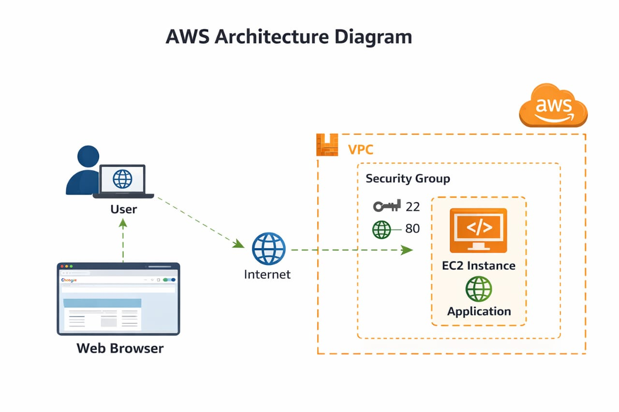
Architecture diagram

Slide 6
Implementation steps
1.created AWS account with root email.
2.created IAM group and users.
3.created VPC.
4.launched EC2 inside VPC.
5.configure security group.
6.connected using SSH.
7.installed web server.

Slide 7
Security configuration
Security group allows SSH(22)
HTTP(80) enabled
IAM user created with limited access

Slide 8
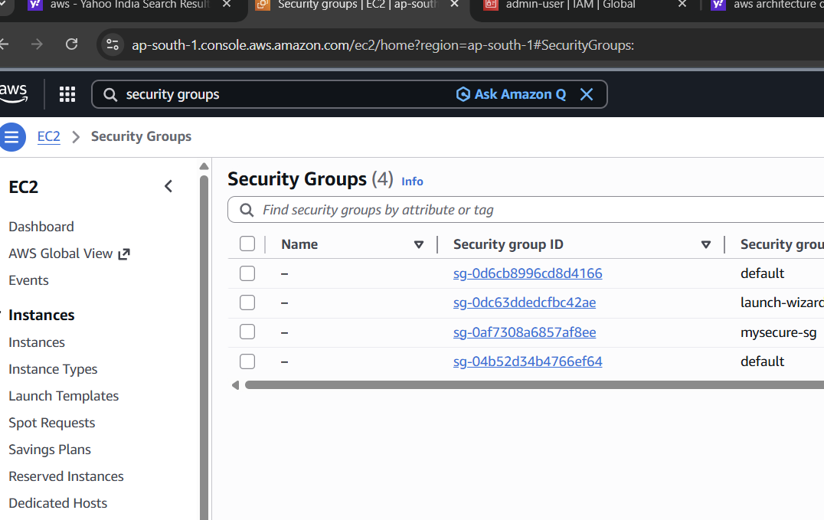
security groups

Slide 9
Monitoring and logs
AWS cloudtrail logs API activities.
Cloudwatch monitors EC2 performance.

Slide 10
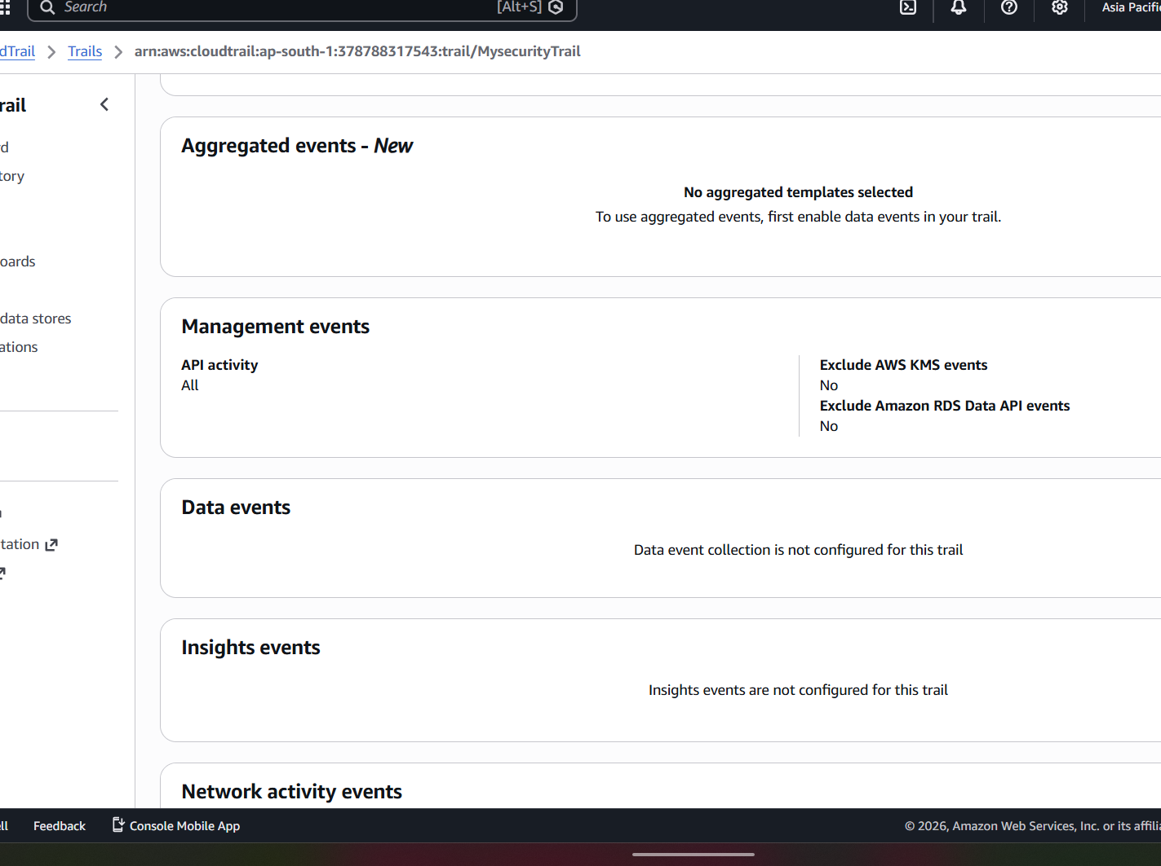

Slide 11
output
EC2 instance launched successfully.
Secure access configured.
Application running successfully.

Slide 12
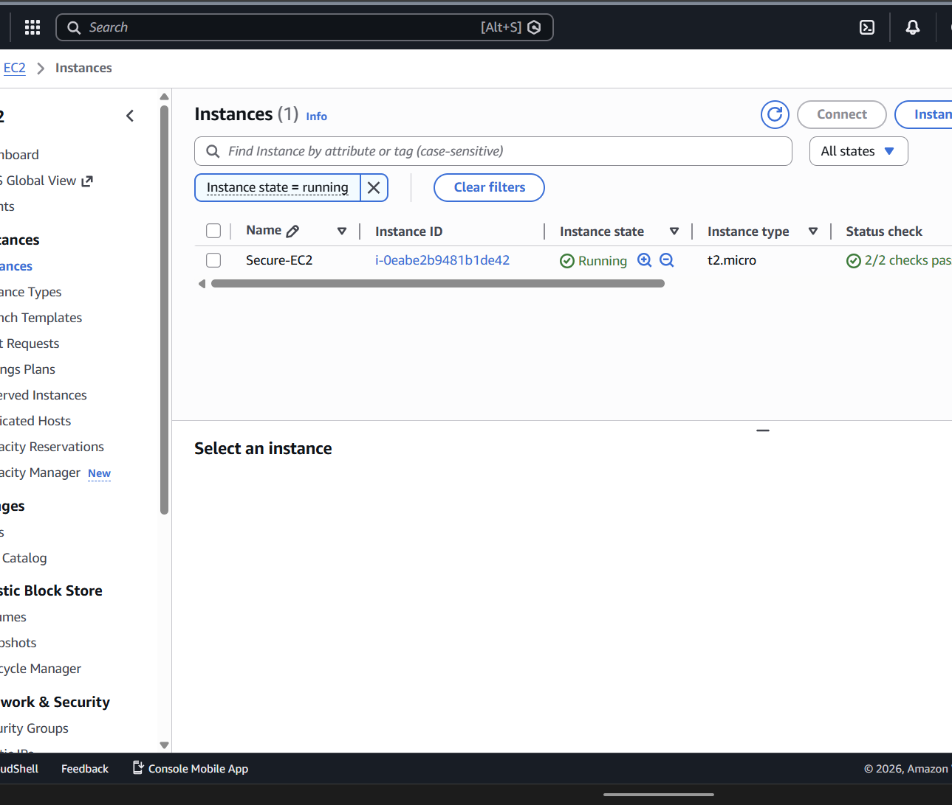
Ec2 instance

Slide 13
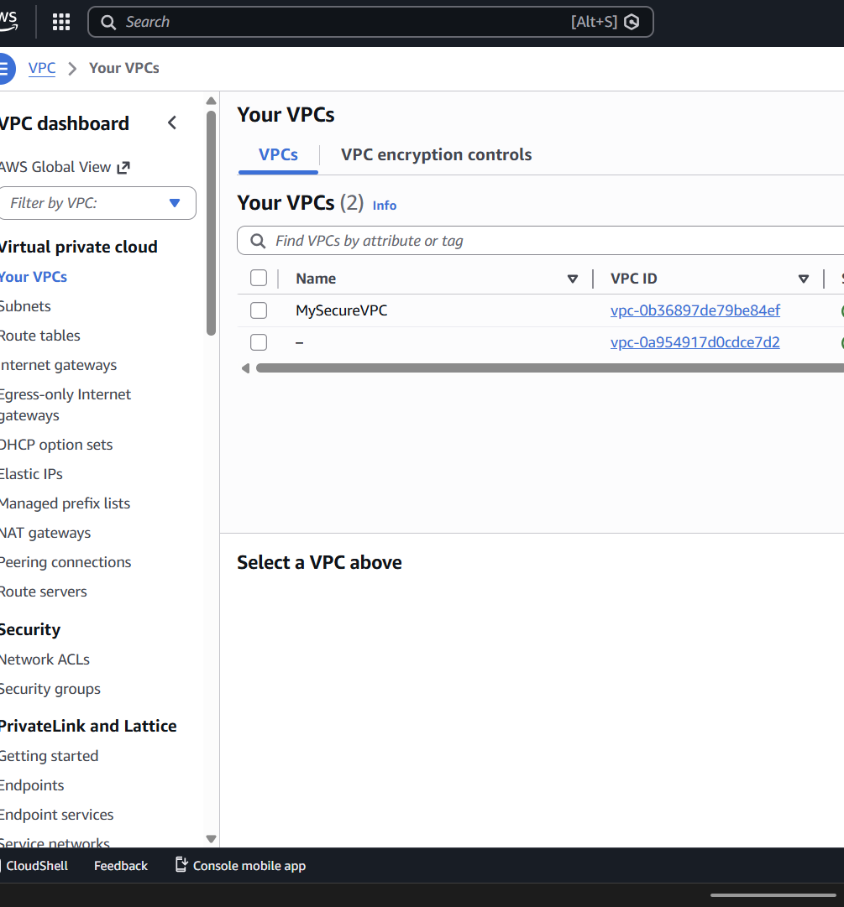
VPC

Slide 14
conclusion
AWS EC2 is flexible and scalable.
Security and monitoring are easy to manage.
Project achieved successfully.

