Slide 1
Employee Data Analysis using Excel
STUDENT NAME: N.S.LAYAA
REGISTER NO: 322200039
DEPARTMENT: B.COM HONOURS (shift 2)
COLLEGE: ANNA ADARSH COLLEGE FOR WOMEN, CHENNAI

Slide 2
PROJECT TITLE
Employee Performance Analysis using Excel

Slide 3


AGENDA
Problem Statement
Project Overview
End Users
Our Solution and Proposition
Dataset Description
Modelling Approach
Results and Discussion
Conclusion
3/21/2024 Annual Review

Slide 4

PROBLEM STATEMENT
To track the performance of the employee so as to analyse his/her growth in the organization.
To understand how to incentivize the employees based on their performance

Slide 5

PROJECT OVERVIEW
The main aim of this project is to evaluate employee performance with MS Excel.
The employee performance is evaluated through various factors such as Employee name, Performance level, Employee rating, Gender and other relevant factors.
Using this analysis, employees are categorized into Very High, High, Medium and Low performing employees
It also provides the trend of the employees performing in the organisation
This will enable the employer to know the areas in which more attention should be paid.

Slide 6

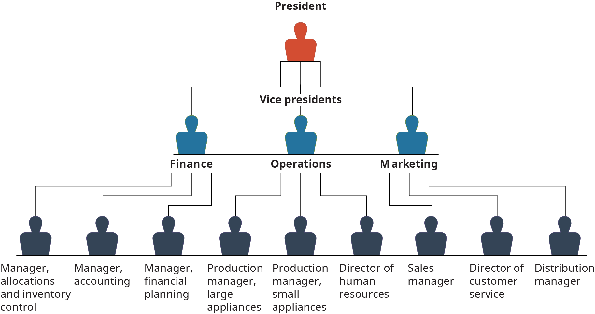

WHO ARE THE END USERS?
EMPLOYEES OF THE ORGANISATION:
THE PERFORMANCE REVIEW OF EMPLOYEES ENABLE THEM TO IMPROVE THEIR PERFORMANCE BY KNOWING HOW THEY ARE CURRENTLY PERFORMING.
2) MANAGEMENT OF THE ORGANISATION:
THE MANAGEMENT OF THE ORGANISATION CAN ASSESS THE PERFORMANCE OF THE EMPLOYEES AND FURTHER PROVIDE ANY REWARDS OR PENALTIES BASED ON THEIR PERFORMANCE

Slide 7

OUR SOLUTION AND ITS VALUE PROPOSITION
CONDITIONAL FORMATTING: TO HIGHLIGHT MISSING VALUES
FILTER: TO REMOVE MISSING VALUES FROM THE GIVEN DATA
FORMULA: TO CALCULATE THE PERFORMANCE OF EVERY EMPLOYEE
PIVOT TABLE: TO SUMMARIZE THE EMPLOYEE DATA
GRAPHS: TO VISUALIZE THE PERFORMANCE OF EMPLOYEES

Slide 8
Dataset Description
EMPLOYEE DATASET – FROM KAGGLE
TOTAL : 26 FEATURES
USED 9 FEATURES:
EMPLOYEE ID: NUMERICAL
EMPLOYEE FIRST NAME: TEXT
EMPLOYEE LAST NAME: TEXT
PERFORMANCE LEVEL
GENDER : MALE/ FEMALE
EMPLOYEE RATING: NUMERICAL
BUSINESS UNIT: TEXT
EMPLOYEE STATUS: TEXT
EMPLOYEE TYPE: TEXT

Slide 9

THE "WOW" IN OUR SOLUTION
THE PERFORMANCE LEVEL OF THE EMPLOYEES WERE CATEGORIZED INTO LOW, MEDIUM, HIGH AND VERY HIGH.
PERFORMANCE LEVEL WAS CALCULATED USING:
=IFS(Z8>=5,"VERY HIGH",Z8>=4,"HIGH",Z8>=3,"MED",TRUE,"LOW")
3/21/2024 Annual Review
9

Slide 10
MODELLING
DATA COLLECTION:
DATA SET WAS DOWNLOADED FROM KAGGLE.COM
FEATURE SELECTION
THE MAIN THEME OF THE PROJECT IS EMPLOYEE PERFORMANCE. SO, FEATURES LIKE EMPLOYEE NAME, PERFORMANCE CODE, EMPLOYEE RATINGS, GENDER, START AND END DATE WERE SELECTED TO ANALYSE THE DATA
DATA CLEANING:
IDENTIFICATION OF MISSING VALUES: THE MISSING DATA WAS HIGHLIGHTED IN EXCEL USING THE CONDITIONAL FORMATTING TECHNIQUE. THE BLANK SPACES WERE HIGHLIGHTED USING THIS METHOD.
FILTERING THE MISSING VALUES: THE MISSING VALUES WERE FILTERED USING THE FILTER OPTION IN EXCEL SO AS TO HAVE ONLY EXISTING VALUES
CALCULATION OF PERFORMANCE LEVEL :
PERFORMANCE LEVEL OF EACH EMPLOYEE WAS CALCULATED USING THE FORMULA:
=IFS(Z8>=5,"VERY HIGH",Z8>=4,"HIGH",Z8>=3,"MED",TRUE,"LOW") TO CATEGORIZE EACH EMPLOYEE AS VERY HIGH, HIGH , MEDIUM OR LOW LEVEL PERFORMING EMPLOYEE
10

Slide 11
SUMMARY:
THE PERFORMANCE LEVEL OF EMPLOYEES WERE SUMMARIZED USING THE PIVOT TABLE FUNCTION IN EXCEL
VISUALIZATION:
THE EMPLOYEES’ PERFORMANCE IS VISUALLY PRESENTED WITH THE HELP OF GRAPHS IN THE FORM OF CLUSTERED COLUMNS
EMPLOYEES ARE CLASSIFIED INTO LOW, MEDIUM, HIGH AND VERY HIGH LEVEL PERFORMING EMPLOYEES

Slide 12
RESULTS
12

Slide 13
conclusion
FROM THE GIVEN TABLES AND GRAPHS, WE CAN OBSERVE THAT THERE ARE A MAXIMUM OF MEDIUM PERFORMING EMPLOYEES AND A MINIMUM OF VERY HIGH PERFORMING EMPLOYEES.
THESE MEDIUM OR AVERAGE PERFORMING EMPLOYEES CAN BE TRAINED BY PROVIDING TASKS WHICH PUSHES THEM TO THEIR MAXIMUM CAPACITY. THEIR NEEDS SHOULD BE SATISFIED BY PROVIDING MONETARY AND NON MONETARY INCENTIVES.
THE HIGH AND VERY HIGH LEVEL PERFORMING EMPLOYEES COULD BE PROMOTED TO HIGHER LEVELS AND BE PROVIDED WITH MORE CHALLENGING TASKS
PROPER TRAINING SHOULD BE GIVEN TO LOW PERFORMING EMPLOYEES SO AS TO IMPROVE THEIR PERFORMANCE.

