Slide 1


PAPER ID: ICISC 143
Comparison of sarsa and temporal difference learning algorithm for robotic path planning for static obstacles
Dr. P.SUPRIYA
SUPERVISOR Associate Professor Electrical & Electronics Engineering Amrita Vishwa Vidyapeetham
Coimbatore
LAYA HARWIN
CB.EN.P2EBS17014
MTech 2nd Year
Electrical & Electronics Engineering
Amrita Vishwa Vidyapeetham
Coimbatore

Slide 2
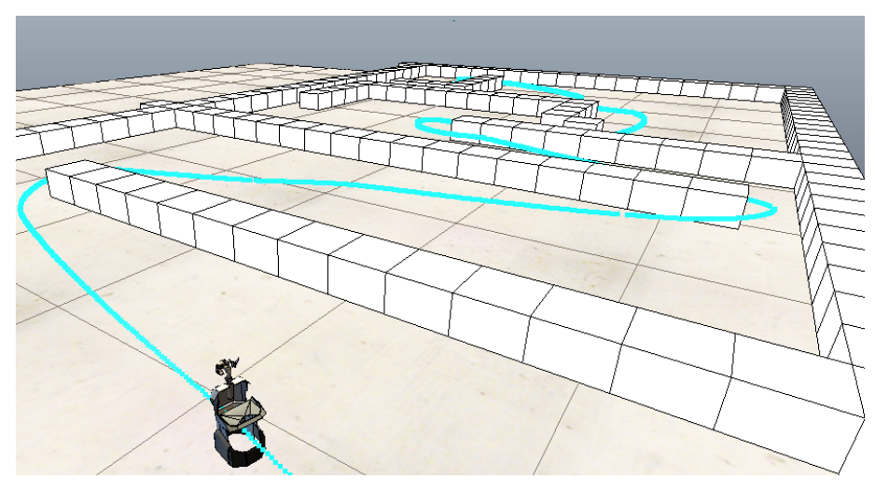
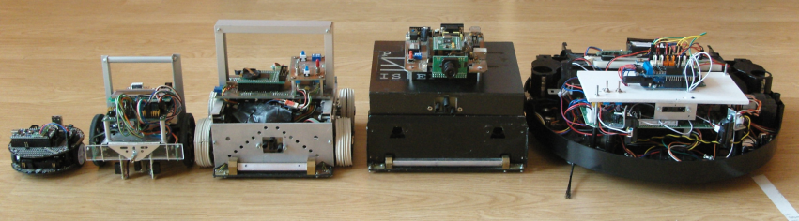
INTRODUCTION
Automation is turning into a vital part of human day to day life.
Robotics is a versatile domain with various areas open.
Robotic path planning can be done by various techniques.
Path planning is an important requirement for autonomous mobile robots

Slide 3
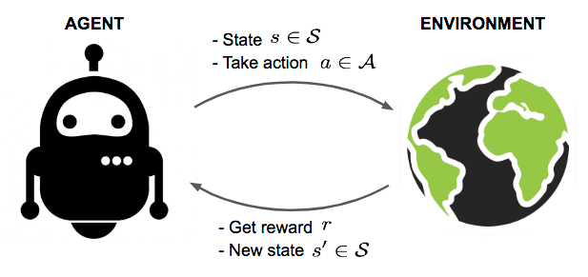

Reinforcement learning
WHAT IS RL ALGORITHM?
Type of Machine Learning
Allows machines and software agents- determines ideal behaviour-maximize its performance.
Simple reward feedback
agent learns by trial-and-error method
Punishes for wrong action
WHY RL ALGORITHM?
Learn its behaviour based on feedback from the environment.
Can be learnt once and for all, or keep on adapting as time goes by.
Less human effort
Less time
WHY RL?
Learn its behaviour based on feedback from the environment.
Can be learnt once and for all, or keep on adapting as time goes by.
If the problem is modelled with care, some RL algorithms can converge to the global optimum.
Little need for a human expert who knows about the domain of application.
Much less time will be spent designing a solution, since no complex sets of rules
WHICH RL?
REINFORCEMENT LEARNING
SARSA
(STATE,ACTION,REWARD,NEXT STATE,NEXT ACTION)
WHICH RL ALGORITHM?
REINFORCEMENT LEARNING
SARSA
(STATE,ACTION,REWARD,NEXT STATE,NEXT ACTION)

Slide 4
SARSA ALGORITHM (STATE ACTION REWARD STATE ACTION)
Uses <state, action, reward, state, action> experiences rather than the <state, action, reward, state> used by Q-learning.
Instead of looking for the best action at every step, it evaluates the actions suggested by the current policy
Uses this info to revise it
On-policy learning learns the value of the policy being followed.
e.g., act greedily 80% of the time and act randomly 20% of the time

Slide 5
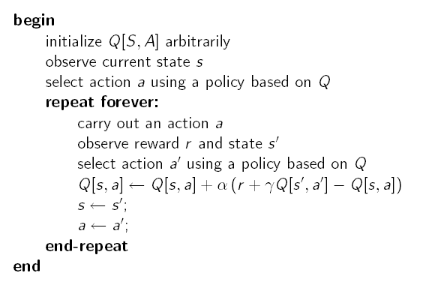
SARSA ALGORITHM (STATE ACTION REWARD STATE ACTION)
This could be, for instance any ε-greedy strategy:
Choose random ε times, and max the rest
This could be, for instance any ε-greedy strategy:
- Choose random ε times, and max the rest
If the random step is chosen here, and has a bad negative reward, this will affect the value of Q[s,a].
Next time in s, a’ may no longer be the action selected because of its lowered Q value

Slide 6
REWARD FUNCTION OF SARSA ALGORITHM
SL NO | POSITION IN THE GRID | REWARD POINTS
1 | Source Point | 0
2 | Destination Point | 1
3 | Obstacles | -1

Slide 7
Temporal Difference Learning Algorithm
- ALGORITHM:
The algorithm for the TD learning is described below:
1. Start the trajectory from source point.
2. A reward function is assigned for all possible movements. First-diagonally forward movement, next priority- vertically forward movement and last precedence - horizontally forward.
3. Q(st,at)←Q(st,at)+α[rt+1+γmaxQ(st+1,at+1)−Q(st,at)], where R(a’) is the reward function assigned for action a’.
4. Follow the path having higher value.
5. Repeat the steps 1-4 until the target position is reached.

Slide 8

SARSA TD learning
SARSA
TD LEARNING
ON policy
Q(st,at)←Q(st,at)+α[rt+1+γQ(st+1,at+1)−Q(st,at)]
Take actual action
Explores the environment
Allows possible penalties from exploratory restricted areas
SARSA will tend to avoid a dangerous optimal path and only slowly learn to use it when the exploration parameters are reduced.
OFF policy
Q(st,at)←Q(st,at)+α[rt+1+γmaxQ(st+1,at+1)−Q(st,at)]
Take the action with highest reward.
Doesn’t explore the environment
Q-learning will ignore them.
More concentrated on the optimal path and not on the consequences

Slide 9
Assumptions Made while simulating sarsa and td learning algorithm
- Assumptions Made
Some of the major assumptions applied for path planning are as follows:
1. A 6x6 grid with 36 cells is considered for path planning environment.
2. Obstacles are located at the centre of each cell.
3. Target position is altering in the environment.
4. Robot is forbidden from moving backwards.

Slide 10
SYSTEM LAYOUT OF A 6X6 GRID
(0.5,5.5) | (1.5,5.5) | (2.5,5.5) | (3.5,5.5) | (4.5,5.5) | (5.5,5.5)
(0.5,4.5) | (1.5,4.5) | (2.5,4.5) | (3.5,4.5) | (4.5,4.5) | (5.5,4.5)
(0.5,3.5) | (1.5,3.5) | (2.5,3.5) | (3.5,3.5) | (4.5,3.5) | (5.5,3.5)
(0.5,2.5) | (1.5,2.5) | (2.5,2.5) | (3.5,2.5) | (4.5,2.5) | (5.5,2.5)
(0.5,1.5) | (1.5,1.5) | (2.5,1.5) | (3.5,1.5) | (4.5,1.5) | (5.5,1.5)
(0.5,0.5) | (1.5,0.5) | (2.5,0.5) | (3.5,0.5) | (4.5,0.5) | (5.5,0.5)

Slide 11
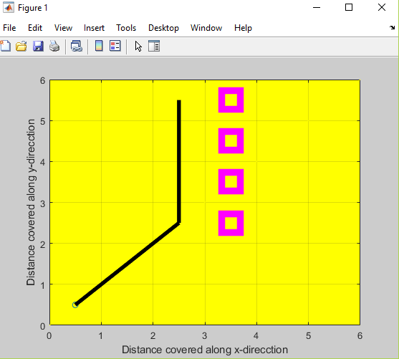
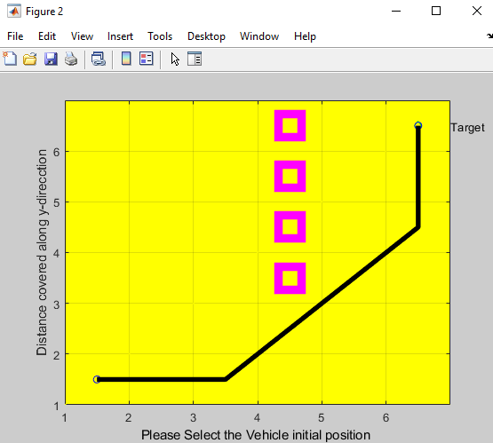
Comparison of SARSA algorithm and Temporal Difference Learning Algorithm BASED ON THEIR SUCCESS RATE
Cases where SARSA works and TD fails
CASE 1:
Case where TD fails
Case where SARSA works

Slide 12
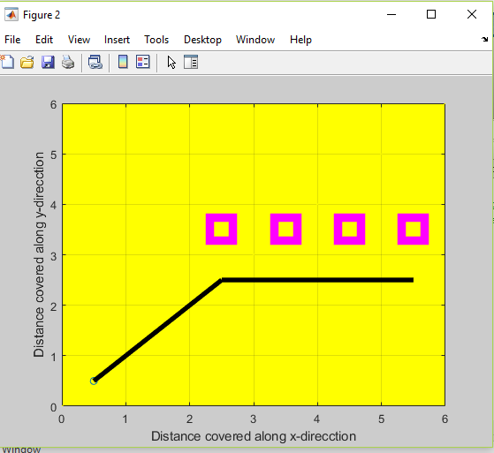
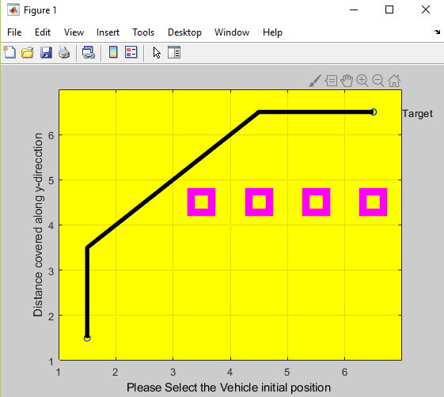
Comparison of SARSA algorithm and Temporal Difference Learning Algorithm BASED ON THEIR SUCCESS RATE
CASE 2:
Case where TD fails
Case where SARSA works

Slide 13
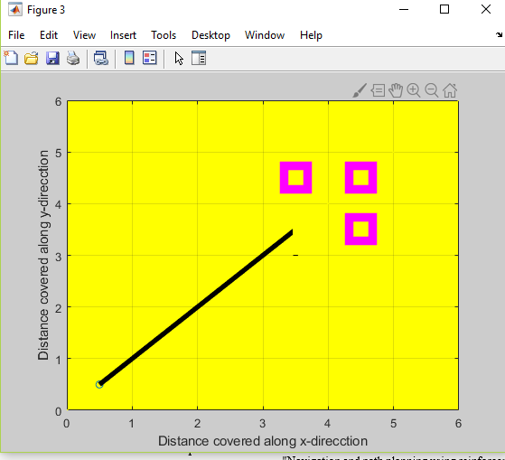
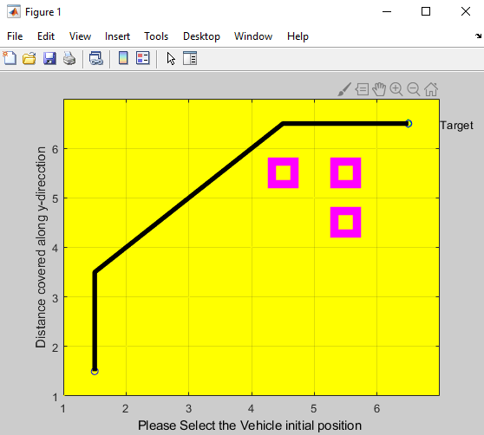
Comparison of SARSA algorithm and Temporal Difference Learning Algorithm BASED ON THEIR SUCCESS RATE
CASE 3:
Case where TD fails
Case where SARSA works

Slide 14


Comparison of SARSA algorithm and Temporal Difference Learning Algorithm BASED ON THEIR SUCCESS RATE
SL No | No. of Obstacles | Special Cases | TD | SARSA
1 | 3 | a. (4.5,5.5),(4.5, 4.5 ),(4.5 ,3.5) (3.5,4.5),(4.5,4.5), (4.5,3.5)
2 | 4 | (3.5,5.5),(3.5 ,4.5),(3.5,3.5), (3.5,2.5) (2.5,3.5),(3.5, 3.5),(4.5,3.5), (5.5,3.5)
3 | 5 | a. (2.5,4.5),(3.5, 4.5),(4.5,4.5), (4.5,3.5),(4.5,2.5) b. (0.5,5.5),(1.5, 4.5),(2.5,3.5),(3.5,2.5),(4.5,1.5)
4 | 6 | a. (2.5,4.5),(3.5,4.5),(3.5,3.5),(3.5,2.5),(3.5,1.5),(3.5,0.5) b.(0.5,3.5),(1.5,3.5),(2.5,3.5),(3.5,3.5),(3.5,2.5),(3.5,1.5)
Table 1: Cases where TD fails and SARSA works for different number of obstacles

Slide 15
Conclusions
Path Planning is simulated with various number of obstacles using two algorithms- TD and SARSA for a 6×6 grid.
Different cases of obstacle positions are simulated and tested for both SARSA and TD.
In majority of the cases, both the algorithms work similarly but there are few cases where TD fails and SARSA works precisely.
This proves that the success rate is for SARSA is higher than TD.
This is due to the interaction with the environment in SARSA algorithm which helps it to solve the problem in spite of the presence of many obstacles.

Slide 16
FUTURE SCOPE
SARSA algorithm can be used to solve complex mazes with a greater number of obstacles and with increased size of grid.
SARSA can be extended for dynamic obstacles.
The same algorithm can be implemented for static and dynamic obstacles in iRobot interfaced with a mbed controller.
SARSA can be used for cases where the algorithm needs to get information from the environment.

Slide 17
resources
Zhang, Qian et al. “Reinforcement Learning in Robot Path Optimization.” JSW 7 (2012): 657-662.
D. P. Romero-Martí, J. I. Núñez-Varela, C. Soubervielle-Montalvo and A. Orozco-de-la-Paz, "Navigation and path planning using reinforcement learning for a Roomba robot," 2016 XVIII Congreso Mexicano de Robotica, Sinaloa, 2016, pp. 1-5.
Shreyas J and Sandeep J,” Modern Machine Learning Approaches For Robotic Path Planning”, IJCSIT(2016):256-259
P. Joshy and P. Supriya, "Implementation of robotic path planning using Ant Colony Optimization Algorithm," 2016 International Conference on Inventive Computation Technologies (ICICT), Coimbatore, pp. 1-6 , 2016.
D. Davis and P. Supriya, “Implementation of Fuzzy-Based Robotic Path Planning”, ICETECH, 2016.
RAVISHANKAR, N. R.; VIJAYAKUMAR, M. V.”Reinforcement Learning Algorithms: Survey and Classification”. ISSN: 0974-5645, 2017.
J. K. Goyal and K. S. Nagla, "A new approach of path planning for mobile robots," 2014 International Conference on Advances in Computing, Communications and Informatics (ICACCI), New Delhi, 2014, pp. 863-867. doi: 10.1109/ICACCI.2014.6968200

Slide 18
resources
8. M. Lin, K. Yuan, C. Shi and Y. Wang, "Path planning of mobile robot based on improved A∗ algorithm," 2017 29th Chinese Control And Decision Conference (CCDC), Chongqing, 2017, pp. 3570-3576. doi: 10.1109/CCDC.2017.7979125
9. H. Iima and Y. Kuroe: “Reinforcement Learning through Interaction among Multiple Agent”, SICEICASE International Joint Conference 2006 CDROM, pp.2457–2462, 2006.
M. R. Tousi, S. H. Hosseinian, A. H. Jadidinejad and M. B. Menhaj, "Application of SARSA learning algorithm for reactive power control in power system," 2008 IEEE 2nd International Power and Energy Conference, Johor Bahru, 2008, pp. 1198-1202. doi: 10.1109/PECON.2008.4762658
N. Lilith and K. Dogancay, "Distributed reduced-state SARSA algorithm for dynamic channel allocation in cellular networks featuring traffic mobility," IEEE International Conference on Communications, 2005. ICC 2005. 2005, Seoul, 2005, pp. 860-865 Vol. 2. doi: 10.1109/ICC.2005.1494473
H. Iima and Y. Kuroe, "Swarm reinforcement learning algorithms based on Sarsa method," 2008 SICE Annual Conference, Tokyo, 2008, pp. 2045-2049.
C. Li, M. Wang, S. Yang and Z. Zhang, "Urban Traffic Signal Learning Control Using SARSA Algorithm Based on Adaptive RBF Network," 2009 International Conference on Measuring Technology and Mechatronics Automation, Zhangjiajie, Hunan, 2009, pp. 658-661.doi: 10.1109/ICMTMA.2009.445
R.S. Sutton and A.G. Barto: Reinforcement Learning, MIT Press, 1998

Slide 19
THANK you!!!

