Slide 1

CMR COLLEGE OF ENGINEERING & TECHNOLOGY
Kandlakoya, Medchal, Hyderabad – 501401
Department of Computer Science and Engineering
File Management System
Batch No:06
K.Dhathri Gupta -20H51A05J9
B.Manichandana -20H51A05N0
M.Laya -20H51A05P4
Under esteemed guidance of
Mr.V.Venkataiah
Associate Professor of CSE & Additional Controller of Examinations

Slide 2
Outline
Abstract
Introduction
Research Objective
Problem Definition
Scope of the Project
Research work
- Proposed Methodologies
- System Architecture
- Comparison of Proposed system with an existed system
Results
Conclusion
Future Work
References
Notes:
2

Slide 3
Abstract
Notes:
3

Slide 4
ABSTRACT
This project presents a file management system that provides an efficient and user-friendly solution for managing files and directories. A file manager (destiny) is a computer program that provides a user interface to manage files and folders of different formats (e.g.: - pdf's, doc's, jpg files etc). The most common operations performed on files or groups of files includes opening (e.g., viewing, playing, editing or printing), renaming, moving or copying, deleting and searching for files. Folders and files may be displayed in a hierarchical tree based on their directory structure. Additionally, the system should be customizable, allowing users to add extra features and functionalities as needed. With the ability to sort and merge files, users can better organize their data, making it easier to find what they need. Some data structures that will be used in the program are linked list, queue and tree. It is a program encrypted in tkinter python language and will also include searching and sorting’s.

Slide 5
INTRODUCTION
Notes:
5

Slide 6
Introduction
The File Management System is designed to be flexible, efficient, and user-friendly, and it is intended to make file management tasks easier and more convenient for users. The system can be easily customized and extended to meet the changing needs of the users, and it provides a powerful tool for managing files and directories.
The File Management System is a software application that provides users with a simple and efficient way to manage their files and directories. The system is built using Python, and it integrates the "os" and "shutil" modules to provide a wide range of file management functionalities. The system also provides a graphical user interface (GUI) built using Tkinter, which makes it easy for users to interact with the system and perform common file management tasks . Some of the key features of the File Management System include:
File Sorting: The system allows users to sort their files and directories in a variety of ways, including by name, size, type, and date modified.
File Merging: The system allows users to merge multiple files into a single file, for example, merge all text files in a folder into one file.
Notes:
6

Slide 7
Research Objective
Notes:
7

Slide 8
Research objective
In this project, we have used the following Modules :-
Tkinter
OS module
Shutil
Tkinter is a Python module that provides a set of tools for creating graphical user interfaces (GUIs).
It is based on the Tcl/Tk GUI toolkit and provides a simple, efficient, and easy-to-use way to create GUI applications in Python.
Tkinter provides a variety of widgets, such as buttons, labels, and text boxes, that can be used to build the user interface.
It also provides methods for event handling, such as button presses and mouse clicks, making it a complete GUI solution for Python applications.
Tkinter is a standard component of Python, making it widely available and easily accessible for Python users.

Slide 9
os module in Python is a built-in library that provides a set of functions and tools for working with the operating system. It allows you to perform various operations such as accessing and manipulating files and directories, executing shell commands, and managing processes.
The OS module provides a portable way of using operating system dependent functionality.
Recursive directory creation function.
Like mkdir(), but makes all intermediate-level directories needed to contain the leaf directory.
OS.makedirs(path[,mode])
Return a string representing the path to which the symbolic link points. The result may be either an absolute or relative pathname; if it is relative, it may be converted to an absolute pathname
using :- OS.path.join(os.path.dirname(path), result)
shutil module in Python is a built-in library that provides a set of high-level file operations. It is built on top of the "os" module and provides a more convenient and user-friendly interface for working with files and directories.

Slide 10
Problem Definition
Notes:
10

Slide 11
Problem Definition
A file manager (destiny) is a computer program that provides a user interface to manage files and folders of different formats (E.g.: - pdfs, doc’s, jpg files etc..). The most common operations performed on files or groups of files includes opening (E.g., viewing, playing, editing or printing), renaming, moving or copying, deleting and searching for files.
Given a folder with multiple files in different formats (text, image, video, etc.), create a system that allows users to easily sort, merge, improving their productivity. The system should have a graphical user interface (GUI) that makes it easy for users to perform these tasks, reducing the need for technical expertise. Additionally, the system should be customizable, allowing users to add extra features and functionalities as need.

Slide 12
Scope of the Project
Notes:
12

Slide 13
Scope of the Project
The scope of the above project is that allows users to sort ,merge and split files from several sources ,which results in
Increased productivity and efficiency: By organizing and automating common file management tasks, users can save time and increase their productivity.
Improved file organization: With the ability to sort and merge files, users can better organize their data, making it easier to find what they need.
Ease of use: A graphical user interface (GUI) can make the system easier for users to navigate and use, reducing the need for technical expertise.

Slide 14
Research Work
Notes:
14

Slide 15
Proposed Methodologies
1.open a file
2.copy a file
3.rename a file
4.delete a file
5.open a folder
6.delete a folder
7.move a folder
8.list all file in folder
9.sort the files
10.split the files
11.merge the files
Select any option from list
You will get the desired output

Slide 16
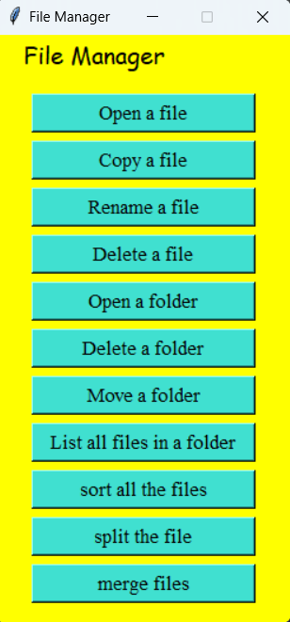
System Architecture
GUI Interface

Slide 17
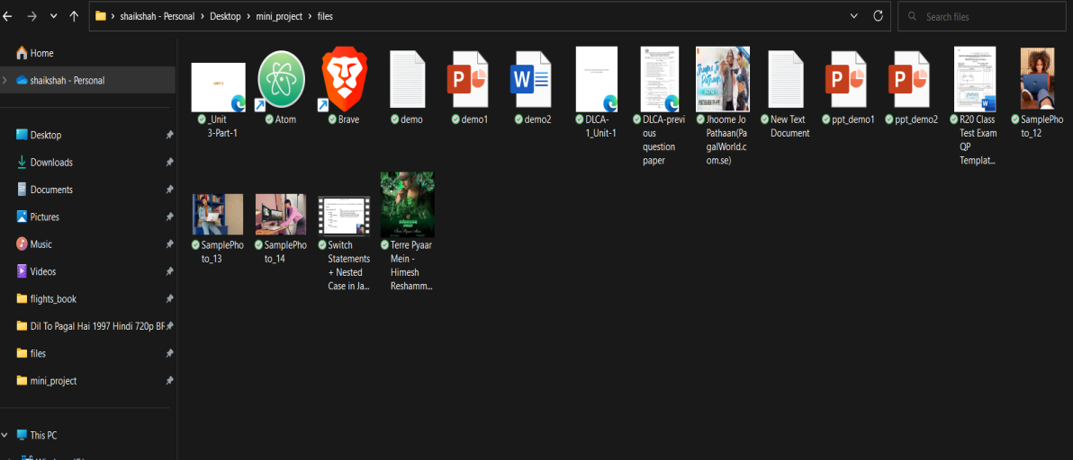
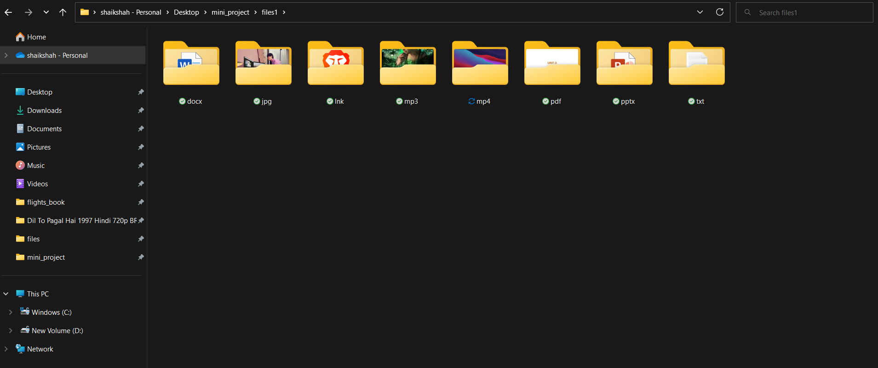
Comparison of Proposed system with an existed system
Unsorted files
Sorted files

Slide 18
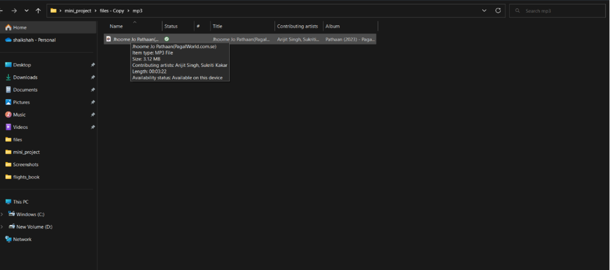
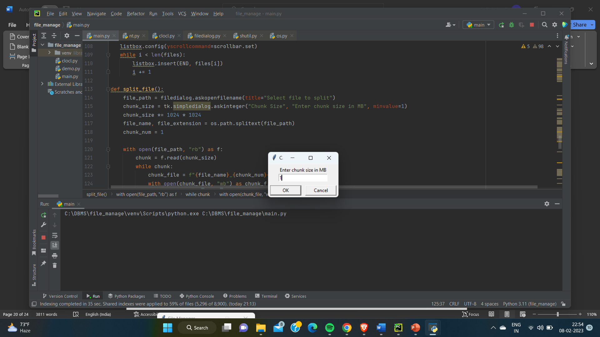
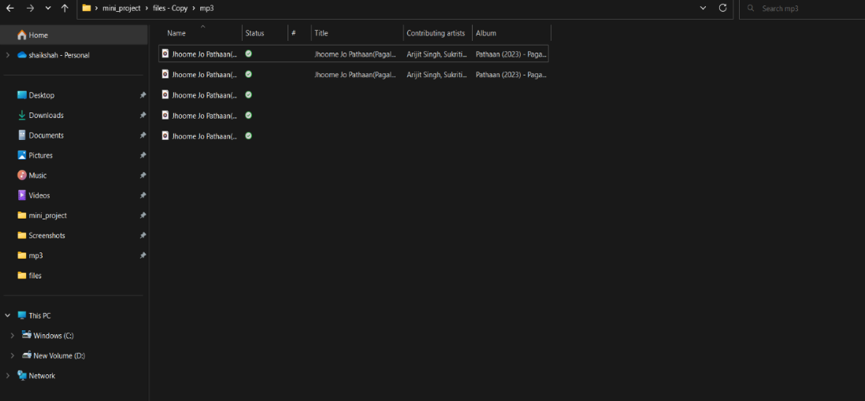
Before splitting
After Splitting

Slide 19
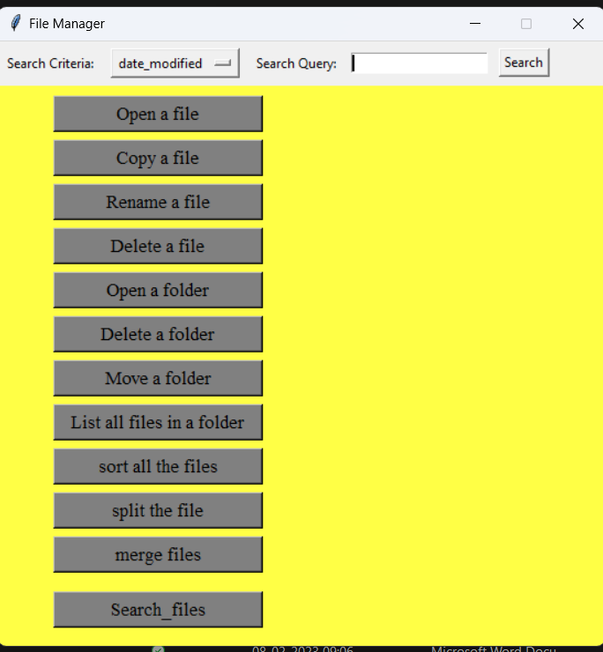
Result Analysis
from this project we find that it allows users to sort ,merge and split files from several sources which results in Increased productivity and efficiency, Improved file organization and easy of use

Slide 20
Conclusion
We conclude from this file management system project provides an efficient and user-friendly way of managing files and directories. With the help of os and shutil modules in Python, the system can perform tasks such as file sorting, merging, splitting, backup, and encryption/decryption, making it a comprehensive solution for file management needs. In conclusion, the file management system project provides a strong foundation for managing files and directories in a computer system.

Slide 21
Future work
The project can be further improved by adding additional functionalities like:
Compression and decompression of files
Search and filter files based on different criteria
Add version control for files
Enable multi-user support for shared file management
Integration with cloud storage services for backup and file sharing.
The future scope of the project is immense, with several possibilities for further improvement and enhancement, making it a continuously evolving solution.

Slide 22
References
https://www.ijariit.com/manuscripts/v3i6/V3I6-1480.pdf
https://www.mysql.com/products/connector/
https://myfik.unisza.edu.my/www/fyp/fyp19sem2/report/047263.pdf

Slide 23
Thank You!

