Slide 1
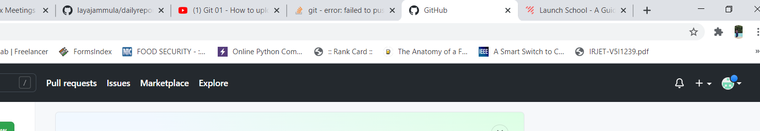
GitHub Introduction
A . Creating a GitHub Repository-
Step1: Go to the official site of GitHub and Signup/Login
Step2: After the successful login now we need to create the repository for our own purpose
Step3: On the top right corner as shown in the below picture there will be a plus symbol . Press that .

Slide 2
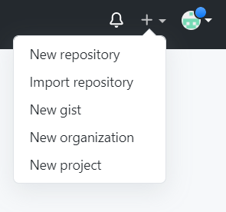
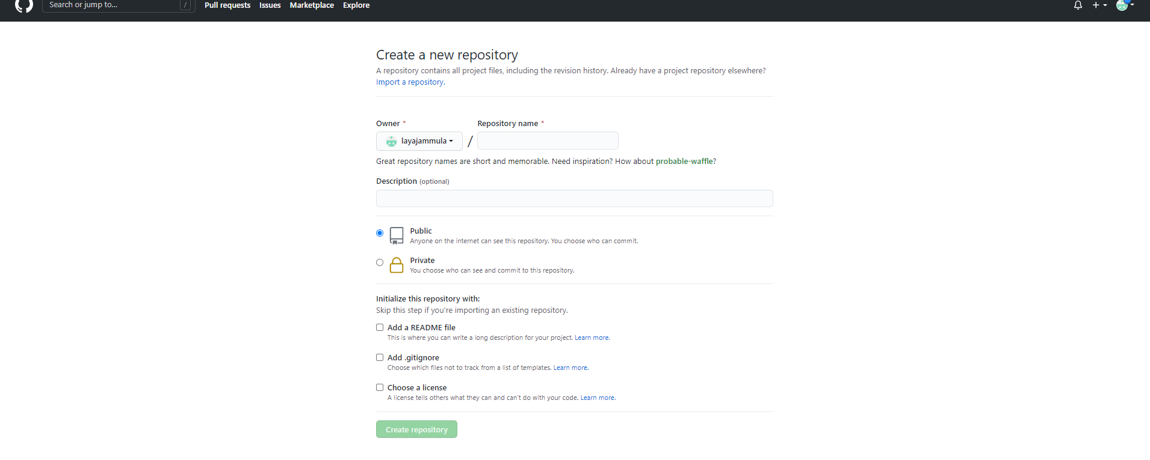
Step4: After clicking on that you will get some options as shown in the below figure, there
you should now select new repository
Step5: You will now be redirected to the repository page as shown below.

Slide 3
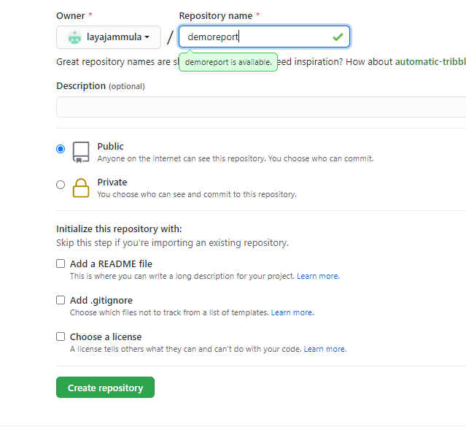
Step6: There you will have an option asking about the name you want to give to the repository, put your preferred name
and then click create repository present at the end of the page.
1
2
Step7: Now your repository is created in the GitHub.

Slide 4
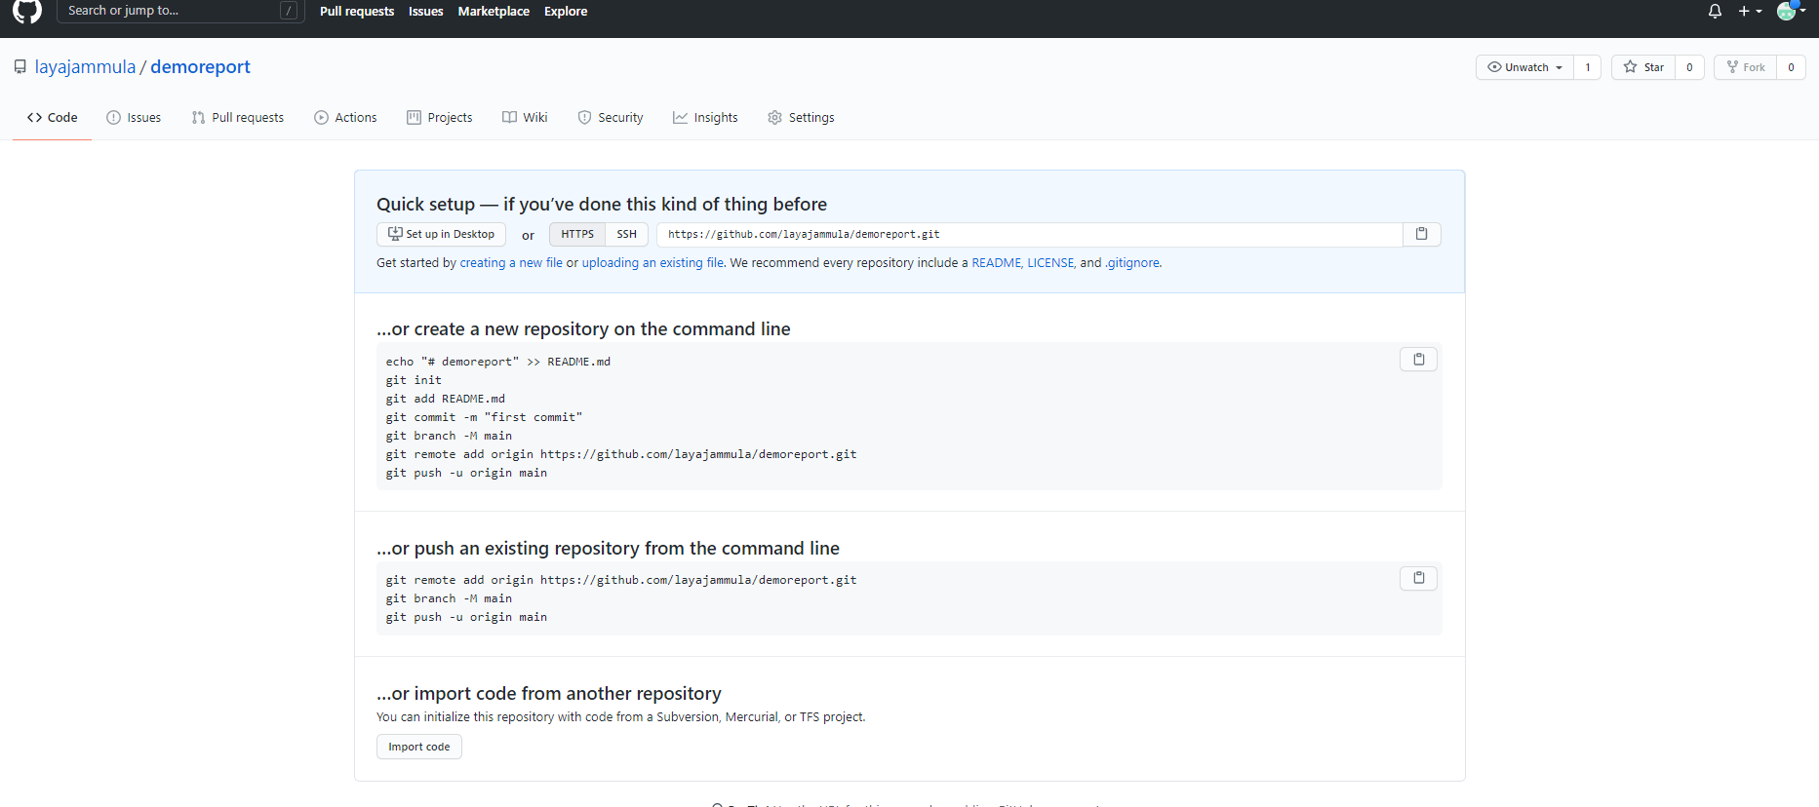

Slide 5
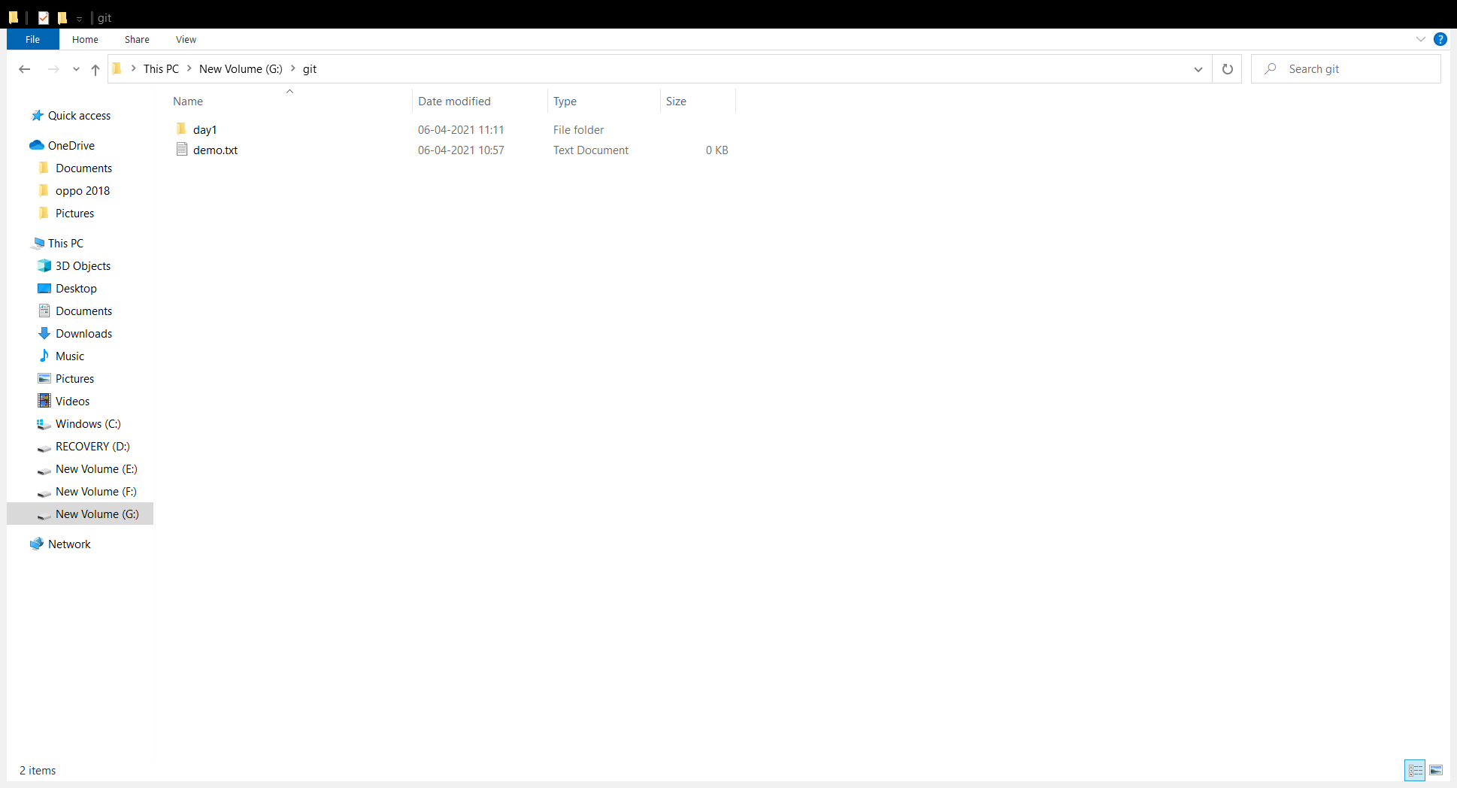
B . Uploading a file in the repository:
After creating the repository now you can upload files to that by some using commands in the
command prompt.
Step1: Go to the file which you want to upload to the GitHub repository.

Slide 6
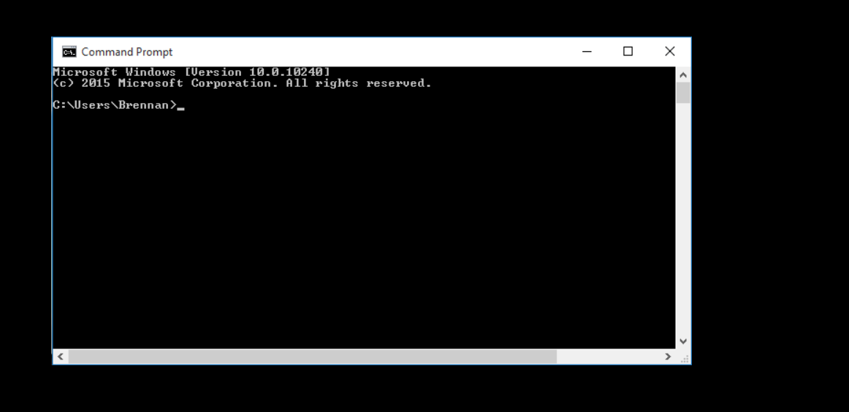
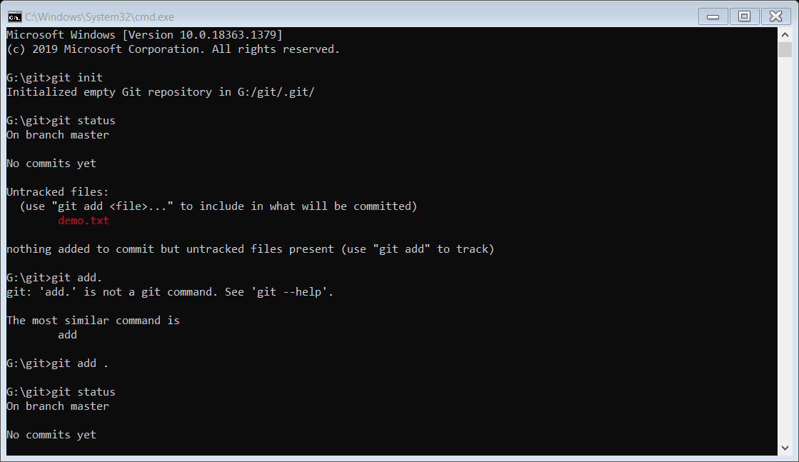
Step2: Now on the top where the path will be present, there press cmd and then the command prompt with that particular
path will be created and pop’s up.
Step3: Now we need to press the commands required for the uploading of the file into the GitHub
Step4:Press git init . And the below text appears

Slide 7
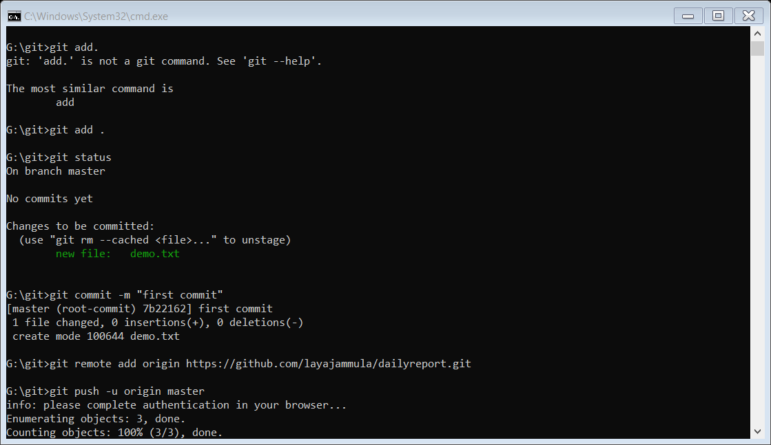
Step5: Next press git status. Now the below text appears . Here it just checks the files present but it is not committed.
Step6: Press git add . . Here it will be sent to the next line.
Step7: Press git status . The below lines appear.

Slide 8
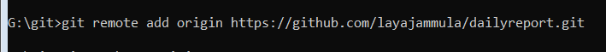
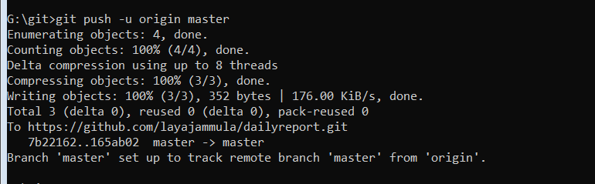
Step8: Press git commit -m “first commit” . Below text appears.
Step9: Press git remote add origin (the quick set up link present in the GitHub page). Example shown below.
https://github.com/introduction/demoreport.git
Step10: Press git push –u origin master . Now the line below appear and the files are uploaded to the repository.

Slide 9
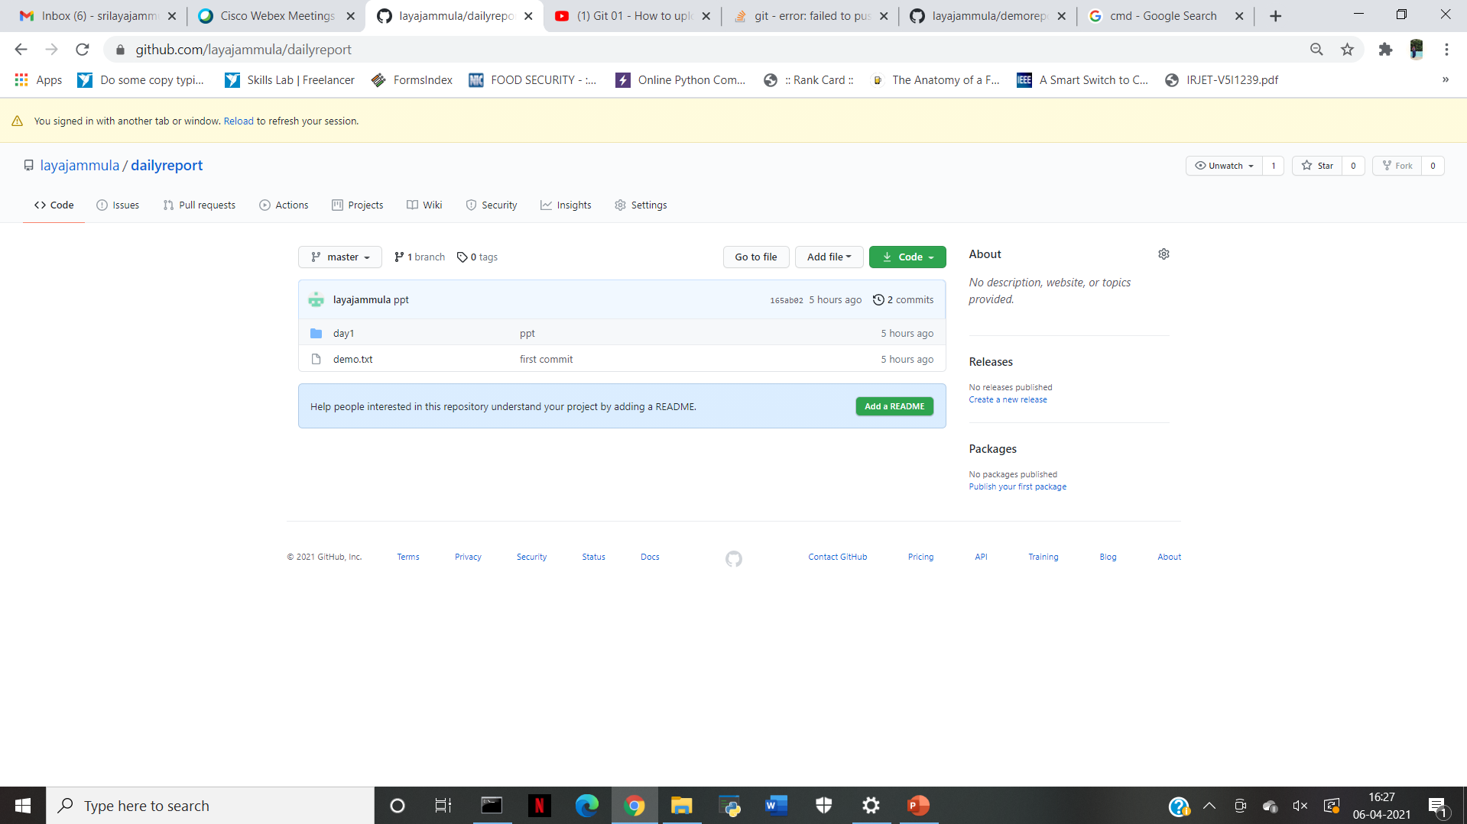
Step11: Now go to the GitHub repository page and refresh the page, there you can see your files which are uploaded.

