Slide 1

Data Science
in Drug Discovery
vecteezy.com

Slide 2

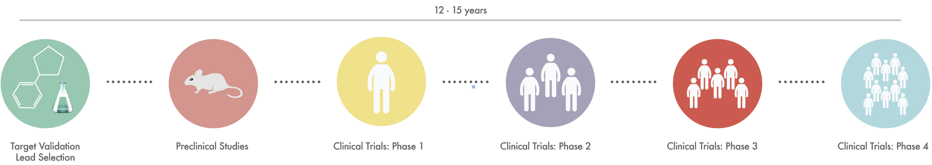
Pain Data Results Conclusion
Freepik.com
Drug Development Process

Slide 3
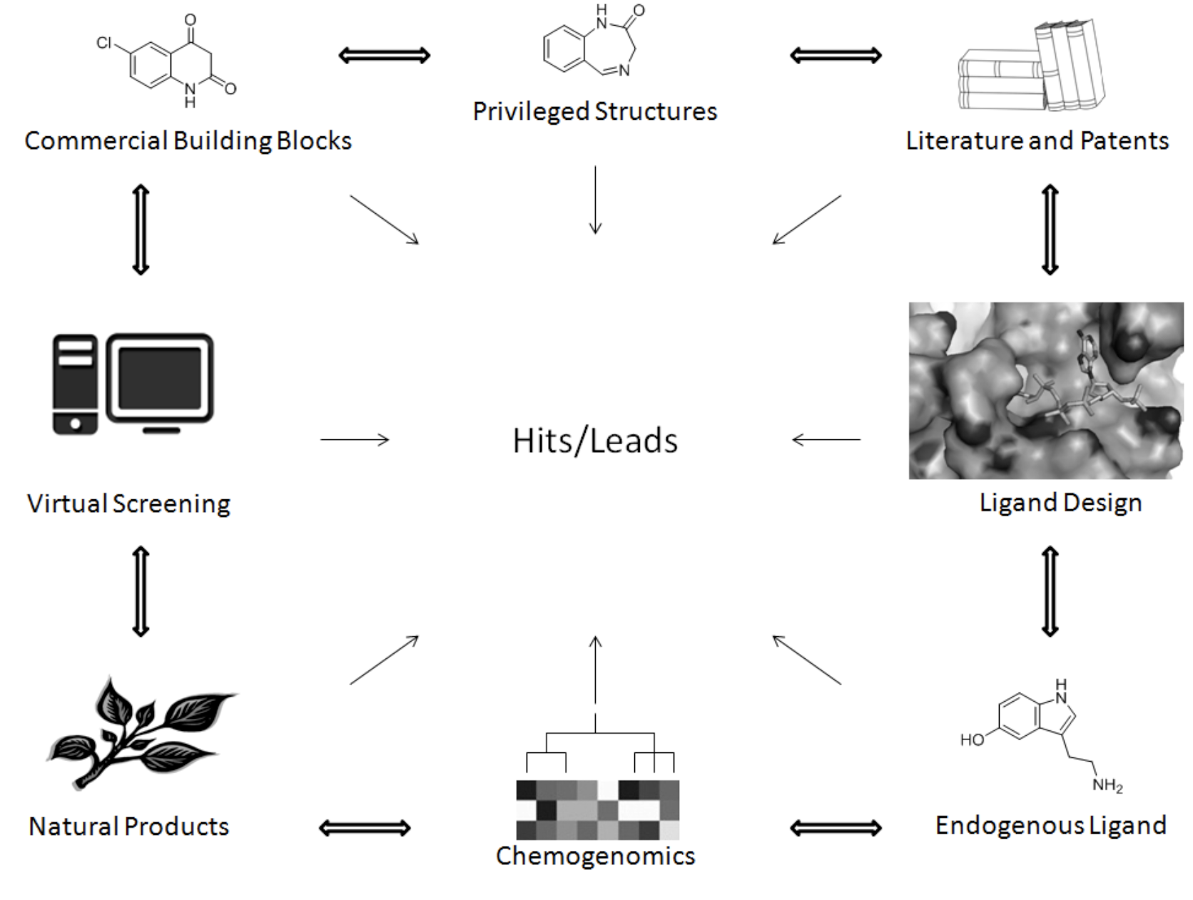

Pain Data Results Conclusion
Target Validation and Lead Selection
In this phase, thousands of chemical compounds are tested against multiple biological targets through automated High-Throughput Screening.
Leeson, P. D.; Davis, A. M.; Steele J. Drug-Like Properties: Guiding Principles for Design – or Chemical Prejudice? Drug Discov. Today: Technol. 2004, 1, 189-195 Bleicher, K. H.; Böhm, H. J.; Müller K.; Alanine, A. I. A Guide to Drug Discovery: Hit and Lead Generation: Beyond High-Throughput Screening. Nat. Rev. Drug Discov. 2003, 2, 369-378

Slide 4
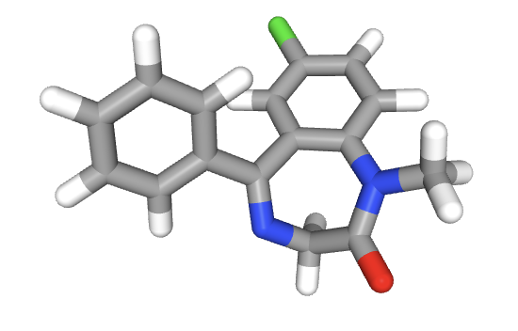
Pain Data Results Conclusion
Reseach Questions
- Do similar compounds have similar bioactivity?
- Bioactivity Data
- What are the parameters that mostly contribute to compounds sharing similar bioactivity?
- Benchmarks of Druglikeness (Lipinski)

Slide 5

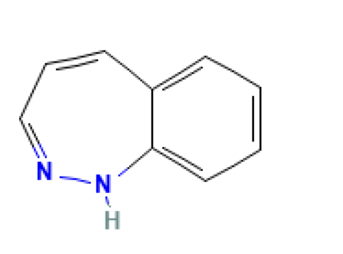
Pain Data Results Conclusion
Data was collected from Pubchem library
Benzodiazepines related to Diazepam and Alprazolam were chosen
Benzodiazepine

Slide 6
Pain Data Results Conclusion
Approach
Compound Based
Selecting shared bioassays
Data Wrangling
Selecting a target that was tested on maximum number of compounds
Target Based

Slide 7
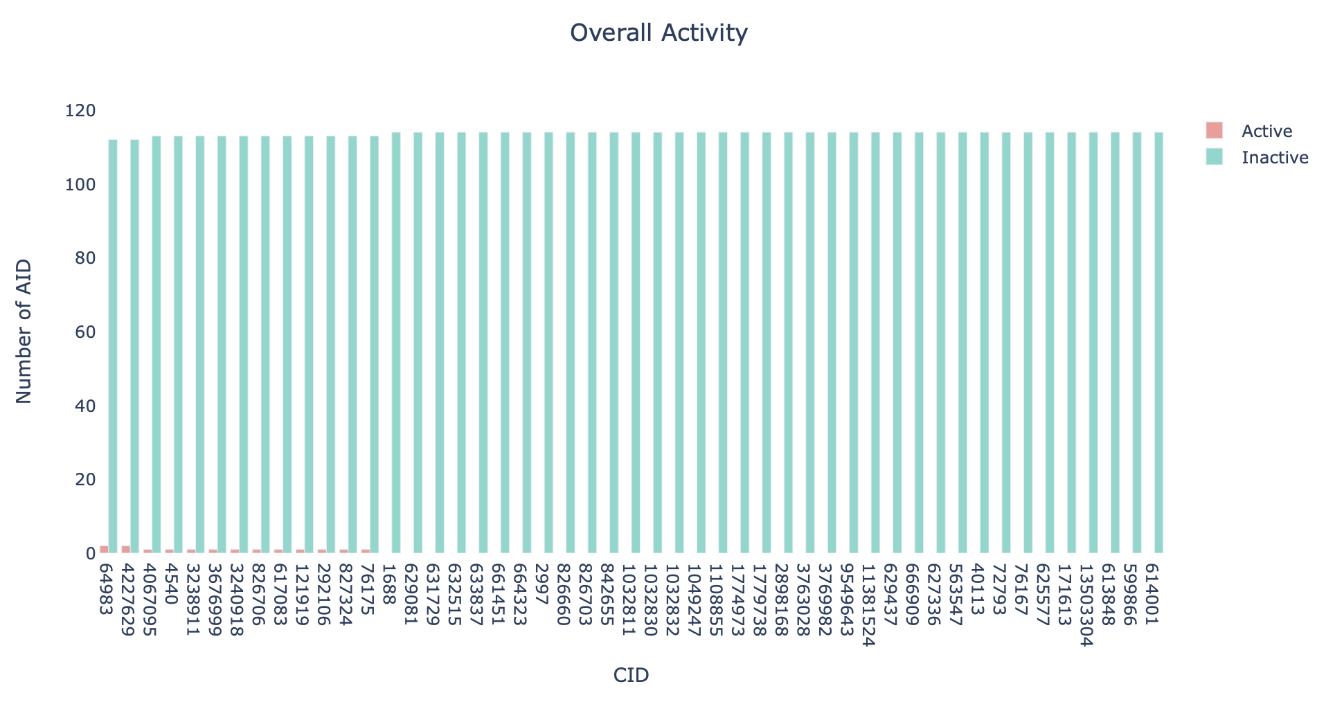
Pain Data Results Conclusion
Compound Based

Slide 8
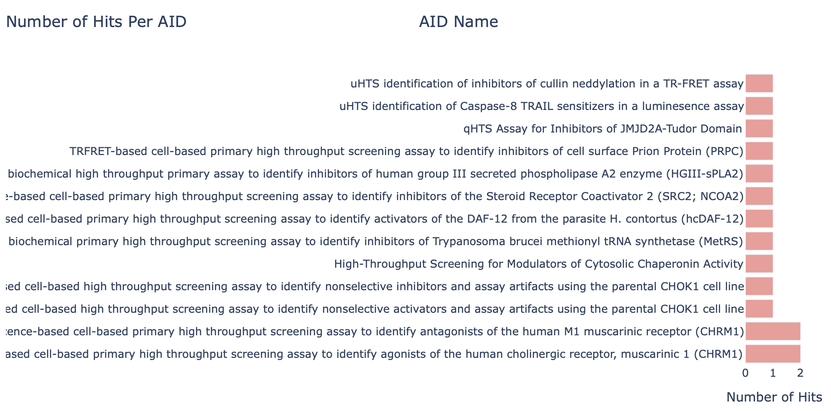
Pain Data Results Conclusion
Compound Based

Slide 9
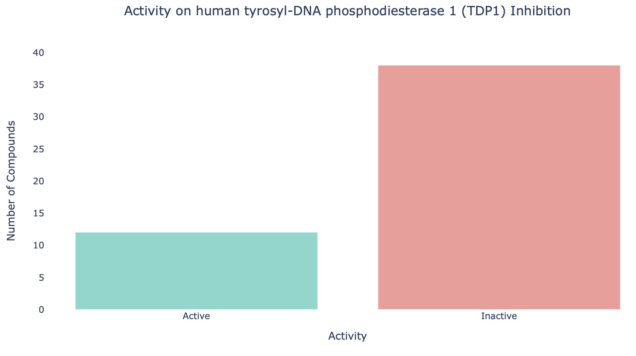
Pain Data Results Conclusion
Target Based

Slide 10
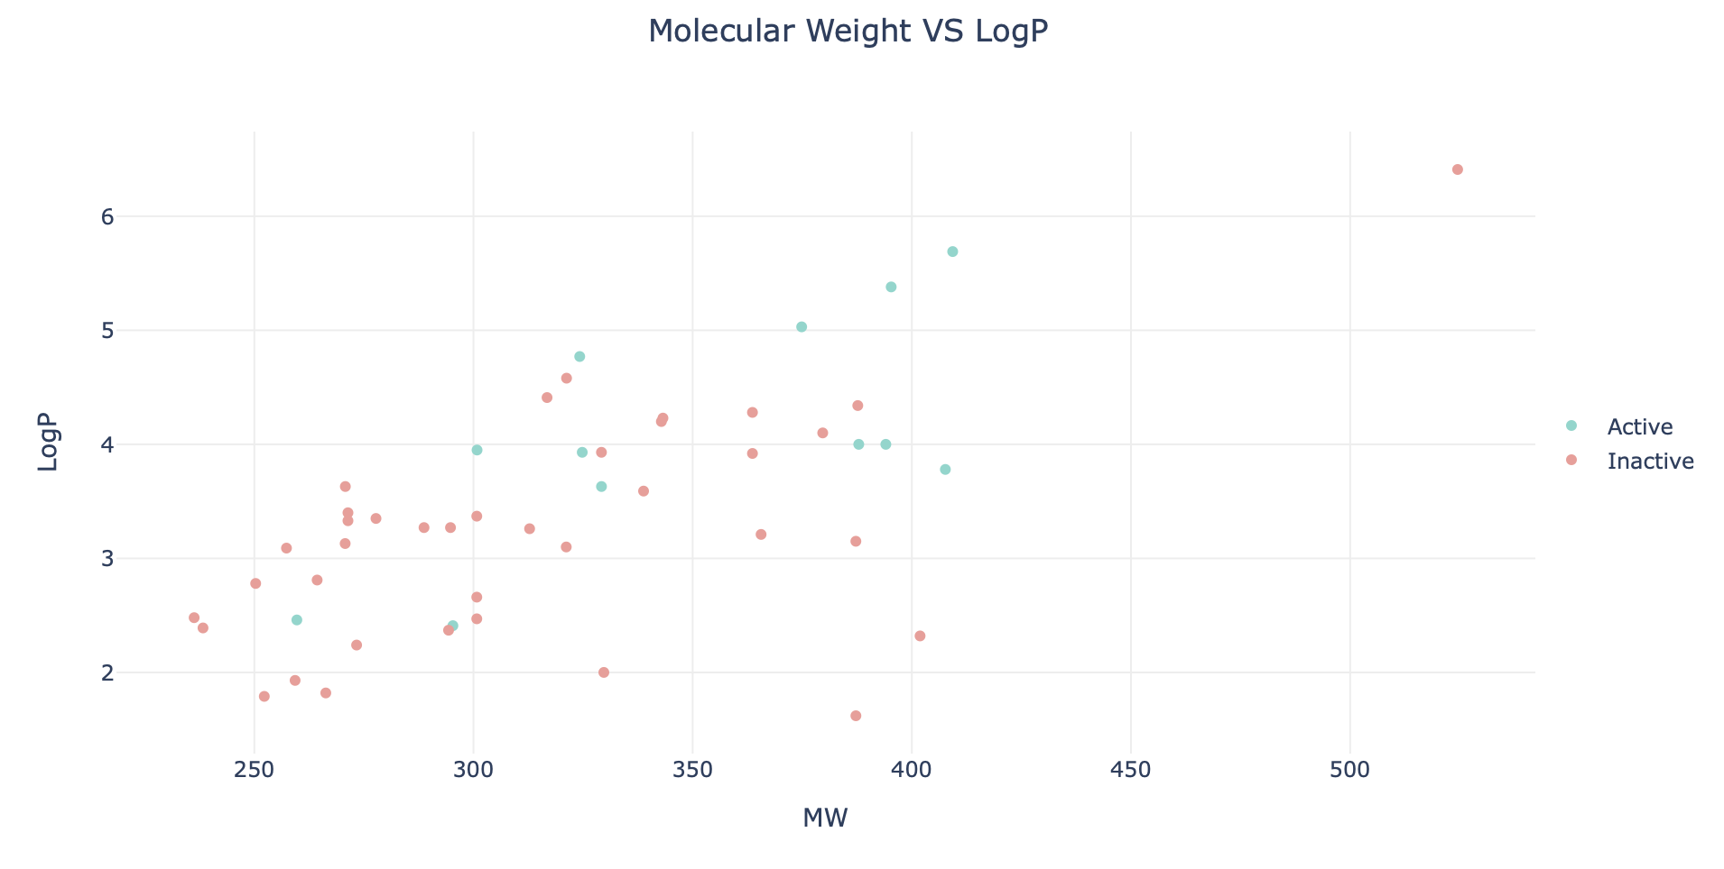
Pain Data Results Conclusion
Target Based

Slide 11
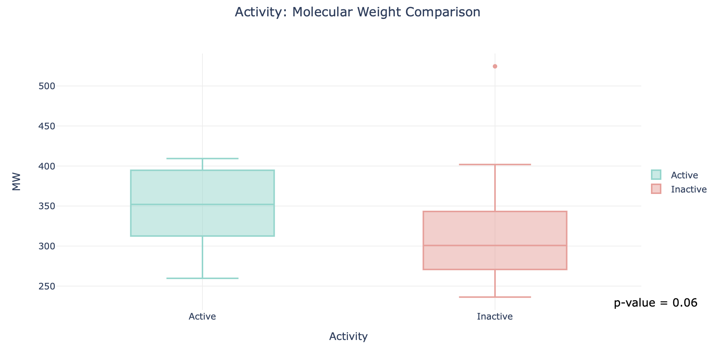
Pain Data Results Conclusion
Target Based

Slide 12
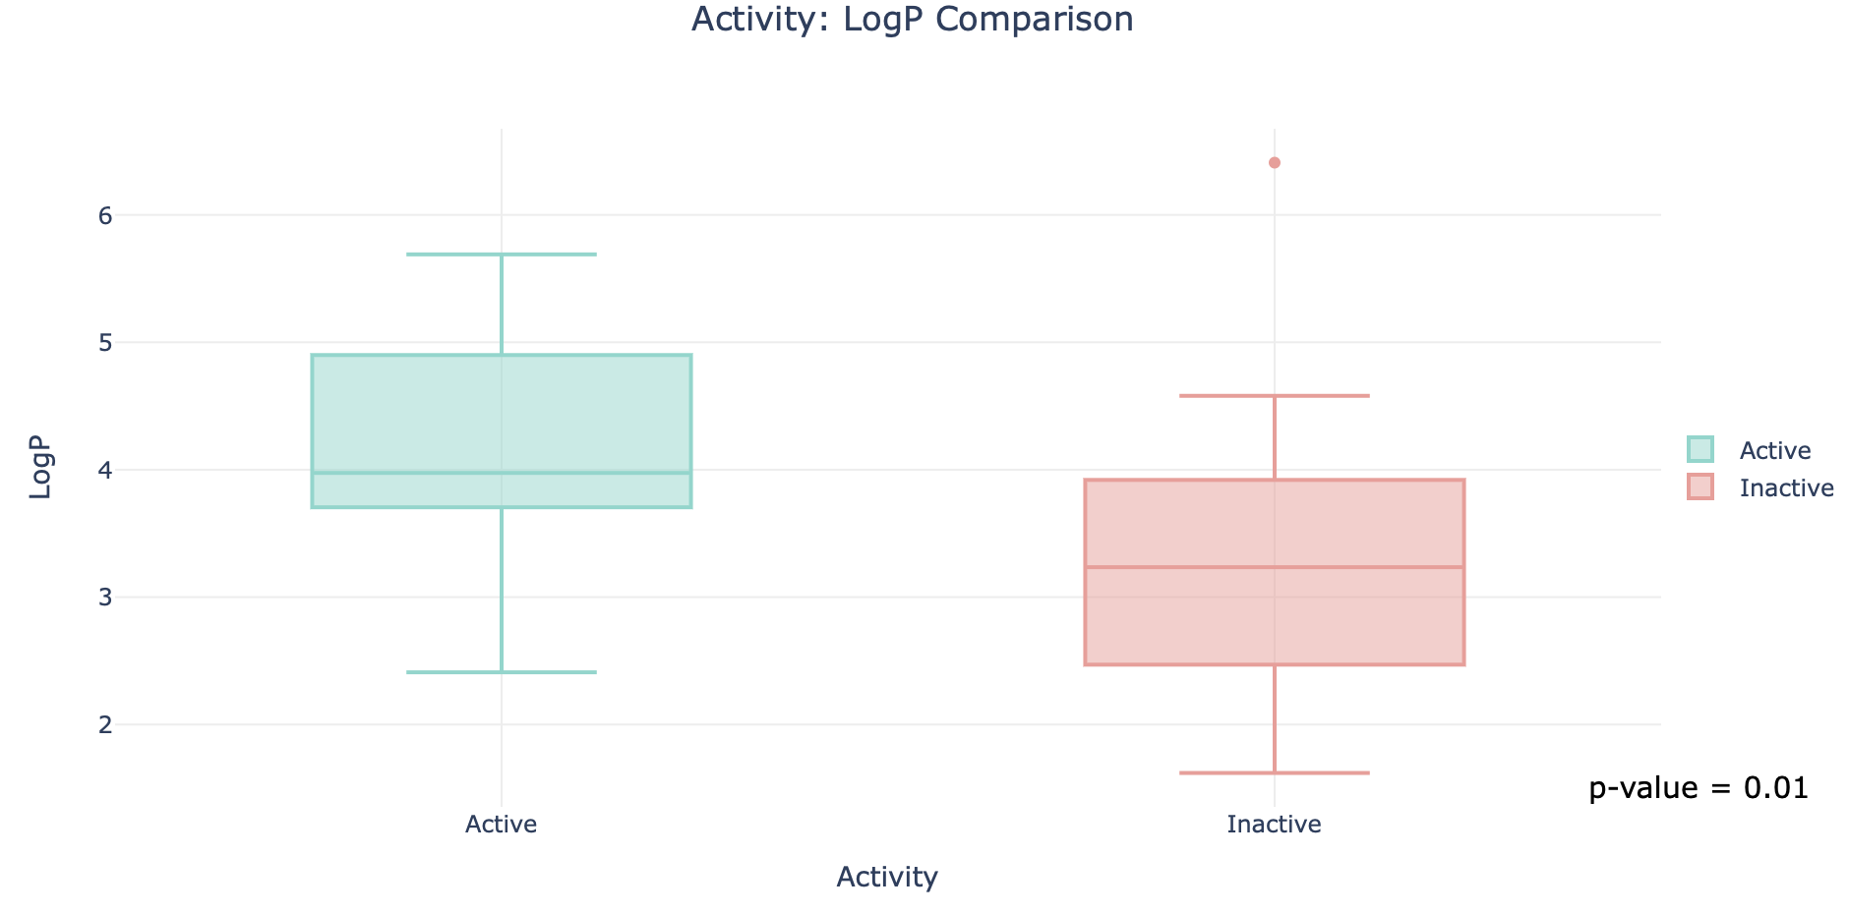
Pain Data Results Conclusion
Target Based

Slide 13
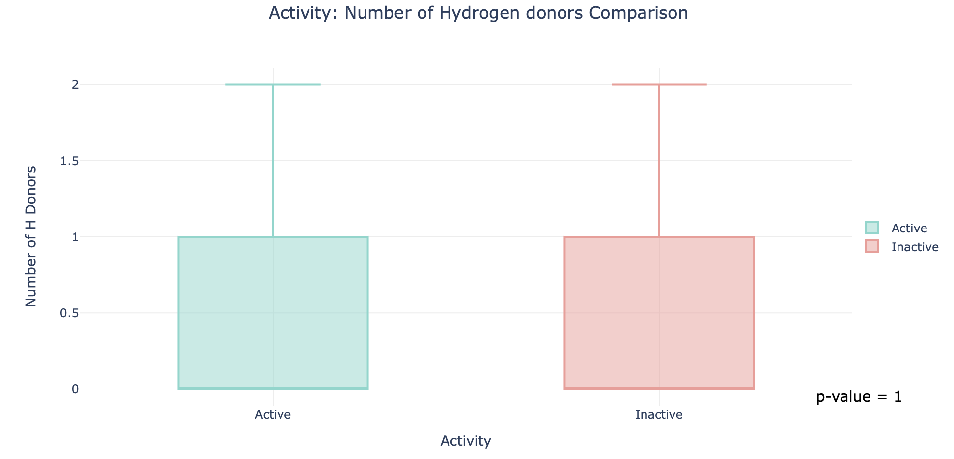
Pain Data Results Conclusion
Target Based

Slide 14
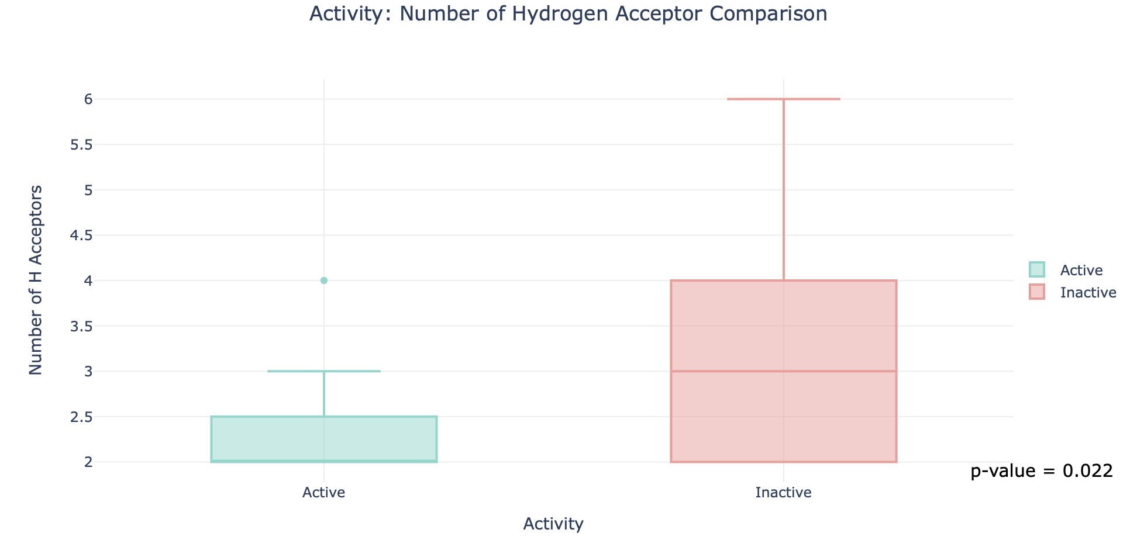
Pain Data Results Conclusion
Target Based

Slide 15
Pain Data Results Conclusion
Compound Based
Although, data did not similarities in biological activity, the results showed a similar biological behavior which makes benzodiazepine a High quality core structure.
It was concluded that some Benzodiazepines possess anti-cancer properties.
LogP and Number of Hydrogen Acceptors in compounds played a significant role in determining hits toward the target.
Target Based

Slide 16
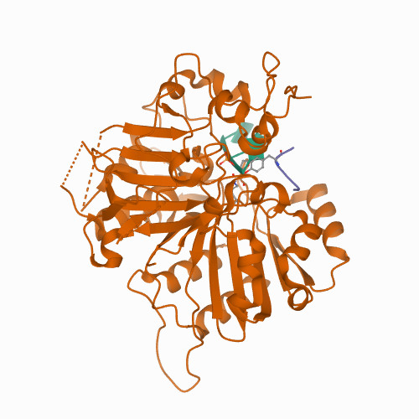
Pain Data Results Conclusion
Further studies on Benzodiazepines activity against (TDP1) should be carried out in order to find more parameters that will help in predicting the activity of untested compounds.
Future Direction

Slide 17
Pain Data Results Conclusion
References and Resources
Leeson, P. D.; Davis, A. M.; Steele J. Drug-Like Properties: Guiding Principles for Design – or Chemical Prejudice? Drug Discov. Today: Technol. 2004, 1, 189-195.
Bleicher, K. H.; Böhm, H. J.; Müller K.; Alanine, A. I. A Guide to Drug Discovery: Hit and Lead Generation: Beyond High-Throughput Screening. Nat. Rev. Drug Discov. 2003, 2, 369-378.
Lipinski, C. A. Lead- and Drug-Like Compounds: the Rule-of-Five Revolution. Drug Discov. Today: Technol. 2004, 1, 337-341.
https://pubchem.ncbi.nlm.nih.gov
https://github.com/dataprofessor

