Slide 1
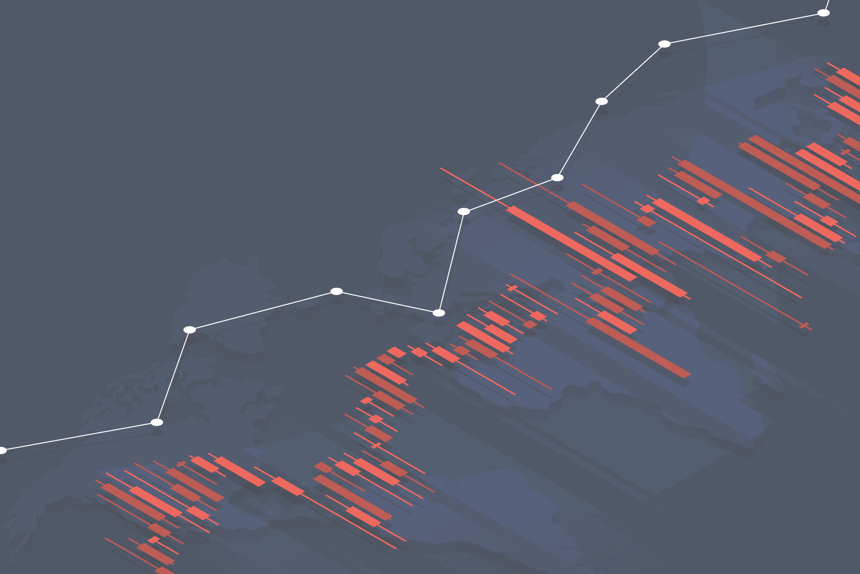
Causes of Death:
Observational Study
vecteezy.com

Slide 2
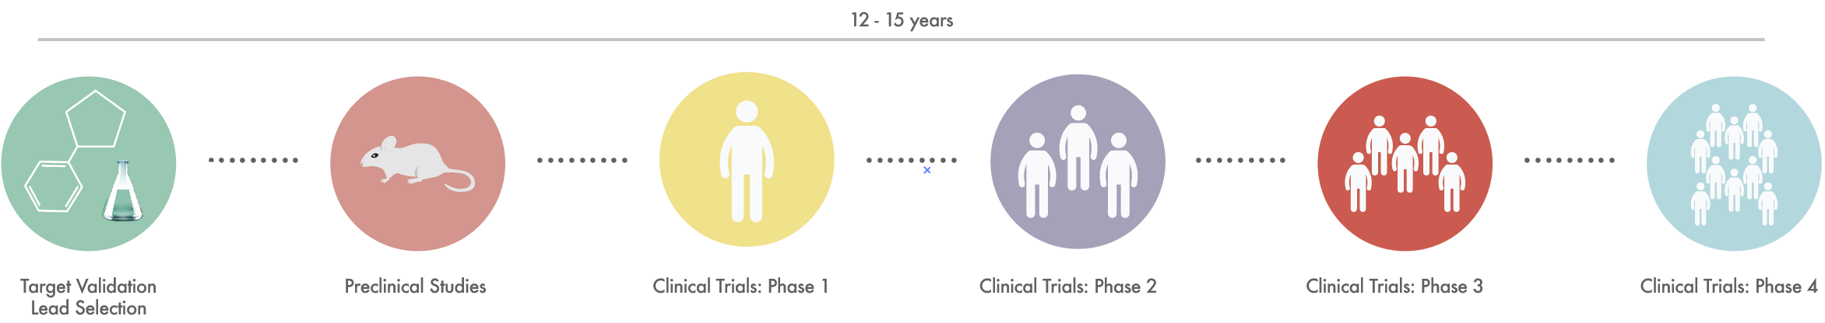
Background Data Results Conclusion
Drug Development Process
Prior to Drug Development Process, pharmaceutical companies go through intensive research to choose the disease target to be investigated.
As part of their business strategies, selecting the right disease through identifying the target market and converting threats into opportunities is crucial to achieve a feasible balanced portfolio.

Slide 3

Background Data Results Conclusion
Reseach Questions
Do top causes of death serve as good markers to identify target market?
- Causes of Death Dataset
Do top causes of death affect disease target selection?
- Approved Novel Drugs Dataset

Slide 4


Background Data Results Conclusion
Causes of Death Data was collected Kaggle website
Novel Drug Approvals was collected from FDA website

Slide 5
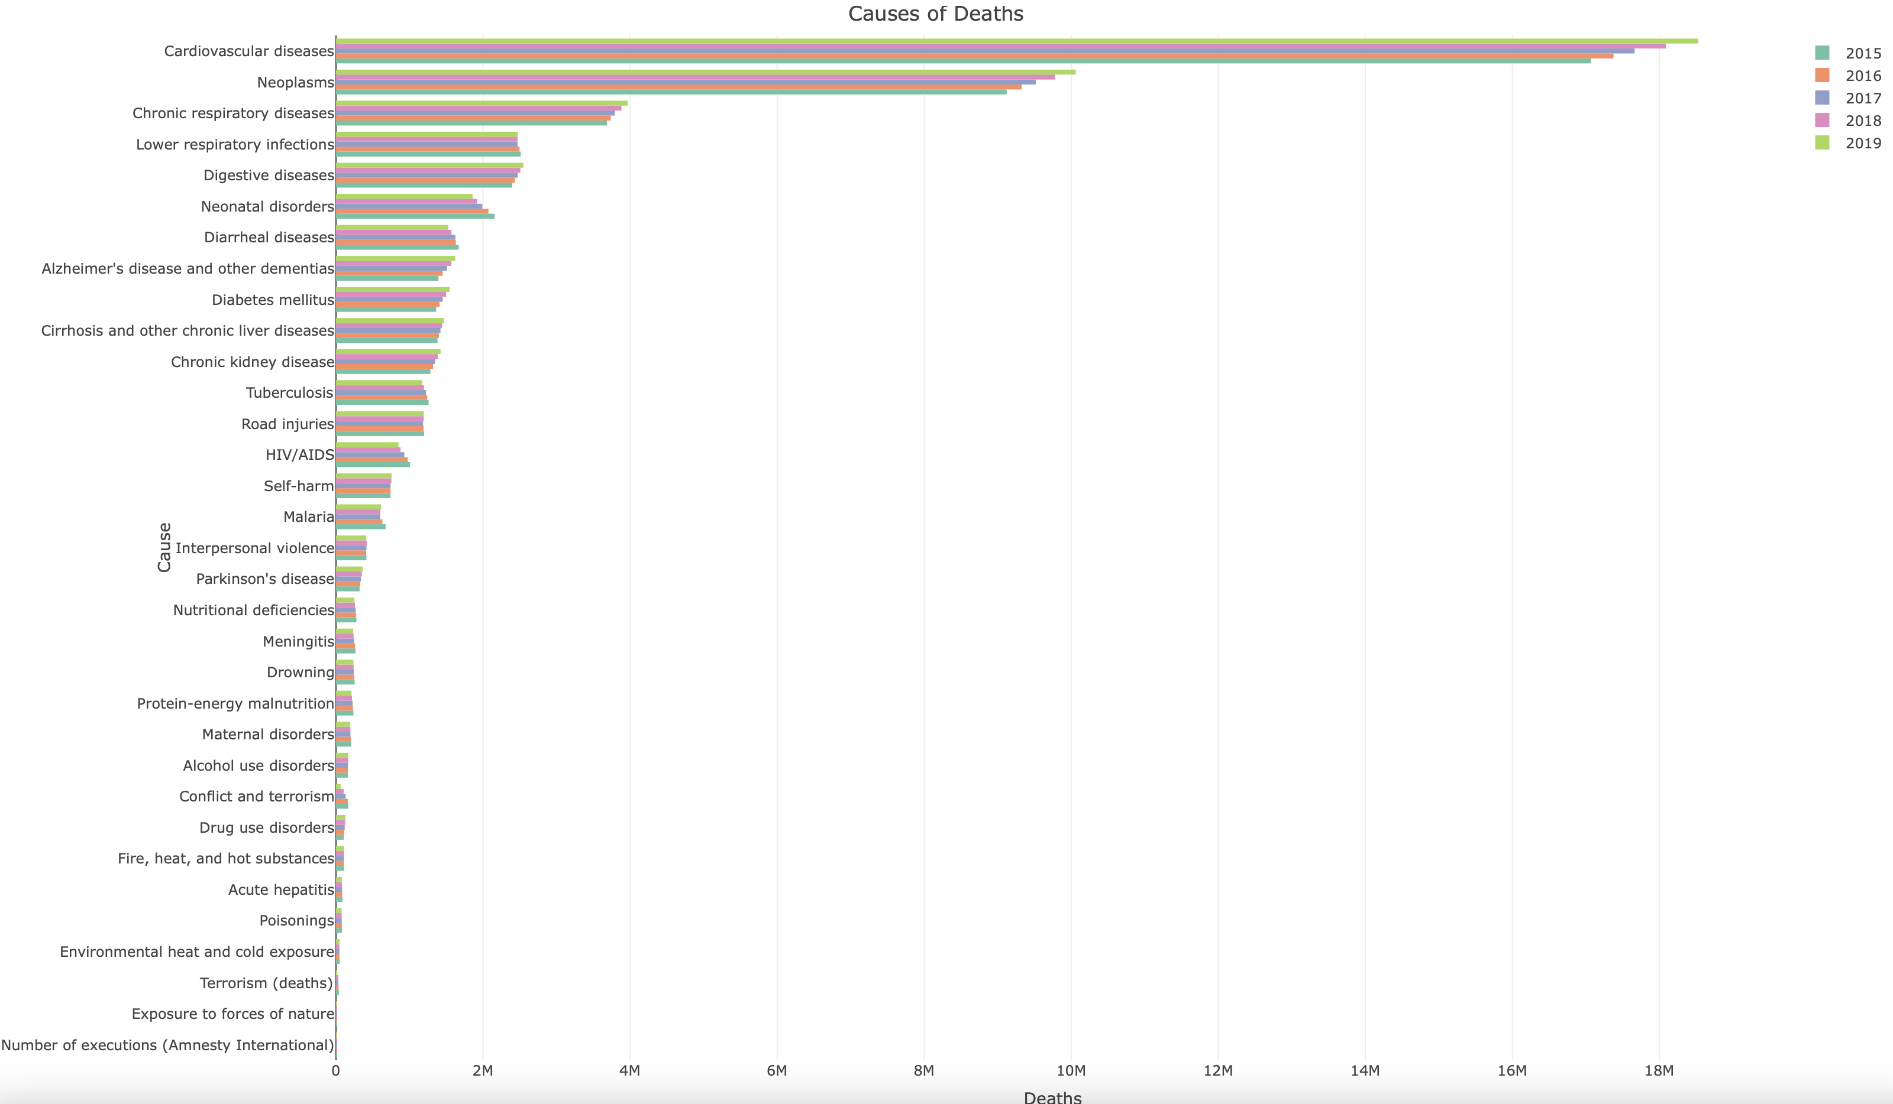
Background Data Results Conclusion
Source: https://ourworldindata.org/causes-of-death

Slide 6
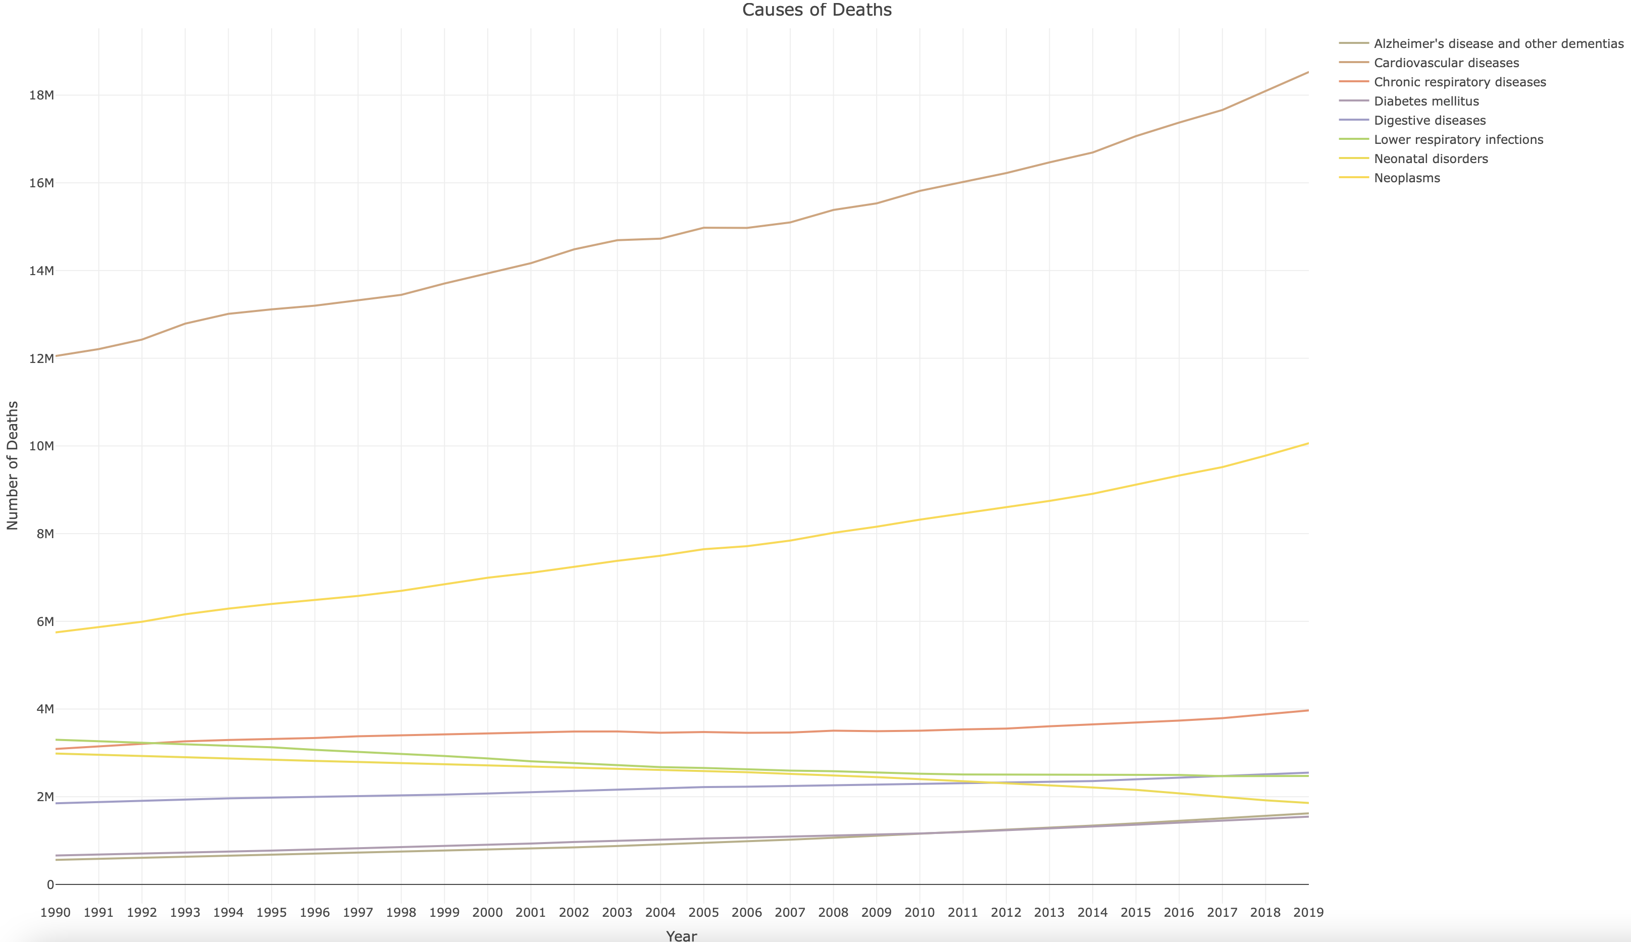
Background Data Results Conclusion
Source: https://ourworldindata.org/causes-of-death

Slide 7
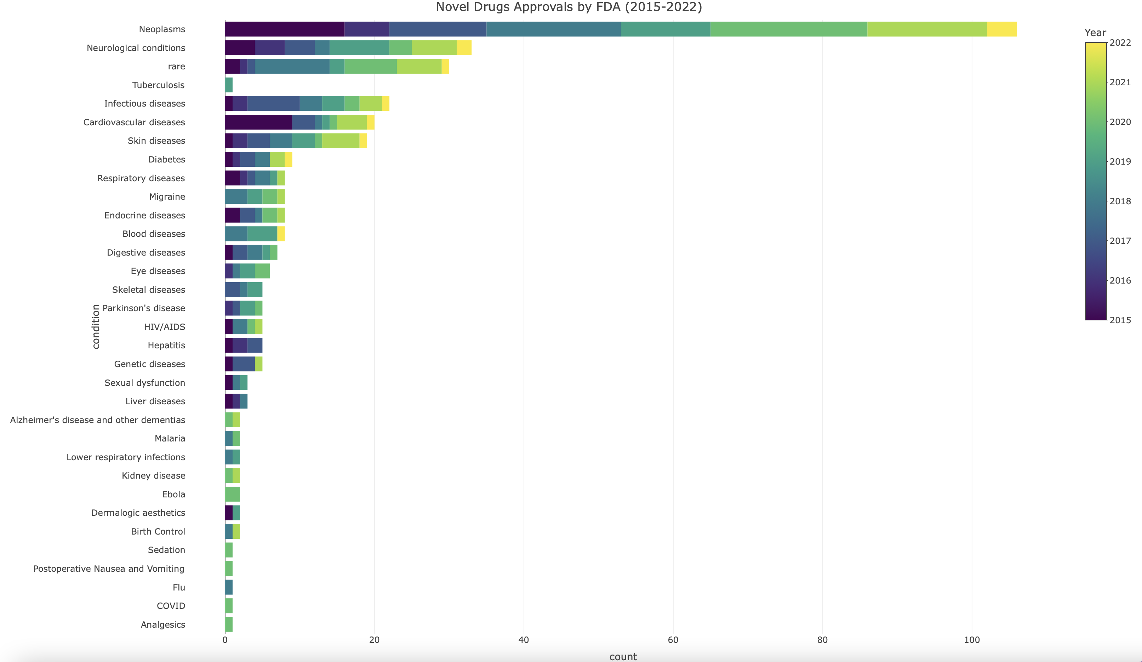
Background Data Results Conclusion
Source: https://www.fda.gov/drugs/development-approval-process-drugs/new-drugs-fda-cders-new-molecular-entities-and-new-therapeutic-biological-products
Notes:
Out of 33, 16 Novel Drug categories are targeting causes of death, 200 out of 325 novel drugs are targeting causes of death (62%)

Slide 8
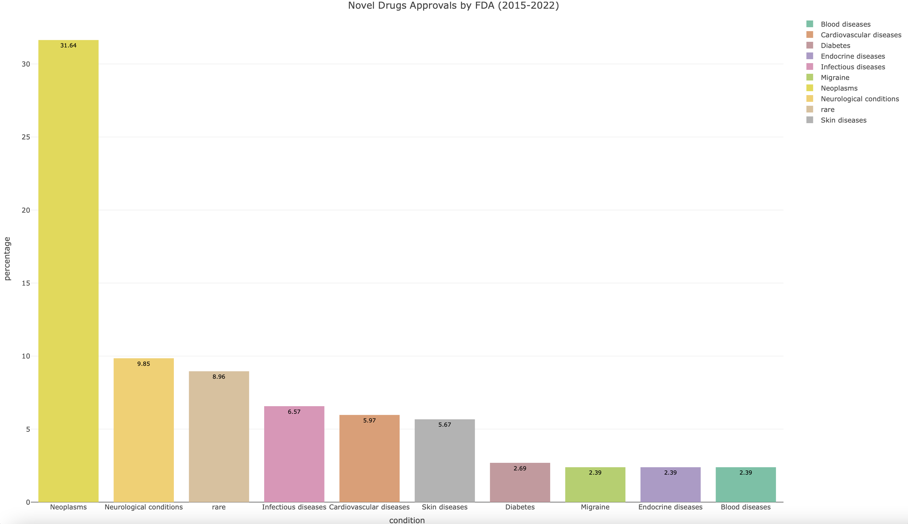
Background Data Results Conclusion
Source: https://www.fda.gov/drugs/development-approval-process-drugs/new-drugs-fda-cders-new-molecular-entities-and-new-therapeutic-biological-products

Slide 9
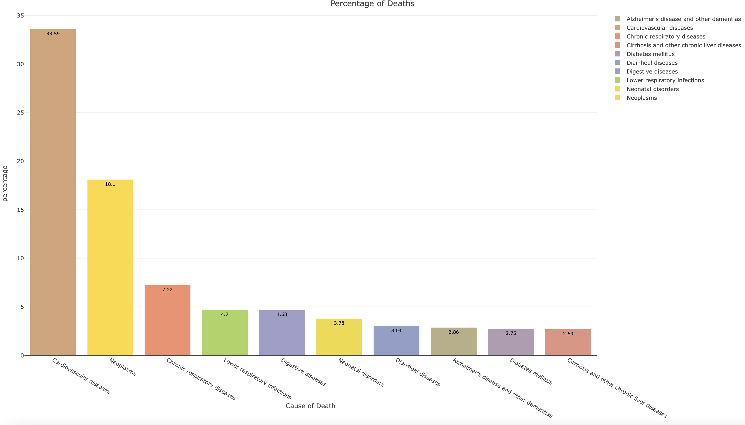
Background Data Results Conclusion
Source: https://www.fda.gov/drugs/development-approval-process-drugs/new-drugs-fda-cders-new-molecular-entities-and-new-therapeutic-biological-products

Slide 10
Background Data Results Conclusion
Causes of Death Data is crucial in identifying market needs for pharmaceutical companies.
According to the data provided, it was concluded that pharmaceutical companies do consider Causes of Death Data when selecting disease target.
Further studies in regard to population should be carried out in order to identify more factors that influence the decision of selecting the right disease target.
Future Direction

Slide 11
Background Data Results Conclusion
References
https://www.kaggle.com/datasets/ivanchvez/causes-of-death-our-world-in-data
https://www.fda.gov/drugs/development-approval-process-drugs/new-drugs-fda-cders-new-molecular-entities-and-new-therapeutic-biological-products

