Slide 1
Micromouse Competition

Slide 2
agenda
INTRODUCTION 3
PROJECT OBJECTIVE 4
COMPONENTS 5
I2C PROTOCOL 13
FLOOD FILL ALGORITHIM 15

Slide 3
Introduction

Slide 4
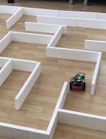
This project focuses on designing a robot that can efficiently solve a 8*8 maze, where each cell measures 20×20 cm. The goal is to find the shortest path and complete the maze in the shortest possible time. To achieve this, the robot will use the Flood Fill Algorithm, which helps in mapping and navigating the maze efficiently.

Slide 5
Project Objective :
The main goal of this project is not only design a maze solving robot but also to gain hands on experience in hardware integration and communication protocols. Through this project we learn how to :
Work with hardware components and understand how to connect and configure them properly.
Use communication protocols related to ESP to control and coordinate the robot’s function.
Integrate various sensors .including IR sensor and lidar .
Control motor effectively by using motor with encoder and H-Bridge

Slide 6
Component

Slide 7
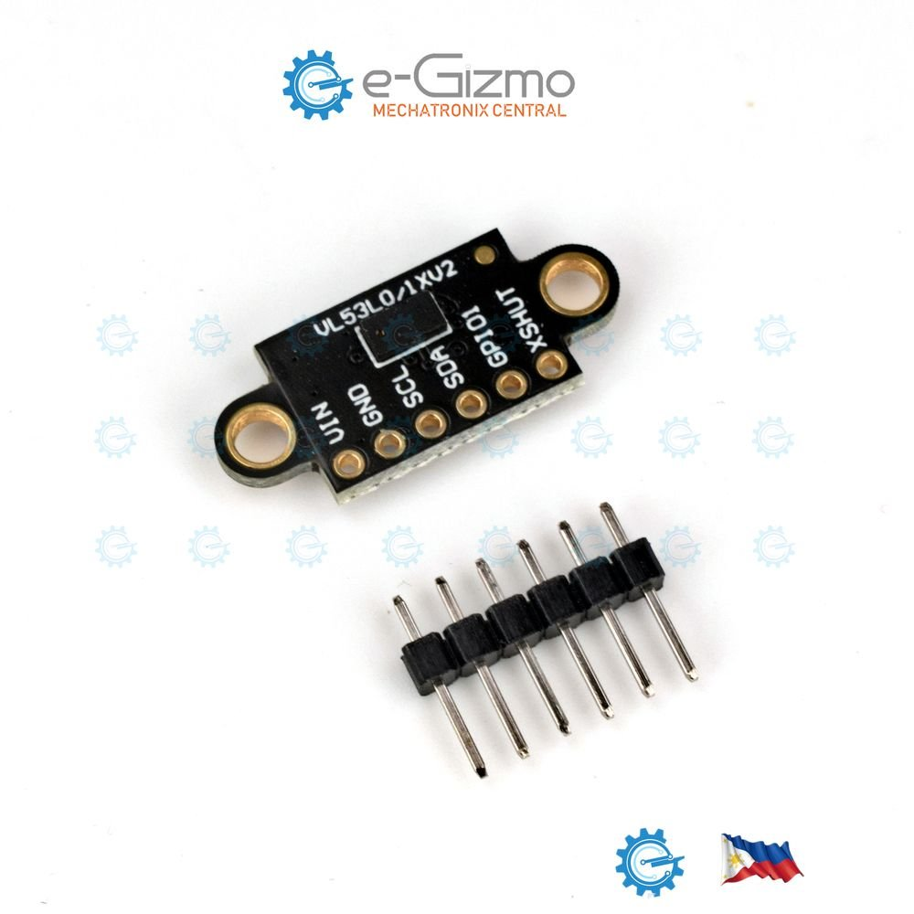
The component we use are :
1)Lidar (VL53L0X):
In our robot, the VL53L0X LiDAR sensor is used for distance measurement and obstacle detection. It continuously measures the distance to nearby objects and helps the robot navigate through the maze by identifying walls and obstacles. The sensor works using Time-of-Flight (ToF) technology, which means it send an infrared laser pulse and calculates the time it takes for the pulse to bounce back from an object. This allows for highly accurate distance readings. The LiDAR sensor communicates with the ESP using the I2C (Inter-Integrated Circuit) protocol, which enables fast and efficient data exchange between the microcontroller and the sensor. The robot uses these real-time distance readings to avoid collisions, make navigation decisions, and implement the Flood Fill Algorithm effectively to find the shortest path in the maze.

Slide 8
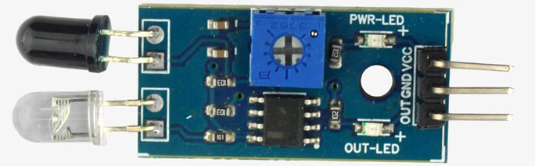
2) IR Sensors:
the IR sensors help detect nearby walls. They work by sending out infrared light and checking if it reflects back from an object. If the light bounces back, it means there is an obstacle close to the sensor. We use two IR sensors, one on the left and one on the right, to help the robot detect walls and stay on the correct path. The left IR sensor is connected to pin 34, and the right IR sensor is connected to pin 35 on the ESP/Arduino. These sensors use digital input pins, allowing the robot to quickly check for walls and obstacles. This helps the robot make smart decisions, like turning left or right, and ensures it follows the best route while solving the maze.

Slide 9
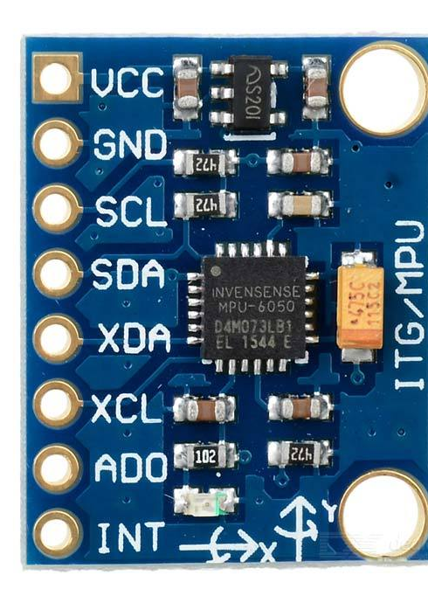
3) MPU6050: In our robot, the MPU6050 sensor is used to measure motion and orientation. It has a built-in accelerometer to detect movement and a gyroscope to measure rotation. This helps the robot maintain balance and track its direction while navigating the maze. The MPU6050 connects to the ESP/Arduino using the I2C (Inter-Integrated Circuit) protocol, with the SDA (data line) connected to pin 21 and the SCL (clock line) connected to pin 22. By continuously reading data from this sensor, the robot can detect if it has turned correctly, adjust its movement, and ensure stable navigation through the maze

Slide 10
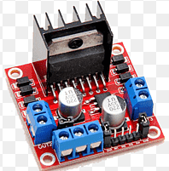
4) H-Bridge motor driver :
the H-Bridge motor driver is used to control the direction and speed of the motors. It allows the robot to move forward, backward, turn left, and turn right by controlling the voltage direction sent to the motors. The H-Bridge connects to the ESP/Arduino using multiple pins: IN1 (pin 13), IN2 (pin 12), IN3 (pin 14), and IN4 (pin 27) to control the motor direction, while ENA (pin 26) and ENB (pin 25) are used for speed control via PWM (Pulse Width Modulation) signals. By adjusting these signals, the robot can smoothly navigate the maze, change directions, and maintain precise control over its movements.

Slide 11
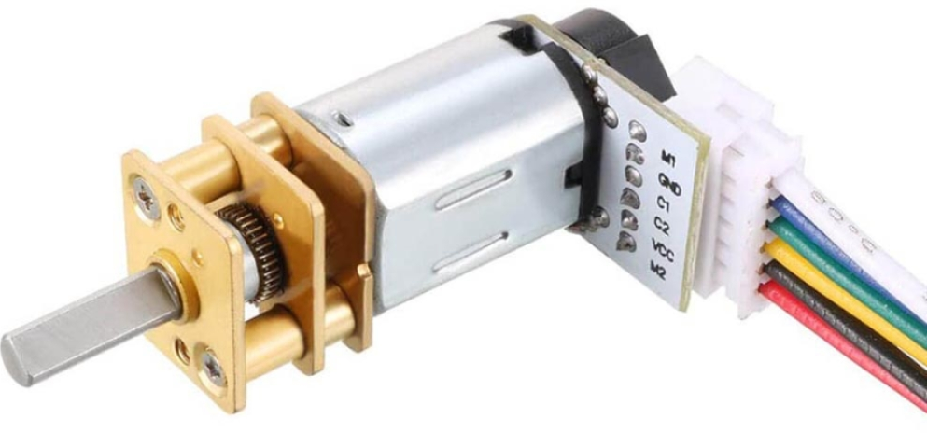
5) DC Motors with Encoder :
The DC motors with encoders help track the movement and speed of the wheels. The encoders generate signals as the motor rotates, allowing the robot to measure how far it has moved and how fast it is going. This helps in precise control of movement, ensuring the robot follows the correct path while solving the maze. The left motor encoder is connected to pins ENCA_A (pin 4) and ENCA_B (pin 18), while the right motor encoder is connected to pins ENCB_A (pin 19) and ENCB_B (pin 23). These encoders send signals to the ESP, which counts the pulses and calculates the distance traveled. This data is used to adjust the robot’s speed, correct its direction, and improve navigation accuracy.

Slide 12
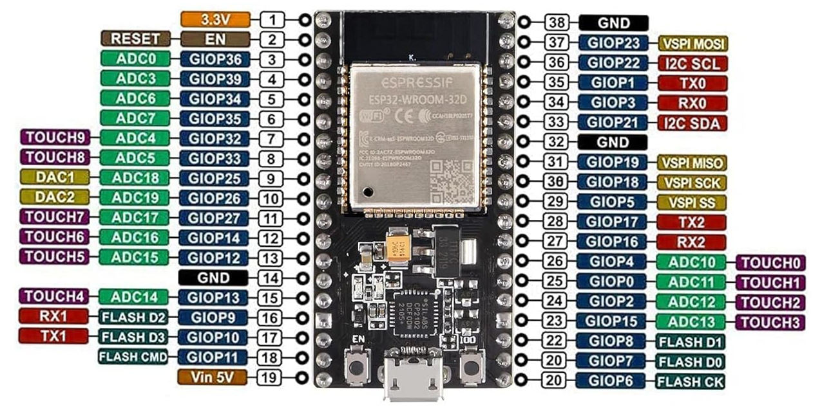
6) ESP32­WROOM­ :
the ESP (ESP32 microcontroller) is the brain that controls all components, processes sensor data, and makes decisions for navigation. It communicates with various hardware components using different protocols and pins

Slide 13
How We Use the I2C Protocol in Our Robot:
In our robot, we use the I2C (Inter-Integrated Circuit) protocol to communicate with multiple sensors using only two shared wires:
SDA (Serial Data Line) → Pin 21 on ESP32
SCL (Serial Clock Line) → Pin 22 on ESP32
The I2C protocol allows multiple devices (sensors) to connect to the same two pins, and each device is identified by a unique I2C address.

Slide 14
DEVICES USING I2C IN OUR ROBOT:
We are using the I2C protocol to communicate with :
Lidar its address is 0x29
And the MPU6050 its address is 0x68
Both sensors share the same SDA and SCL pins but their addresses are different .

Slide 15
Flood fill Algo

Slide 16
the Flood Fill Algorithm is used to explore the maze and find the shortest path to the goal.
The maze is represented as an 8x8 grid, where each cell has a weight value indicating the distance from the starting position.
Initially, all cells are set to 0, meaning they are unexplored. The robot begins at a starting position, assigning a weight of 1 to that cell. As it moves, it updates the weights of surrounding cells, increasing the value step by step. The robot
always moves towards the cell with the lowest weight, ensuring it follows the shortest path.
If an obstacle is detected using the LiDAR or IR sensors, the robot updates the maze,
marking that path as blocked, and recalculates a new path.
The flood fill function is continuously called during movement,
allowing the robot to adapt in real-time. By following the lowest-weighted path
and avoiding obstacles, the robot efficiently navigates the maze and reaches the goal as quickly as possible.

