Slide 1
PoV: Agentic AI on Azure
Architecture • Use Cases • TCS Perspective

Slide 2
Agenda
Executive Summary
Architecture
Use Cases
Maturity Model
TCS Differentiators

Slide 3
Executive Summary
Agentic AI moves enterprises from assistance to autonomy.
Azure enables secure, scalable agentic systems.
25–50% uplift in automation, 40–65% faster cycles.

Slide 4
Reference Architecture
Interaction Layer (Teams, Web, Mobile)
Agent Orchestration (Semantic Kernel, Autogen)
Model Execution (Azure OpenAI)
Tools Layer (Functions, Logic Apps)
Memory (Vector DB, Search)
Data Platforms (Fabric, Synapse, SQL)
Governance & Security

Slide 5
Key Enterprise Use Cases
Autonomous ITSM
Finance Close Automation
KYC/AML Agents
Predictive Maintenance
Procurement Optimization

Slide 6
Enterprise AI Maturity Model
Level 1 – Assisted Intelligence
Level 2 – Augmented Intelligence
Level 3 – Autonomous Agents
Level 4 – Multi-Agent Ecosystems
Level 5 – Autonomous Enterprise

Slide 7
TCS Differentiators
Azure Engineering Partnership
Industry-Focused Accelerators
MFDM™ & Business 4.0™ Alignment
Proven AI Transformation Playbooks

Slide 8
BFSI – Key Use Cases
KYC/AML Autonomous Processing
Fraud Investigation Agents
Risk Scoring Automation

Slide 9
Retail & CPG – Key Use Cases
Smart Pricing Agents
Demand Forecasting Agents
Supply Chain Optimization

Slide 10
Manufacturing – Key Use Cases
Predictive Maintenance Agents
Digital Twin Automation
Quality Inspection Agents

Slide 11
Healthcare – Key Use Cases
Care Pathway Agents
Claims Automation
Clinical Decision Support

Slide 12
Telecom – Key Use Cases
Network Optimization Agents
Customer Value Management Agents
Fault Resolution Agents

Slide 13
Agentic AI Adoption Roadmap
Phase 1: Discover & Strategize – Identify use cases, readiness assessment
Phase 2: Pilot – Build PoCs, validate agent behavior & safety
Phase 3: Scale – Integrate agents, implement governance, expand coverage
Phase 4: Transform – Multi-agent ecosystems, autonomous enterprise operations

Slide 14
ROI Model for Agentic AI
Baseline Effort Analysis (current manual hours)
Automation Potential (% tasks reducible via agents)
Cycle-Time Compression Benefits
Quality Gains (error reduction value)
Azure Operational Cost Model (model inference, agents, tooling)
Net Annual Business Value (gains - cloud cost)

Slide 15
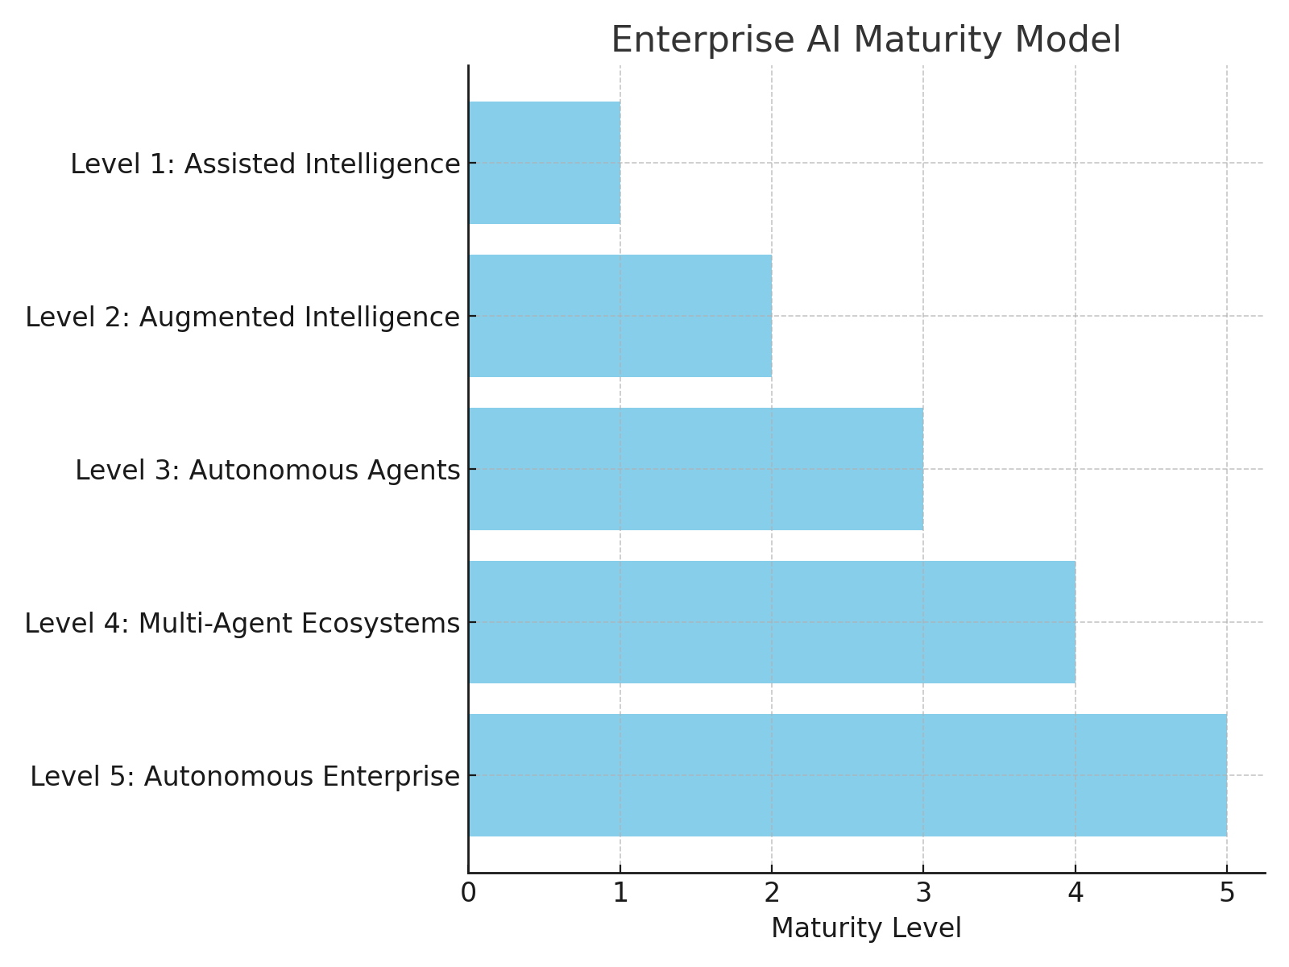
Enterprise AI Maturity Model

Slide 16
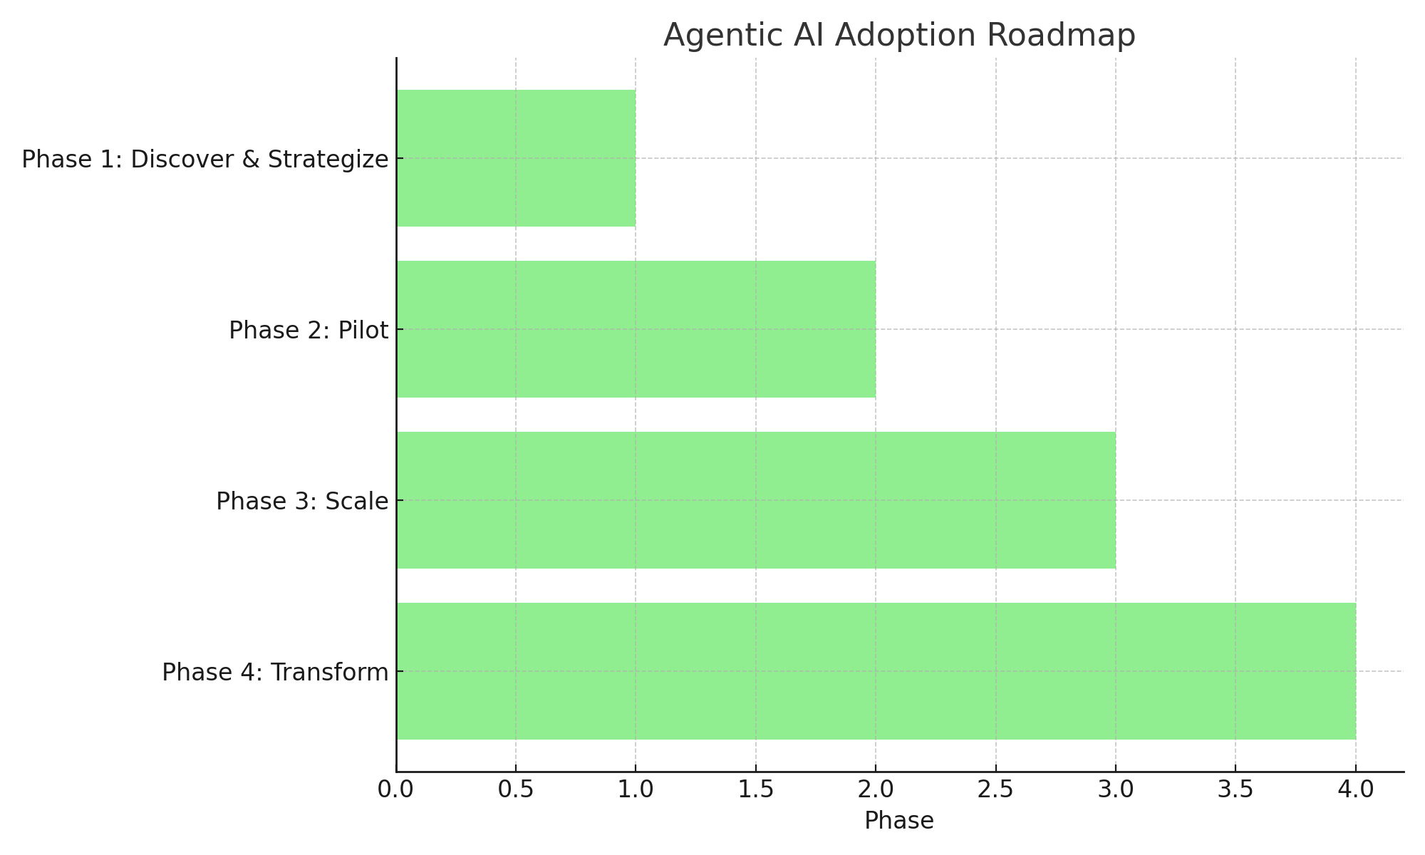
Agentic AI Adoption Roadmap

