Slide 1


Slide 2

Agenda
Introduction to Cryptography
Cryptography in NCL
Tools
Examples
Challenges
Download at: git clone https://github.com/layer-zero-unlv/training-sessions

Slide 3
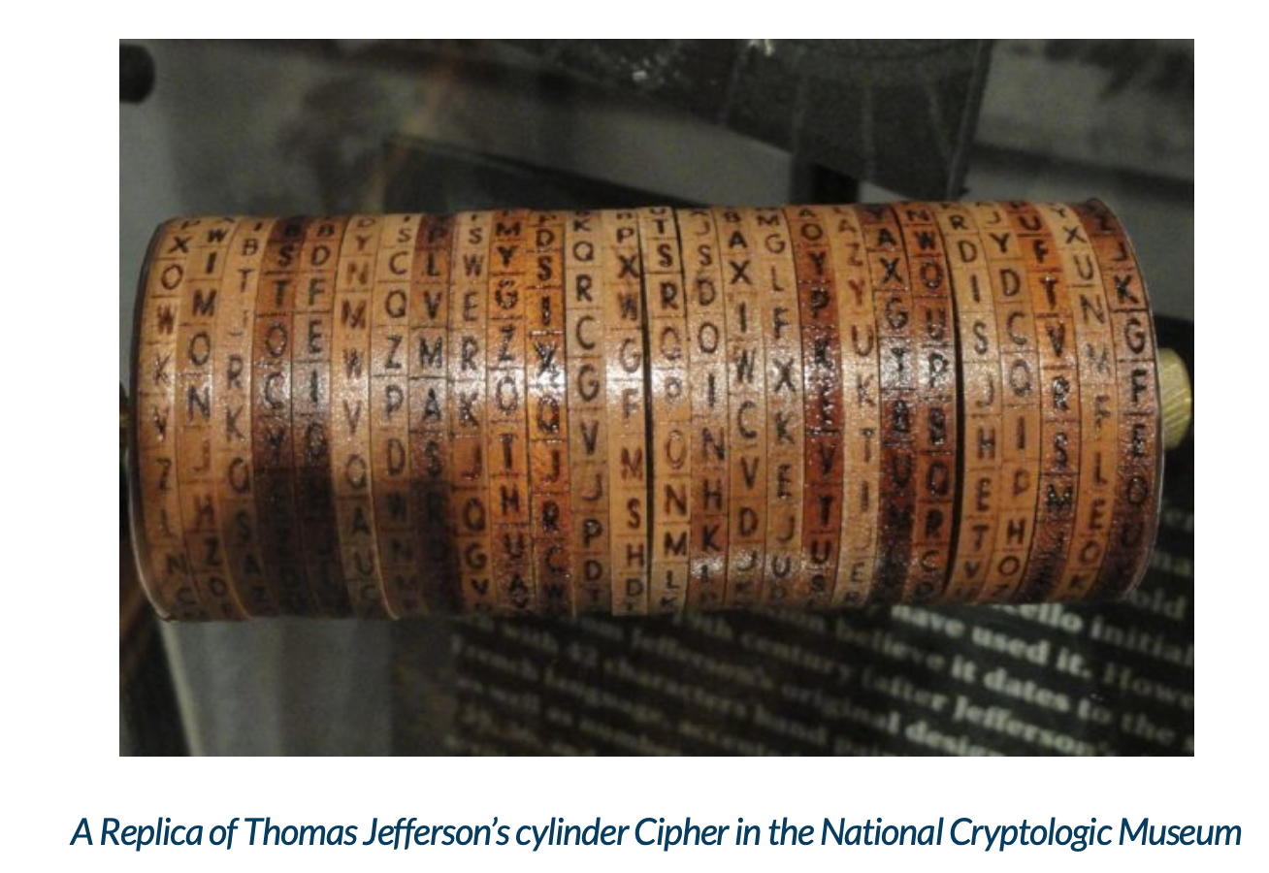
Introduction
“Hidden Secret”
Dates back thousands of years (~1900 BC)
Two Main ideas: Encryption and Decryption
Don’t need to understand the math and proofs for NCL
Be familiar with basic cyphers
Use problem solving skills with underlying cryptography concepts
PRACTICE, PRACTICE, PRACTICE!
Notes:
Art and Science of encrypting sensitive information
Dates back to Egyptians (hieroglyphs)

Slide 4
Cryptography in NCL
XOR (Exclusive OR)
Caesar Cipher / ROT
Substitution Cipher
Vigenere Cipher
Hasing
RSA (Rivest-Shamir-Adleman)

Slide 5

XOR (Exclusive Or)
Bitwise operation

Slide 6
XOR (Exclusive Or)
Perform XOR between letters ‘p’ and ‘a’
p = 0x70 = 01110000 a = 0x61 = 01100001
Can use used to quickly encrypt passwords using a secret character
0 1 1 1 0 0 0 0 (p) 0 1 1 0 0 0 0 1 (a) 0 0 0 1 0 0 0 1
reversible
0 0 0 1 0 0 0 1 0 1 1 0 0 0 0 1 (a) 0 1 1 1 0 0 0 1 (p)
Notes:
XOR is a quick way to encrypt passwords

Slide 7
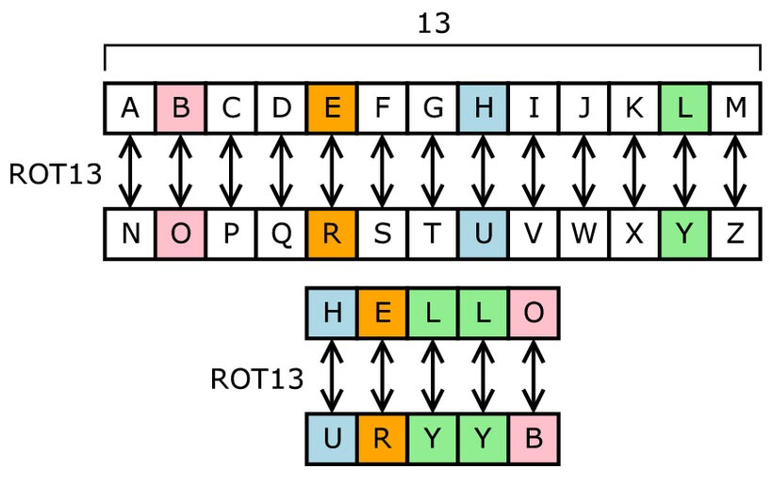
Caesar Cipher / Rotation Cipher
Letters are shifted given a shift value
Common value is 13 (ROT13)

Slide 8
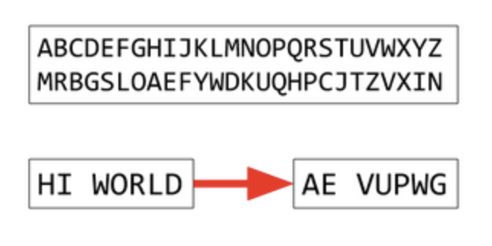
Substitution Cipher
Similar to Caesar Cipher, but the encryption symbols is chosen by the user
Doesn’t have to be letters!
Notes:
Doesn’t have to be letters.

Slide 9

Vigenere Cipher
Extension of a Caesar Cipher
Uses a “passphrase” to encrypt
Same “passphrase is used to decrypt
“IAMREALLYCOOL”
Passphrase: “phill”

Slide 10
Vigenere Cipher
Input: “IAMREALLYCOOL”
Pad with input with the passphrase
I A M R E A L L Y C O O L P H I L L P H I L L P H I
Use Vigenere table to encrypt
X H U C P P S T J N D V T
Do same to decrypt
passphrase: “phill”

Slide 11

Hashing
One way encryption
MD5, SHA256, SHA512, CRC…
Think of a hash as a “fingerprint”
Maybe given a hash and you have to find the input or you have to hash an input to reveal the flag
HASH
5BAA61E4C9B93F3F0682250B6CF8331B7EE68FD8
output
input

Slide 12
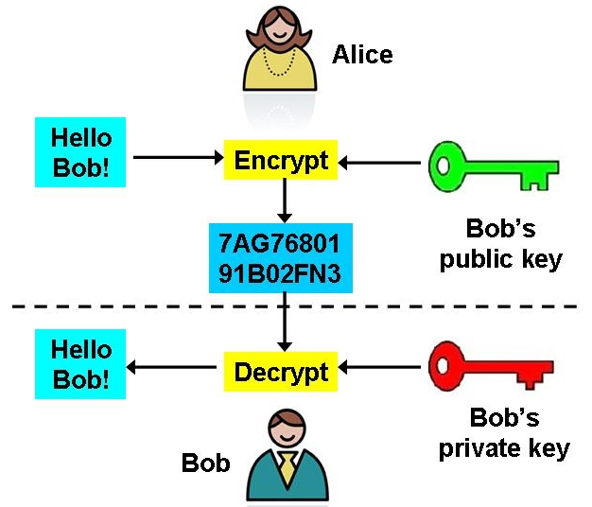
RSA
Asymmetric Key Encryption
Public and Private Keys
The keys can encrypt and decrypt each other!
Encrypt
Decrypt
Decrypt
Encrypt
Private Key
Public Key

Slide 13
RSA
2.) Bob decrypts message with his private key
How does bob know message came from Alice?
Alice encrypts message with Bob’s public key
Alice encrypts message with her private key
2.) Bob decrypts message with his private key and again with Alice’s Public key
2.) Alice encrypts message again with bob’s public key
Alice’s public key

Slide 14
Tools
Google
Scripting Python or Bash
Excel

Slide 15

Example 1
“Jinger is not a very good spy and left this layer around: blorpy gwox{RgqssihYspOntqpxs}.......I wonder what it says”
flag{ }

Slide 16
Example 1
flag{ CiphersAreAwesome}

Slide 17
Example 2
“Beep beep beeeeep….”
..-. .-.. .- --. ... .- -- ..- . .-.. -- --- .-. ... . .. ... -.-. --- --- .-.. -... -.-- - .... . .-- .- -.-- .. .-.. .. -.- . -.-. .... . . ...
flag{ }

Slide 18
Example 2
flag{SAMUELMORSEISCOOLBYTHEWAYILIKECHEES}

Slide 19
Challenge

Slide 20
Thank You
Sources: https://ctflearn.com/
https://ctf101.org

