Slide 1
HOUSE DARK
CURRENT LIVE UI / AUGUST 2026
UI handoff
The live design, product states and build rules for the next LLM.
THE BEST FILM EXPERIENCES HAPPEN WHEN YOU KNOW NOTHING.
This documents the current system. It is not a redesign brief.
Notes:
Cover and handoff purpose.
[Sources]
House Dark live deployment, version 19: https://opening-night-app.layers188.chatgpt.site
House Dark brand and product book, Version 1.0, August 2026.

Slide 2
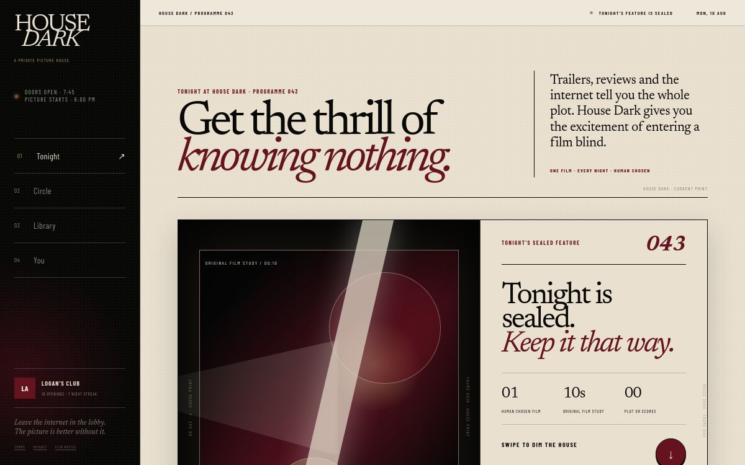
HOUSE DARK
LIVE PRODUCT
A private picture house, not a streaming catalogue
The deployed desktop interface translates the phone ritual without becoming a dashboard.
01
House rail
Programme time, four destinations and the member's current ritual.
02
Editorial opening
The proposition appears before feature mechanics.
03
Feature console
A distinct No Trailer material study sits beside one clear action.
04
No catalogue
Tonight owns the page. Everything else remains behind navigation.
02
Notes:
The image is the deployed Sites preview captured from version 19 on 11 August 2026.
[Sources]
House Dark live deployment, version 19: https://opening-night-app.layers188.chatgpt.site
House Dark brand and product book, Version 1.0, August 2026.

Slide 3
HOUSE DARK
MOBILE SHELL
The house stays one action away
The phone is the primary product. Desktop only widens the same hierarchy.
HOUSE
DARK
HOUSE OPEN
01
Four permanent tabs
Tonight, Circle, Library and You. No fifth destination.
HOUSE DARK PRESENTS · OPENING 043
Get the thrill of
knowing nothing.
02
Current state first
House time, edition and sealed status appear before detail.
ONE FILM · EVERY NIGHT · HUMAN CHOSEN
03
One dominant action
Every state has one clear next move. Supporting options recede.
TONIGHT'S SEALED FEATURE · 043
Tonight is sealed.
Keep it that way.
04
Character through structure
Codes, rules, timing and type create film character without props.
TONIGHT
CIRCLE
LIBRARY
YOU
03
Notes:
Editable reconstruction of the live mobile shell using deployed colours, typography and copy.
[Sources]
House Dark live deployment, version 19: https://opening-night-app.layers188.chatgpt.site
House Dark brand and product book, Version 1.0, August 2026.

Slide 4
HOUSE DARK
TONIGHT
The unknown is the product
No title, poster, cast, synopsis, score or recognisable story material reaches the member before reveal.
HOUSE
DARK
HOUSE OPEN
01
Server boundary
The title is withheld at data level, not hidden with CSS.
TONIGHT AT HOUSE DARK · PROGRAMME 043
Tonight is sealed.
Keep it that way.
Safe prelude
02
The member gets only mood, pace, content care and house timing.
01
10s
00
03
Deliberate gesture
HUMAN CHOSEN
ORIGINAL STUDY
PLOT OR SCORES
Dimming the house turns pressing play into a conscious choice.
SWIPE TO DIM THE HOUSE
04
Immediate reassurance
BRIGHT
DARK ↓
01 human chosen, 10 seconds, 00 plot or scores.
TONIGHT
CIRCLE
LIBRARY
YOU
04
Notes:
Tonight sealed state. Title data stays on the server until the opening completes.
[Sources]
House Dark live deployment, version 19: https://opening-night-app.layers188.chatgpt.site
House Dark brand and product book, Version 1.0, August 2026.

Slide 5
HOUSE DARK
OPENING SEQUENCE
Three states make the reveal feel earned
The transition is short, legible and repeatable. The material changes for every film.
HOUSE
DARK
HOUSE OPEN
HOUSE
DARK
HOUSE OPEN
HOUSE
DARK
HOUSE OPEN
01 DIM THE HOUSE
02 NO TRAILER · 00:10
03 TITLE RELEASED
Leave the internet
in the lobby.
PAST LIVES
Swipe the light down when you are ready to begin.
Now you know. Nothing else.
Watch without preview.
THE PICTURE IS
INTRODUCING ITSELF
TONIGHT
CIRCLE
LIBRARY
YOU
TONIGHT
CIRCLE
LIBRARY
YOU
TONIGHT
CIRCLE
LIBRARY
YOU
05
Notes:
Editable reconstruction of dim, No Trailer and reveal states. A No Trailer lasts 10 to 10.5 seconds and every film uses a distinct material language.
[Sources]
House Dark live deployment, version 19: https://opening-night-app.layers188.chatgpt.site
House Dark brand and product book, Version 1.0, August 2026.

Slide 6
HOUSE DARK
CIRCLE
Social context arrives after the picture
Friends create trust and return without pre-framing an unopened film.
HOUSE
DARK
HOUSE OPEN
01
Sealed inbox
The sender and personal note appear. Film metadata does not.
YOUR PRIVATE FILM CIRCLE
Trust people,
not percentages.
02
Small groups
Circles are trusted rooms, not public follower networks.
SEALED FOR YOU · FROM RORY
03
Activity with restraint
A film chosen
without the sales pitch.
Friends can see that something was watched without leaking the unopened title.
TITLE WITHHELD · OPEN PRIVATE OPENING ↗
04
After Credits
THE BALCONY · FIVE PEOPLE YOU TRUST
Reviews and discussion unlock only after participants mark the film watched.
ALEX · watched something that stayed
RORY · sent a film under seal
AISHA · screening Friday at 8:15
TONIGHT
CIRCLE
LIBRARY
YOU
06
Notes:
Circle For You state, sealed inbox and trusted activity. After Credits remains locked until watching is complete.
[Sources]
House Dark live deployment, version 19: https://opening-night-app.layers188.chatgpt.site
House Dark brand and product book, Version 1.0, August 2026.

Slide 7
HOUSE DARK
SEND UNDER SEAL
The recommendation itself becomes an opening
A three-step flow keeps personal trust visible while removing the sales pitch.
HOUSE
DARK
HOUSE OPEN
HOUSE
DARK
HOUSE OPEN
HOUSE
DARK
HOUSE OPEN
01 FIVE PEOPLE YOU TRUST
02 YOUR FILM RECORD
03 TITLE FREE PREVIEW
Who gets
the opening?
Choose something
you trust.
Ready to send
under seal.
RORY KENT
AFTERSUN · OPENING 038
TO RORY · TITLE WITHHELD
QUIET / INTIMATE / LINGERING
“Do not look it up.
Just trust me.”
AISHA PATEL
Only approved safe cues travel with the film.
THE BALCONY CIRCLE
SEND THE PRIVATE OPENING
TONIGHT
CIRCLE
LIBRARY
YOU
TONIGHT
CIRCLE
LIBRARY
YOU
TONIGHT
CIRCLE
LIBRARY
YOU
07
Notes:
Editable reconstruction of the sender flow using live production copy and the approved one friend or whole Circle model.
[Sources]
House Dark live deployment, version 19: https://opening-night-app.layers188.chatgpt.site
House Dark brand and product book, Version 1.0, August 2026.

Slide 8
HOUSE DARK
PRIVATE OPENING
The recipient receives trust, never metadata
The title, year, poster, cast and runtime remain sealed through notification and acceptance.
HOUSE
DARK
HOUSE OPEN
HOUSE
DARK
HOUSE OPEN
01
Accept unseen
YOUR SEAT IS WAITING
PRIVATE OPENING · TITLE WITHHELD
The member can enter or dismiss without penalty.
One film is
sealed for you.
HOUSE DARK
A film is waiting under seal
02
Same opening ritual
Rory sent you a private opening. The title is withheld.
FROM RORY
The approved No Trailer plays before the server releases the title.
No title in the notification.
No poster in the preview.
No metadata in the share card.
“Do not look it up. Just trust me.”
03
Return loop
QUIET / INTIMATE / LINGERING
The sender is notified when the recipient reveals and leaves six words.
OPEN PRIVATE OPENING
TONIGHT
CIRCLE
LIBRARY
YOU
TONIGHT
CIRCLE
LIBRARY
YOU
08
Notes:
Recipient notification and accepted private opening states. Pre-reveal content remains title free.
[Sources]
House Dark live deployment, version 19: https://opening-night-app.layers188.chatgpt.site
House Dark brand and product book, Version 1.0, August 2026.

Slide 9
HOUSE DARK
LIBRARY
Remember how it felt, not how it scored
The archive is a private film record with programmes, six words and emotional discovery.
HOUSE
DARK
HOUSE OPEN
01
Archive and programmes
Two sections only. A private record and finite seasons.
HOUSE ARCHIVE · PREVIOUS PROGRAMMES
Remember how
it felt.
02
Six words, no score
Memory becomes the organising principle rather than rating.
ON THIS NIGHT · ONE YEAR AGO
03
Browse by feeling
You watched something that stayed.
Emotional temperature replaces ranking and popularity charts.
“Memory flickers where love cannot speak.”
04
History import
THE PROGRAMME WALL · BROWSE BY FEELING
Bring titles and watch dates from Letterboxd or IMDb. Ratings stay outside.
LONGING
MEMORY
BECOMING
DESIRE
TONIGHT
CIRCLE
LIBRARY
YOU
09
Notes:
Library Archive state reconstructed from live copy. Ratings and plot descriptions are deliberately excluded.
[Sources]
House Dark live deployment, version 19: https://opening-night-app.layers188.chatgpt.site
House Dark brand and product book, Version 1.0, August 2026.

Slide 10
HOUSE DARK
PROGRAMMES
Finite seasons add depth without endless browse
A programmer releases one sealed film at a time around a clear point of view.
HOUSE
DARK
HOUSE OPEN
HOUSE
DARK
HOUSE OPEN
01
Human authorship
HOUSE PROGRAMMES · FINITE BY DESIGN
YOUR PRIVATE 2026 PROGRAMME
Programmer identity and reason for the season stay visible.
Cinema of
Longing
Ten films.
Twenty four days.
02
Sealed cadence
GUEST PROGRAMMER · CLARA NG
A finish line without a leaderboard.
The programme has a point of view without publishing future titles.
Five Sunday films about bad timing, private grief and the difficult work of letting another person remain unknowable.
01 RITUAL
03
Clear finish line
02 DESIRE
Progress gives return a shape without streak pressure or competition.
03 OBSESSION
FIVE FILMS · ONE RELEASED EACH SUNDAY
04 MEMORY
03 OF 05
05 BECOMING
TONIGHT
CIRCLE
LIBRARY
YOU
TONIGHT
CIRCLE
LIBRARY
YOU
10
Notes:
Programmes state reconstructed from deployed live copy and approved product model.
[Sources]
House Dark live deployment, version 19: https://opening-night-app.layers188.chatgpt.site
House Dark brand and product book, Version 1.0, August 2026.

Slide 11
HOUSE DARK
YOU
Identity, ritual and membership live in one seat
The member controls privacy, history, services and house preferences without public performance.
HOUSE
DARK
HOUSE OPEN
HOUSE
DARK
HOUSE OPEN
01
Private by default
MEMBER 01842
HOUSE DARK MEMBERSHIP
History, saves, reviews and services are not public unless deliberately shared.
Your seat in
the dark.
Keep your seat.
Go deeper in the dark.
02
Membership is depth
CURRENT RITUAL
Paid value comes from unlimited sends, Circles, archive and programming.
PRIVATE BETA ACCESS
18 OPENINGS · 7 NIGHTS IN A ROW
Every House Member feature is active.
YOUR FILM RECORD
03
No surprise billing
WATCH SERVICES
FREE A$0
HOUSE MEMBER A$4.99 MONTHLY
HOUSE SETTINGS
Beta access is free. Billing begins only after active consent.
No payment is collected during beta. The member must actively agree before billing begins.
VIEW MEMBERSHIP
TERMS AND FILM OWNERSHIP
TONIGHT
CIRCLE
LIBRARY
YOU
TONIGHT
CIRCLE
LIBRARY
YOU
11
Notes:
You and membership states reconstructed from the deployed production copy.
[Sources]
House Dark live deployment, version 19: https://opening-night-app.layers188.chatgpt.site
House Dark brand and product book, Version 1.0, August 2026.

Slide 12
HOUSE DARK
OWNER OPERATION
The programming desk makes the ritual repeatable
Automation supports production. Rights review and named human approval stay permanent.
HOUSE
DARK
HOUSE OPEN
01
Unique every night
Choose architectural light, macro material, practical shadow, stop motion, graphic rhythm or another approved language.
HOUSE DARK · PROGRAMMING DESK
Prepare the next
sealed opening.
Original material only
02
No protected footage, music, faces, characters, locations or recognisable story beats.
01
BRIEF
Mood only. No plot language.
03
Owner only
02
TREATMENTS
Three materially different directions.
Programming, uploads, health metrics and publication controls never appear to signed-out members.
03
SPOILER CLEARANCE
Reject literal or recognisable clues.
04
Human approval
04
RIGHTS
Every visual and audio element cleared.
No automated score can publish a No Trailer. If there is doubt, remove the clue.
05
HUMAN APPROVAL
A named editor publishes the master.
TONIGHT
CIRCLE
LIBRARY
YOU
12
Notes:
Owner-only programming desk and No Trailer pipeline reconstructed from deployed production copy.
[Sources]
House Dark live deployment, version 19: https://opening-night-app.layers188.chatgpt.site
House Dark brand and product book, Version 1.0, August 2026.

Slide 13
HOUSE DARK
UI SYSTEM
The interface feels cinematic through restraint
Typography, paper, darkness and timing do the work. Decorative film props do not.
CORE PALETTE
01
Square, not soft
Clear rules, paper sheets and hard edges. Avoid excessive rounded cards and glass effects.
PROGRAMME PAPER
PAPER 2
HOUSE BLACK
02
Motion creates anticipation
House dim 360ms. Panels under 300ms. No Trailer 10 to 10.5 seconds. Reveal still and earned.
OXBLOOD
BRASS
BOTTLE GREEN
03
Phone first
Strong vertical sequence, one dominant action and 44 pixel touch targets.
TYPOGRAPHY
Newsreader
BARLOW CONDENSED
04
No cinema costume
Editorial statements and reflective copy
Navigation, labels, codes and timing
No popcorn, reels, clapperboards, red carpets, neon or velvet rope decoration.
13
Notes:
Live colour tokens, approved typography and interaction timings from the House Dark brand system.
[Sources]
House Dark live deployment, version 19: https://opening-night-app.layers188.chatgpt.site
House Dark brand and product book, Version 1.0, August 2026.

Slide 14
HOUSE DARK
BUILDER HANDOFF
Protect these rules before extending the UI
New features can add depth. They cannot weaken the unknown.
MUST PRESERVE
CAN EXTEND
01
Keep the current title at the server boundary.
Deep linked invitations
Sender receipts
Push delivery
Six word share cards
Circle screenings
Availability data
History import
Creator programmes
Analytics and operational alerts
02
Keep social activity sealed until after reveal or watch.
03
Keep Tonight focused on one nightly ritual.
04
Give every film a distinct No Trailer visual language.
05
Keep human programming and approval visible.
06
Use original or properly licensed material only.
Do not add a feature if it makes the home screen explain more than the film does.
14
Notes:
Final build rules for another LLM or development team.
[Sources]
House Dark live deployment, version 19: https://opening-night-app.layers188.chatgpt.site
House Dark brand and product book, Version 1.0, August 2026.

