Slide 1

"Where Every Thread Tells Your Story"

Slide 2

Defining the content and field of activity of the company:
Our company prioritizes customer comfort through Comprehensive Customization, DIY Kits, and Ready-to-Wear Options.
Discover a unique DIY fashion store where creating your own outfits is effortless. Browse our extensive catalog, each item listing detailed material options—colors, fabric types, and textures. Enhance your ensemble with recommended shoes, makeup, and accessories that perfectly complement your chosen outfit.
What sets us apart is our commitment to inclusivity in design and decision-making. Customers can personalize their measurements, from waist to bust to hips, ensuring a perfect fit tailored just for you.

Slide 3
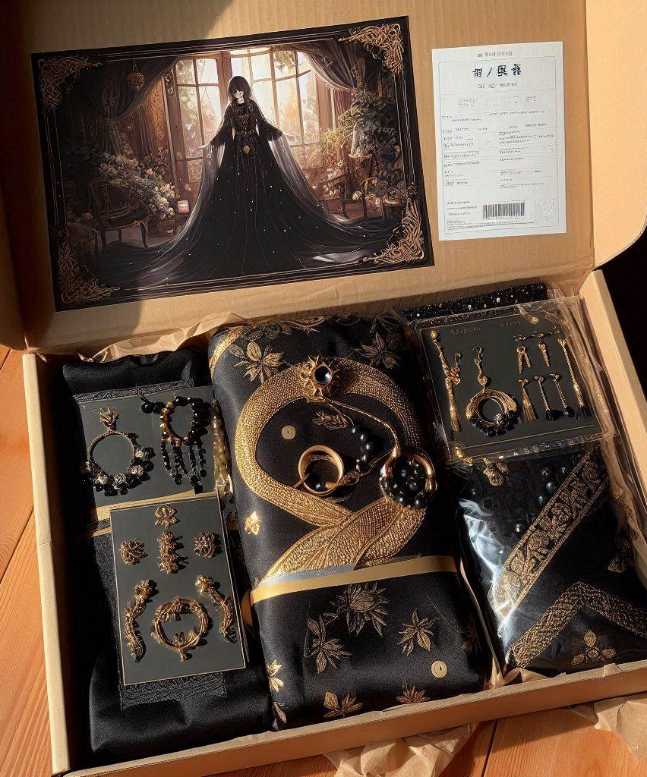
The business model and revenues:
We use B2C model, we offer monthly subscriptions for complete access to our products, support, and personalized info. We also make money from direct product sales, site promotions, and future premium features.

Slide 4
Ways to monetize this website:
B. Custom Order: Premium services for personalized outfits.
C. Premium Membership: Exclusive tutorials, discounts, and freebies.
A. Subscription Boxes: Monthly kits with varying complexity.
D. Brand Collaborations: Limited-edition products with well-known brands.

Slide 5
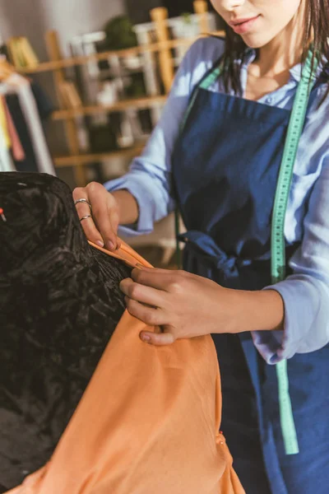
Target audience, market and relationships:
By integrating these features, our DIY store will be the ultimate destination for fashion enthusiasts, offering everything needed for beginners and seasoned designers to bring their creative visions to life.

Slide 6
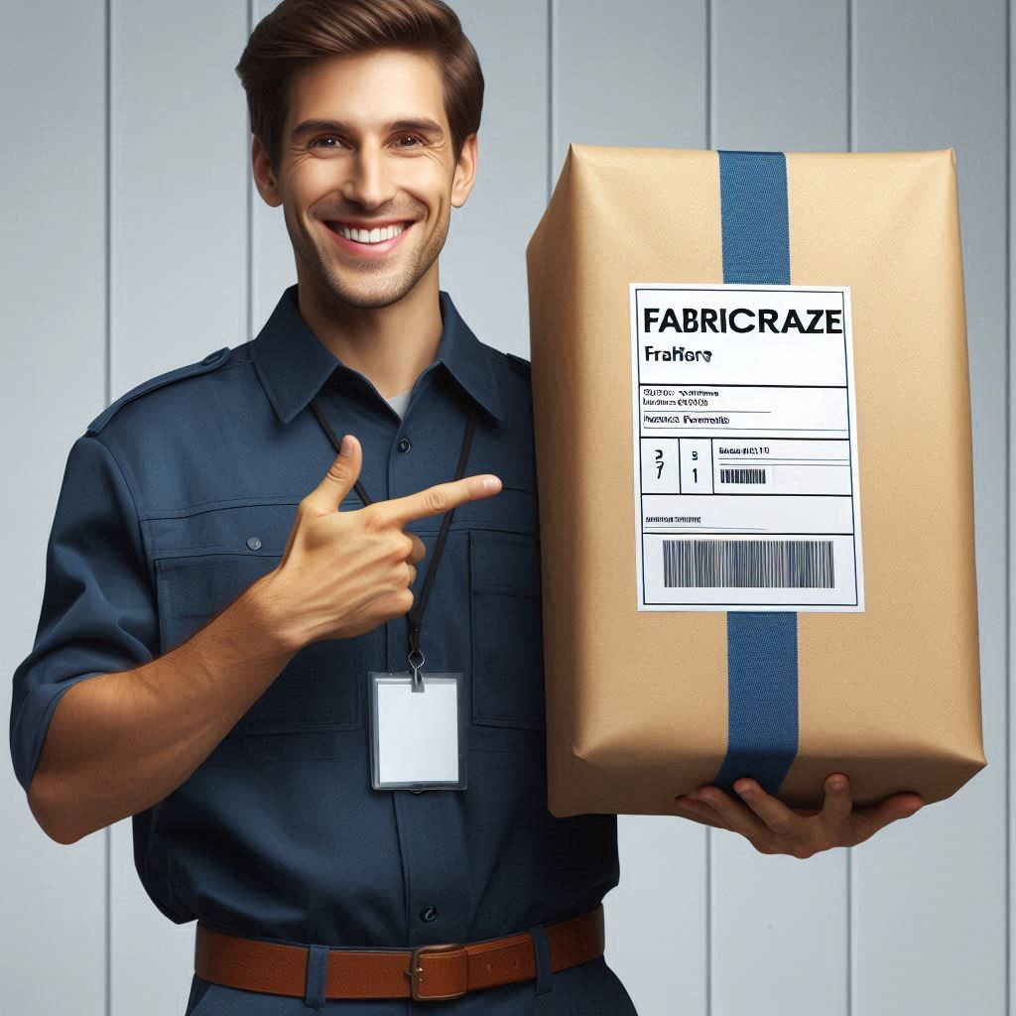
Relative advantages:
One-Stop Shop: Simplifies fashion shopping.
Efficient Delivery: Timely order receipt enhances satisfaction.
Unique Offering: Combining DIY and ready-to-wear options.
customization: Personalize your outfit design, and we'll deliver a package containing all the fabric needed for you to sew it yourself.

Slide 7

Analysis of the business environment:
FabriCraze operates in the competitive realm of fashion subscriptions, alongside notable players like Stitch Fix and ASOS. It offers personalized clothing styling services and a range of monthly subscription products, competing with companies such as Trunk Club, JustFab, and ShoeDazzle in fashion, accessories, and shoes.

Slide 8
Analysis of the business environment:
Bargaining Power of Suppliers:
When the number of suppliers is limited, their bargaining power is high, and they can impose stricter conditions.
Competitors Market Entry Stages:
ASOS, stitchFix
Traditional competitors: Etsy, AliExpress
Bargaining Power of Customers:
The bargaining power of customers against our company is high due to the abundance of alternatives in the market, low switching costs, price sensitivity, and wide access to information.
Threat of Substitutes: Purchasing equipment at a lower price from online websites.

Slide 9

Submitted by: 1. Layla hallumi – 212930952 2. Mohammad Amara – 214578007 3. Fozi Sayed Ahmad – 213912215 4. Waseem Sayed Ahmad – 212687073 5. Nmr Ziad -212018535

