Slide 1
Creating Cytoscape Networks from CausalR Output
Layla Hosseini-Gerami

Slide 2
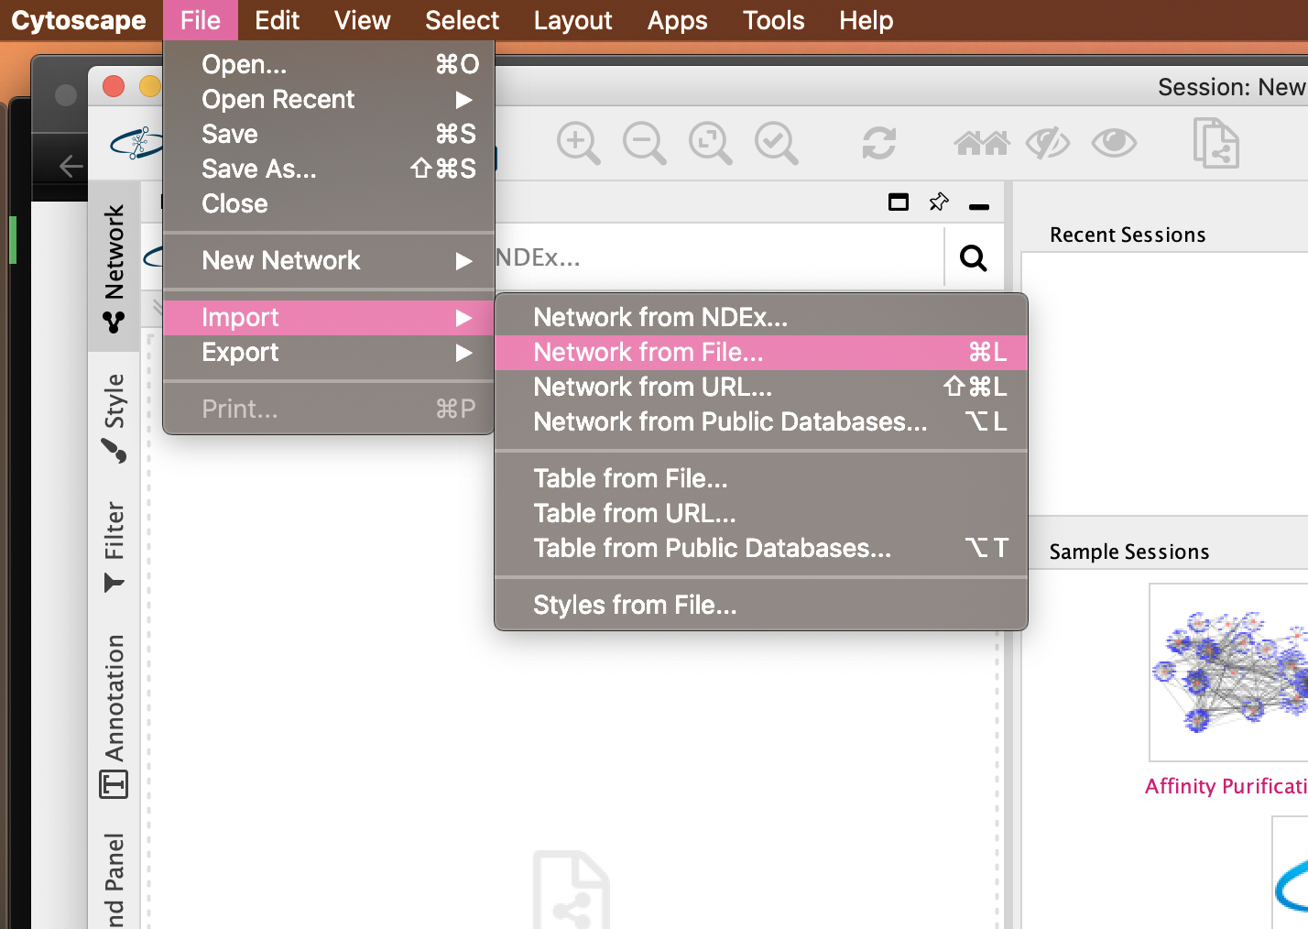
In Cytoscape, click File -> Import -> Network from File…

Slide 3
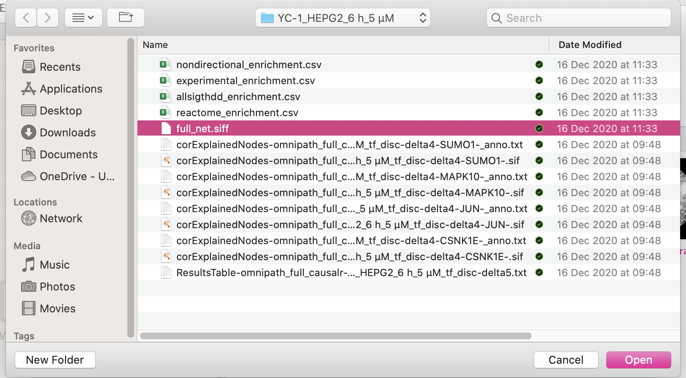
Select the full_net.siff file in the experiment’s Results folder

Slide 4
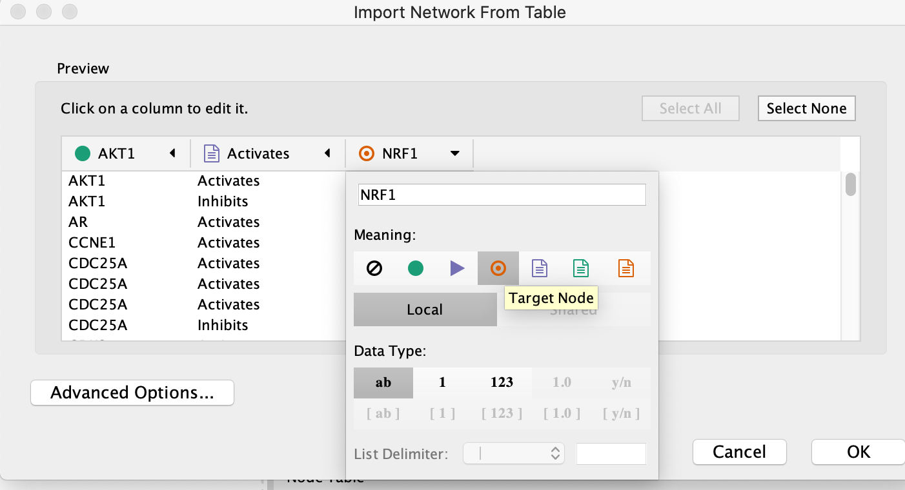
Ensure you assign Source and Target nodes

Slide 5
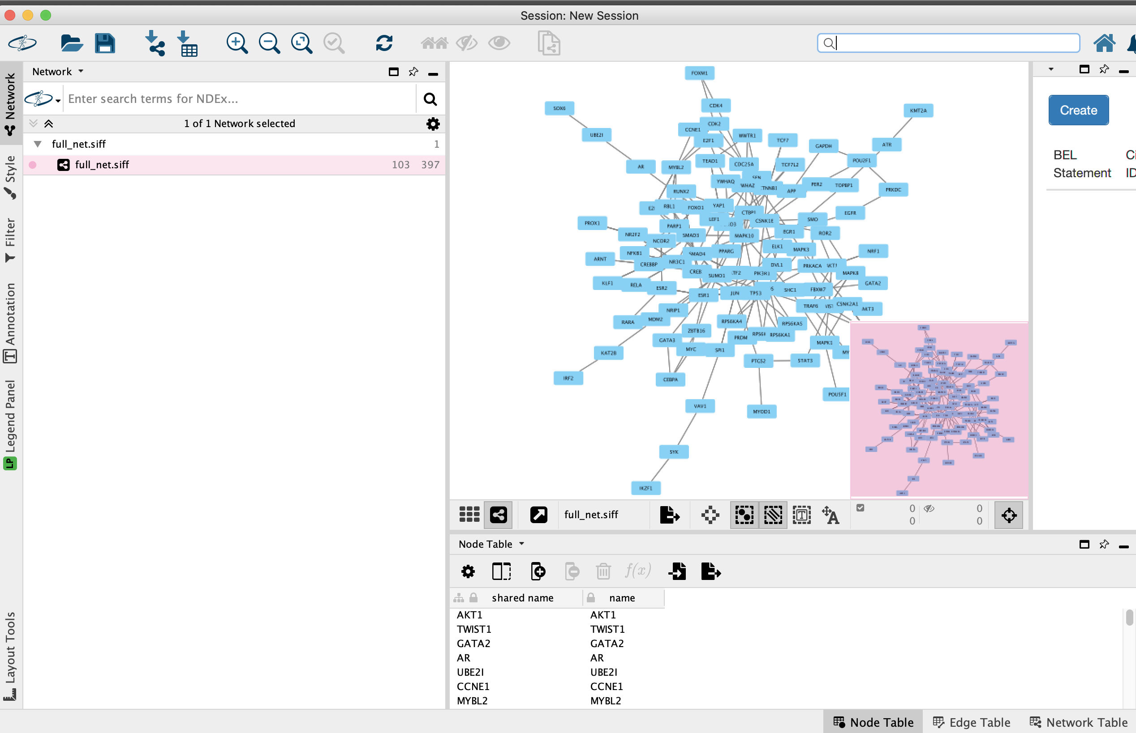
You should be able to see your network, play with the layout etc.

Slide 6
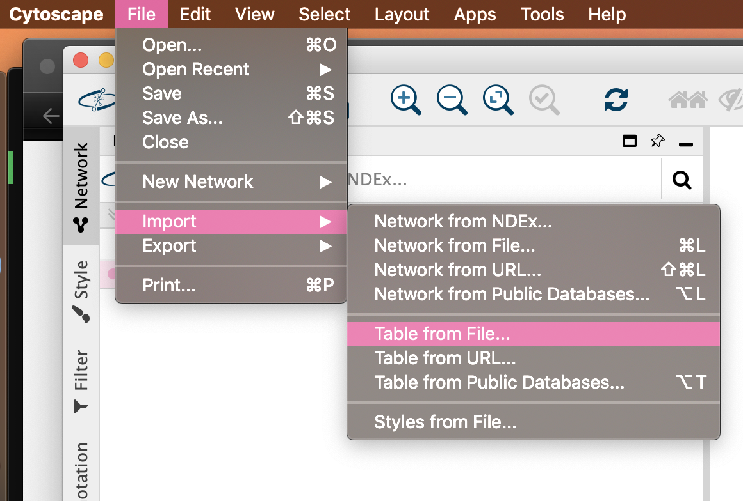
You can also add annotations like so…

Slide 7
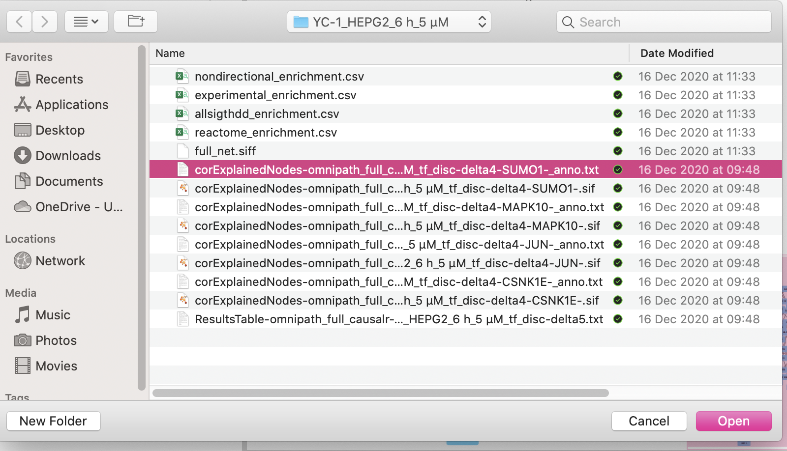
Select one of the *anno.txt files. You can also merge them on the command line (cat *anno.txt > full_anno.txt), or just import them one by one. The protein in the file name refers to the key driver identified by CausalR (significantly dysregulated at multiple path lengths)

Slide 8
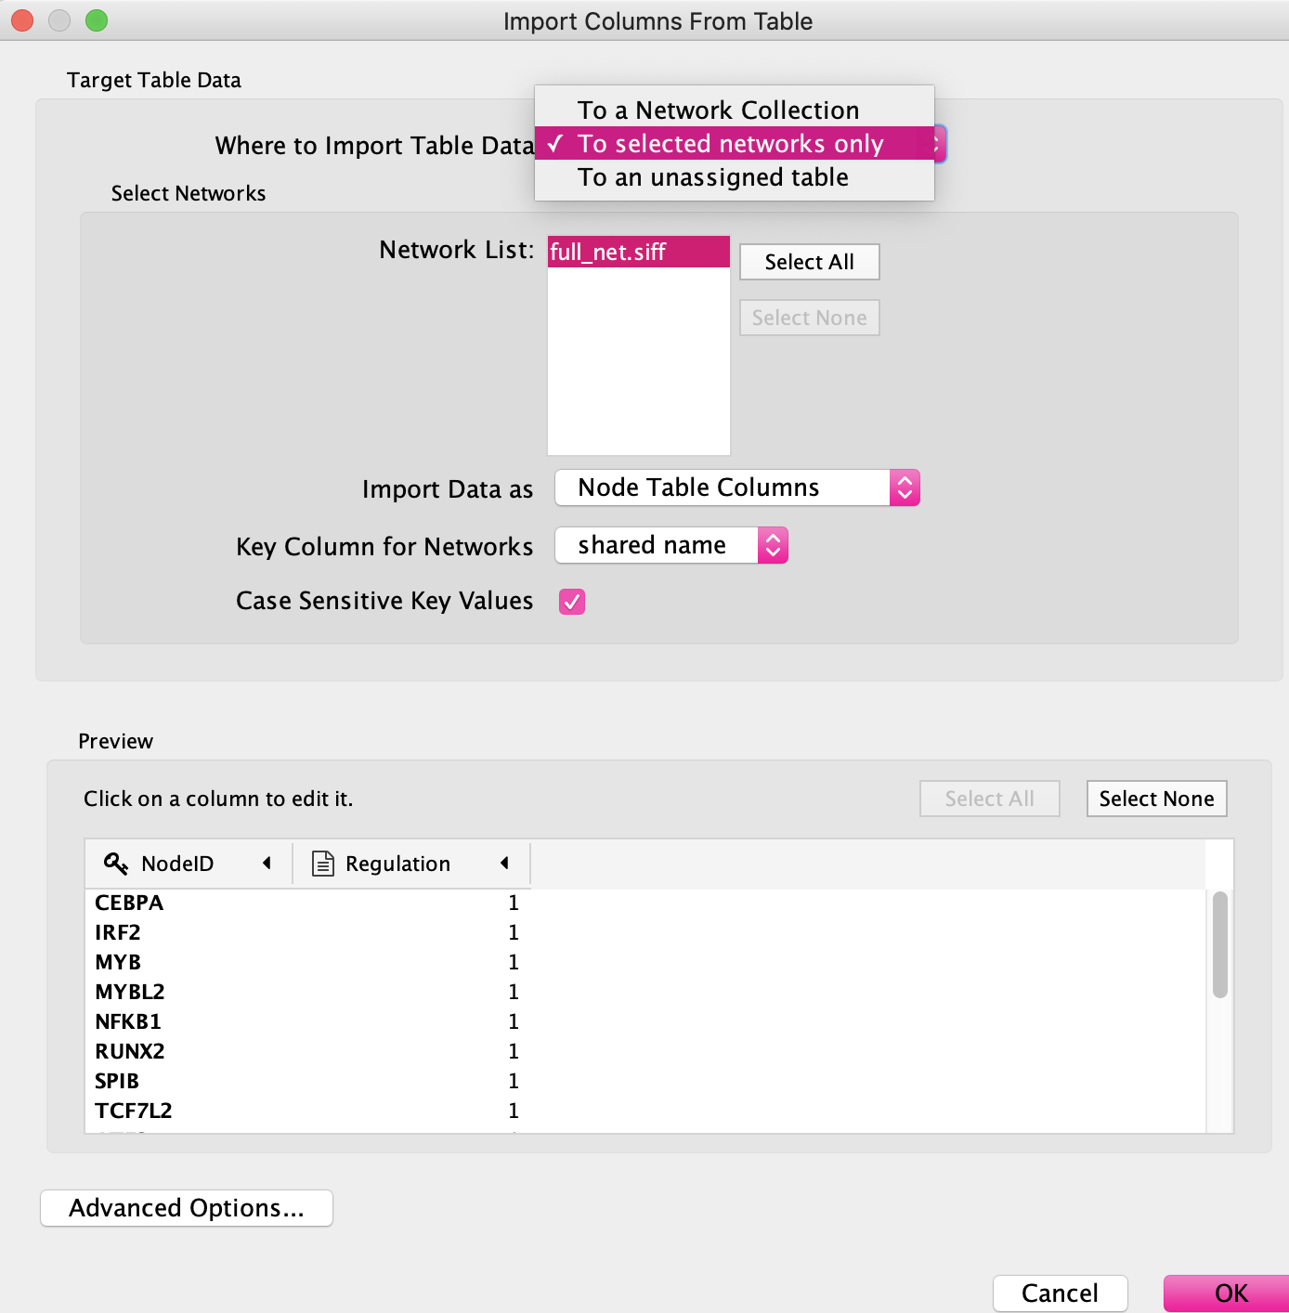
Assign the table to the network to merge gene symbols

Slide 9
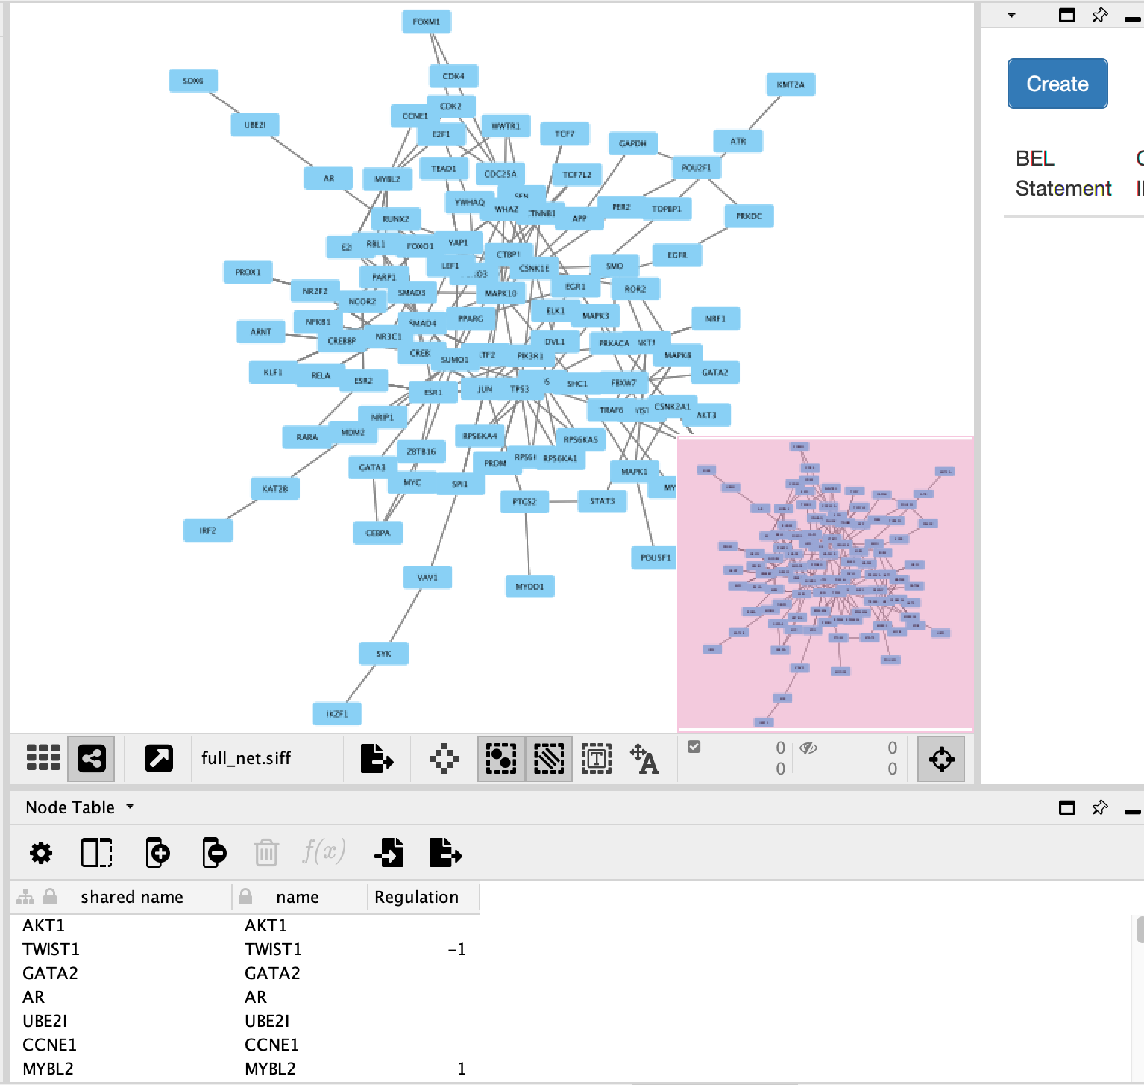
You should see a “Regulation” column underneath the network image, in the network table

Slide 10
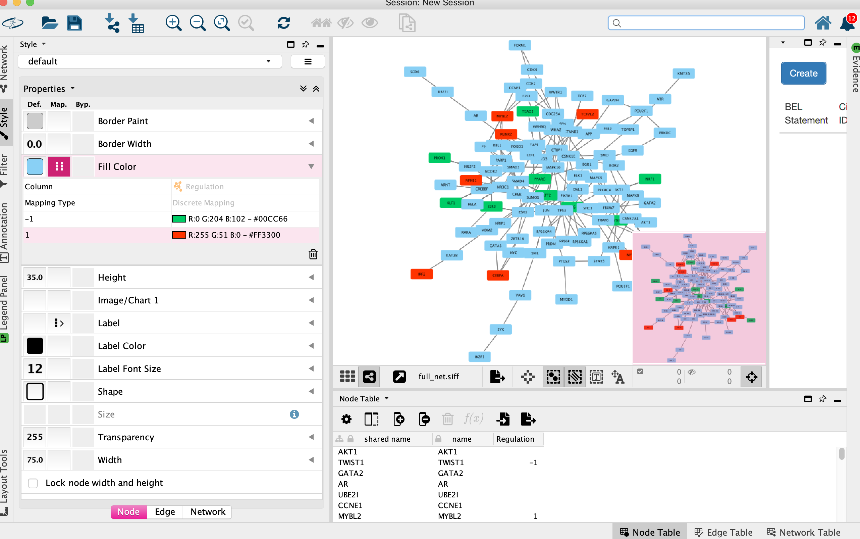
Use the Styles tab to colour nodes by their inferred dysregulation state

