Slide 1
Semester Project: Analysis and Prediction of Oil Pressure
By: Group 16
Dave Yonkers, Henry ji, Luke Layman, Victor Rosolem

Slide 2
Introduction
Oil pressure plays an important role in how well a formula racing car is able to function throughout a race.
The goal of this project was to create a model that would help determine if the oil pressure in the race car is acceptable at any given moment. Which would allow the team to notify the driver in real time.

Slide 3
Data
Acquired from Dave, a leader on the MSU Formula Racing team, the data is from real live practice runs, which include good and bad data.
The data files are huge and messy, which gives us plenty of space to cut it down and look what we need exactly.

Slide 4
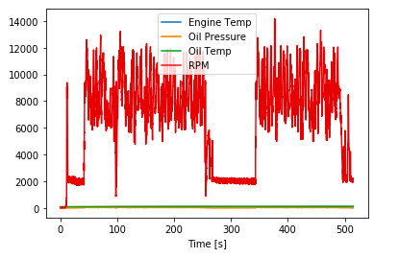
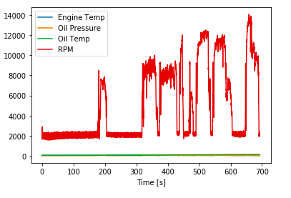
Data: examples
Good Data:
Bad Data:

Slide 5
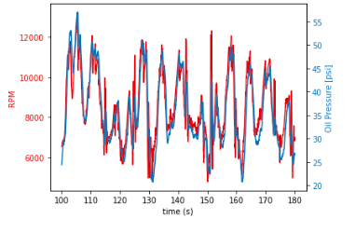
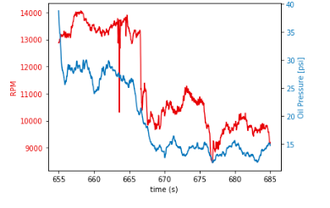
Data
We chose a certain instance to examine, that way we would have a reference for our model:
Notes:
Good on left, bad on right
Talk about how the rpms and oil pressure supposed to be the same

Slide 6
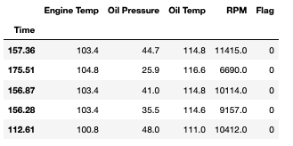
Model: Preparing
Vectors:
We created vectors of the data, with a ‘0’ representing the good data, and a ‘1’ representing the bad data; denoted as ‘Flag’
Notes:
Talk about shuffling the data, and representing them as simply a 0 or 1 to make the model an easier process

Slide 7
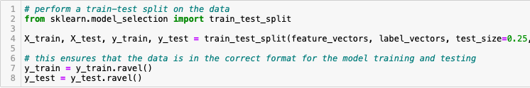
Model
We used the sklearn package for our model, and by using the ’train_test_split’ module, we were able to break up the data to preform the prediction onto the data:
Notes:
Talk about testing size ~25%, the types of data put into the train_test_split function

Slide 8
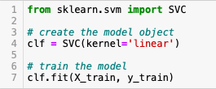
Model: Selection
We chose a Support Vector Machine Learning Model (SVC), mainly due to its simplicity and its effectiveness in high-dimensional applications.
This model was very appropriate for our dataset since we mainly wanted to see if the oil pressure was good or bad, and this classification method achieves that

Slide 9
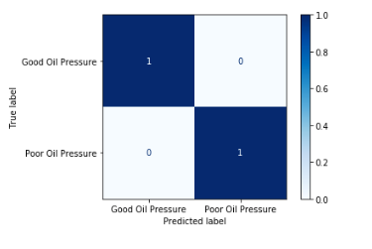
Model: Testing
Running the model:
Plotting a confusion matrix of the results:

Slide 10

Conclusion
As you saw from the last slide, the accuracy of our model was 100%, this could be partly due to us choosing very definitive areas of good and bad oil pressure:
Using the model we selected, we were able to achieve what we initially wanted, to tell whether the oil pressure was good or bad at any given moment

Slide 11
Conclusion: Problems
Working with the data:
Since the data was so big and messy, it was hard to work with. So we had to clean it up and make it readable for us and the viewers
Choosing the correct model:
This took some time since most models did not fit the data directly, which is why we decided to create vectors of 1s and 0s, and to classify the data rather than predicting the future data
We could have modeled it differently:
This would have made a model that would predict the actual numbers, rather than simply stating if the oil pressure was good or bad. However, this would have been very difficult

Slide 12
Thank you for listening (:

