Slide 1
Evaluation and Experiments
Goal: evaluate whether Q-learning improves Snake performance
Metrics: average score, total reward, survival steps
Notes:
Today I will present the evaluation and experiment part of our Snake Q-learning project. The main goal is to check whether the trained Q-learning agent performs better than simple random actions. For evaluation, I use three metrics: average score, average total reward, and average survival steps.

Slide 2
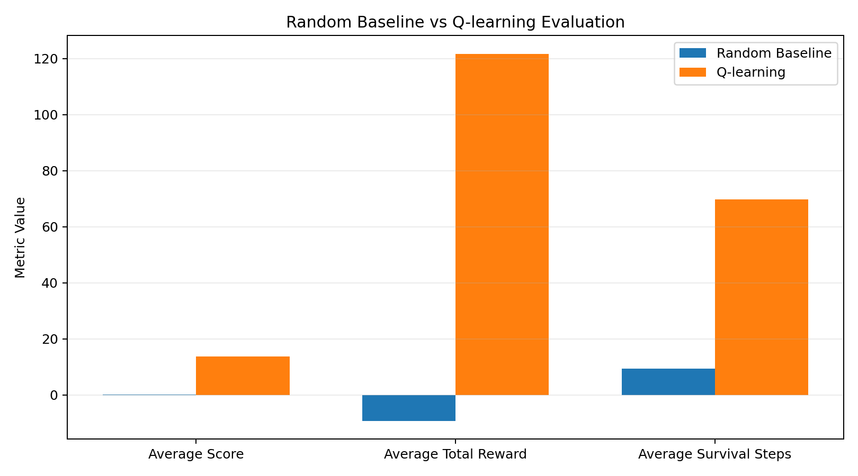
Random Baseline vs Q-learning
Random baseline:
Avg score = 0.16
Avg reward = -9.22
Avg steps = 9.33
Q-learning:
Avg score = 13.74
Avg reward = 121.69
Avg steps = 69.78
Notes:
First, I compare the random baseline with the trained Q-learning agent. The random agent chooses actions uniformly from straight, turn left, and turn right. As we can see, the random baseline gets an average score of only 0.16, while Q-learning reaches 13.74. The reward and survival steps also improve a lot, which shows that the learned policy is much better than random behavior.

Slide 3
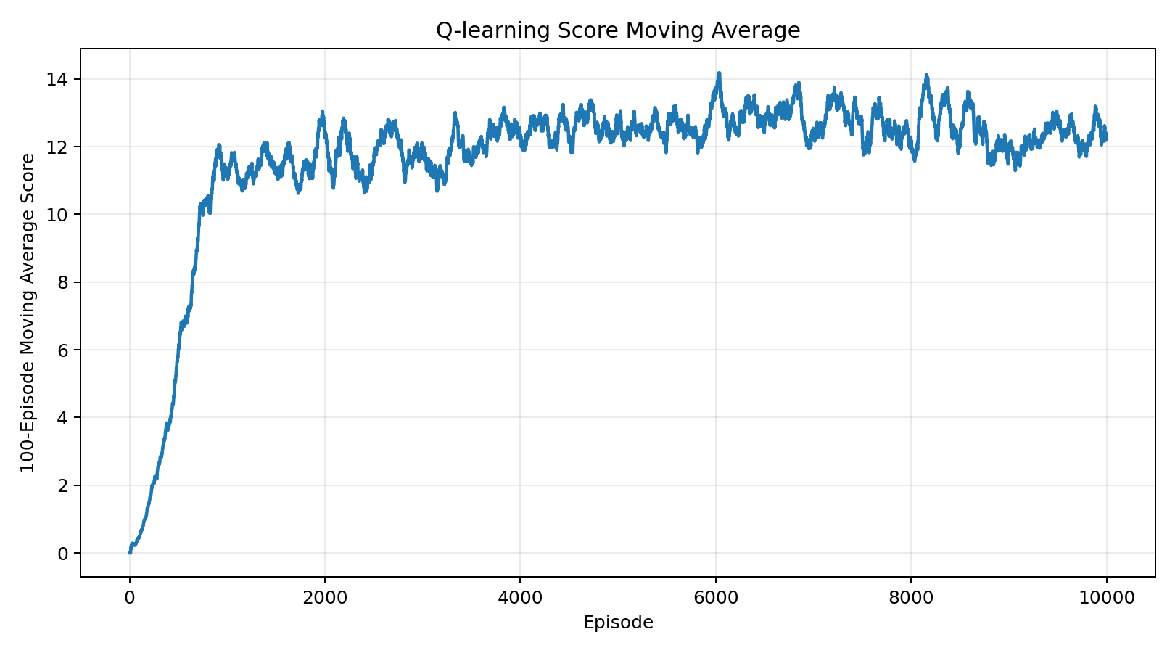
Learning Curve
Trained for 10,000 episodes
100-episode moving average used to smooth noise
Final moving average score ≈ 12.31
Notes:
Next, this slide shows the learning curve over 10,000 training episodes. I use a 100-episode moving average to smooth the results, because individual Snake episodes can be noisy. The final moving average score is about 12.31, which means the agent gradually learns a stable policy during training.

Slide 4
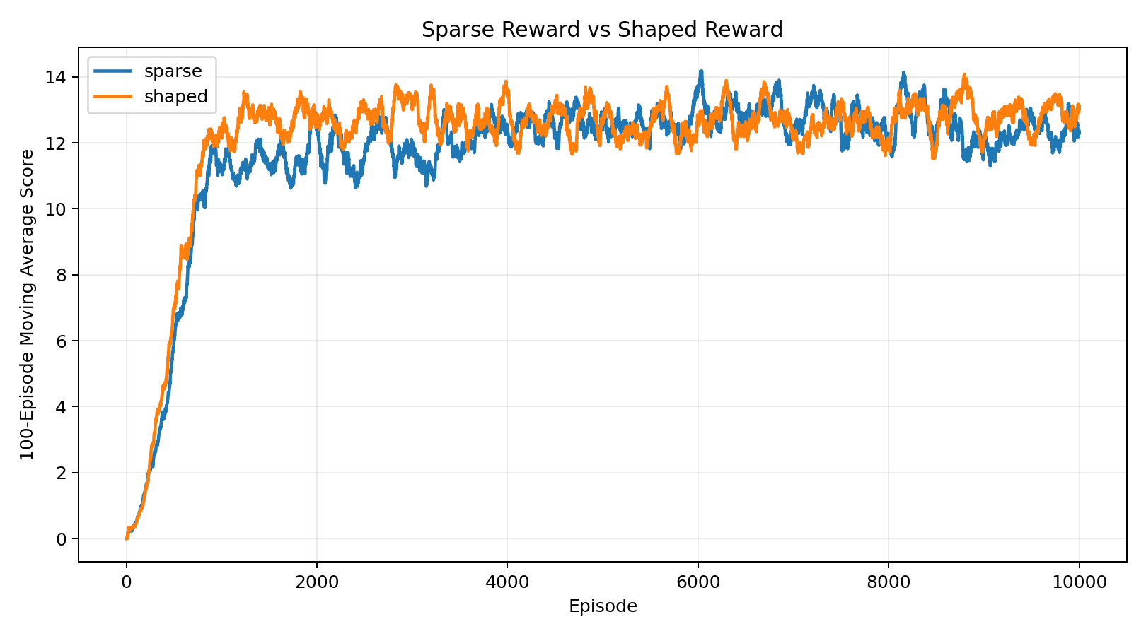
Sparse Reward vs Shaped Reward
Sparse reward:
+10 food, -10 death, -0.1 step
Shaped reward:
Sparse reward plus distance-based bonus/penalty
Final moving avg score:
Sparse = 12.31
Shaped = 13.04
Notes:
I also compared sparse reward and shaped reward. The sparse reward gives plus 10 for food, minus 10 for death, and minus 0.1 for each step. The shaped reward adds a small bonus if the snake moves closer to food, and a penalty if it moves farther away. The shaped reward achieves a slightly higher final moving average score, 13.04 compared with 12.31.

Slide 5
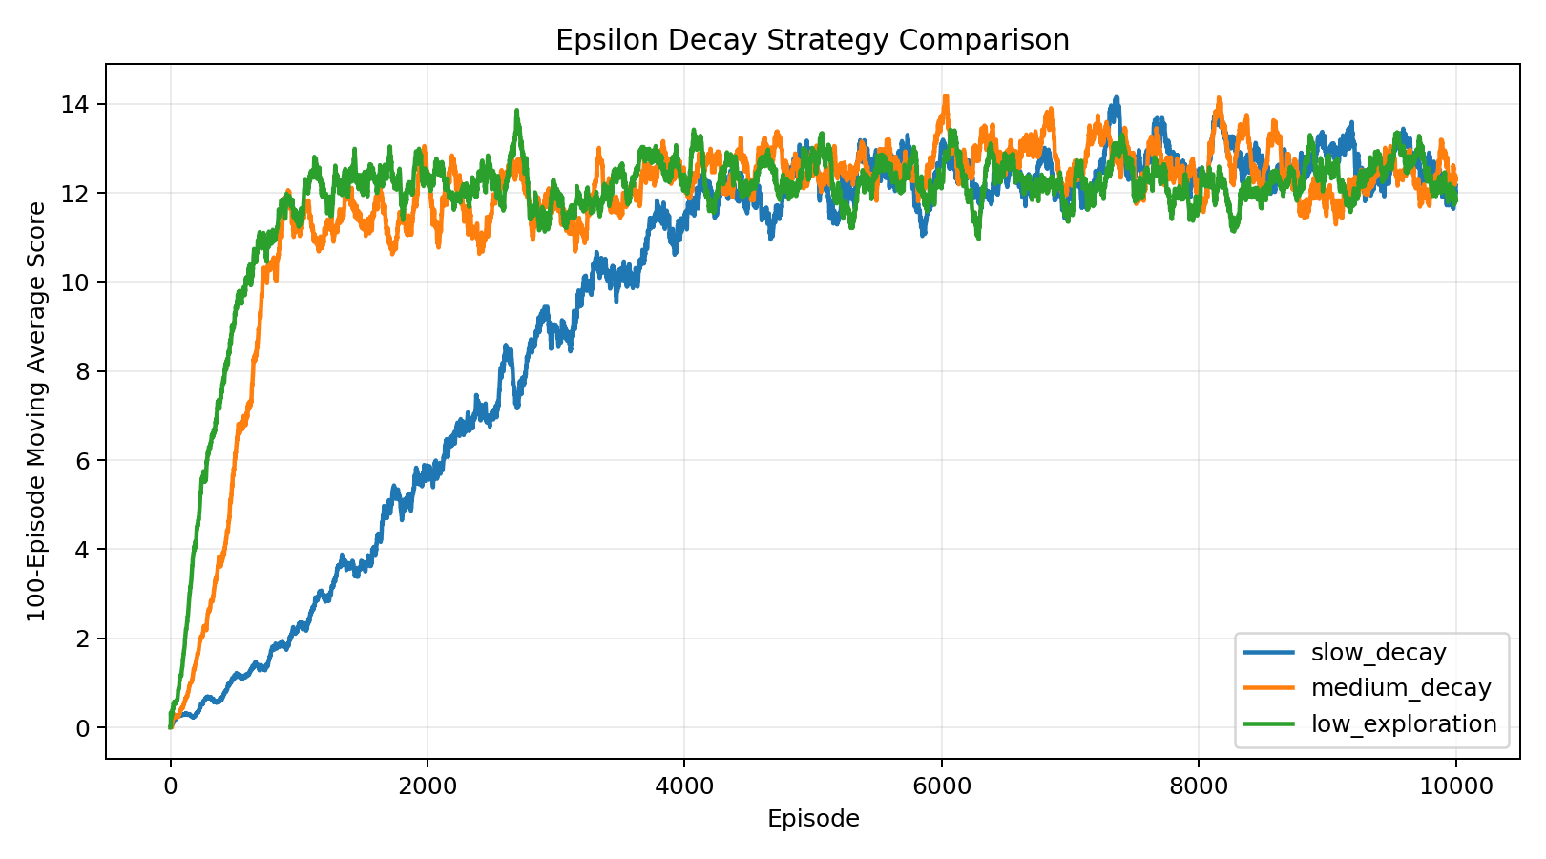
Exploration Strategy Comparison
Compared:
slow decay: 1.0, 0.999
medium decay: 1.0, 0.995
low exploration: 0.3, 0.995
Final moving avg score:
slow = 12.16
medium = 12.31
low = 11.84
Notes:
This experiment compares different epsilon decay strategies. Slow decay explores for longer, medium decay reduces exploration faster, and low exploration starts with epsilon only 0.3. The medium decay strategy gives the best final moving average score among these three settings. This suggests that enough early exploration is important, but exploration should also decrease at a reasonable speed.

Slide 6
Conclusion
Q-learning clearly outperforms random actions.
Medium epsilon decay gives stable performance.
Reward shaping slightly improves final learning performance.
Notes:
To conclude, the experiments show three main points. First, Q-learning clearly outperforms random actions. Second, medium epsilon decay gives stable learning performance. Third, reward shaping can slightly improve the final result by giving the agent denser learning signals. Overall, these results support that tabular Q-learning is effective for this simplified Snake environment.

