Slide 1
Project designs printed circuit beard(PCB)
By Kone Laye Aziz

Slide 2
Table of Contents
SL.NO DESCRIPTION
Introduction
PCB design tools
Schematic
Types of PCB schemas
Getting fabrication file
Conclusion

Slide 3
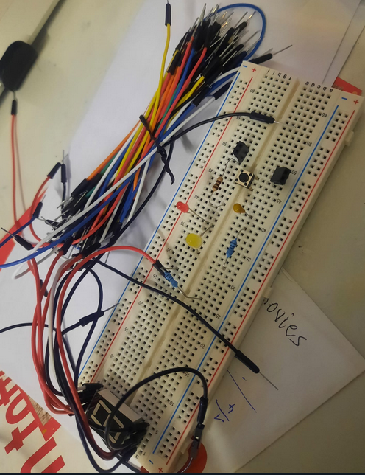
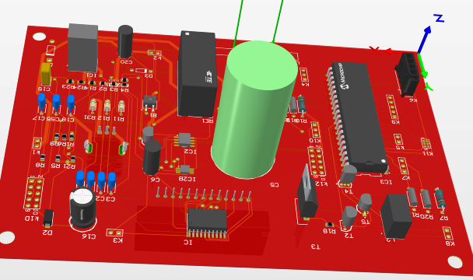
Introduction
A printed circuit board (PCB) serves as both a mechanically and electrically important support system that facilitates the interconnection of electrical or electronic components. This is accomplished by using conductive rails, pads, and other features etched from one or more layers of copper foil. These copper layers are laminated on top of and/or between the conductive substrate, resulting in a cohesive and functional PCB design.
Why PCB? Why not Breadboard?
Permanent project Rapid Prototyping project

Slide 4
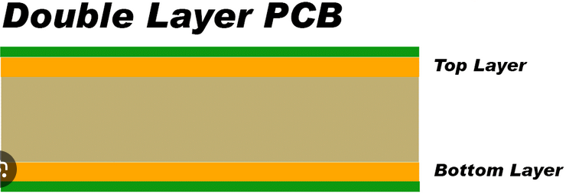
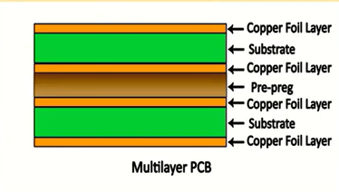
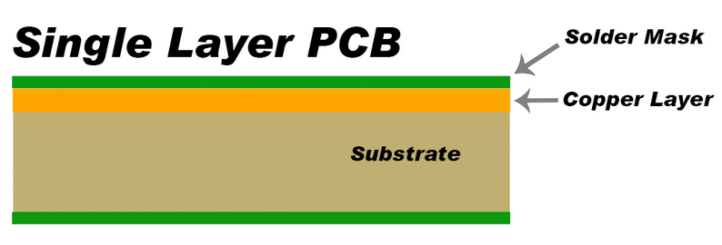
The three basic variants of PCB
Double-sided PCB: In this type, copper traces are present on both sides of the board, allowing for more complex circuit designs and increased component density.
Multilayer PCB: These PCBs consist of multiple layers of conductive material separated by insulating layers. They offer higher component density, better signal integrity, and are commonly used in advanced electronic devices.
Single-sided PCB: This is the simplest and most common type of PCB, with copper traces on only one side of the board.

Slide 5

PCB Design Tool
Altium Designer - PCB Design Software :
Altium Designer is the world’s most trusted PCB design
system for professionals and students. Powerful, modern And it is easy to use and helps designers
Create their own designs as prototypes.
Design PCB has to be the most crucial part of an electronics engineers job.
Circuit design
Circuit design is the first step in actually designing an electronic circuit. generally Sketches are
drawn on paper and entered into a computer using a schematic editor. process We usually start by translating the
specifications into block diagrams of the various functions. It just means that the circuit needs to work.

Slide 6
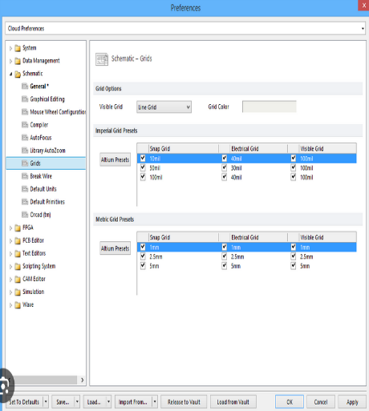
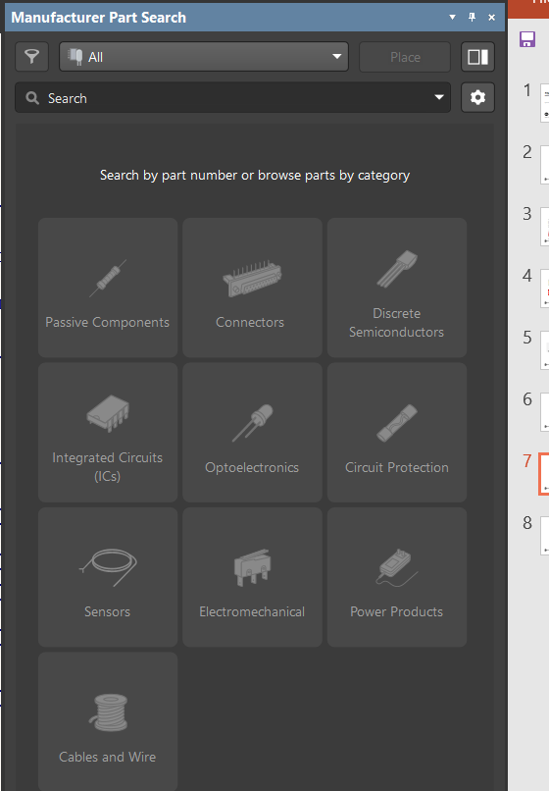
Schematics
A schematic or schematic diagram is a representation of the elements of a system using abstract graphic symbols rather than realistic images. In the electrical and electronic industry, device designs are often used as diagrams.
Altium design can create highly professional looking schematics…
Using the drawing feature to full effect in symbols creation, schematic can be built by the different tools bare like :
Grid and snap
Manufacture part search
Grid is to dimension the size and Any valid color, And the Line or Dot.
Manufacture is to find out the different components.

Slide 7
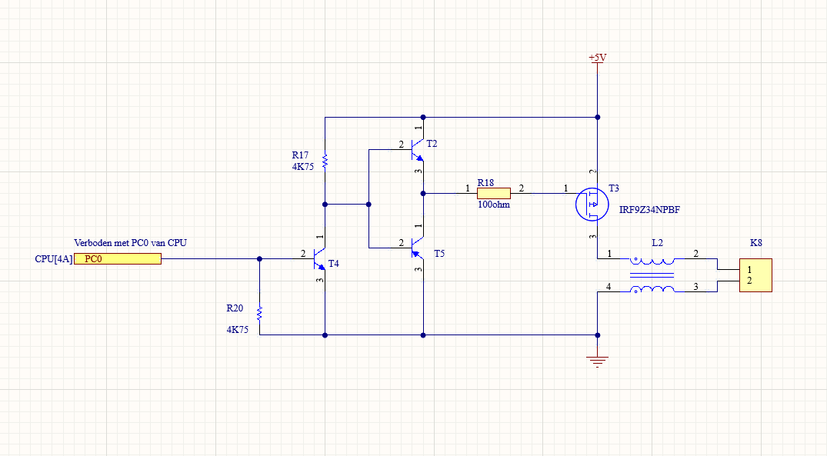
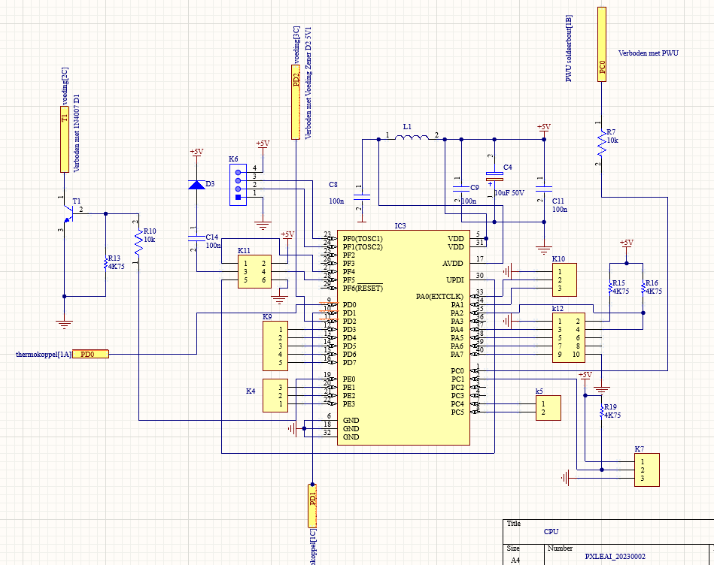
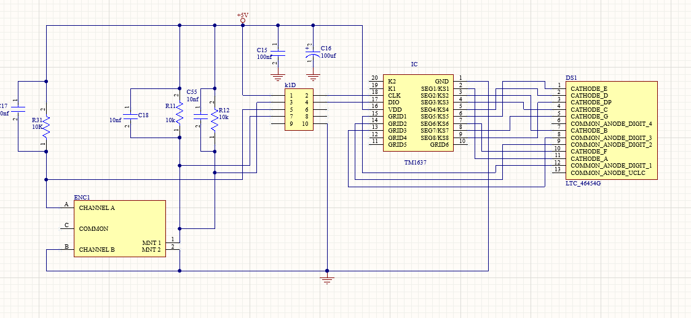
Types of PCB scheams
The different schemas in the PCB circuit board for the soldering station serve specific functions and are designed to address different aspects of the overall system. Here's why these schemas are necessary:
PWU Schema (Power Unit):
CPU Schema:
DISPLAY Schema:
The display schema is essential for providing visual feedback and user-friendly features in the soldering station. It includes components like displays, LED drivers, and input devices. This schema enables the user to monitor and interact with the system effectively.
The PWU schema, or power unit, is responsible for managing the power supply and distribution within the soldering station. It ensures that the system receives the required power in a controlled and regulated manner.
The CPU schema serves as the central processing unit of the soldering station. It is responsible for tasks such as temperature control, user interaction, security, and overall system reliability.

Slide 8
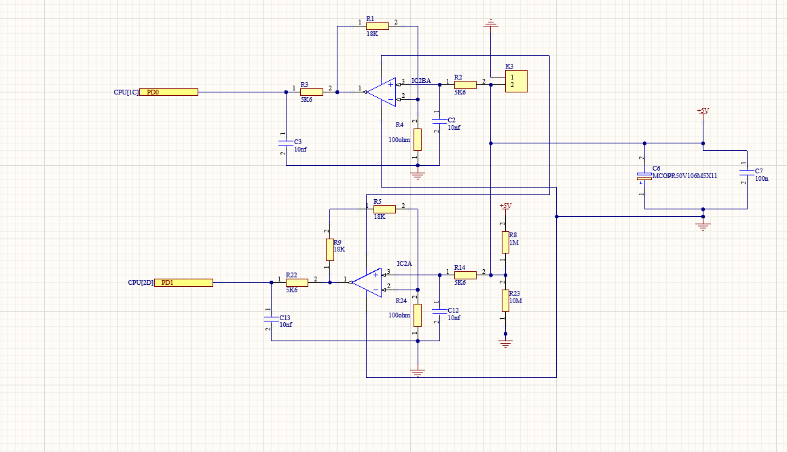
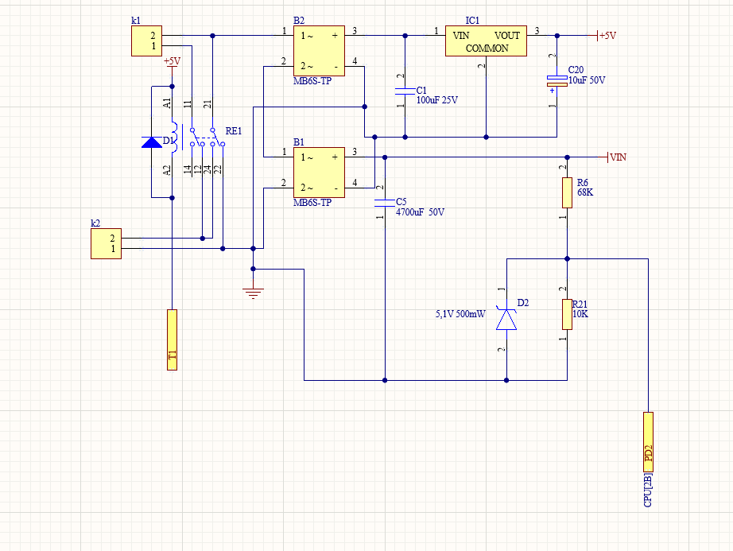
Thermocouple Schema:
Power Source Schema:
The power source schema focuses on providing a stable and reliable power source to the soldering station. It includes components for power regulation, voltage stability, and signal control. This schema ensures that the system receives clean and consistent power, which is critical for its performance and prevents damage to sensitive components.
The thermocouple schema is crucial for accurate temperature sensing in the soldering station. It allows the system to measure the temperature precisely and provide appropriate feedback for temperature control.

Slide 9
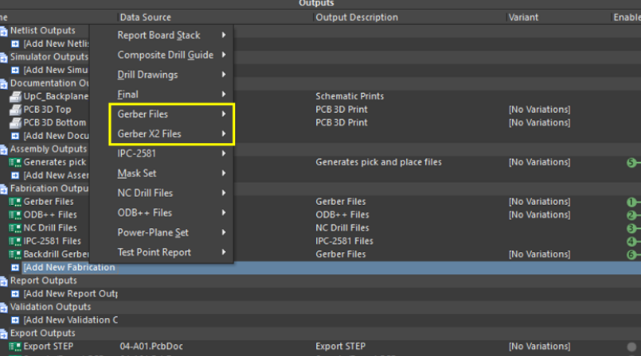
Getting Fabrication file
When PCB is finished, Fabrication Files(Gerber file) can be taken out via:
File → Fabricant output → Gerber file.
It will open a webpage as shown in the image below, and the Gerber file can be download as a zip file.

Slide 10
Conclusion
Printed circuit boards are very important in all electronic devices used for domestic or industrial use. Effective PCB design helps reduce potential failures and the risk of short circuits. Learning how to design circuits on printed circuit boards is therefore a great way to learn about the world of electronics.
This valuable experience and knowledge is gained not only through direct participation in tasks, but also through other aspects related to the laboratory such as work control interactions.

