Slide 1

AUTOMATED PENSION STATEMENT FOR PENSION SCHEMES {KURBS} “Retirement Made Easy”
THEME :
“REDEFINING AN ACTUARY”
DATE:
4TH AND 5TH JULY 2024
VENUE:
UNIVERSITY OF NAIROBI

Slide 2
TITLE: Continued..
KABARAK UNIVERSITY
SCHOOL OF SCIENCE ENGINEERING AND TECHNOLOGY
DEPARTMENT OF MATHEMATICS AND ACTUARIAL SCIENCE
PRESENTERS
OF
THE PRODUCT
MAXWELL LELEUR –ACTS/MG/0907/09/20
BARAKA ONYANGO- ACTS/MG/0638/09/20
VIOLA CHERONO- ACTS/MG/0631/09/20
LAYTON MUSYOKI- CS/MG/3317/09/22

Slide 3
INTRODUCTION
The KURBS PENSION SYSTEM is designed to streamline the process of generating pension statements.
It is meticulously designed to address the needs of the ever-evolving landscape of financial management and data processing.
It offers a quick and efficient solution for financial professionals and individuals involved in pension management
By automating the creation of pension statements, this tool aims to save time, reduce manual errors, and improve overall productivity
The KURBS system revolutionizes the production and delivery of pension statements

Slide 4
PROBLEMS ASSOCIATED WITH MANUAL PREPARATIONS
Manual processing and delivery are prone to errors, delays, and inconsistencies which bring up the following issues:
Lack of real time information for pensioners.
Substantial administrative resources are consumed in preparing them.
Hampers timely communication between pension providers and recipients.
Difficulties in ensuring data security and customization.
Implementing automated system is essential to address these issues
It provides seamless, secure and personalized approach to pension distribution, ensures accurate, timely, and accessible information for pensioners, and streamlines administrative processes for pension providers.

Slide 5
MARKET ANALYSIS
The Kenyan pension administration market is rapidly expanding, driven by an increasing workforce, proactive government initiatives, and digital transformation trends.
The market is expected to grow at a CAGR of 8-10% over the next five years.
Key industry trends include digital solutions adoption, regulatory compliance needs, and mobile integration. The target market comprises corporate employers, pension funds, financial institutions, and government agencies.
These customers prioritize accuracy, compliance, ease of use, customization, and mobile accessibility. Key competitors in this space are Enwealth Financial Services -formerly known as Liberty Financial Services-(25% market share), and Zamara (20%), with the remaining 55% shared by smaller niche players.

Slide 6
MARKET ANALYSIS
The competitive landscape highlights wealth's comprehensive service offering, Alexander Forbes‘ (now known as Zamara) customization capabilities, integrated solutions.
To successfully penetrate the market, our automated pension statement system should focus on user-friendly interfaces, mobile compatibility, strong compliance features, strategic marketing efforts, and competitive yet flexible pricing strategies.

Slide 7
MARKET ANALYSIS..SWOT analysis
STRENGTHS
WEAKNESSES
OPPORTUNITIES
THREATS
Customization capabilities and robust compliance features
Higher implementation complexity
Digital expansion and mid-sized business market penetration
Rapid technological changes and increased competition.

Slide 8
BUSINESS MODEL
KEY PARTNERS
Who are/could be our Key partners?
HR managers
KEY RESOURCES
What resources are needed?
Pension administrators
IT managers
Finance Directors
Human Resource
Knowledge Resources
Physical Resources
Technological Resources
External Resources such as 3rd party API’s

Slide 9
BUSINESS MODEL
KEY ACTIVITIES
-
Data Collection and integration
VALUE PROPOSITION
-
Ease of Use
System Development/maintenance
User interface and experience
Security and compliance
Communication, reporting and Analytics
Training and documentation
Feedback mechanism
Accuracy and compliance
Customization
Mobile accessibility

Slide 10
BUSINESS MODEL
CUSTOMER SEGMENTS
-
Corporate Employers
CUSTOMER RELATIONS
How would the customers want us to relate with them to maximize value?
Marketing- such as content marketing
CHANNELS
-
Direct Sales
Pension Funds and Administrators
Financial institutions
Government Agencies
Sales strategy
Pricing strategy that emphasizes value and affordability
Channel Partners
Webinars and Workshops

Slide 11
BUSINESS MODEL
COST STRUCTURE
- What are our most important costs?
Technological Resources are the most costly section inherent in our model
REVENUE STREAMS
-
Usage/subscription fee
Security, compliance and automation management are also equally important
Fixed costs such as Salaries, cost for acquiring the human resource is vital
Transaction based fee (charging on the number of statements generated)
Set up and implementation fees
Customization fee (charging for customization and branding services to align the system with the partner company’s brand and specific requirements)

Slide 12
DESIGN PROCESS
1.
REQUIREMENT GATHERING
Obtain pension related data from: HR departments, employees, retirees to understand their needs
Analyze existing pension statement process to identify areas that need to be automated
2.
DESIGN PHASE.
User interface:
This is where users interact with the system, include excel application where users can input information and customize their pension statements.

Slide 13
DESIGN PROCESS: Continued
3. INTEGRATION AND TESTING.
Integrate system with existing payroll and HR system
Thorough testing i.e.(Unit testing, integration testing and user acceptance testing)
4. TRAINING:
Provide training materials
User training process: Provide training sessions to equip system users with necessary skills to operate new system efficiently (on-site and online training)
5. MAINTENANCE AND UPDATES:
Continuous monitoring of system performance and user feedback

Slide 14
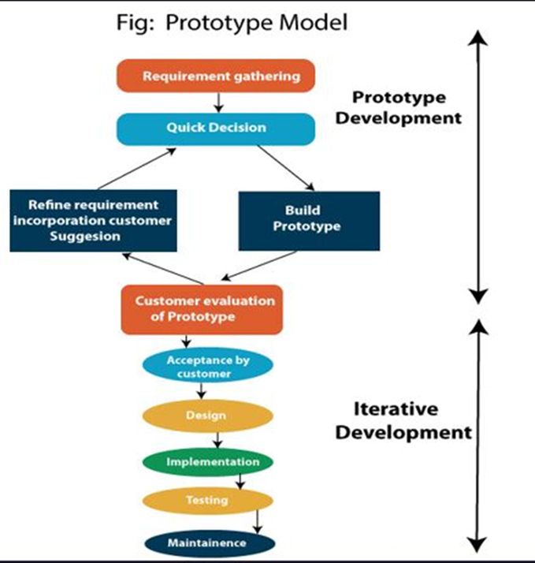
DESIGN PROCESS: SYSTEM ARCHITECTURE
PROTOTYPING OF THE AUTOMATED PENSION STATEMENT

Slide 15
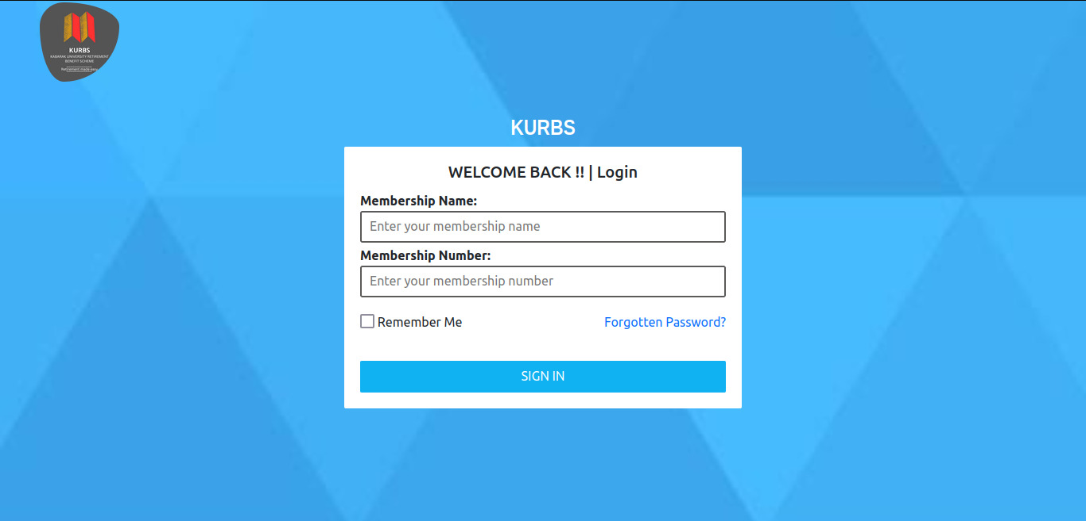
LOGIN SECTION

Slide 16
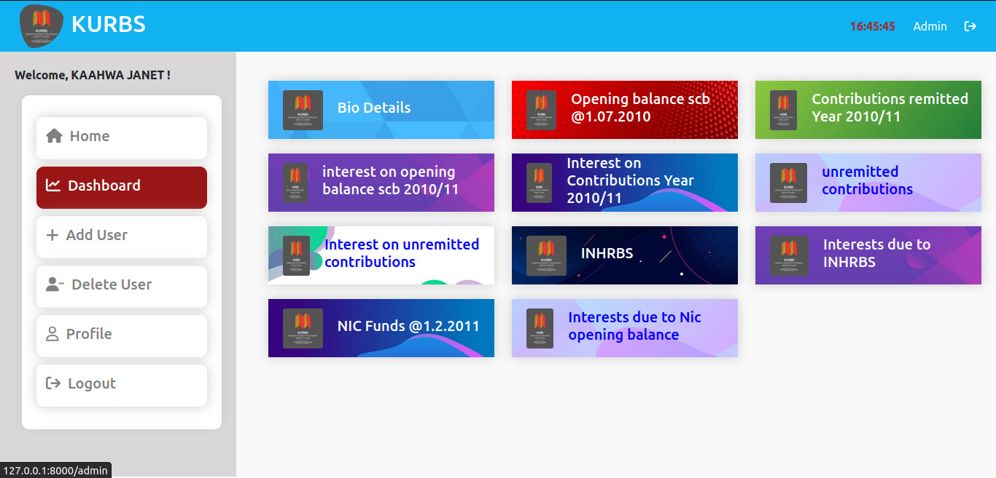
ADMIN SECTION

Slide 17
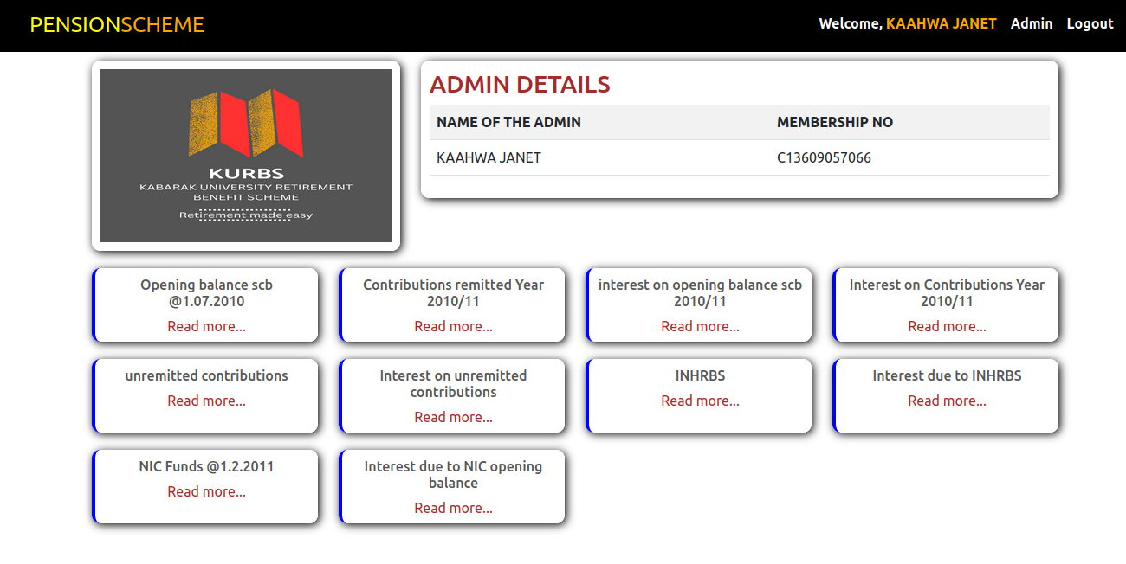
ADMIN SECTION

Slide 18
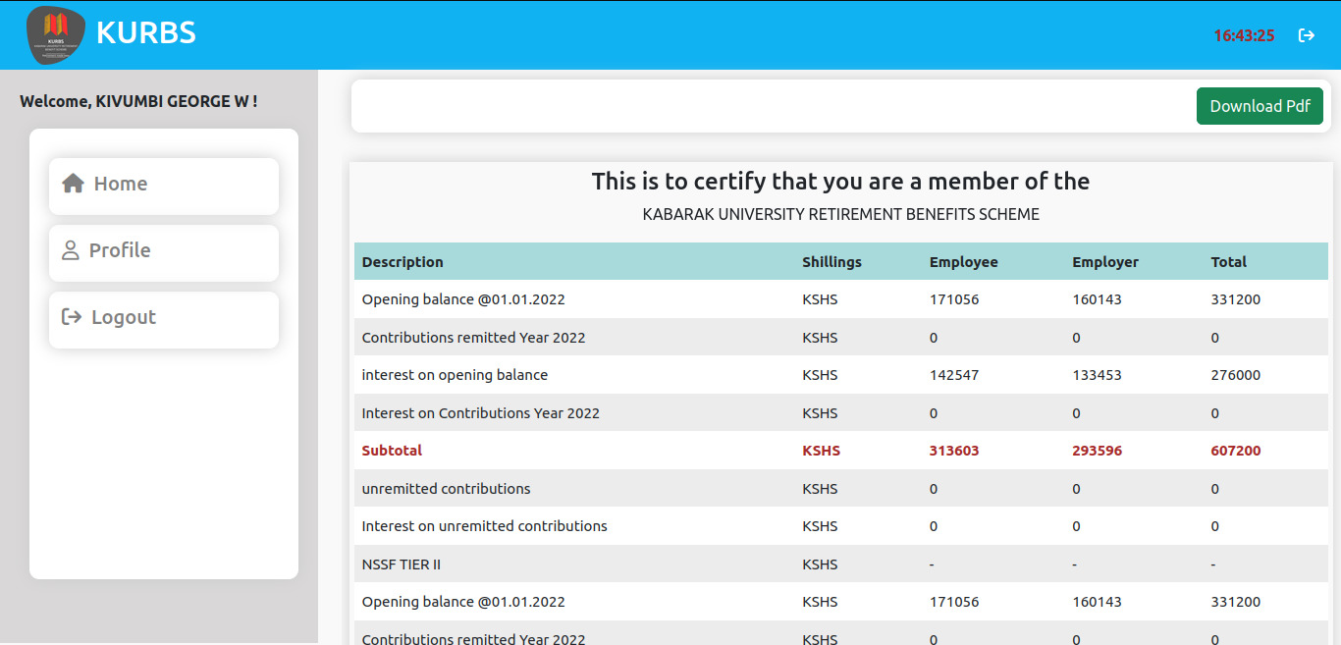
EMPLOYEE PART

Slide 19
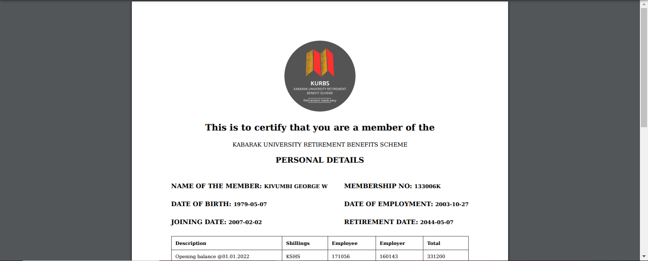
EMPLOYEE PENSION STATEMENT

Slide 20
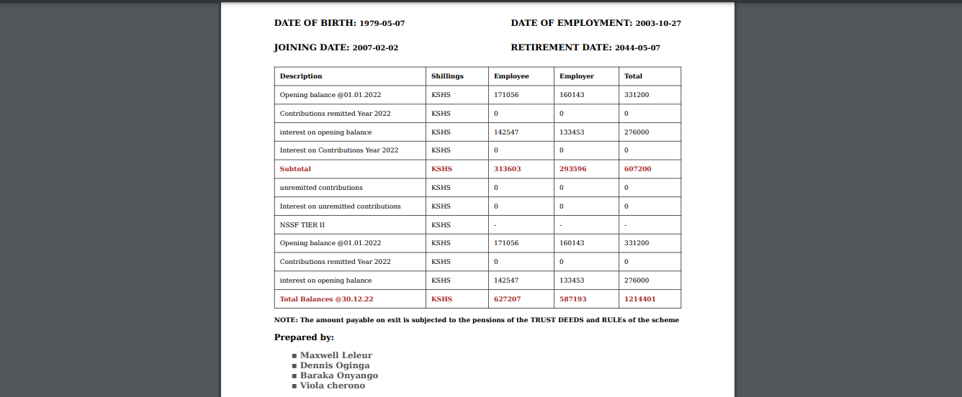
EMPLOYEE PENSION STATEMENT

Slide 21
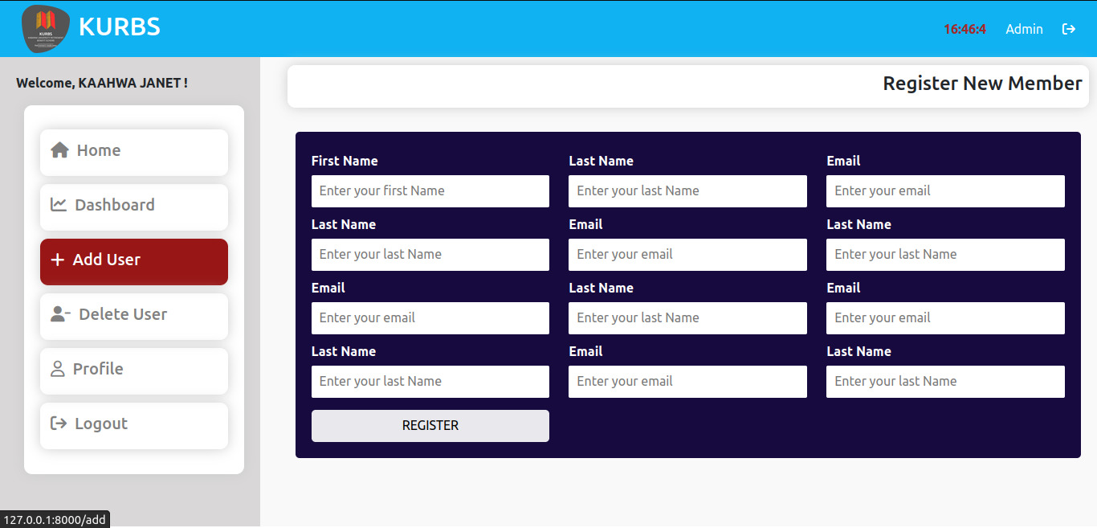
REGISTRATION PART

Slide 22
FEATURES AND FUNCTIONALITY
FEATURES
Real-time data access.
Integration allowed for real-time updates on employee status change, contribution and access to data.
User friendly interface.
Easy navigation of dashboard for both web and mobile application.
Comprehensive reporting
Provides detailed reports for individuals and administrators
Allows users to download or print statements and reports in various formats
Integration capabilities
Seamlessly integrate with existing HR payroll and financial systems.
Support data exchange with pension fund managers and financial institutions.
Communication and Customer Support
customer support through chatbots, FAQs and helpdesk.
Access to educational resources and guides to help users understand their pension plans

Slide 23
FEATURES AND FUNCTIONALITY
Automated data collection and processing.
Ability to automatically gather and process data from various sources e.g. payroll systems and financial institution
Ensure data accuracy and consistency.
Dynamic Pension Calculation engine
Calculate pension benefits based on real-time data inputs
Handle complex calculations considering factors like years of service, salary history and contribution rates.
Interactive Dashboards.
Provides interactive visualizations of pension data through timelines and charts
Workflow automation
Automation of workflow tasks such as statement generation and data updates
Streamlines administrative processes to reduce manual efforts and errors.

Slide 24
FEATURES AND FUNCTIONALITY: Continued
Compliance and audit trails
Maintain detailed audit trails of all actions and changes in the system
Ensures compliance with legal and regulatory requirements through regular audits.
Mobile accessibility
Provide full functionality through the KURBS mobile app for easy access and friendly user experience across all devices

Slide 25
TESTING AND FEEDBACK
Critical Role: Testing and quality assurance ensured system reliability, accuracy, and Security.
Processes: Rigorous testing, quality control, and issue resolution minimized defects.
Tools Used: Jira and TestRail for test management, execution, and reporting.
Manual Testing: Validated user interactions, UI components, and data accuracy.
Security: Vulnerability scanning and penetration testing identified and addressed security weaknesses.
Team Collaboration: Ensured issue resolution with transparent communication channels.

Slide 26
FUTURE DEVELOPMENT
Future enhancements will introduce new features based on user feedback.
Feature improvements will ensure that the system remains versatile and adaptable to evolving user needs.
The Future Development highlights the commitment to adapting to emerging technologies and aligning with trends in pension management.
It emphasizes the importance of user feedback in guiding future development, ensuring that the automated pension statement system remains a user-centric, efficient, and trustworthy solution for pension management needs.
Enhancements and Updates
Performance Optimizations:
Addressing performance concerns, particularly during peak usage, is a top priority.
Ongoing performance optimizations will ensure that the system operates smoothly and efficiently even under heavy loads.

Slide 27
FUTURE DEVELOPMENT: Continued
User-Centric Approach:
Continuous User Engagement:
A core principle of the system's future development is continuous user engagement. User feedback will continue to be actively sought and used to drive system enhancements and improvements. Users will remain at the center of development decisions, ensuring that the system evolves to meet their evolving needs.
Regular Updates:
The automated pension statement system will continue to receive regular updates.
Updates will be planned and executed to introduce new capabilities and address any identified issues.
Users can expect a consistent stream of improvements to ensure the system remains at the forefront of pension management technology.

Slide 28
CONCLUSION
Strong Positive Feedback: High user satisfaction with ease of use, data accessibility, and customization.
Trust in Data Accuracy: Users trust the system, though complex pension calculations raise some concerns.
Robust Performance: Significant efficiency and time savings, with minor peak hour challenges.
Future Development Focus:
Enhanced customization based on user feedback.
Improved transparency in pension calculations.
Ongoing performance optimizations.
Embracing Emerging Technologies: A user-centric approach will keep the system a leading solution in pension management.

Slide 29
REFERENCES
Johnson, A. B. (2023). Enhancing Retirement Planning: The Role Of Automated Pension Statements. Journal Of Retirement Planning, 10(2), 45-60.
Rodriguez, M. L. (2023). Enhancing Pension Communication through Automation. In P. Anderson & B. Thompson (Eds.), Proceedings of the International Conference on Financial Technology (pp. 45-58). Springer.
U.S. Department of Labor. (2023). Annual Report on Automated Pension Statements. Report No. Dol-2023-001.
Miller, C. D. (2023). Innovations In Automated Pension Statement Delivery.
In S. Jones & A. Smith (Eds.), Proceedings of The International Conference on Retirement Planning (Pp. 123-135). Academic Press. Doi:
Johnson, M. A. (2023). Transforming Retirement Savings: The Impact of Automated Pension Statements. Retirement Solutions Inc.

Slide 30
REFERENCES: Continued
Davis, C. E. (2023). Pensions in the Digital Age: A Comprehensive Guide. Wiley.
Turner, B. (2023, April). Streamlining Retirement Planning with Automated Statements. Financial Review, 34-41.
Anderson, J. R. (2023). Modernizing Pension Systems: A White Paper on Automated Statements. Pension-Tech Solutions.
Brown, S. (2023, February 10). The Future of Retirement: Automated Pension Statements Explained. RetirementInsights.com.
Patel, K. S. (2023). The Impact of Automated Pension Statements on Retirement Savings. University of Economics Repository
Ramirez, L. (2023, June 20). Demystifying Automated Pension Statements. Retirement Explained

Slide 31
THANK YOU ALL
For those who would like to reach us and know more about the product ,you can reach us through the following personal details
S/NO | NAMES | PHONE NUMBERS | EMAILS
1 | Maxwell Leleur | +254740620878 | Maxwelleleur@gmail.com
2 | Baraka Onyango | +254703880421 | onyangobaraka5@gmail.com
3 | Viola Cherono | +254740219865 | Violacherono69@gmail.com
4 | Layton Musyoki | +254740620878 | Laytonmacheka7@gmail.com

