Slide 1

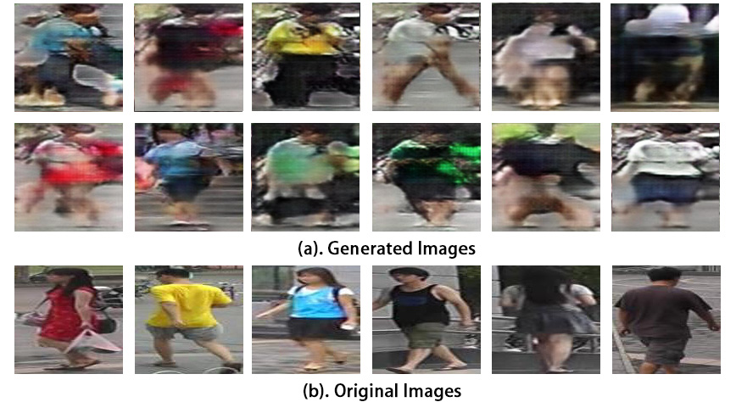
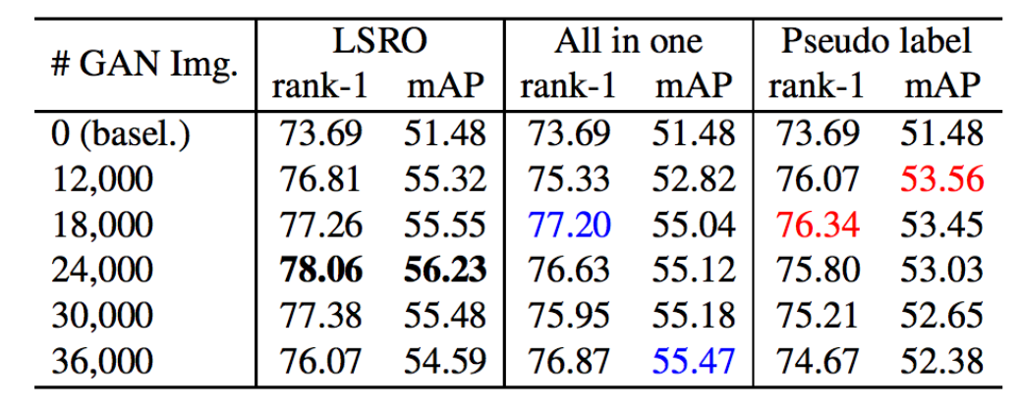
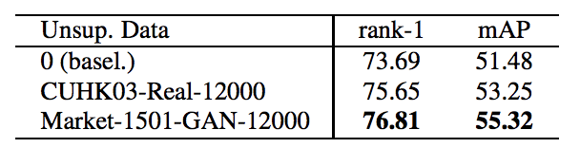
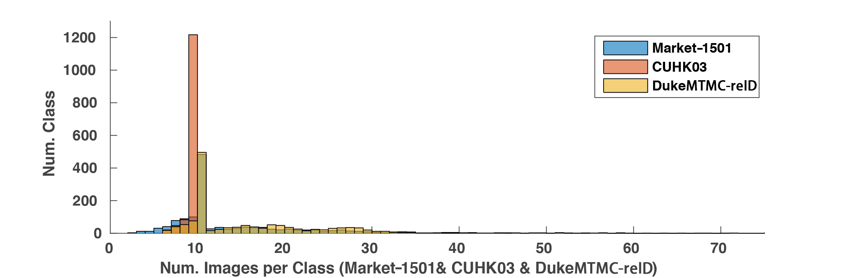
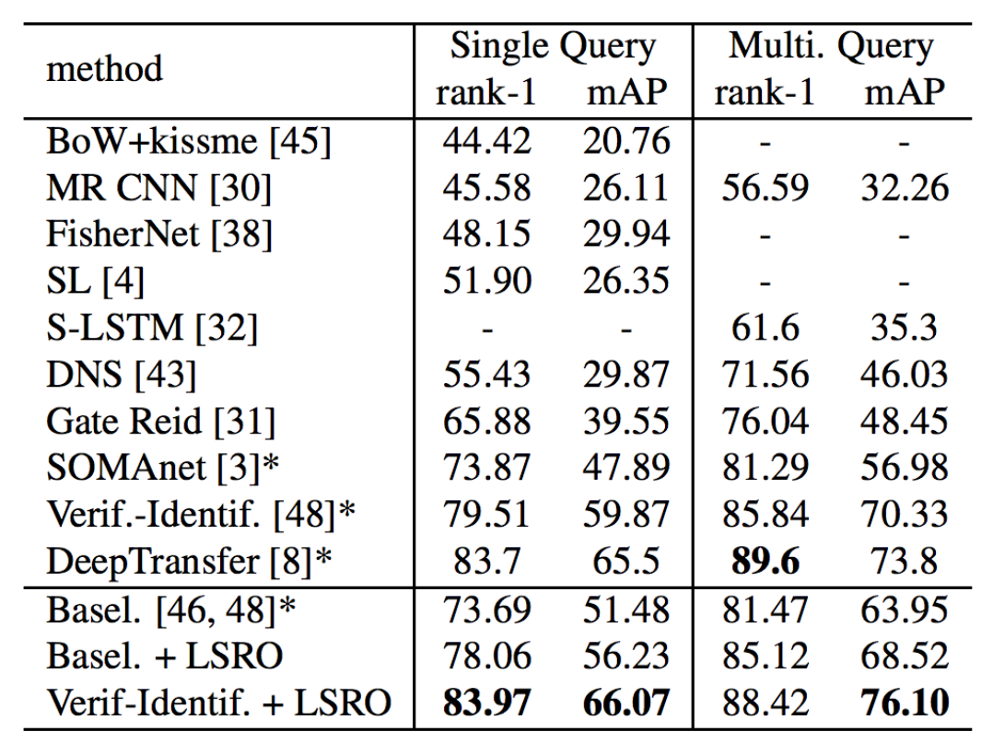
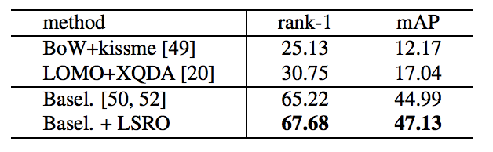
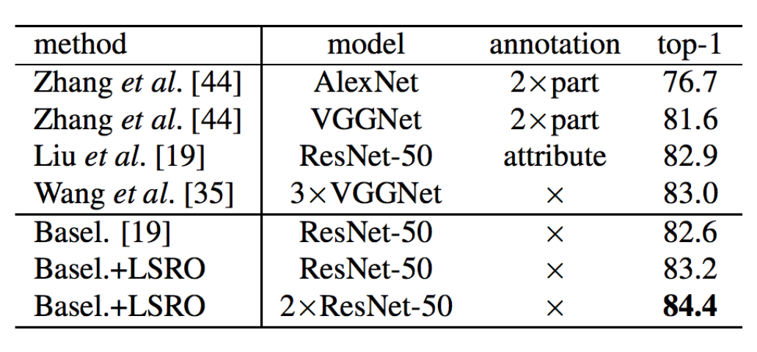
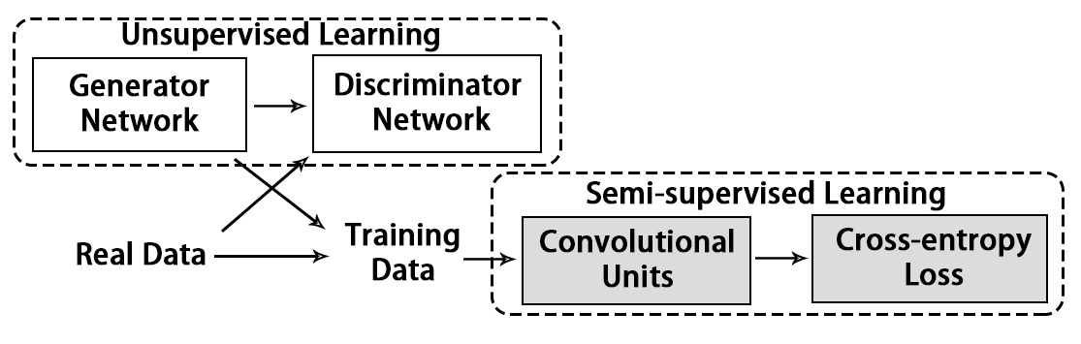
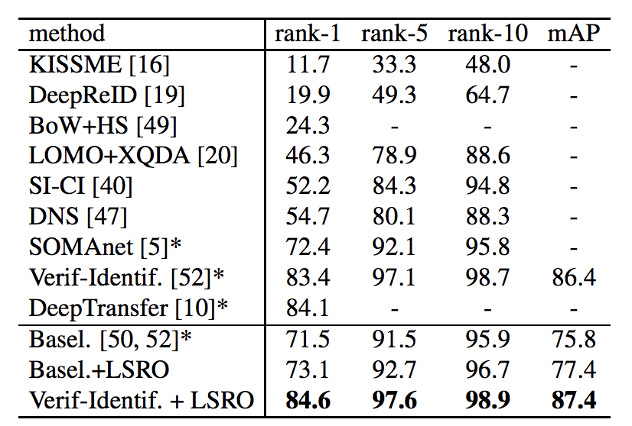
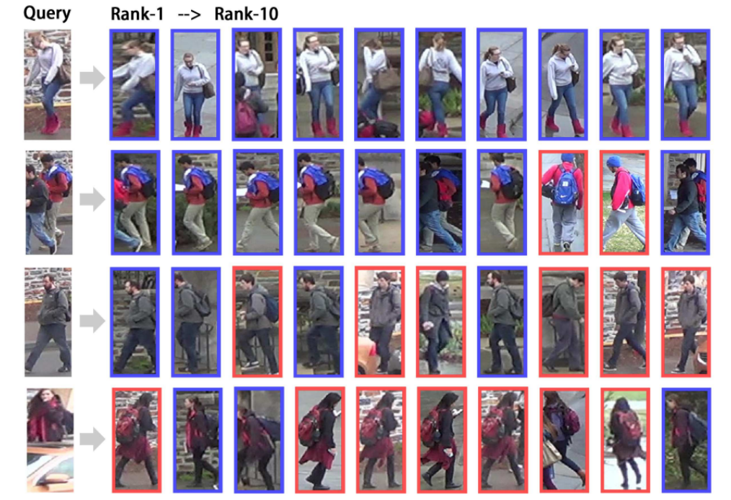
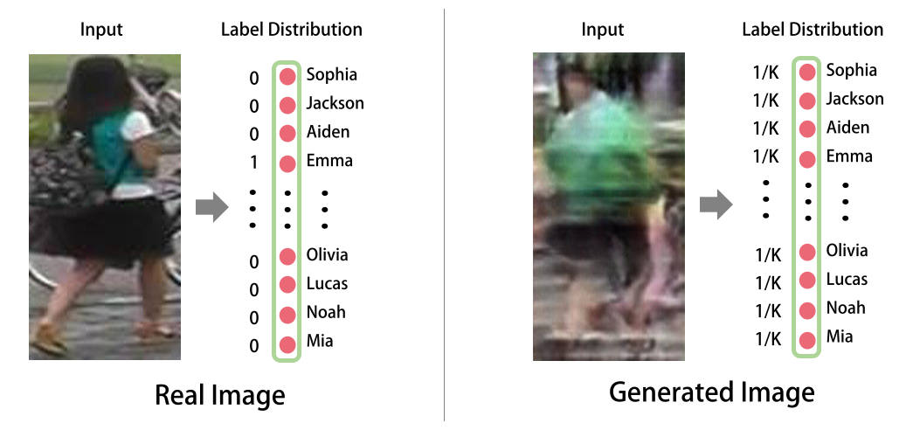
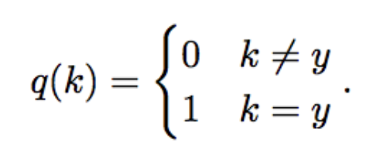
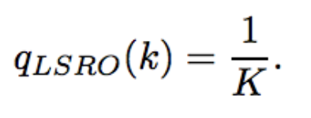
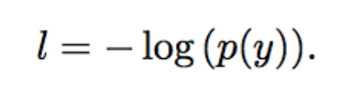
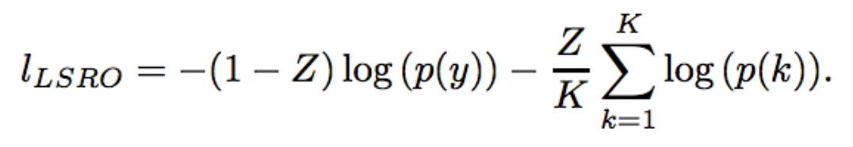
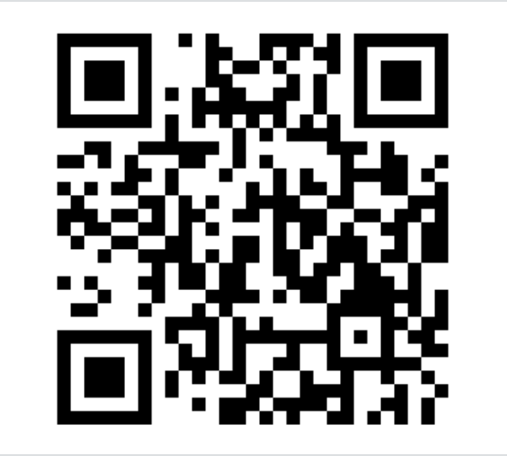
Unlabeled Samples Generated by GAN Improve the Person Re-identification Baseline in vitro
Zhedong Zheng, Liang Zheng and Yi Yang
Centre for Artificial Intelligence，University of Technology Sydney
# Motivation
# Method
# Experiments and Results
Can we make use of the samples generated by GAN? How to make it compatible with the current classification model?
The generated samples do not have labels. How to assign labels for the generated data?
In many practical tasks, such as person re-ID and fine-grained recognition, we may have only 10-20 images pre class for training. Can we use GAN to regularize the CNN model?
Network Overview
Brief Conclusions
Our system does not make major changes to the network structure of the GAN or the CNN model.
In our implement, we utilize the DCGAN model and ResNet-50 as baseline model.
Generated images improve the baseline performance on four datasets although they are imperfect (to cheat human).
Generated images possess similar regularization ability as the real images borrowed from other datasets.
Three label assignment methods all improve the performance by GAN images. The proposed method LSRO performs better.
The images generated from original training set
Label Assignment Comparison
GAN image vs. real image in training
10-20 images pre class
on three person re-ID datasets.
State-of-the-art comparison
Market-1501
DukeMTMC-reID
# Contribution
Bird Recognition
Examples of GAN images and real images. (a) The top two rows show the pedestrian samples generated by DCGAN (b) The bottom row shows the real samples in training set. Although the generated images in (a) can be easily recognized as fake images by a human, they still serve as an effective regularizer in our experiment.
CUHK03
Retrieval Sample
Label Smoothing for Outliers
1. We propose a semi-supervised learning pipeline.
There are two components: a generative adversarial network (GAN) for unsupervised learning and a convolutional neural network (CNN) for semi-supervised learning.
2. An LSRO method for semi-supervised learning. The integration of unlabeled data regularizes the CNN learning process. We show that the LSRO method is superior to the two available strategies.
3. A demonstration that the proposed semi-supervised pipeline have a consistent improvement over the ResNet baseline on four datasets.
# Dataset & Code
# Conclusion
We also propose a large-scale dataset, DukeMTMC-reID for person re-ID. This dataset is derived from DukeMTMC.
The introduction of a semi-supervised pipeline;
LSRO for label assignment;
Competitive results on three Person re-ID datasets and one bird classification dataset.
✓ Compatible with conventional CNN model
We assume that generated samples do not belong to any of the predefined classes, so we assign a uniform distribution for generated images. We call the policy label smoothing for outliers (LSRO).
Code & Data is available online:
http://zdzheng.xyz

