Slide 1
Person detection using FMCW radar and CNN LSTM
Team Despot Petar Lazarevic – LC Novi Sad

Slide 2
Data acquisition
FMCW radar Infineon BGT60TR13C
2 scenes
Scene modification
23 scenarios
24 000 frames (~8GB data)

Slide 3
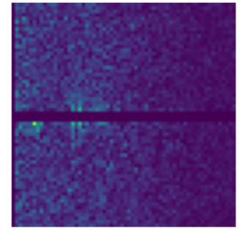
Data preprocessing
Normalisation
DC component removal
Sequence creation

Slide 4
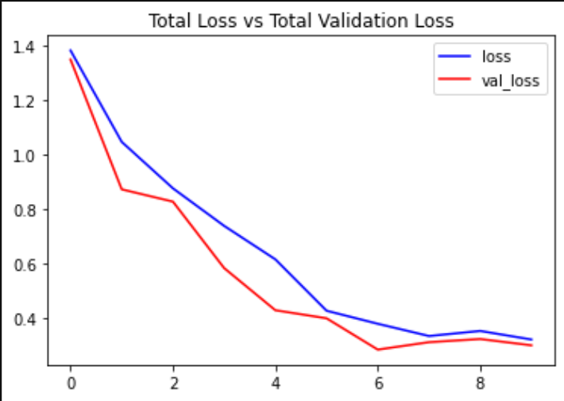
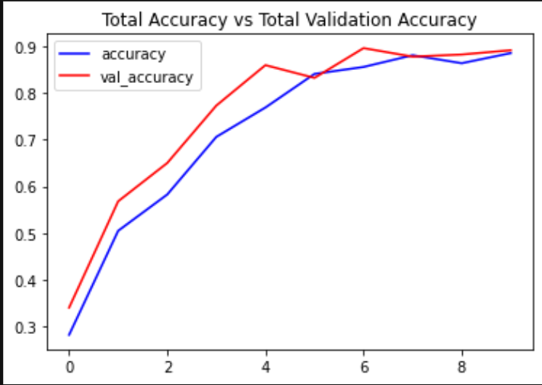
Network
Convolutional Neural Network
Long Short Term Memory
73 764 parameters
19 fps

Slide 5
Future work
Preprocessing algorithm
Data generation
Cross validation

