Slide 1
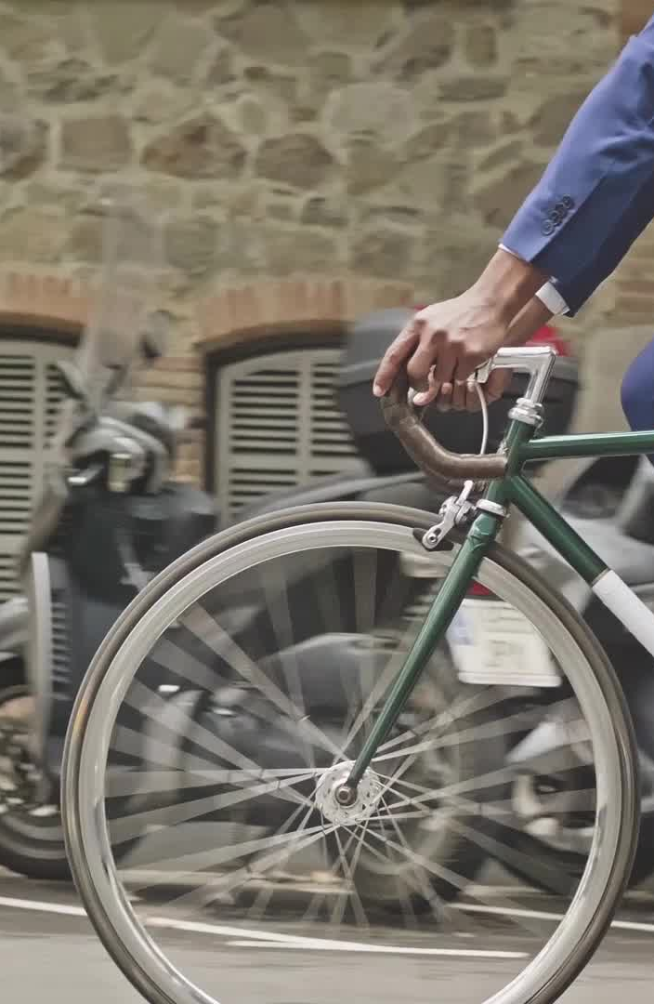
Cyclistic Bike-Share User Analysis & Strategy
Understanding Member vs. Casual User Behavior
Lazarina Slavcheva – 27.06.2025

Slide 2
ASK – Business Challenge
How do casual and member riders use Cyclistic bikes differently?
What trends can inform marketing strategies to convert casual users into members?
How can we optimize pricing, station planning, and promotions?

Slide 3
PREPARE – Data Collection
Source: Cyclistic’s historical trip data
Time Range: 29 months - 2013-2025
Tools: Excel, SQL, Python (optional), Tableau, Power Shell

Slide 4
PROCESS – Data Cleaning
Removed nulls, duplicates, and incorrect timestamps
Merged datasets across months for consistency
Standardized column names for analysis

Slide 5
ANALYZE – Key User Share
64.5% of all trips are by members → Members are core users
36% of trips by casual riders
Casuals ride longer but less frequently

Slide 6

USER BEHAVIOR COMPARISON
Trip Duration: Casual – 25 mins | Members – 12 mins
Casual riders contribute ~10% more total ride time
Bike Type Preference: Classic – 45%, Electric – 55%
→ Equal use = All bike types should be membership inclusive

Slide 7
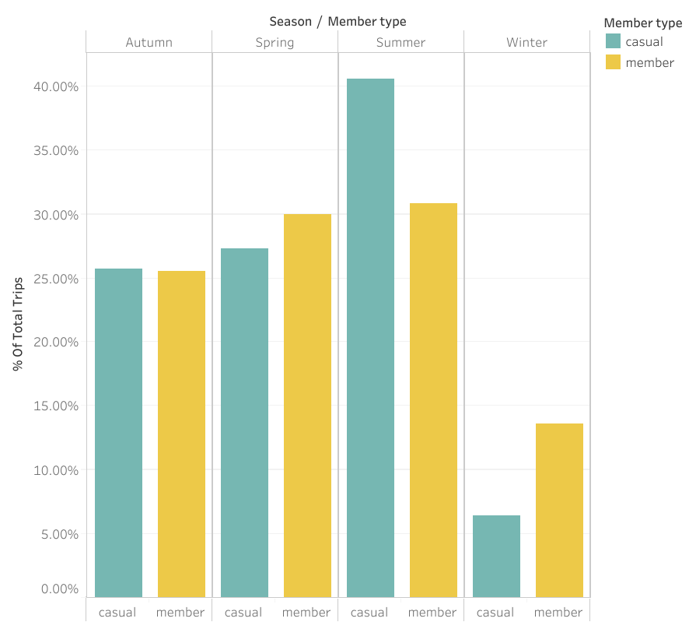
Season Trends
93% of casual rides = Spring–Autumn | Summer Peak: 41%
Members ride more consistently year-round

Slide 8
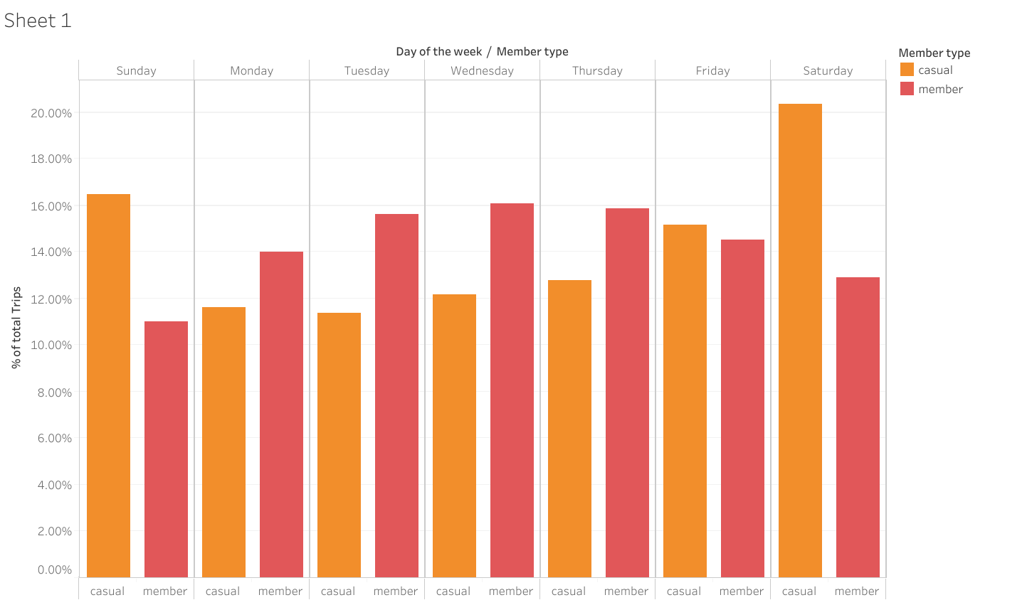
Day-of-Week Trends
37% of casual rides on weekends | 20% of member rides on weekdays
63% of casual rides on work week | 80% of member rides on work week

Slide 9
Time-of-Day Trends
60% of casual riders ride between 11:00–18:00
40% of member riders ride between 15:00-18:00
Ideal window for promotions and events targeting casual users

Slide 10
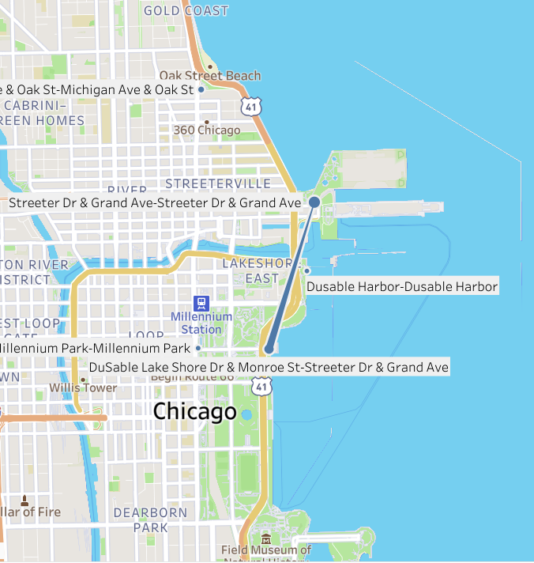
Top Trips
33% of casual trips: Jane Addams Park ↔ Chicago Yacht Club

Slide 11
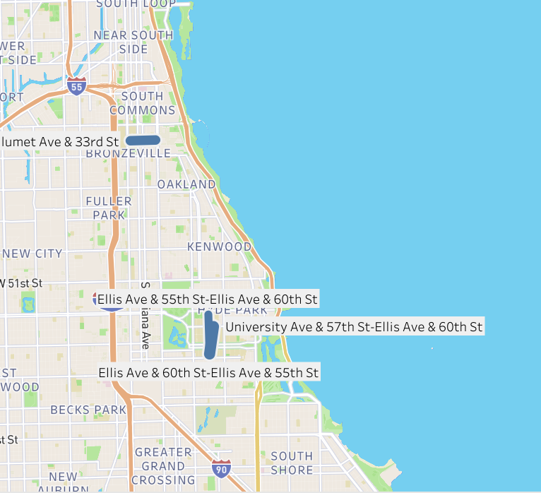
Top Trips
50% of member trips to University of Chicago & IIT

Slide 12
Strategic Recommendations
Target Promotions: May–August at top casual stations
01
Promote memberships at UChicago and IIT
02
Introduce time-based casual pricing
03
Offer seasonal passes (Spring–Fall)
04
Maintain access to both bike types for all users
05

Slide 13
ACT – Next Steps
Pilot targeted seasonal campaigns
Revise pricing model based on usage patterns
Deeper segmentation (age group, ZIP code)
Track casual → member conversion rates

