Slide 1
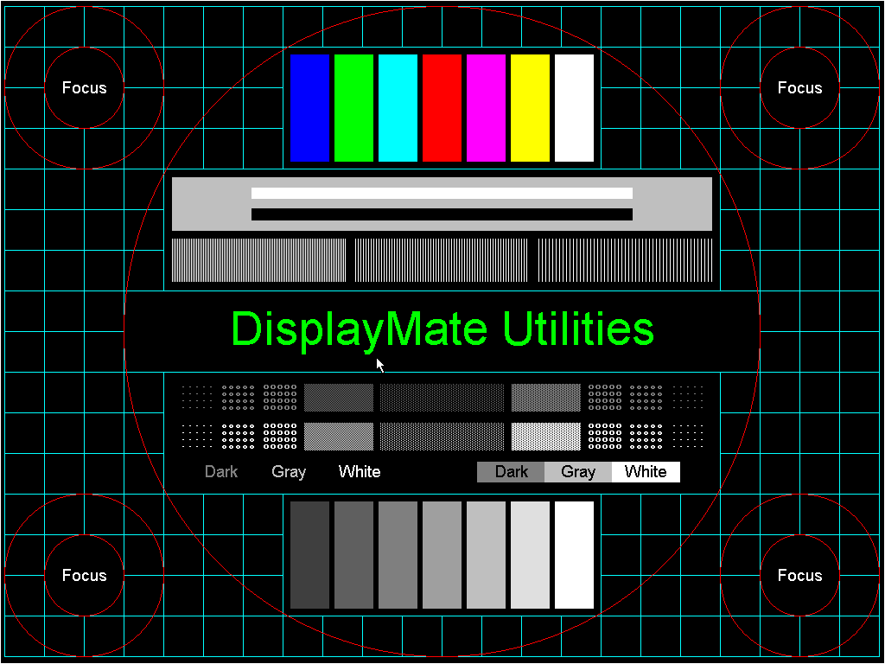
PROJECTION TEST

Slide 2
Ed Plamondon

Slide 3
50 Point Arial 1234567890
40 Point Arial 1234567890
30 Point Arial 1234567890
20 Point Arial 1234567890
16 Point Arial 1234567890

Slide 7


Slide 8

Screen Calibration

Slide 9
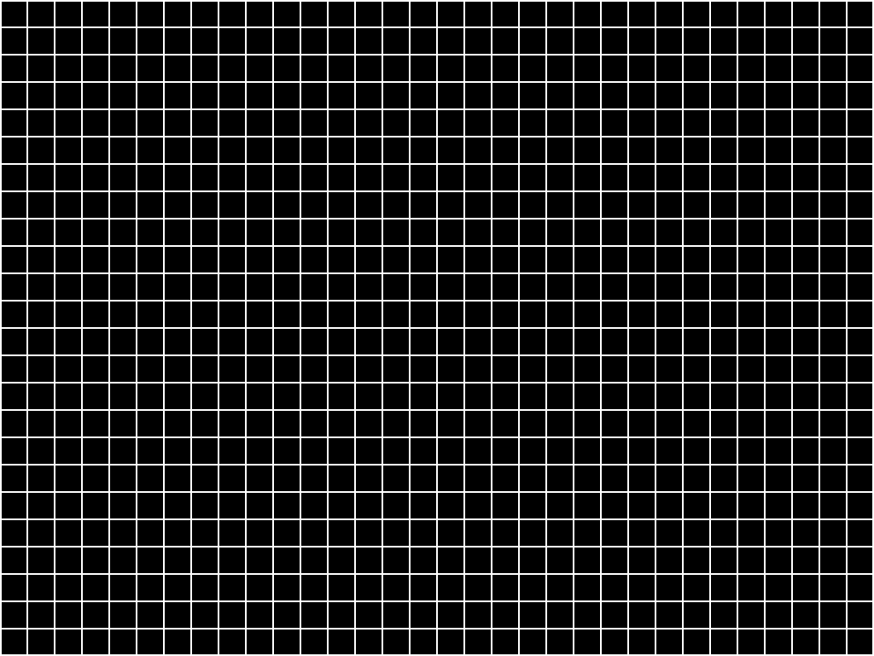

Slide 10
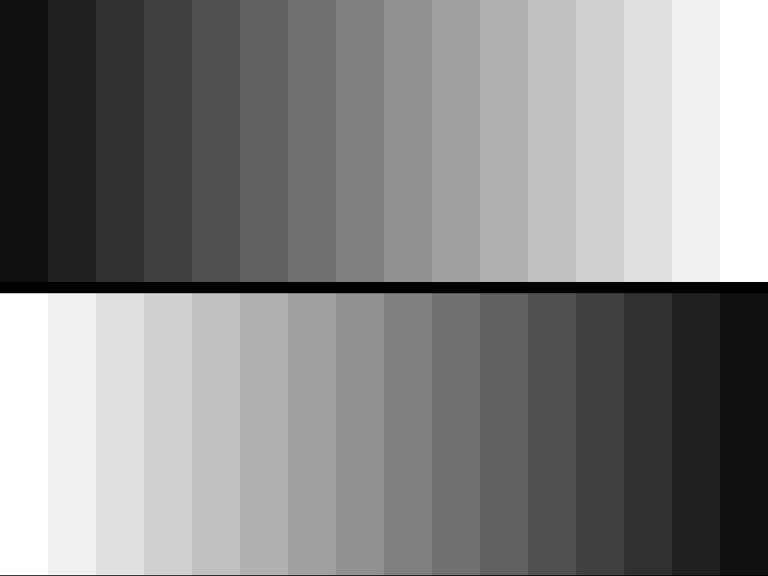

Slide 11


Slide 12


Slide 13


Slide 14
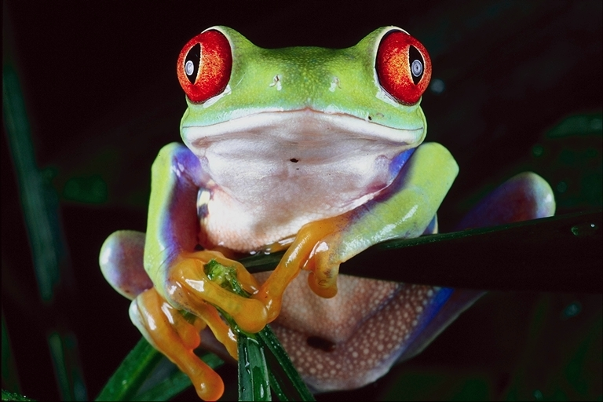

Slide 15

10 pt Arial w/ Drop Shadow
12 pt Arial w/ Drop Shado
14 pt Arial w/Drop Shado
16 pt Arial w/ Drop Sha
18 pt Arial w/ Drop S
20 pt Arial w/ Drop
24 pt Arial w/ Dro
28 pt Arial w/ Dr
32 pt Arial w/ D
40 pt Arial w/
60 pt Arial
80 pt Arial
Notes:
5

Slide 16
TL
BR

Slide 17
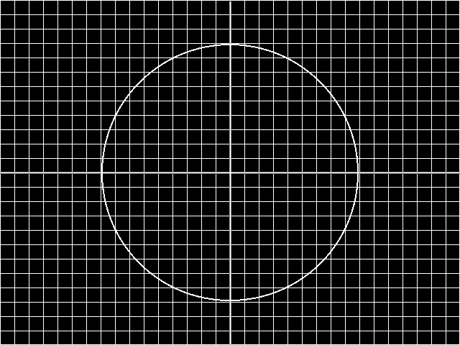
Circle Convergence

Slide 18
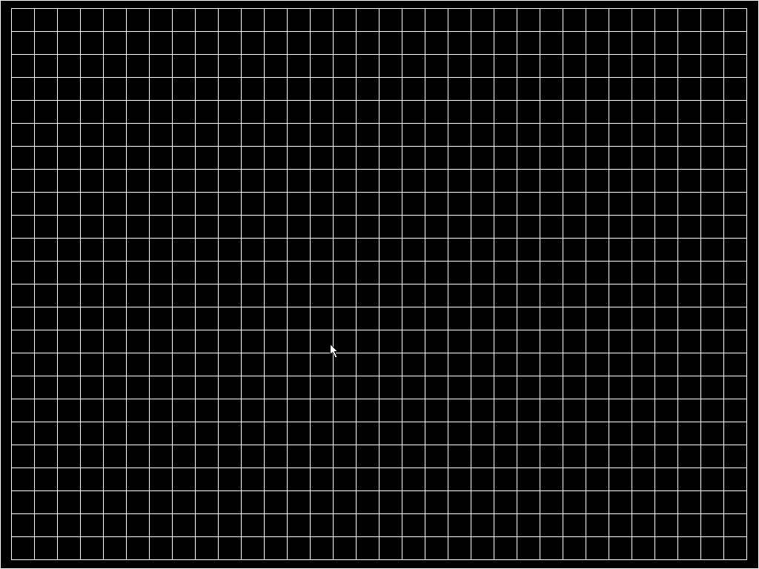

Slide 19
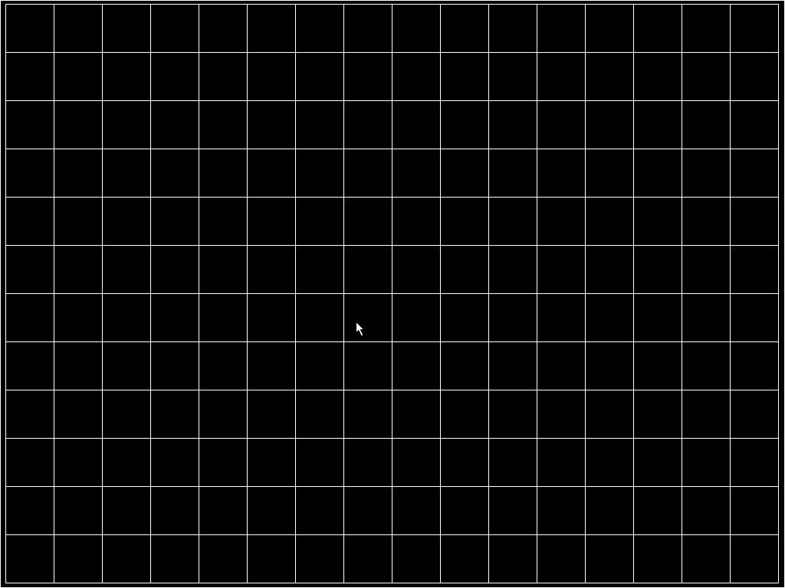

Slide 20
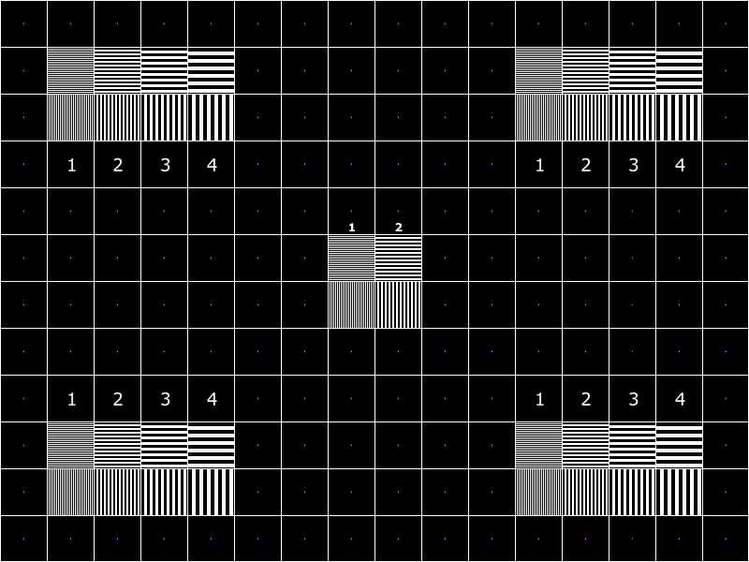

Slide 21
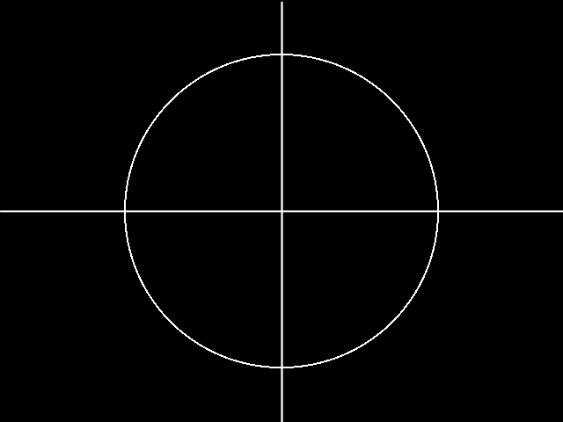
Circle Cross

Slide 22
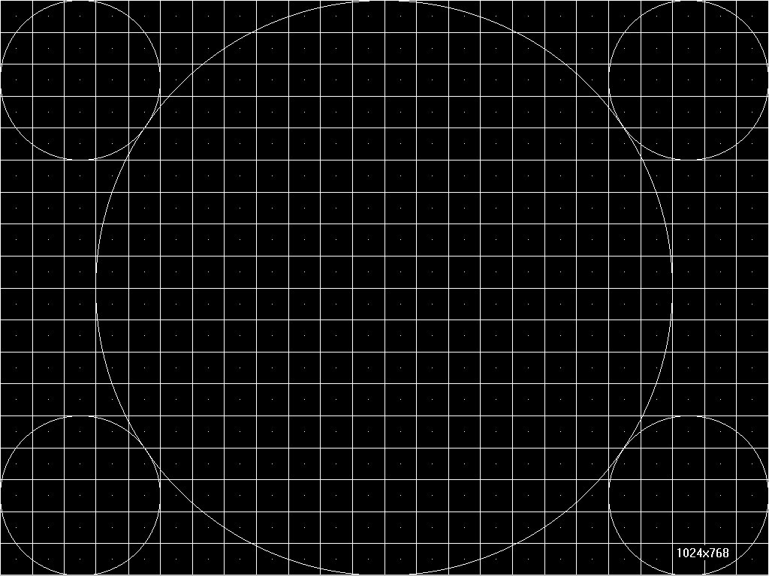

Slide 23
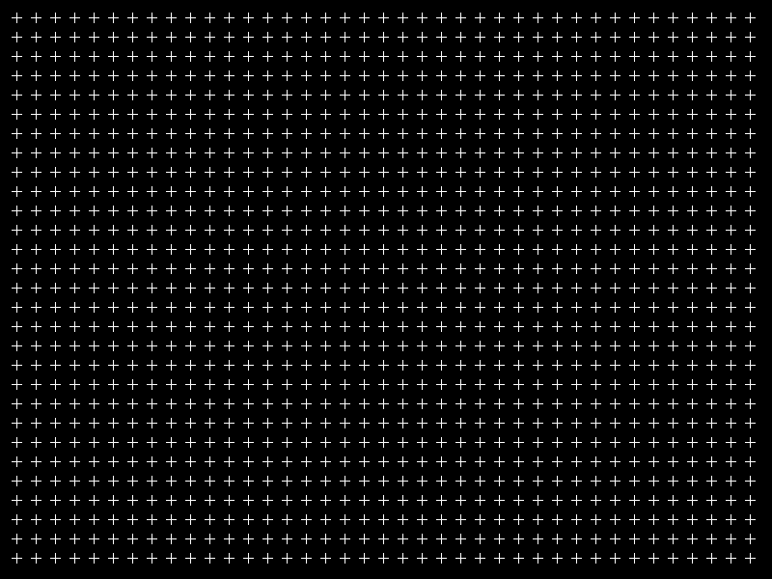
Crosses 800

Slide 24
Arial Type 24 Point
Arial Type 24 Point
Arial Type 20 Point
Arial Type 20 Point
Arial Type 18 Point
Arial Type 18 Point
Arial Type 16 Point
Arial Type 16 Point
Arial Type 14 Point
Arial Type 14 Point
Arial Type 12 Point
Arial Type 12 Point
Arial Type 10 Point
Arial Type 10 Point
Arial Type 9 Point
Arial Type 9 Point
Arial Type 8 Point
Arial Type 8 Point

Slide 25

Color Luma Bars

Slide 26


Slide 27
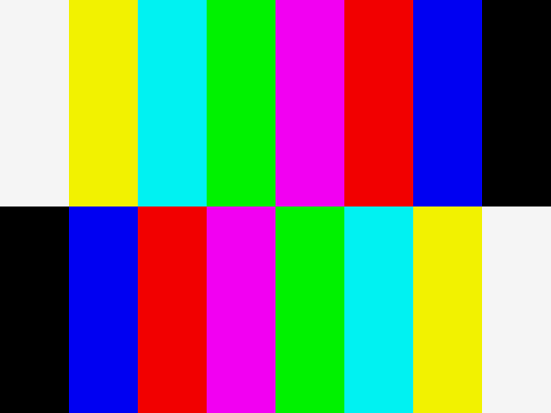
100% Color Bar

Slide 29
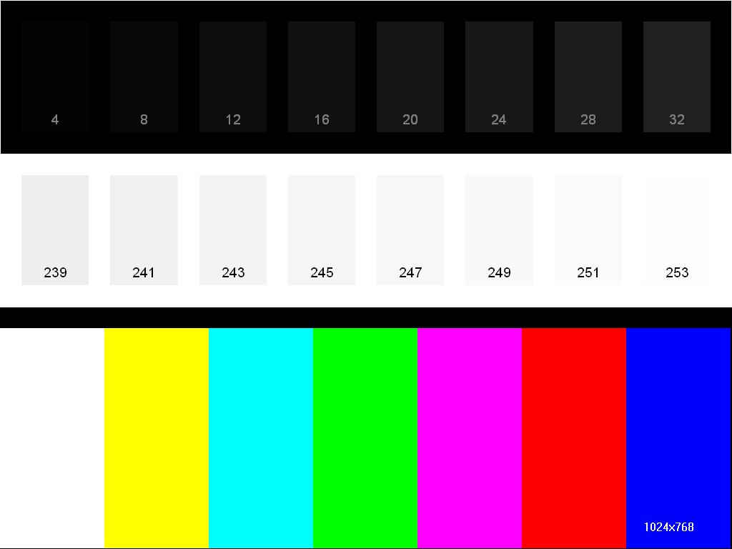

Slide 30
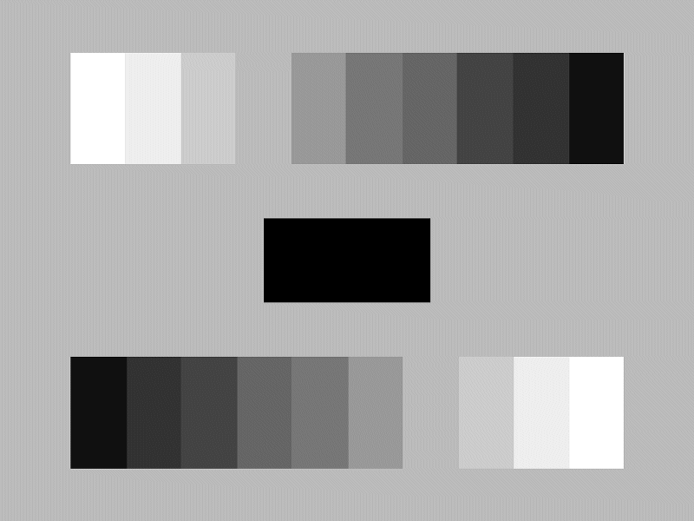
Chip Chart

Slide 31
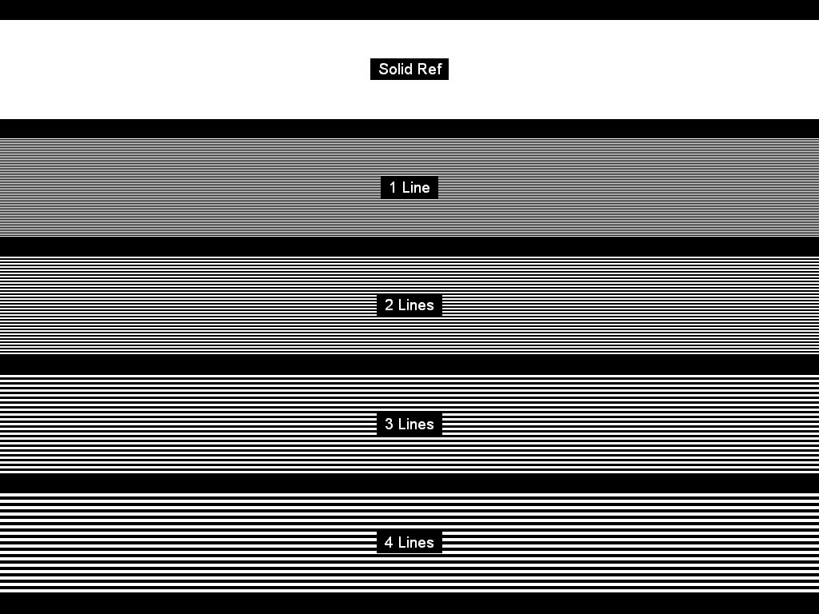

Slide 32
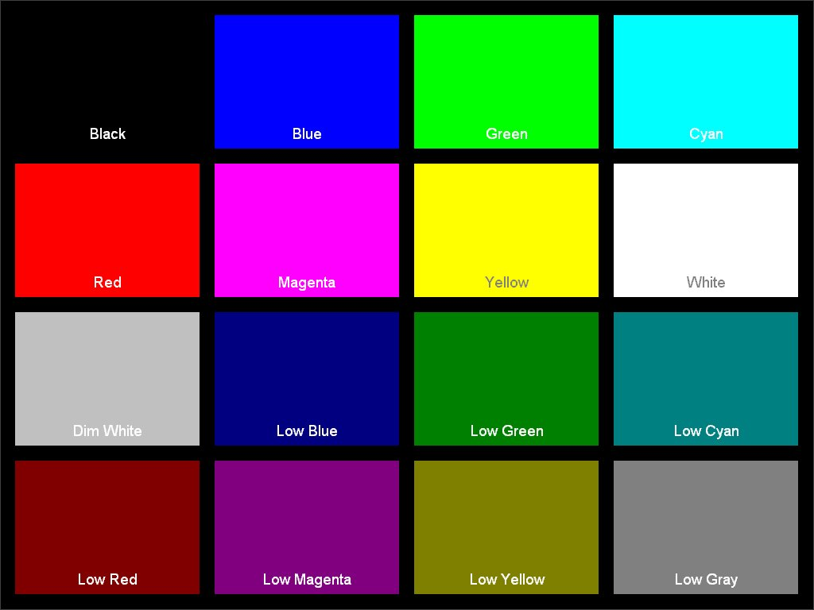

Slide 33
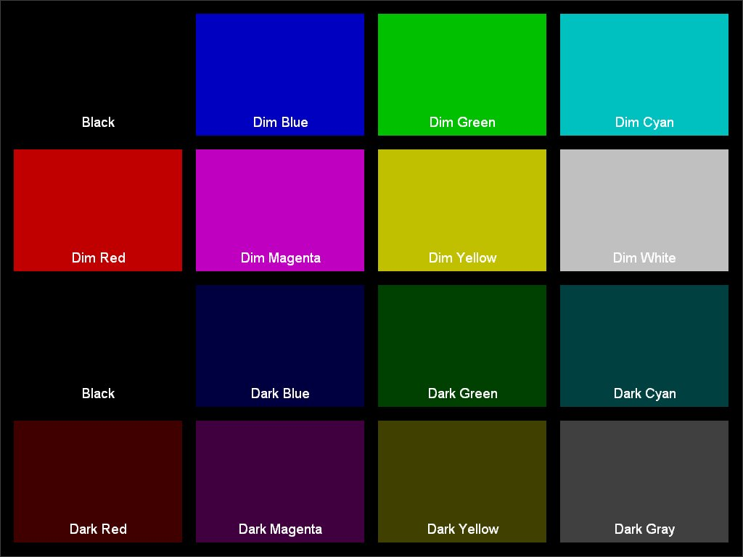

Slide 36
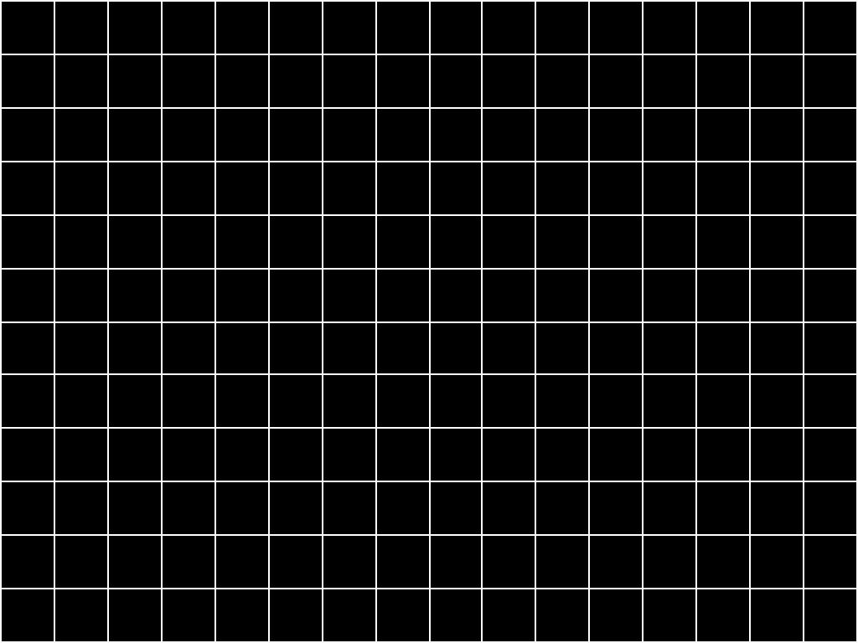

Slide 37
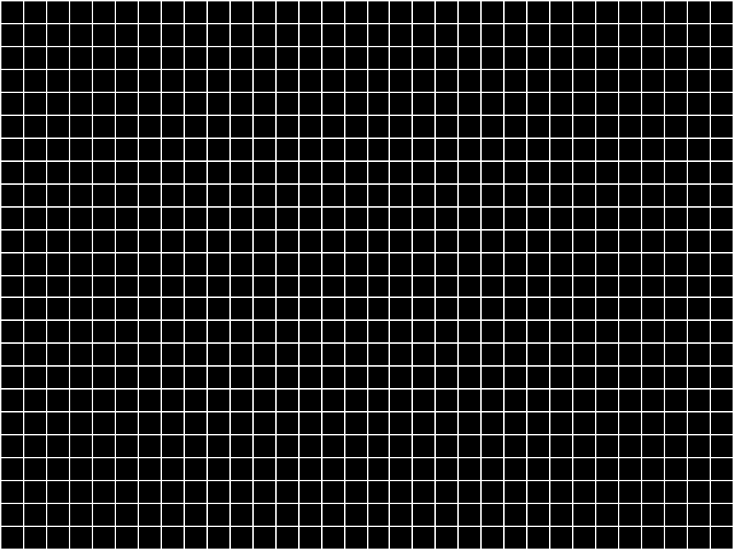

Slide 38
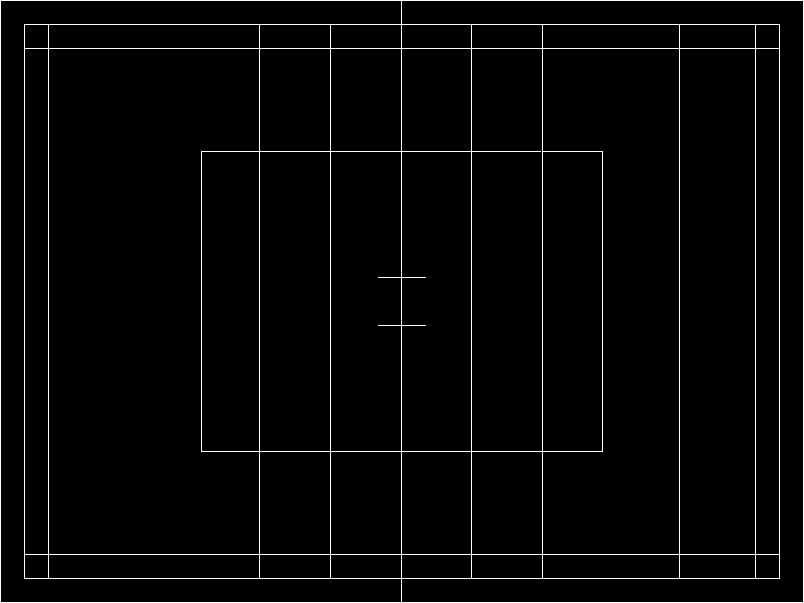

Slide 39
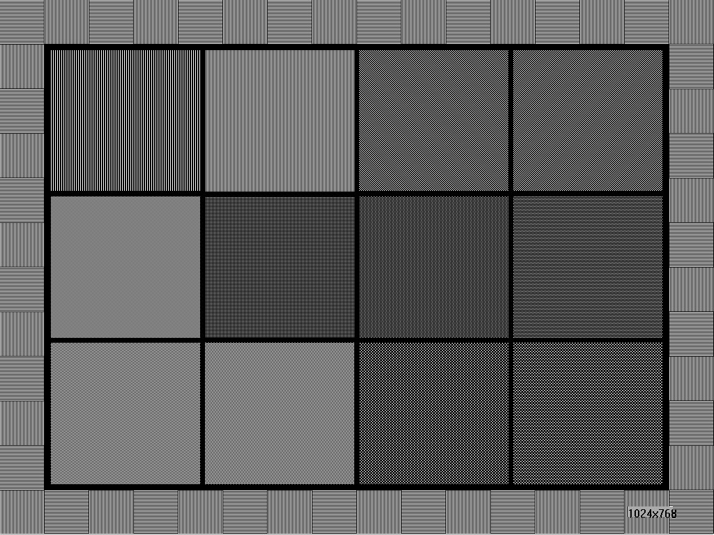

Slide 40
