Slide 1


ACE2 Orthologs and SARS-CoV-2
David Lázaro, Luis Carlos Ospina and Jan Jardí

Slide 2

01
Introduction

Slide 3
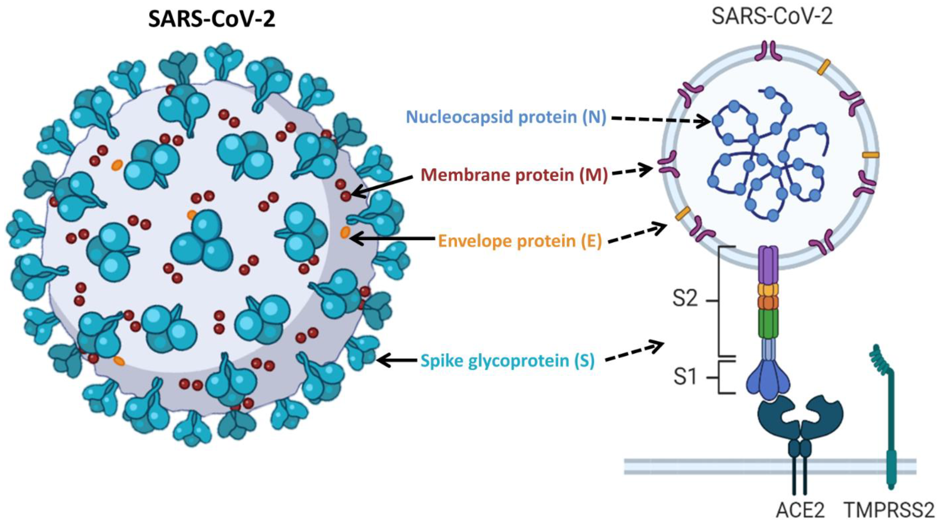
Angiotensin-converting enzyme 2 (ACE2)
Membrane-bound protein
Physiological processes
SARS-CoV, SARS-CoV-2 and HCoV-NL63

Slide 4
“To what extent can susceptibility to COVID-19 be predicted based on variations in the ACE2 sequence?”

Slide 5
02
Methodology

Slide 6

Data collection
Placentals
Marsupials
Monotremes

Slide 7
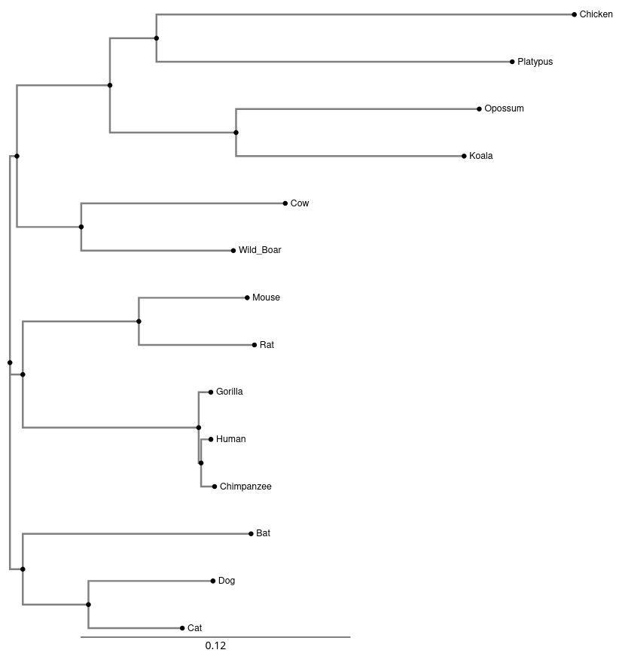
Multiple Sequence Alignment
Clustal Omega

Slide 8
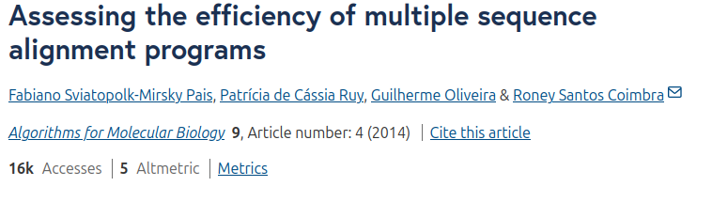
MAFFT vs. T-COFFEE

Slide 9
03
Results

Slide 10
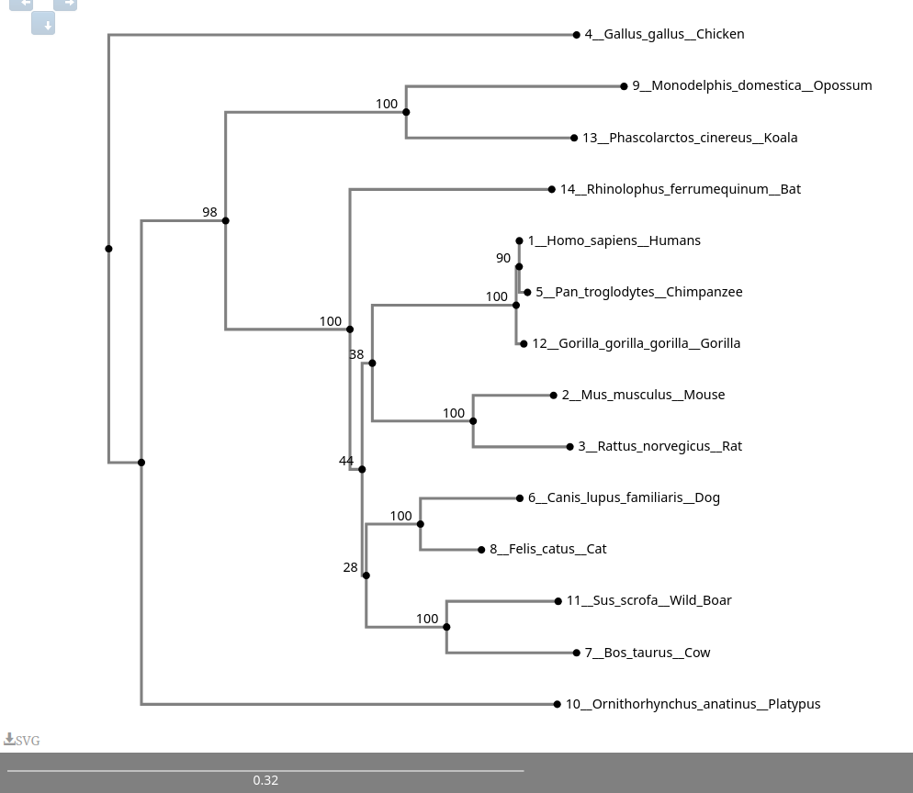

Slide 11
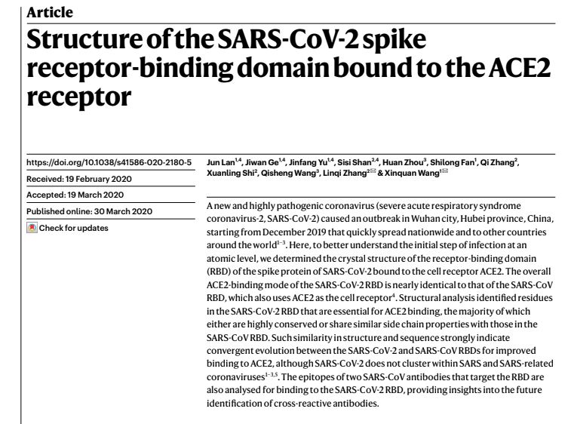
What did we realize through this study?

Slide 12
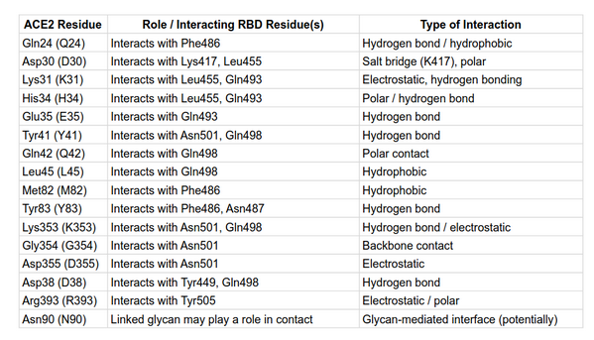
16 important residues

Slide 13
Original sequence (805 aa)
ARTICLE I
We extract the positions
PYTHON FUNCTION
We get new sequences (16 aa)

Slide 14
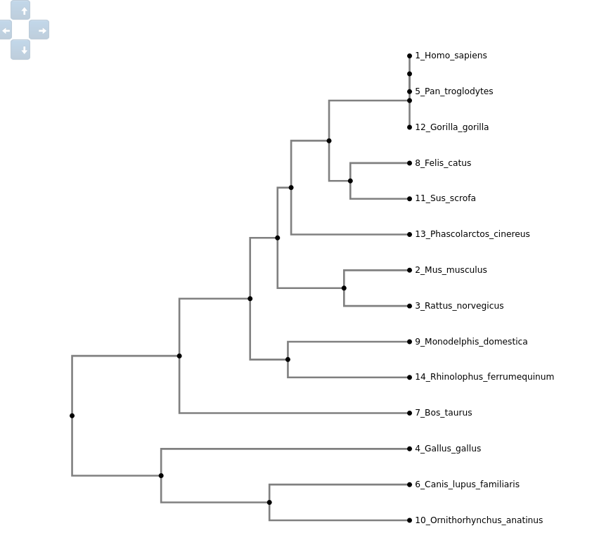
Final phylogenetic tree

Slide 15
04
Discussion

Slide 16
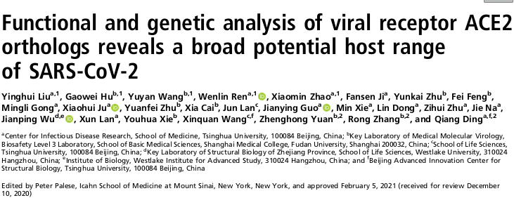
Prediction of SARS-CoV-2 Resistance
What divergence level indicates SARS-CoV-2 resistance?
Dog and mouse?
Just partial overlapping

Slide 17
Prediction of SARS-CoV-2 Resistance

Slide 18
Prediction of SARS-CoV-2 Resistance

Slide 19
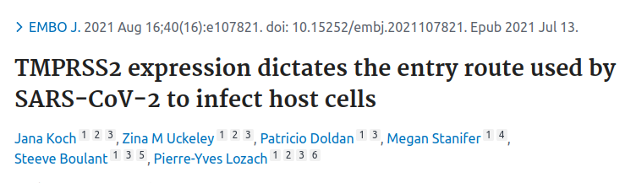
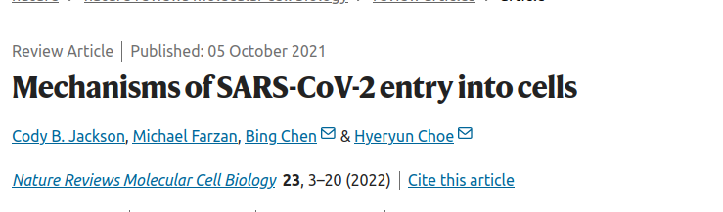
Prediction of SARS-CoV-2 Resistance
Do not rely solely on full-sequence similarity or critical residues
Other factors:
  ACE2 expression levels
  Presence of proteases such as TMPRSS2
  Additional host-pathogen interactions

