Slide 1

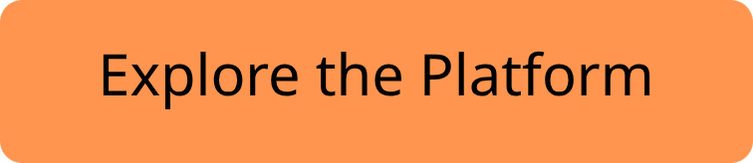

Plan Events
Modern Event Management, Built for Scale
A full-stack platform for scheduling, ticketing, and analytics — engineered with precision, designed for production.

Slide 2
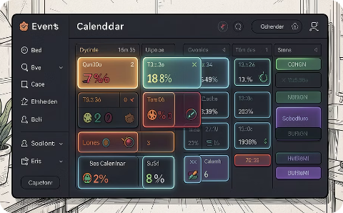
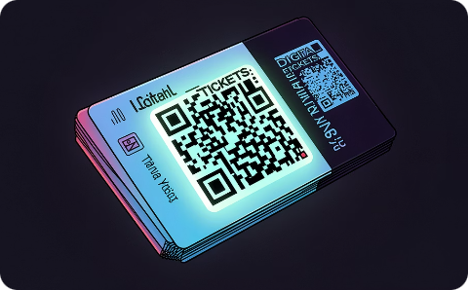
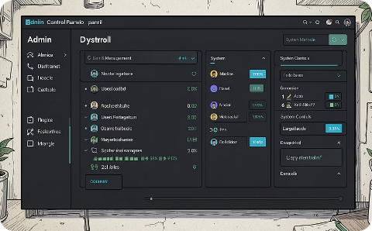
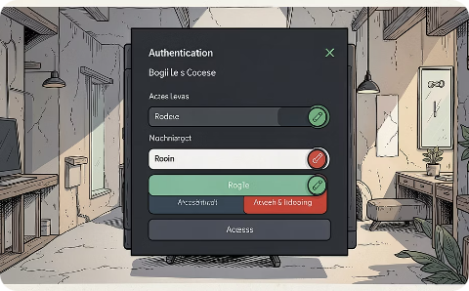
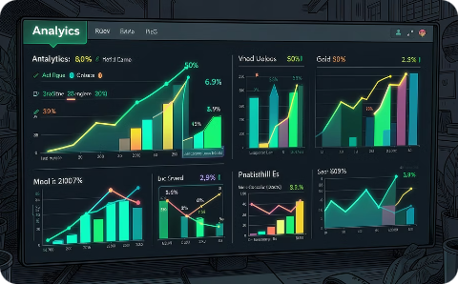
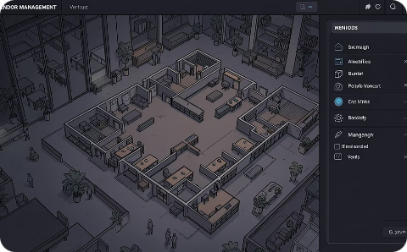
CORE CAPABILITIES
Everything You Need to Run Events
Event Management
Ticketing & Attendance
Admin Dashboard
Roles & Authentication
Create, schedule, and manage events with a clean, intuitive interface.
Issue tickets, track check-ins, and manage capacity in real time.
Full control panel for platform oversight, user management, and system health.
JWT-based auth with granular role permissions for admins, vendors, and attendees.
Analytics & Reports
Venue & Vendor Planning
Live insights on ticket sales, attendance trends, and event performance.
Coordinate venues and vendors seamlessly within a single unified workspace.

Slide 3
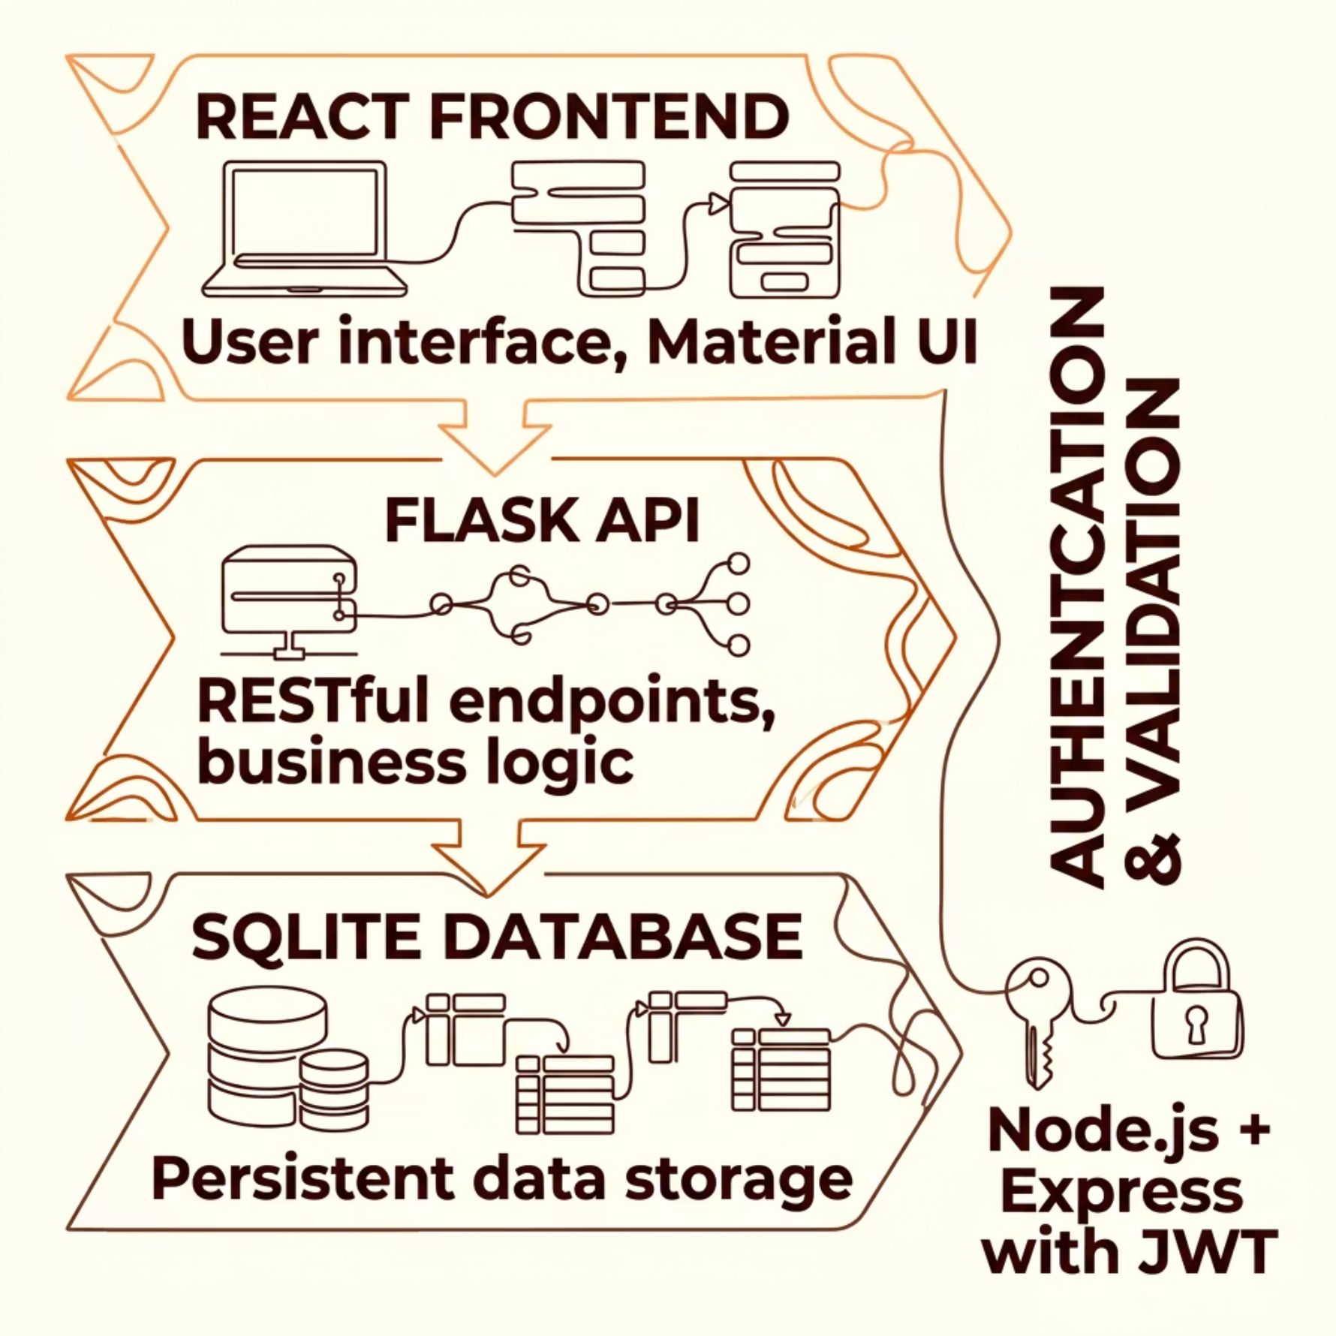

UNDER THE HOOD
Architecture at a Glance
Separation of Concerns
Each layer operates independently — React handles the UI, Flask powers the API, SQLite persists data, and Node.js + Express manages auth. Swap or scale any layer without touching the rest.
Authentication is decoupled via JWT, enabling stateless, scalable sessions across services.

Slide 4

TECH STACK
Built with Modern, Proven Tools
React
Flask
Component-driven UI with fast rendering and seamless state management.
Lightweight Python backend powering clean, predictable RESTful APIs.
Node.js + Express
SQLite
Handles authentication layer with JWT tokens and session management.
Zero-config relational database — ideal for rapid development and testing.
Chart.js + Recharts
Material UI
Responsive, animated charts for real-time analytics dashboards.
Polished component library delivering a consistent, premium design system.

Slide 5

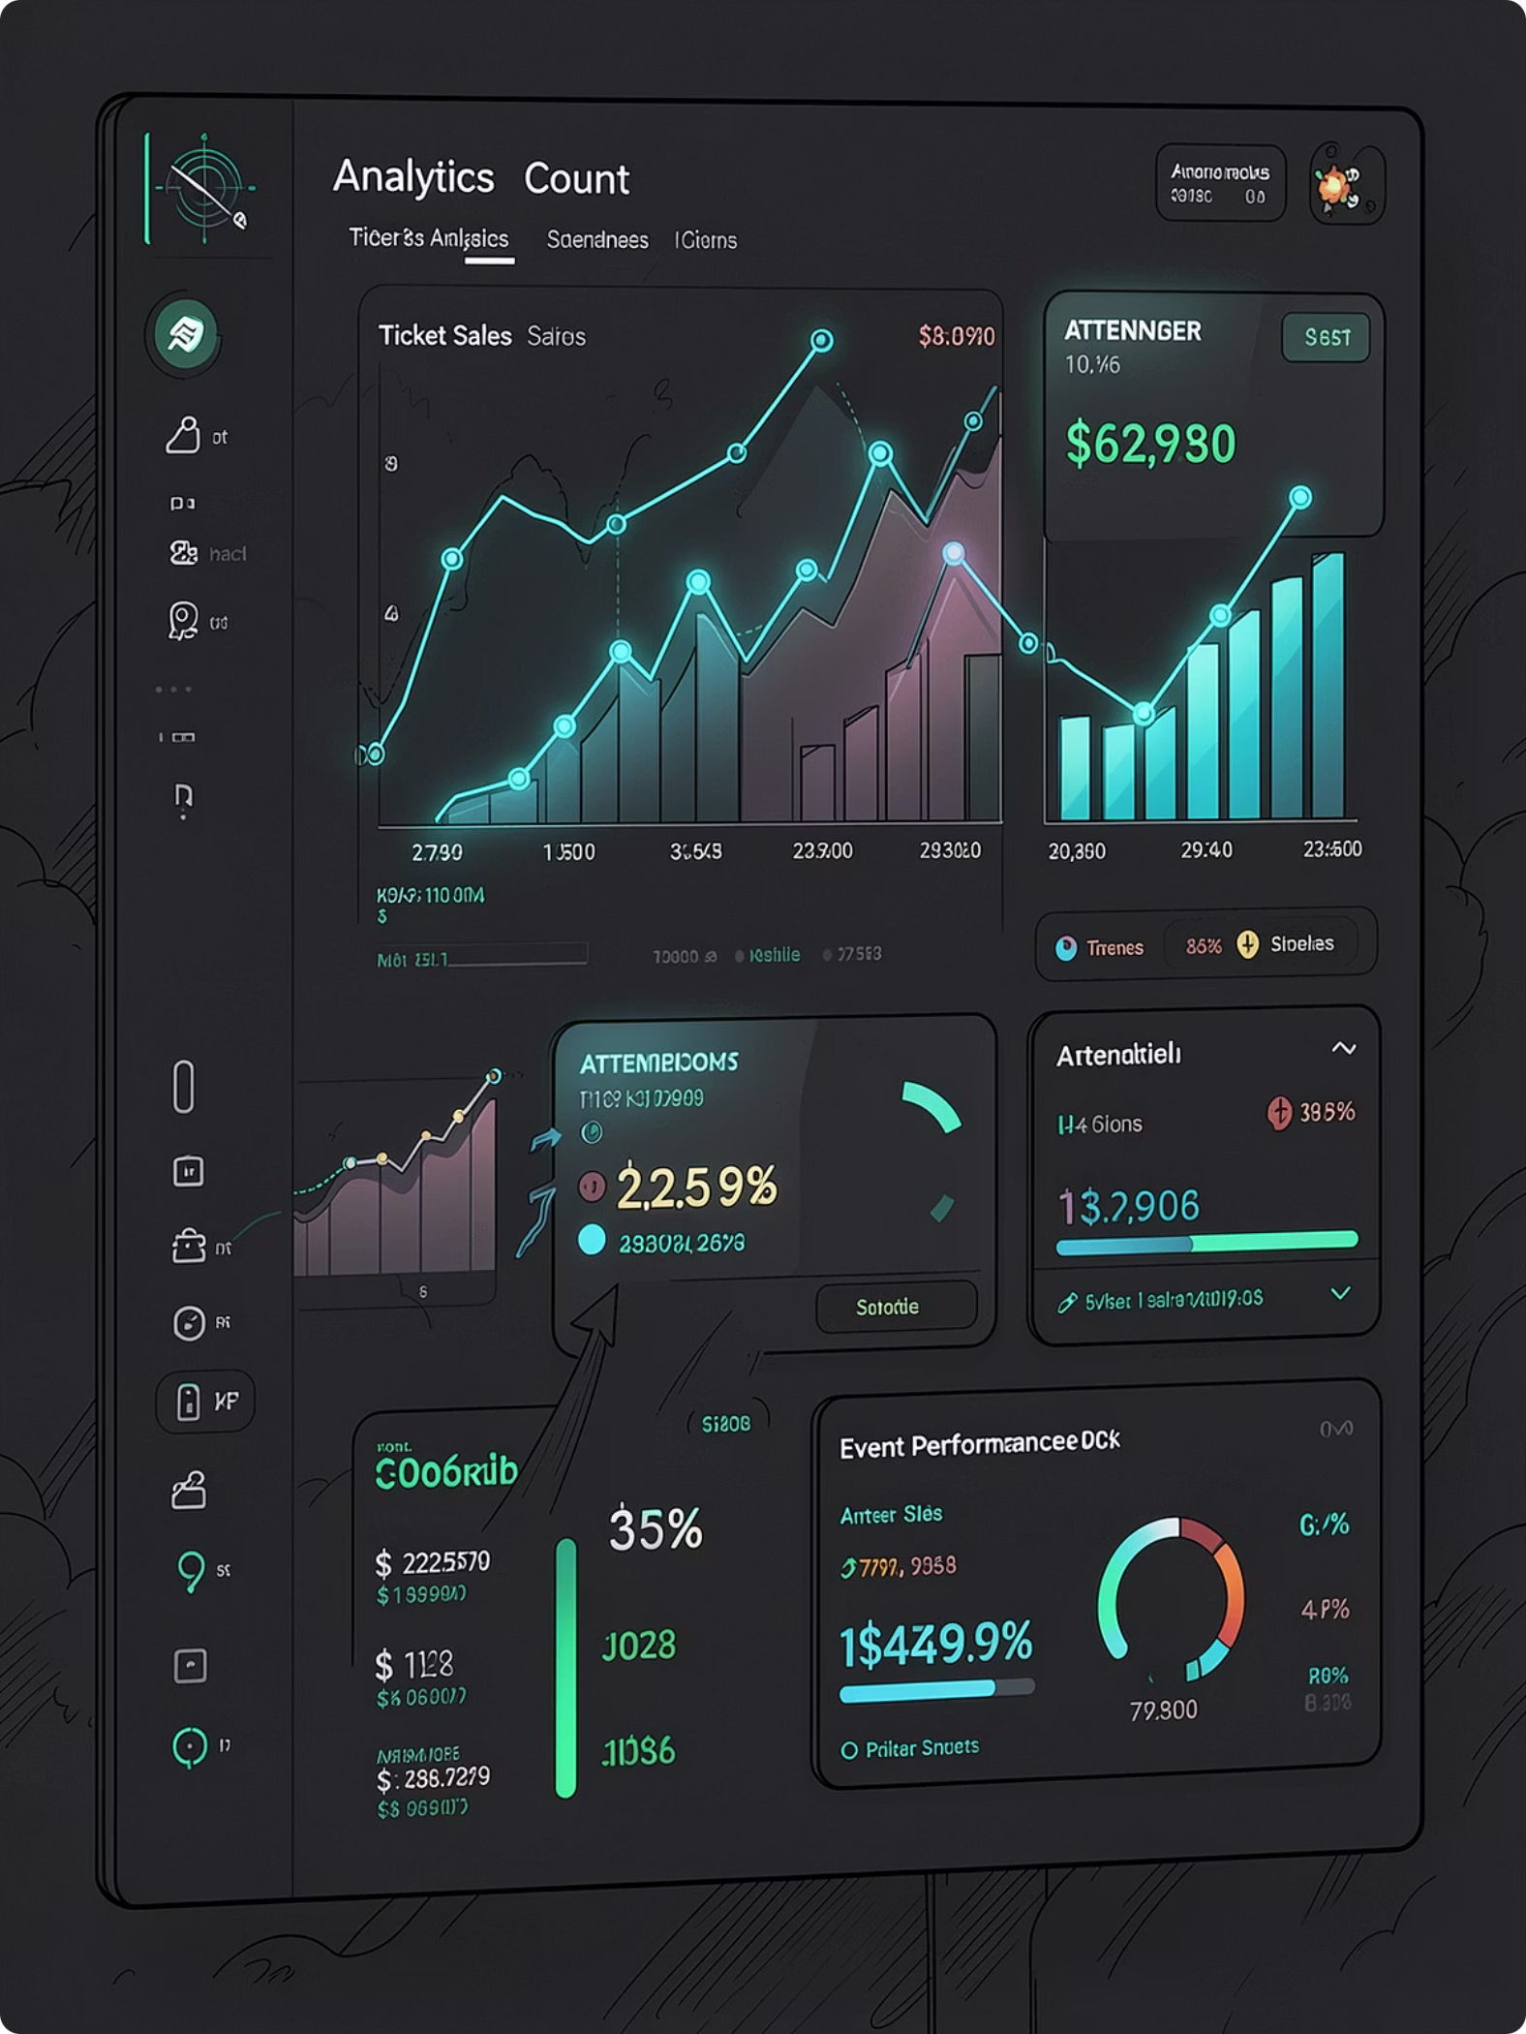
DASHBOARD PREVIEW
Insights, Front and Center
The Plan Events dashboard surfaces ticket revenue, attendee trends, and event health at a glance.

Slide 6
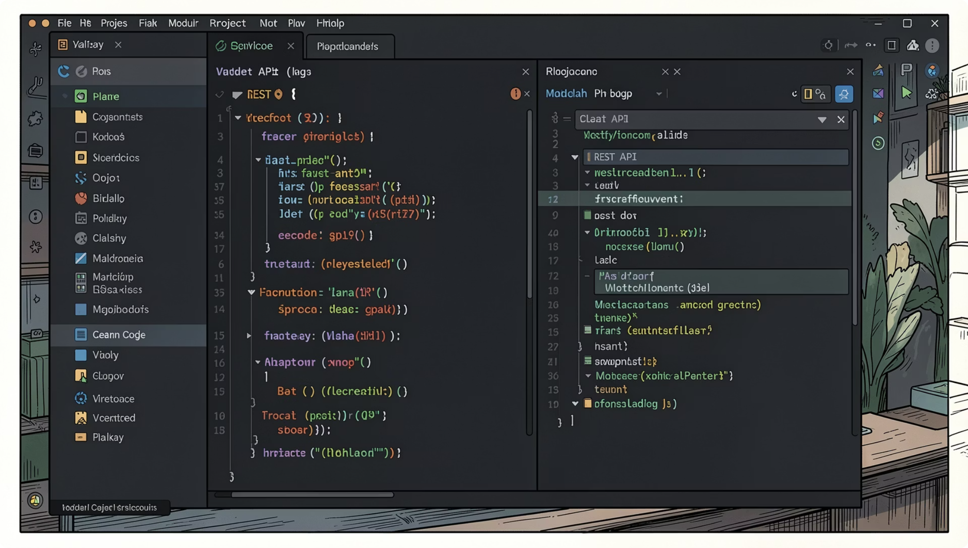
FOR DEVELOPERS
Developer-Friendly by Design
REST API
Every feature is exposed through a documented, versioned REST API. Integrate, extend, or connect third-party tools with ease.
Modular Backend
Flask blueprints keep routes, models, and logic cleanly separated. Add features without touching unrelated code.
Scalable Architecture
Start with SQLite, migrate to PostgreSQL when you're ready. The architecture supports horizontal scaling from day one.
Clean Project Structure
Organized by domain — events, tickets, users, analytics — making onboarding fast and refactoring painless.

Slide 7
WHAT'S NEXT
The Road Ahead
Plan Events is production-ready today. The roadmap is focused on making it indispensable for teams at every scale.
Phase 1 — Payments
1
Stripe integration for seamless ticket purchases, refunds, and payout management.
2
Phase 2 — Intelligence
AI-powered event recommendations and dynamic pricing based on attendance patterns.
Phase 3 — Engagement
3
Email notifications, reminders, and post-event follow-ups automated end-to-end.
4
Phase 4 — Global
Multi-language support and localized experiences for international event organizers.

Slide 8
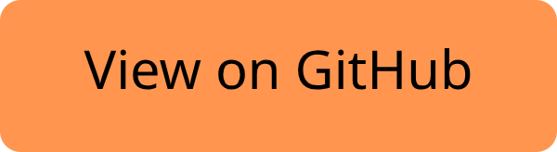

Build Something Great
Plan Events is open source and actively maintained. Whether you're contributing a feature, reporting a bug, or forking it for your next project — you're welcome here.
📦 Get Started
🤝 Contribute
⭐ Star on GitHub
Clone the repo, run npm install, and you're live in minutes.
Open issues, submit PRs, and help shape the future of event management.
Follow the project and stay updated on every release and milestone.

