Slide 1
News Article Summarization Requirements
By: Thomas LAzarus

Slide 2
Description
Due to the amount of daily news thrown at everyone everyday many people do not feel that they have the time to properly read and digest the news.
This project will be to create a website to show summarized news articles.

Slide 3
Requirements
Website must be easy to traverse and efficient
Website must update at least once a day
The backend of the website should preform the summarization as efficiently as possible

Slide 4
Tools
Python
Django
PyTorch
PySpark
Docker

Slide 5

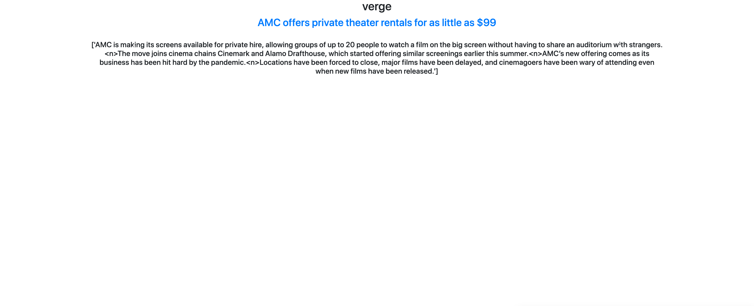
Quick View
The articles are visible in a carousel that can be cycled through

Slide 6
Timeline
In September have the proof of concept and web scraper done
In October optimize the model
In November polish the front-end web page/email

Slide 7
Questions?

