Slide 1
Detecting Spatially Variable Genes
Lazar Velinov 2023/3153

Slide 2
Content
What are spatially variable genes
Calculating SVGs with algorithm based on entropy
Calculating SVGs with algorithm based on Moran’s I score
Comparing results to SVGs calculated with SpaGFT algorithm
Conclusion

Slide 3
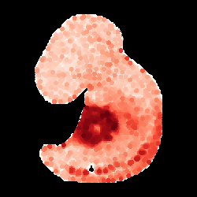
What are spatially variable genes
High spatial correlation
Clustered in most cases
Non-uniform expression

Slide 4
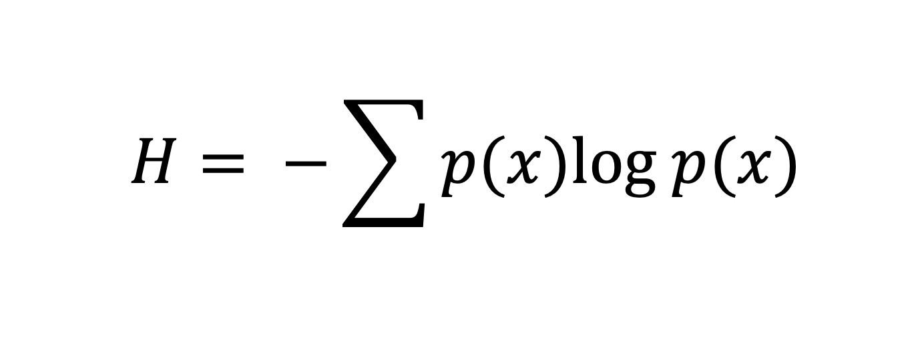
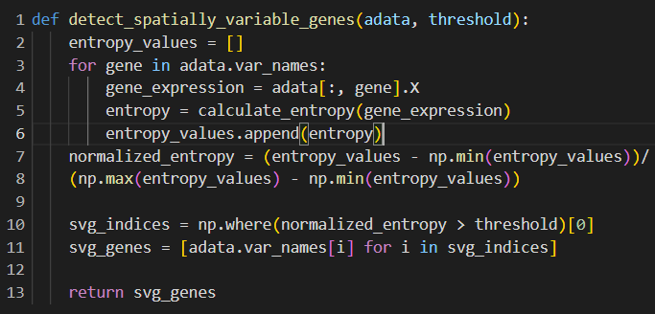
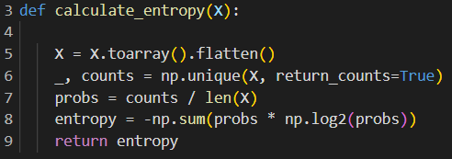
Entropy based Algorithm
Algorithm based on Shannon’s entropy formula
Filtering SVGs based on entropy of gene expression

Slide 5
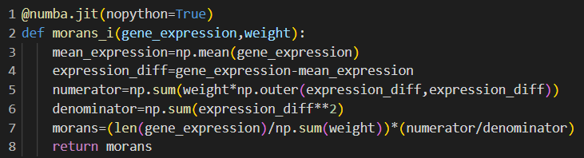
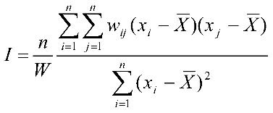
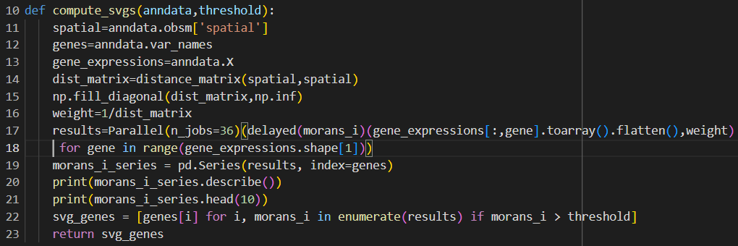
Moran’s I algorithm
Algorithm based on Moran’s I score
Moran’s I is a metric that measures spatial correlation

Slide 6
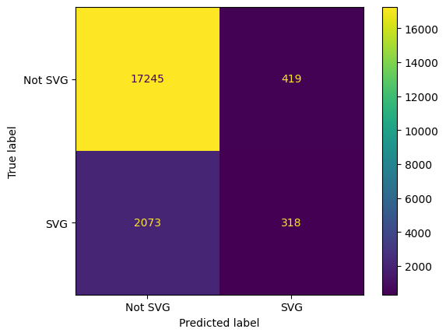

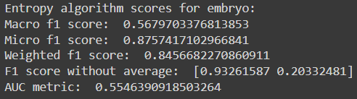
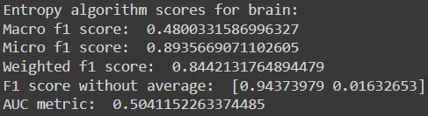
Comparing Entropy results with spagft
Embryo
Brain

Slide 7
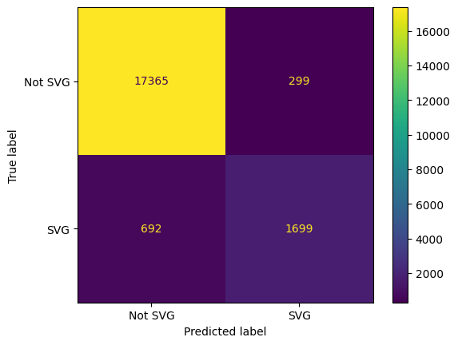
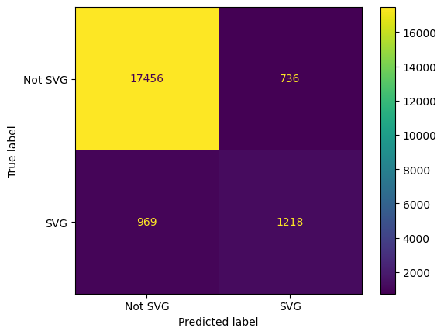
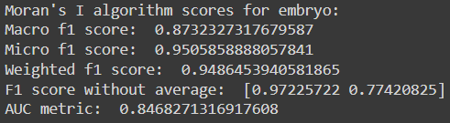
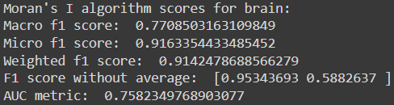
Comparing Moran’s I results with spagft
Embryo
Brain

Slide 8
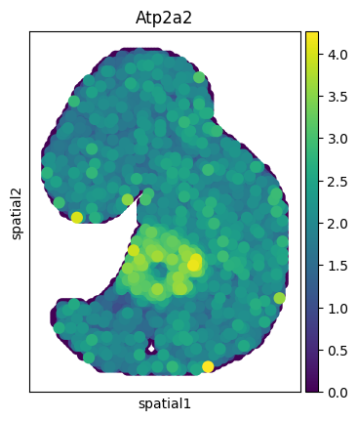
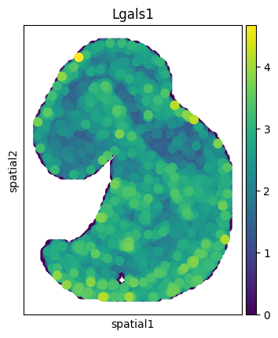
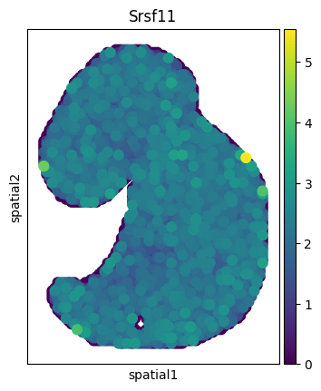
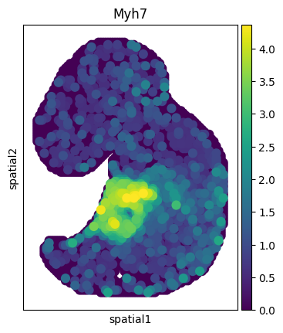
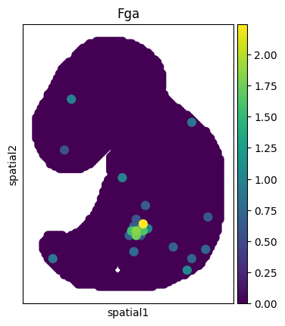
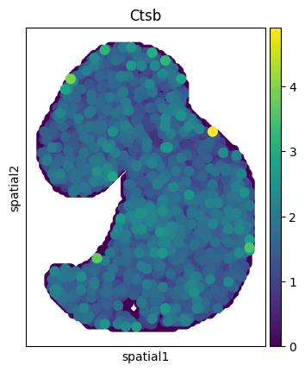
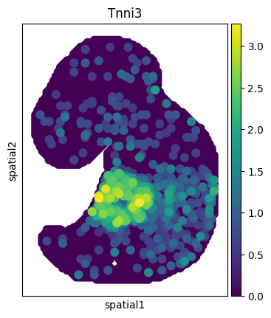
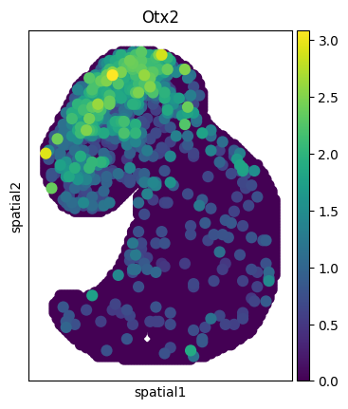
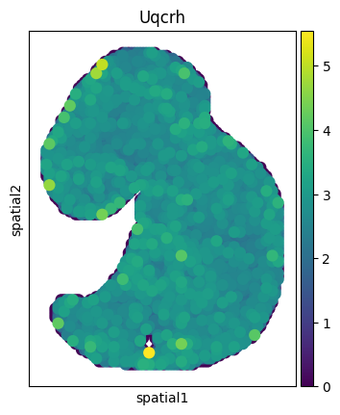
Examples of genes detected as svg
Entropy
Moran’s I
SpaGFT

Slide 9
Conclusion
Entropy based algorithm is far worse than Moran’s I algorithm
Both Moran’s I and SpaGFT algorithms classify some genes as SVG even though it seems that they are not
Threshold for deciding which genes are SVG should be set based on research demands
Optimization is crucial because of large datasets

Slide 10
Thank you for your attention
Any questions?

