Slide 1
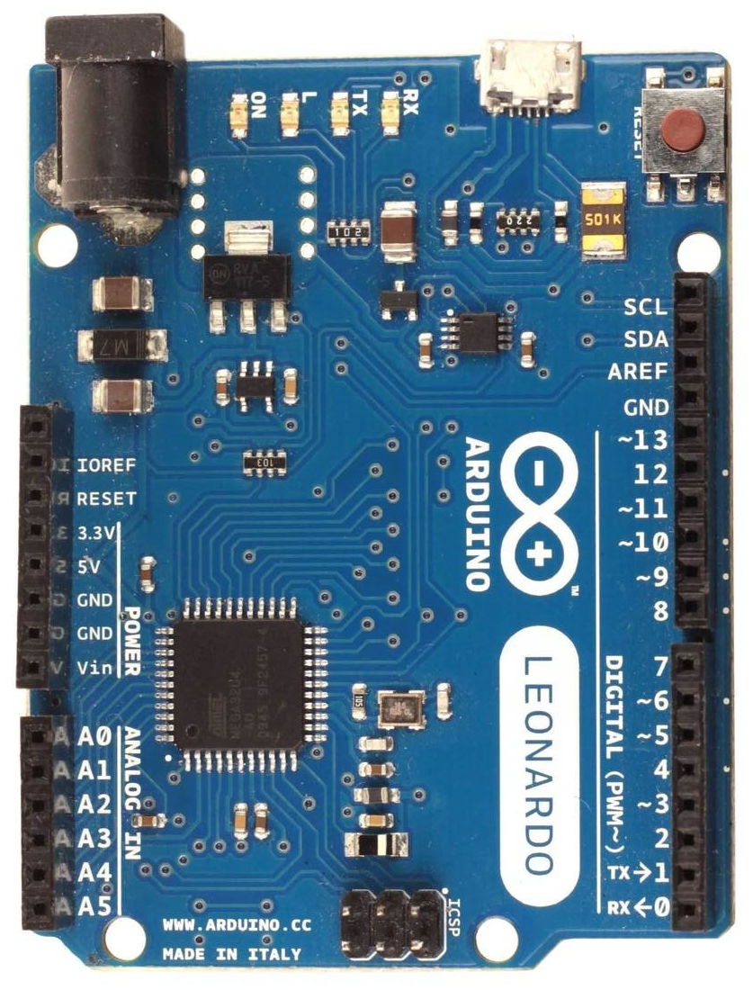
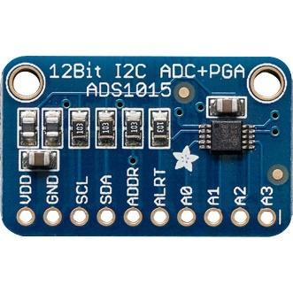
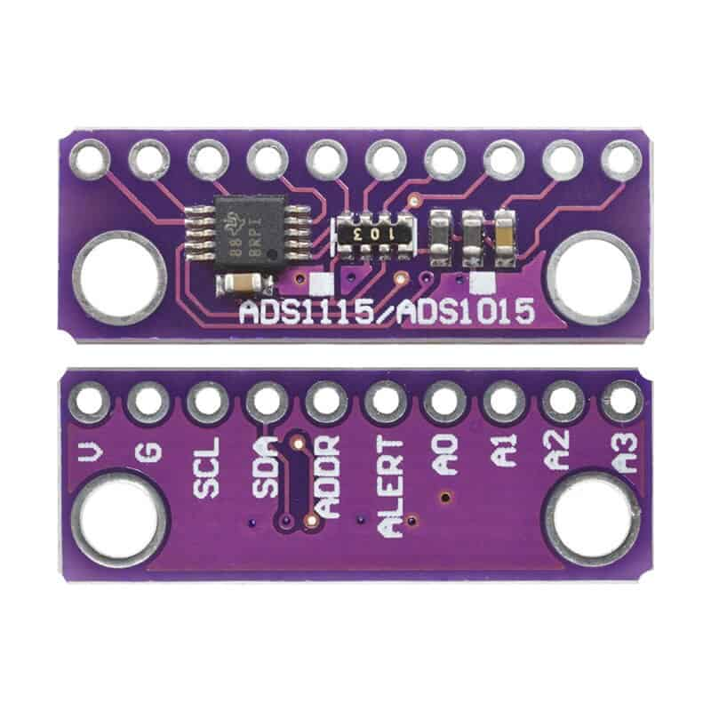
Wiring diagram for external ADC (only valid for firmware with option “s”)
Arduino Leonardo, Micro or ProMicro
ADS1015 - external i²C 12bit ADC
A0 - throttle pot (X axis)
A1 - brake pot (Y axis)
A2 - clutch pot (Z axis)
A3 - handbrake pot (Rx axis)
10k linear pots
ADS1015 gain in the firmware is set to 4.096V
so you have to be careful not to
move pot wiper more than 4.1V
in order to avoid damaging ADC
A0
A1
A2
A3
Arduino ADS1015
5V VDD
GND GND
2 SDA (i²C data)
3 CLK (i²C clock)
you may set ADDR pin to GND
in order to make sure that
ADC gets i²C address 0x48
which is expected by firmware
two board variants
of ADS1015

