Slide 1
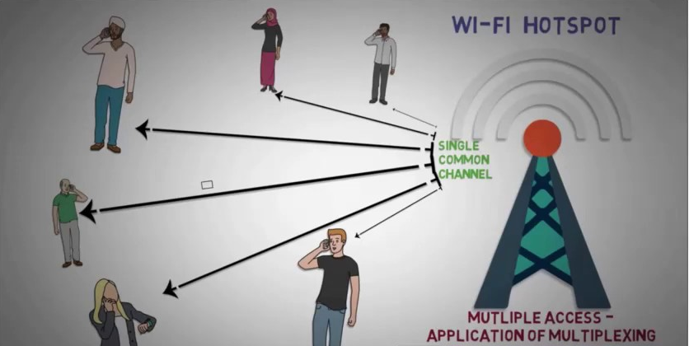
MULTIPLE ACCESS TECHNIQUES

Slide 2
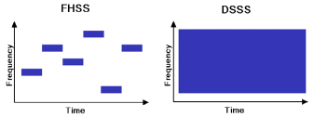
OVERVIEW
Introduction to Multiple Access
FDMA
TDMA
Spread Spectrum Multiple Access
SDMA
OFDMA

Slide 3
Spread Spectrum Multiple Access
Transmission bandwidth is several orders of magnitude greater
than the minimum required RF bandwidth.
Pseudo-noise (PN) sequence converts a narrowband signal to a
wideband noise-like signal.
Provides immunity to multipath interference and robust multiple
access capability.
Bandwidth efficient in a multi user environment.

Slide 4
Types of Spread Spectrum Techniques
Two main types SSMA:
1. Frequency hopped multiple access (FH)
2. Direct sequence multiple access (DS)
Direct sequence multiple access is also called code division multiple access (CDMA).

Slide 5
Frequency Hopped Multiple Access (FHMA)
• The carrier frequencies of the individual users are
varied in a pseudorandom fashion within a wideband
channel.
• The pseudorandom change of the carrier frequencies of
the user randomizes the occupancy of a specific
channel at any given time, multiple access allowed.
• At any given point in time, a frequency hopped signal
only occupies a single, relatively narrow channel.

Slide 6
Frequency Hopped Multiple Access (FHMA)
• The digital data is broken into uniform sized bursts which are transmitted on different
carrier frequencies.
• Instantaneous bandwidth of any one transmission burst is much smaller than the total
spread bandwidth.
FHMA systems often employ energy efficient constant envelope modulation.
• Provides a level of security, especially when large number of channels are used.
• Signal is somewhat immune to fading, since error control coding and interleaving can
be used to protect the frequency hopped signal against deep fades which may
occasionally occur during the hopping sequence

Slide 7
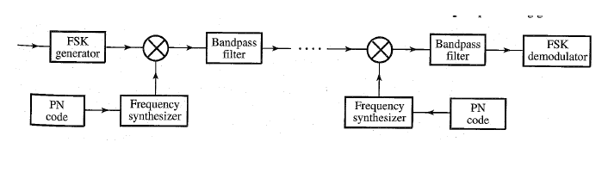
Frequency Hopped Multiple Access (FHMA)

Slide 8
Frequency Hopped Multiple Access (FHMA)
Difference between FHMA and FDMA:
• In FHMA, The frequency hopped signal changes channels
at rapid intervals.
Fast hopping and slow hopping:
• Fast frequency hopping - the rate of change of the carrier
frequency is greater than the symbol rate
• Slow frequency hopping - the channel changes at a rate
less than or equal to the symbol rate

Slide 9
Code Division Multiple Access (CDMA)
• In CDMA, the narrowband message signal is multiplied by a very
large bandwidth signal called the spreading signal.
• The spreading signal is a pseudo-noise code sequence that has
a chip rate which is orders of magnitudes greater than the data
rate of the message.
• All users use the same carrier frequency and may transmit
simultaneously.
• Each user has its own pseudorandom code word which is
approximately orthogonal to all other code words.

Slide 10
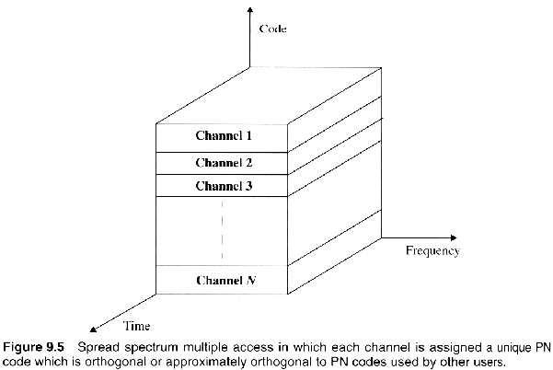
Code Division Multiple Access (CDMA)

Slide 11
Code Division Multiple Access (CDMA)
• The receiver performs a time correlation operation to
detect only the specific desired codeword.
All other codewords appear as noise due to decorrelation.
• The receiver needs to know the codeword used by the
transmitter.
• Each user operates independently with no knowledge of
the other users.

Slide 12
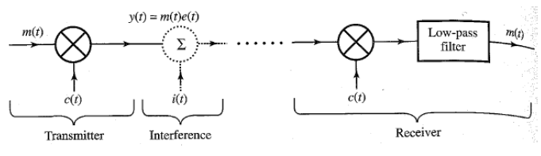
Code Division Multiple Access (CDMA)

Slide 13
Near-far problem in CDMA
• The near-far problem occurs when many mobile users share the same
channel.
• In general, the strongest received mobile signal will capture the
demodulator at a base station.
• In CDMA, stronger received signal levels raise the noise floor at the
base station demodulators for the weaker signals, thereby decreasing
the probability that weaker signals will be received.
• The power of multiple users at a receiver determines the noise floor
after decorrelation.

Slide 14
Power control
• Provided by each base station in a cellular system and assures that
each mobile within the base station coverage area provides the same
signal level to the base station receiver.
• This solves the problem of a nearby subscriber overpowering the base
station receiver and drowning out the signals of far away subscribers.
• Power control is implemented at the base station by rapidly sampling
the radio signal strength indicator (RSSI) levels of each mobile and
then sending a power change command over the forward radio link.

Slide 15
Features of CDMA
• Many users of a CDMA system share the same frequency.
Either TDD or FDD may be used.
• Unlike TDMA or FDMA, CDMA has a soft capacity limit.
Increasing the number of users in a CDMA system raises the
noise floor in a linear manner.
• Multipath fading may be substantially reduced because the
signal is spread over a large spectrum.
• Channel data rates are very high in CDMA systems.

Slide 16
Features of CDMA (Contd.)
• Soft handoff is performed by the MSC, which can simultaneously
monitor a particular user from two or more base stations.
The MSC may choose the best version of the signal at any time
without switching frequencies.
• The near-far problem occurs at a CDMA receiver if an undesired
user has a high detected power as compared to the desired
user.

