Slide 1
MACHINE LEARNING MODULE 3
3.1 Introduction -Probablistic Learning-Naive Bayes Theorem

Slide 2
INTRODUCTION-Probabilistic Learning
Probabilistic learning in machine learning uses probability theory to model uncertainty, allowing models to provide predictions as probability distributions rather than single answers, which enables better risk assessment and decision-making, especially with incomplete or noisy data

Slide 3
Real-life Example
Weather apps say:
“70% chance of rain”
Not “It will rain for sure”

Slide 4
Why do we need it?
Real-world data is:
Incomplete
Noisy
Uncertain
Key Idea
Learn patterns from data and express predictions as probabilities.

Slide 5
Introduction: Naive Bayes Algorithm
The Naive Bayes algorithm is a classification technique based on Bayes' Theorem. It is termed "Naive" because it makes the strong assumption that all predictors (features) are independent of each other given the class label despite this oversimplification, it is surprisingly effective for tasks like spam filtering and document classification.

Slide 6
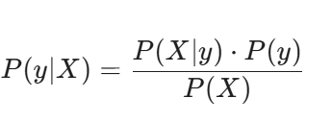
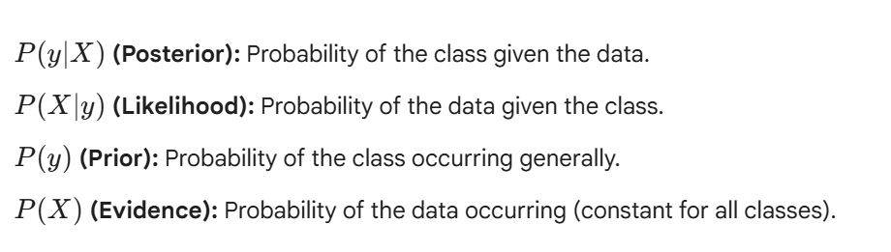
FORMULA
Using Bayes theorem,we calculate the probability of a class y given input data X,

Slide 7
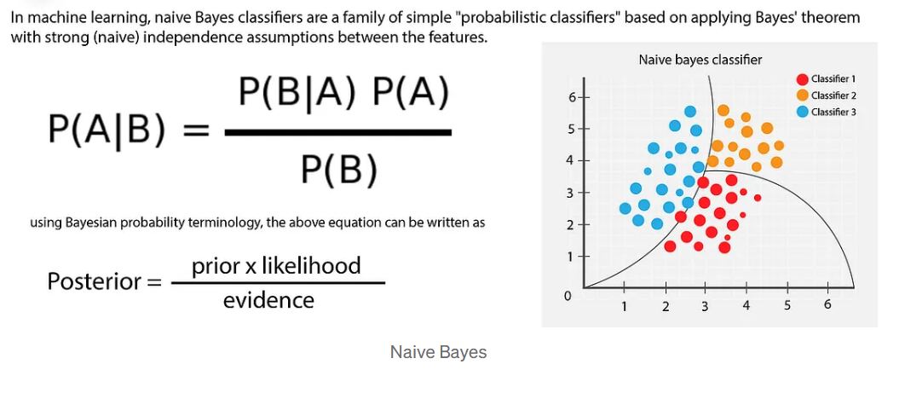
FORMULA

Slide 8
WHY AND HOW?
Because it assumes all features are independent of each other.
This assumption is often false, but the model still works surprisingly well.
How it works (Step-by-step)
Calculate probability of each class
Calculate probability of features given class
Choose the class with highest probability

Slide 9
EXAMPLE
Step 1: Training Data (Past Emails)
The system already has thousands of emails labeled as:
Spam
Not Spam
From these emails, it learns how often certain words appear.
Word | Appears in Spam | Appears in Not Spam
free | Very often | Rare
win | Often | Rare
meeting | Rare | Often
project | Rare | Often

Slide 10
EXAMPLE
Step 2: Naive Assumption
Naive Bayes assumes:
Each word contributes independently to deciding spam.
So it treats:
free
win
offer
as separate clues.

Slide 11
EXAMPLE
Step 3: New Email Arrives
Email content:
"Win free offer now"
Naive Bayes calculates:
Probability of this email being Spam
Probability of this email being Not Spam
Using,

Slide 12

EXAMPLE
Step 4: Decision
If,
E mail is marked as spam

Slide 13
ADVANTAGES
Fast (works in milliseconds)
Works well with text data
Needs less training data

