Slide 1
MACHINE LEARNING MODULE 3
3.2 Maximum Likelihood - Maximum Apriori

Slide 2
Maximum Likelihood Estimation (MLE)
Maximum Likelihood Estimation (MLE) is a foundational statistical method in machine learning used to estimate the parameters of a model that make the observed data most probable.
It frames parameter estimation as an optimization problem, seeking the specific parameters that maximize the likelihood function.

Slide 3
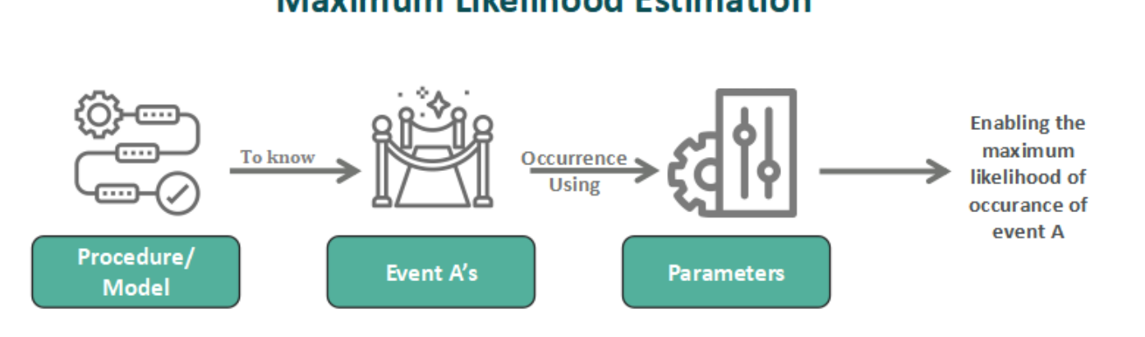
SIMPLE CONCEPT
MLE finds parameters that maximize the likelihood of observed data.
Choose model parameters that make the observed data most probable.

Slide 4
Main Steps:
Using correct distribution for regression or classification problem
Defining the likelihood
Taking the natural log
Reducing the product functions into a function of the summation
Maximizing or minimizing the negative aspect of the objective function
Verifying those safe assumptions comprises uniform priors
Using the above steps and ways to implement MLE would be helpful in successfully estimating distribution data.

Slide 5
MLE Advantages
It becomes the best and the most efficient estimator of a parameter if correct assumptions for the model gets used.
It has the ability to provide the user with a consistent and flexible approach making it more reliable than other estimators.
It gets applied in different types of applications where other models' assumptions get violated.
For larger samples, it produces unbiased outcomes.

Slide 6
MLE Disadvantages
It depends on the assumptions of such a model whose derivation function has never been easy.
It gets highly sensitive to choosing of initiating values of a model, which poses great problems like other models.
The numerical estimation could become quite expensive computationally based on the complexity of the MLE function.
For a smaller sample, it produces biased outcomes.

Slide 7
Maximum A Posteriori (MAP)
Maximum A Posteriori (MAP) Estimation Maximum A Posteriori (MAP) estimation is a Bayesian method used to find the most probable value for a model's parameters (θ) given observed data (D). It is an extension of Maximum Likelihood Estimation (MLE) that incorporates prior knowledge about the parameters.

Slide 8
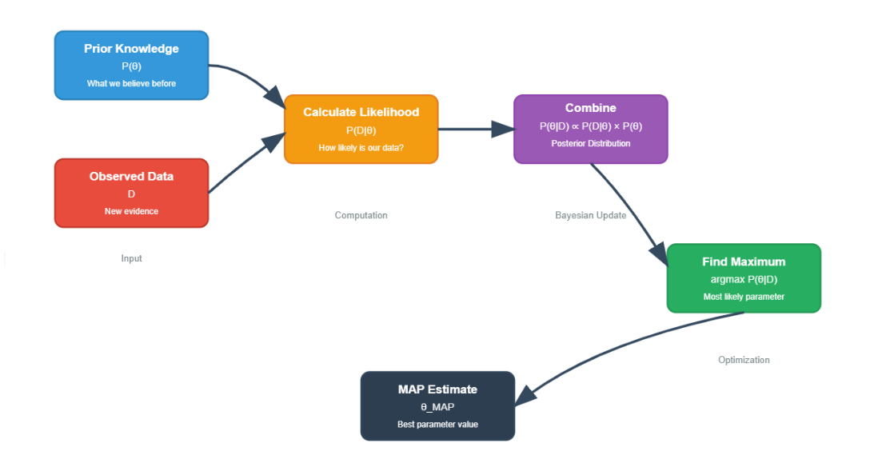
Process

Slide 9

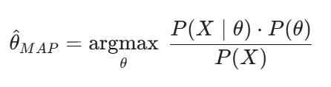
Formula
The goal of MAP is to find the parameter set (θ) that maximizes the posterior probability given the data (D)
Using Bayes' Theorem, we expand this to:

Slide 10
EXAMPLE
Even if you flip 3 Heads,
Your "Prior" belief that coins are usually fair pulls the estimate closer to (50%) rather than (100\%).

Slide 11
Advantages
Works well with Small Datasets: This is the biggest strength of MAP. When you have very little data (e.g., only 3 coin flips), MLE tends to overfit and give extreme probabilities (like 100%). MAP uses the "Prior" to smooth out these extremes, resulting in more realistic estimates.
Incorporates Prior Knowledge: It allows you to inject domain expertise into the model. If you are a doctor modeling a disease, you know certain symptoms are rare. You can encode this "medical knowledge" into the Prior, rather than relying solely on the potentially noisy patient data collected.

Slide 12
Advantages
Prevents "Zero Probability" Issues: In text classification (like Naïve Bayes), if a specific word never appears in the training data, MLE assigns it a probability of 0. This can crash the model (because multiplying by 0 zeros out everything). MAP effectively starts with a "virtual count" (Laplace Smoothing), ensuring no probability is ever truly zero.
Regularization: In mathematical terms, the "Prior" term acts as a regularizer (similar to L2 regularization in regression). It prevents the model parameters from exploding or becoming too complex, effectively penalizing unlikely values.

Slide 13
Disadvantages
Subjectivity of the Prior:The results depend heavily on the prior belief you choose. If your prior is wrong (e.g., you strongly believe a coin is biased towards Tails, but it is actually biased towards Heads), your estimate will be biased and incorrect, taking a lot of data to correct the mistake.
Computational Complexity:MLE is usually a simple optimization (counting frequencies). MAP involves multiplying the likelihood by the prior distribution. Depending on the complexity of the distributions used, this can make the math significantly harder (calculating integrals or difficult derivatives).
Diminishing Returns with Large Data:As the amount of data ($N$) grows to infinity, the influence of the Prior fades away.

Slide 14
Comparison Of MLE and MAP With Example
Table:
Method | Estimate | Interpretation
MLE | 100% | "I saw 3 heads, so Tails is impossible." (Extreme)
MAP | 80% | "I saw 3 heads, but I know coins usually have tails. It's likely biased, but not impossible to get tails." (Balanced)

