Slide 1
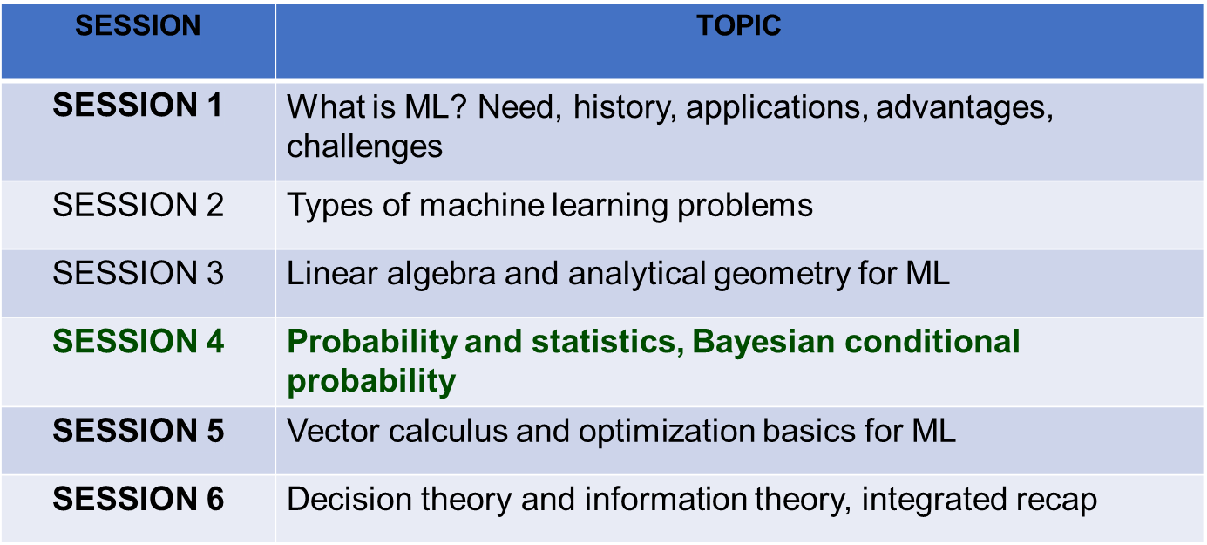
Session Outline

Slide 2
Session Overview
Probability Fundamentals & Distributions
Conditional Probability & Independence
Bayes' Theorem & Its Components
Likelihood, Prior & Posterior Probabilities
Naive Bayes Classification Algorithm
Maximum Likelihood Estimation (MLE)
Bayesian Belief Networks & Applications
Notes:
‹#›

Slide 3
Probability Fundamentals
Definition: P(A) = # favorable outcomes / # total outcomes, where 0 ≤ P(A) ≤ 1
• ML: Confidence scores in classification; Uncertainty quantification in predictions
• Math : Measure of likelihood on interval [0,1]; Foundation of all statistical inference
Sample Space & Events: Ω = all possible outcomes; A ⊆ Ω (event)
• ML: Ω = all possible predictions; Event = specific class label
Complement Rule: P(A') = 1 - P(A) (opposite event probability)
• ML: P(not spam) = 1 - P(spam); Used in binary classification
Addition Rule: P(A ∪ B) = P(A) + P(B) - P(A ∩ B) (either/both events)
• ML: Probability of multiple class membership in overlapping scenarios
Notes:
‹#›

Slide 4
Probability Distributions
Discrete Distributions: Probability Mass Function (PMF): P(X=k)
• ML: Bernoulli (coin flip, binary outcome); Categorical (multi-class); Poisson (count data)
• Bernoulli: P(X=1) = p, P(X=0) = 1-p (single trial, 2 outcomes)
Continuous Distributions: Probability Density Function (PDF): f(x)
• ML: Gaussian/Normal (most common); Exponential (waiting times); Uniform
• Gaussian: f(x) = (1/(σ√(2π))) exp(-(x-μ)²/(2σ²)) (bell curve)
Cumulative Distribution Function (CDF): F(x) = P(X ≤ x)
• ML: Evaluates tail probabilities; Used in hypothesis testing and confidence intervals
Notes:
‹#›

Slide 5
Conditional Probability: Definition
Formula: P(A|B) = P(A ∩ B) / P(B), where P(B) > 0
• ML: Probability of class A given evidence B; Core of classification
• Math: Restricts sample space to B; Updates probability based on evidence
Joint Probability: P(A ∩ B) = P(A|B) × P(B) (both events occur)
• ML: Probability of feature AND class occurring together; Foundation of
Naive Bayes
Marginal Probability: P(A) = Σ_B P(A ∩ B) (summing over all B)
• ML: Class probability P(Y) averaged over all features; Prior probability
Bayes Notation: P(A|B) = P(B|A)P(A) / P(B) (rearrangement)
• ML: Flips conditioning; inverts cause-effect relationship
Notes:
‹#›

Slide 6
Independence & Conditional Independence
Statistical Independence: P(A ∩ B) = P(A) × P(B)
• ML: Features don't influence each other; Simplifies model
• Consequence: P(A|B) = P(A) (evidence B doesn't change P(A))
Conditional Independence: P(A ∩ B|C) = P(A|C) × P(B|C)
• ML: Features independent GIVEN class C; Naive Bayes core assumption
• Why Naive: "Naive" because we assume this even when false in reality
d-separation (Bayesian Networks): Graphical independence criterion
• ML: Determines which variables affect each other in belief networks
Notes:
‹#›

Slide 7
Bayes' Theorem: The Cornerstone
Formula: P(A|B) = P(B|A) × P(A) / P(B)
P(Hypothesis|Evidence) = P(Evidence|Hypothesis) × P(Hypothesis) / P(Evidence)
P(A|B) = Posterior: Updated probability after seeing evidence B
P(B|A) = Likelihood: Probability of evidence given hypothesis A is true
P(A) = Prior: Initial belief about hypothesis before evidence
P(B) = Evidence: Marginal probability (normalizing constant)
Notes:
‹#›

Slide 8
Bayes' Theorem: Component Breakdown
Prior P(A): Belief before observing data
• ML: Class distribution before seeing features; e.g., P(spam) = 0.3
• Properties: Often based on historical data; Can be uninformed (uniform)
Likelihood P(B|A): Probability of observing data B if A is true
• ML: P(email features | spam); Comes from model of data generation
• Assumes: Specific distribution (Gaussian, Bernoulli, etc.)
Evidence P(B): Total probability of observing data (all scenarios)
P(B) = Σ_A P(B|A) × P(A) (law of total probability)
• ML: Computed via marginalization; Often acts as normalizing constant
Posterior P(A|B): Updated belief after observing evidence B
• ML: P(spam | email features); Final classification probability
Notes:
‹#›

Slide 9
Naive Bayes Classifier
Classification Formula: P(C|X) = P(X|C)P(C) / P(X)
Naive Assumption (Conditional Independence):
P(X|C) = P(x₁|C) × P(x₂|C) × ... × P(xₙ|C)
(features independent given class C)
Why Naive?: Assumes feature independence (usually false but works well)
Computational Benefit: Reduces P(x₁,...,xₙ|C) from exponential to linear
Classification: Choose class with highest posterior P(C|X)
Real Applications: Spam detection, sentiment analysis, text classification
Notes:
‹#›

Slide 10
Naive Bayes: Training & Prediction
Training Phase: Estimate P(C) and P(xᵢ|C) from data
P(C) = # samples with class C / total samples (class proportion)
P(xᵢ|C) = # samples with xᵢ AND class C / # samples with class C
Laplace smoothing: Add 1 to numerator/denominator (avoid zero probability)
Prediction Phase: For new sample X, compute P(C|X)
P(C|X) ∝ P(C) × ∏ᵢ P(xᵢ|C) (omit P(X), same for all classes)
Multiply prior by likelihood products for each feature
Choose class with maximum probability (argmax)
Log-space computation: log(P) = log(P(C)) + Σ log(P(xᵢ|C)) (avoid underflow)
Notes:
‹#›

Slide 11
Naive Bayes Variants
Gaussian Naive Bayes: Continuous features from Gaussian distribution
• P(xᵢ|C) = (1/(σ√(2π))) exp(-(xᵢ-μ)²/(2σ²))
• ML: Iris dataset, numeric feature classification
Multinomial Naive Bayes: Discrete feature counts (text, word frequencies)
• P(xᵢ|C) = Nxᵢ,C / NC (count of feature xᵢ in class C samples)
• ML: Document classification (word presence/absence)
Bernoulli Naive Bayes: Binary features (present/absent)
• P(xᵢ=1|C) = probability feature present; P(xᵢ=0|C) = 1-P(xᵢ=1|C)
• ML: Spam detection, sentiment analysis (TF-IDF vectors)
Notes:
‹#›

Slide 12
Maximum Likelihood Estimation (MLE)
Goal: Find parameters θ that maximize likelihood of observed data
L(θ|X) = ∏ᵢ P(xᵢ|θ) (likelihood = probability of data given θ)
θ_MLE = argmax L(θ|X) = argmax log L(θ|X)
Log-likelihood: Sum easier than product; Maximizes same θ
Intuition: Choose parameters making observed data most probable
Example: Coin flips → p = # heads / # total (intuitive!)
Notes:
‹#›

Slide 13
MLE: ML Applications
Logistic Regression: MLE for binary classification
• Likelihood: ∏ᵢ P(yᵢ|xᵢ,w)^yᵢ × (1-P(yᵢ|xᵢ,w))^(1-yᵢ)
• Optimization: Gradient descent on negative log-likelihood (cross-entropy loss)
Gaussian Mixture Models (GMM): MLE for component parameters
• Parameters: Means μₖ, covariances Σₖ, weights πₖ of K Gaussians
• Algorithm: Expectation-Maximization (EM) for MLE
Neural Networks: MLE via cross-entropy loss
• Softmax likelihood: ∏ᵢ softmax(wᵀxᵢ)[yᵢ]
• Backpropagation: Gradient of log-likelihood for weight updates
Notes:
‹#›

Slide 14
Probability Density Estimation
Goal: Estimate probability distribution p(x) from data
Parametric Approach: Assume known distribution, estimate parameters
• Gaussian: Estimate μ and σ from data (μ = mean, σ² = variance)
• Mixture Models: Sum of K component distributions; GMM with EM algorithm
Non-parametric Approach: Don't assume distribution form
• Histogram: Divide space into bins, count samples; Discontinuous
• Kernel Density Estimation (KDE): Smooth using kernels;
p(x) = (1/n)Σᵢ K(x-xᵢ)
Applications in ML:
Generative models: Generate new samples from learned distribution
Anomaly detection: Low density = anomaly
Density-based clustering: DBSCAN uses local density
Notes:
‹#›

Slide 15
Bayesian Inference Framework
Workflow: Prior → Likelihood → Posterior (via Bayes' rule)
Define prior P(θ) (belief about parameters)
Observe data X
Compute likelihood P(X|θ)
Update to posterior P(θ|X) ∝ P(X|θ)P(θ)
Advantages over Frequentist:
Incorporates prior knowledge naturally
Quantifies uncertainty via posterior distribution (not just point estimate)
Sequential learning: posterior becomes prior for next batch of data
Principled decision-making under uncertainty
Notes:
‹#›

Slide 16
Markov Models & HMM
Markov Property: P(Xₜ|X₁,...,Xₜ₋₁) = P(Xₜ|Xₜ₋₁) (memoryless)
• ML: Future depends only on present, not full history; Used in sequences
Hidden Markov Model (HMM): Observable data + hidden state sequence
Hidden States Sₜ: Not directly observable (weather: sunny/rainy)
Observations Oₜ: What we see (mood: happy/sad)
Transition Model: P(Sₜ|Sₜ₋₁) (state changes stochastically)
Emission Model: P(Oₜ|Sₜ) (observations generated from states)
HMM Tasks: Filtering (current state), Smoothing (past states), Prediction (future states)
• Algorithms: Forward algorithm, Viterbi (best path), Baum-Welch (EM for parameters)
Notes:
‹#›

Slide 17
Probabilistic Modeling of ML Problems
Generative vs Discriminative:
• Generative P(X,Y): Model joint; Can generate synthetic X; Naive Bayes, GMM
• Discriminative P(Y|X): Model conditional directly; More data-efficient;
Logistic Reg, SVM
Probabilistic Regression: Predict distribution not point
• Gaussian Process: P(y|x,X,Y) ~ N(μ(x), σ²(x)) posterior distribution
• Quantify uncertainty: μ = prediction, σ = confidence
Probabilistic Classification: Class probabilities with uncertainty
• Softmax classifier: P(Y=k|X) ∝ exp(wₖᵀx); Probability over K classes
• Bayesian CNN: Weight distributions → output distributions (uncertainty)
Notes:
‹#›

Slide 18
Example: Spam Email Detection
Problem: Classify email as Spam (S) or Ham (H) using word features
Bayes' Theorem Application: P(S|words) = P(words|S)P(S) / P(words)
Prior:
P(S) = 0.3 (30% spam)
P(H) = 0.7 (70% ham)
Likelihood:
P("buy"|S) = 0.8
P("buy"|H) = 0.1
Notes:
‹#›

Slide 19
Spam Detection: Naive Bayes Prediction
Email Features: words = {"buy", "limited", "free"}
Likelihoods (training data):
P("buy"|S)=0.8, P("buy"|H)=0.1
P("limited"|S)=0.6, P("limited"|H)=0.05
P("free"|S)=0.9, P("free"|H)=0.02
Posterior Computation (proportional):
P(S|words) ∝ 0.3 × 0.8 × 0.6 × 0.9 = 0.1296
P(H|words) ∝ 0.7 × 0.1 × 0.05 × 0.02 = 0.00007
Ratio: P(S|words) / P(H|words) ≈ 1854:1
Decision: Classify as SPAM (P(S|words) >> P(H|words))
Why effective: High spam-likelihood features + low ham-likelihood
Notes:
‹#›

Slide 20
Key Takeaways
Conditional probability P(A|B) is foundation of Bayesian inference
Bayes' Theorem inverts cause-effect; flips conditioning elegantly
Naive Bayes classifier simple yet effective for real-world classification
Maximum Likelihood Estimation fits parameters to maximize data probability
Prior + Likelihood → Posterior captures complete inference process
Bayesian Belief Networks model complex variable dependencies efficiently
Probabilistic models quantify uncertainty; not just point predictions
Notes:
‹#›

