Slide 1
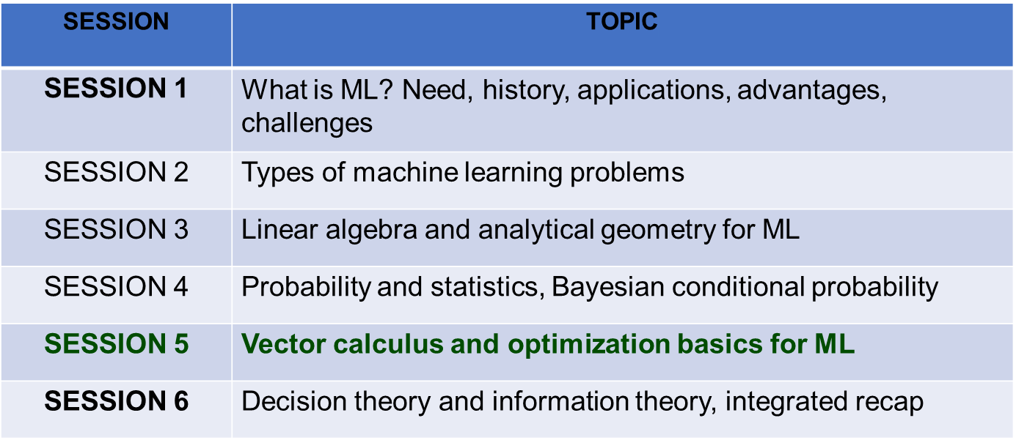
Session Outline

Slide 2
Session Overview
Vector Calculus: Gradient, Divergence, Curl
Partial Derivatives & Chain Rule
Computational Graphs & Backpropagation
Gradient Descent Variants (GD, SGD, Momentum)
Adaptive Learning Rates (Adam, RMSprop)
Practical Optimization in Neural Networks
Notes:
‹#›

Slide 3
Vector Spaces & Scalar Fields
Vector: Quantity with magnitude and direction (e.g., velocity, force)
• ML: Feature vectors (x ∈ ℝⁿ), weight vectors (w ∈ ℝⁿ), gradients
Scalar: Single number without direction (e.g., temperature, loss)
• ML: Loss function L(w) outputs scalar; Models map vectors to scalars
Scalar Field: Assigns scalar to each point in space f(x,y,z)
• ML: Loss landscape: each point (weights) has loss value
Vector Field: Assigns vector to each point F(x,y,z) = (Fx, Fy, Fz)
• ML: Gradient field: each point has direction of steepest ascent
Notes:
‹#›

Slide 4
Partial Derivatives & Gradients
Partial Derivative: Rate of change of f with respect to one variable
∂f/∂x = lim[h→0] (f(x+h, y) - f(x, y)) / h
(fix other variables, differentiate with respect to x)
• ML: How does loss change when weight wᵢ changes (holding other weights fixed)?
Gradient ∇f: Vector of all partial derivatives
∇f = (∂f/∂x₁, ∂f/∂x₂, ..., ∂f/∂xₙ) (point in direction of steepest increase)
• ML: Gradient vector shows direction to increase loss fastest (minimize: go opposite)
Notes:
‹#›

Slide 5
Backpropagation: Chain Rule in Action
Goal: Compute ∂L/∂w for all weights w in network efficiently
Process: Forward pass, then backward pass applying chain rule
Forward Pass: Compute activations a[l], z[l] layer by layer; Final loss L
Backward Pass: Starting from ∂L/∂z[L], compute ∂L/∂z[l] for each layer
Chain Rule: ∂L/∂z[l] = (∂L/∂a[l]) × (∂a[l]/∂z[l]) (activation derivative)
Weight Gradients: ∂L/∂w[l] = (∂L/∂z[l]) × (∂z[l]/∂w[l]) (input activation)
Efficiency: O(n) complexity (one forward, one backward pass)
• vs Numerical gradients: O(n×m) where m=number of parameters
Notes:
‹#›

Slide 6
Gradient Descent Algorithm
Intuition: Move in direction opposite to gradient (downhill) to minimize loss
w ← w - α × ∇L(w)
where α = learning rate (step size)
∇L(w) = gradient of loss w.r.t. weights
Repeat: Compute gradient → Update weights → Check convergence
Learning Rate α: Too small → slow convergence; Too large → divergence
Convergence: Stop when ||∇L(w)|| ≈ 0 (gradient is zero)
Limitation: Can get stuck in local minima (non-convex loss)
Notes:
‹#›

Slide 7
Stochastic Gradient Descent (SGD)
Batch GD: Use entire dataset to compute gradient (slow, stable)
• Pros: Stable direction toward minimum
• Cons: Expensive for large datasets; Slow convergence
SGD: Use single sample or small batch (noisy, fast)
w ← w - α × ∇L(w; xᵢ, yᵢ) (gradient for one sample)
Pros: Fast updates; Can escape shallow local minima (noise helps)
Cons: Noisy updates; May not converge to exact minimum
Mini-batch: Compromise (32-256 samples); Balance speed & stability
Notes:
‹#›

Slide 8
Learning Rate Scheduling
Fixed Learning Rate: α constant throughout training
• Problem: May overshoot minimum later; Too small early causes slow start
Strategies:
Step Decay: Reduce α by factor every N epochs (α ← α × 0.1)
Exponential Decay: α = α₀ × exp(-k×epoch) (smooth reduction)
Warm Restarts: Periodically increase α; Escapes local minima
Cosine Annealing: Smooth decrease from α₀ to αmin (CIFAR-10 SOTA)
Impact: Learning rate often as important as optimizer choice
Notes:
‹#›

