Slide 1

Search for a product
Login/Register
Enter UPI
OR
Connect

Slide 2
You are not registered yet.
Please fill out the following:
Username
Role
Register

Slide 3
Search for a product
Choose a product
001987671
Enter UPI
001987654
Add Product

Slide 4
Add a new product
Product Name
Status
Add Product

Slide 5
Product details
Tracking
Sold In Retail Shipped Shipped Produced In Production
12.01.2024 (47.3769 N, 8.5417 E) 09.01.2024 (47.3769 N, 8.5417 E) 03.01.2024 (51.9496 N, 4.1453 E) 20.12.2024 (10.3932 N, 75.4832 W) 17.12.2024 (4.3674 N, 75.5703 W) 12.12.2024 (4.3674 N, 75.5703 W)
Name
Status
UPI
Cocoa Beans
Sold
001987671
Update Status

Slide 6
Product details
Tracking
Sold In Retail Shipped Shipped Produced In Production
12.01.2024 (Switzerland) 09.01.2024 (Switzerland) 03.01.2024 (Netherlands) 20.12.2024 (Colombia) 17.12.2024 (Colombia) 12.12.2024 (Colombia)
Name
Status
UPI
Cocoa Beans
Sold
001987671
Update Status

Slide 7
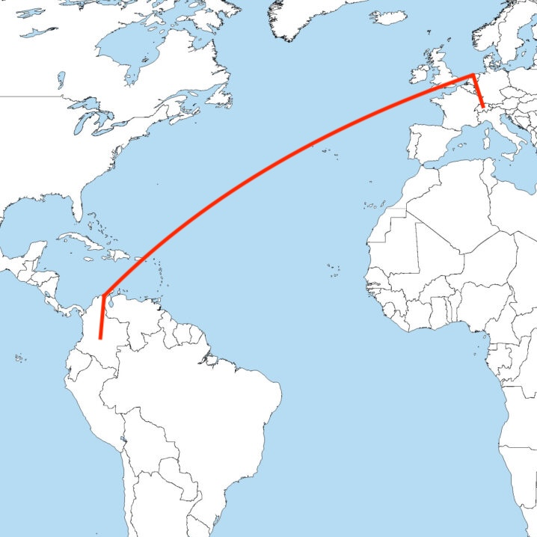
Product details
Tracking
Name
Status
UPI
Cocoa Beans
Sold
001987671
Update Status

Slide 8
Update Product Status
Name
Status
UPI
Cocoa Beans
Shipping
001987671
New Status
Update Status

