Slide 1
Agriculture Information System
IIUC_SQL_INJECTORS

Slide 2
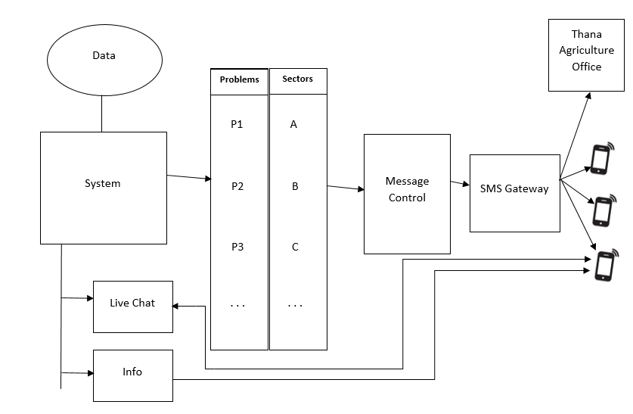
Visualization Diagram:

Slide 3
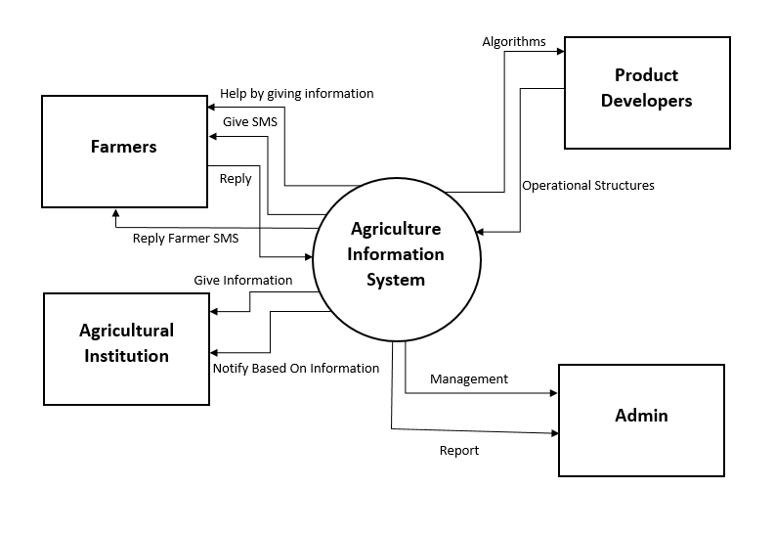
System Diagram:

Slide 4
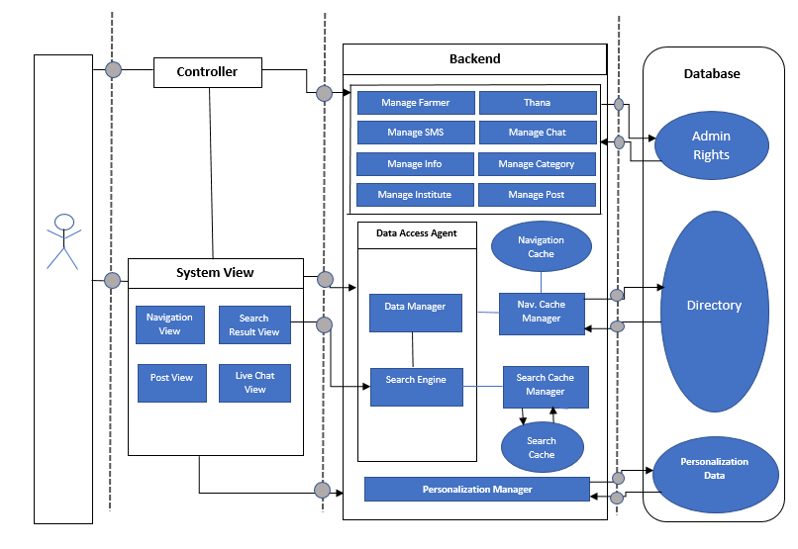
Architecture Diagram:

