Slide 1
TOML
https://toml.io

Slide 2
Why?
pyproject.toml → PEP 517 A build-system independent format for source trees
Poetry etc. → https://python-poetry.org/docs/pyproject/
PEP-665 A file format to list Python dependencies for reproducibility of an application

Slide 3
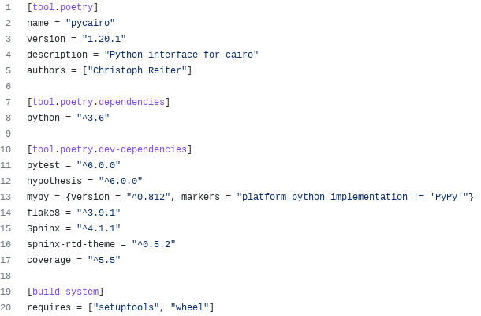
Example pyproject.toml
Similar structure to .ini,
but more features and
has a spec
Only this is PEP 517

Slide 4
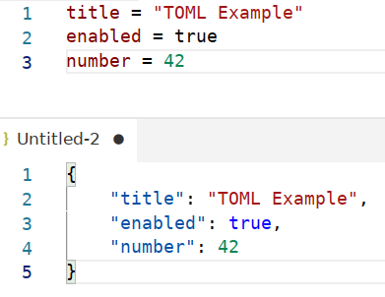
Basics

Slide 5
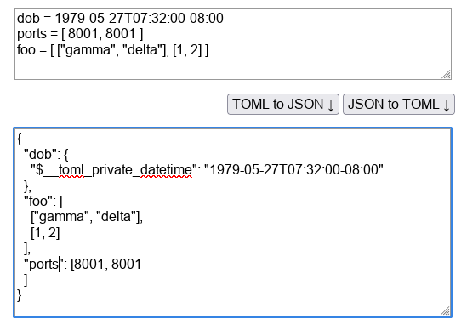
More Stuff
List items need to be the
same type
In Python
this is a
datetime
object

Slide 6
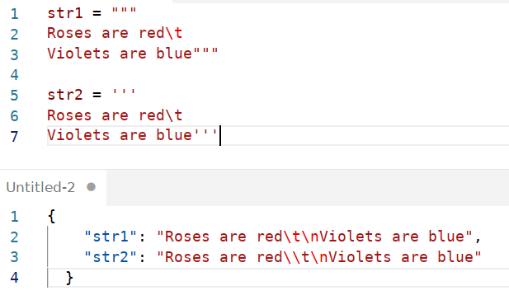
Multi Line Strings
Literal string

Slide 7
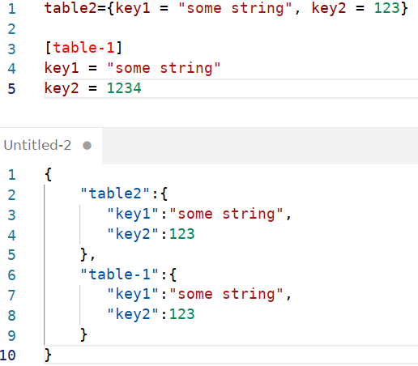
Tables or Dicts

Slide 8
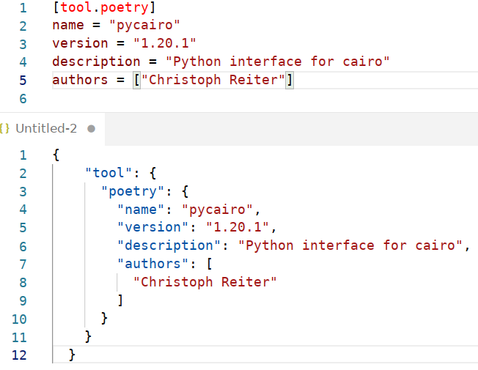
Tables or Dicts

Slide 9
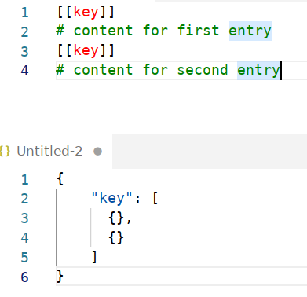
Array of Tables – 1/3

Slide 10
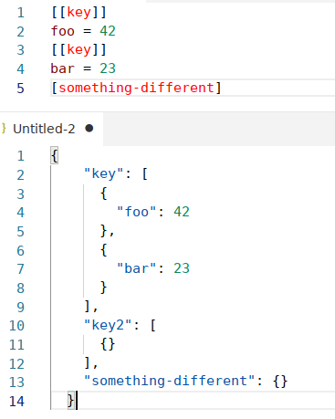
Array of Tables – 2/3

Slide 11
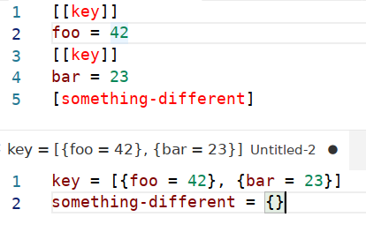
Alternative Syntax 3/3

Slide 12
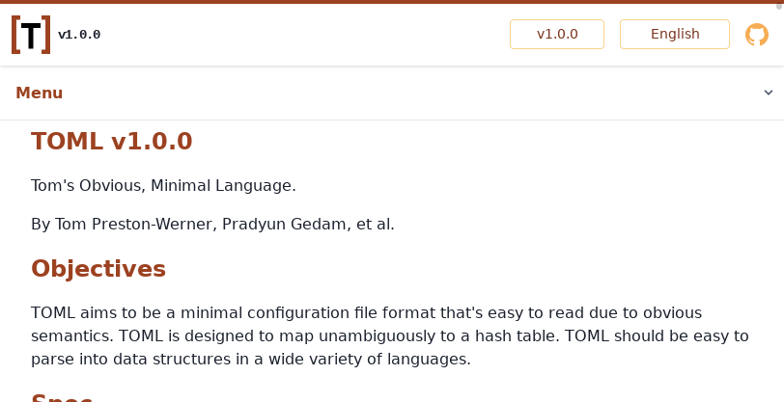
Spec for Details
https://toml.io/en/v1.0.0

Slide 13
poetry uses tomlkit
“It includes a parser that preserves all comments, indentations, whitespace and internal element ordering, and makes them accessible and editable via an intuitive API.”
https://github.com/sdispater/tomlkit

Slide 14
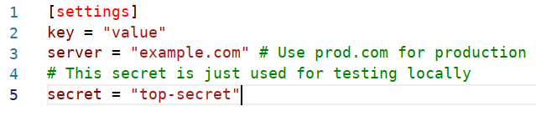
Input TOML file

Slide 15
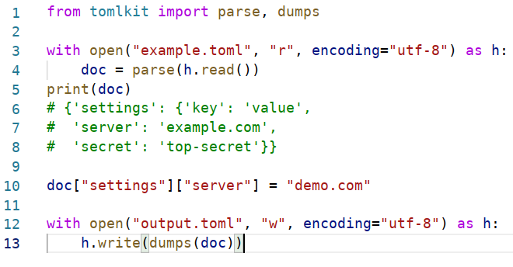
Now we change a value

Slide 16
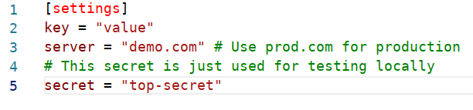
Result

Slide 17
Use cases?
Have a config file that mixes state and config?
Migrate user config on version upgrades?
Have commands that extend the user config?

Slide 18
END

