Slide 1
Deploying a Python web app with docker/docker-compose and traefik+letsencrypt on a cloud VPS (*)
(*) not really production ready.. probably..

Slide 2
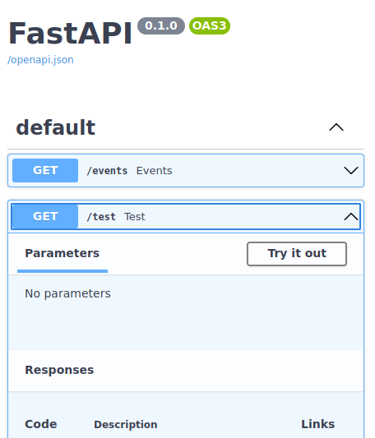
Meet the “app”
https://pygraz.duckdns.org

Slide 3
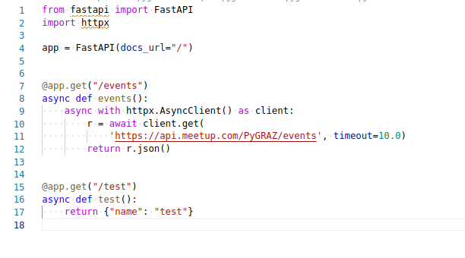
Meet the “app”

Slide 4
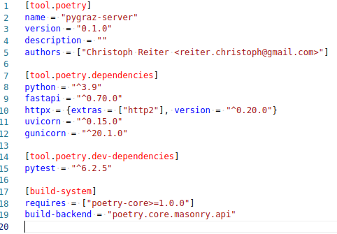
Meet the “app”
poetry init
poetry add fastapi httpx[http2] uvicorn gunicorn

Slide 5
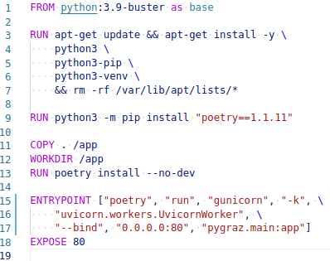
Dockerize
docker build .
docker run -p 8080:80 ec33ba2b264e
http://localhost:8080

Slide 6

Dockerize
Use a good base image:
  Updated frequently
  Supported
  From someone you trust
Python WSGI HTTP Server.
Master process which manages workers
Eventloop (uvloop)

Slide 7
Docker setup pitfalls
docker by default doesn't log rotate (disk will get full). You need to select a different logging backend.
  echo '{"log-driver": "local"}' > /etc/docker/daemon.json
docker uses iptables, potentially overriding your rules: https://docs.docker.com/network/iptables/ (services that are exposed in docker-composer will be public)

Slide 8
Now we have
Python app
Running in Docker
Done?
What handles the docker containers? Updating, restarting, dependencies, other containers like MariaDB etc..

Slide 9
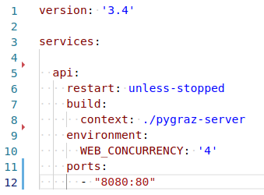
docker-compose
docker-compose.yml
“docker-compose up”
You can create a service from a
Dockerfile, like here, or an image
tag name, or a git repo with a Dockerfile
in it for example.
4 worker processes
Port 80 in the container gets mapped to 8080 on the host

Slide 10
Other commands
docker-compose (ps|rm|build|logs|exec|run|start|stop|restart|….) <service>
Similar to docker itself, but you can reference everything by service name and not by container ID etc..

Slide 11
Now we have
Python app
Running in Docker + managed via docker-compose
Done?
Letsencrypt + TLS, domain, put on server

Slide 12
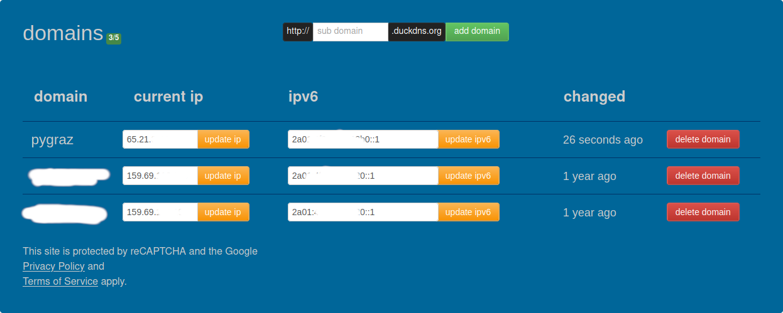
Need a Domain
https://www.duckdns.org/
Like most DynDNS services blocked by facebook etc, so has its limits

Slide 13
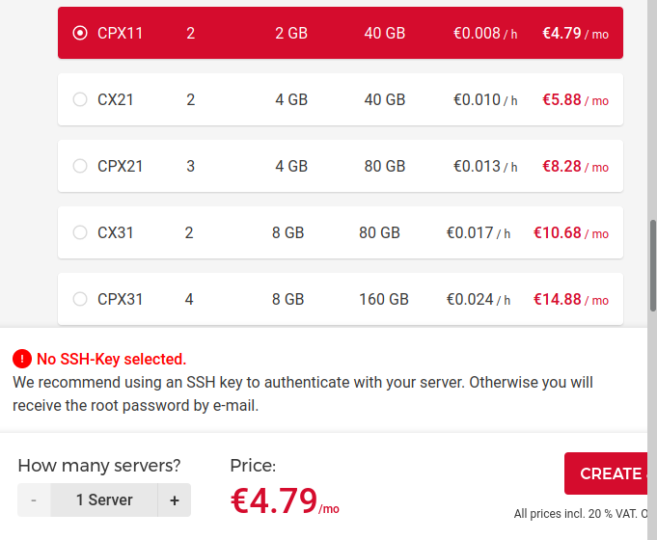
Need a VPS
Billed hourly, so nice for testing here.

Slide 14
Traefik (reverse proxy)
https://traefik.io/
Has nice docker-compose integration
App 1
DB1
traefik
middlewares
App 2
Middlewares: path transformation, buffering, auth,
compression, rate limiting, redirects etc..
Lets encrypt
Handles HTTP, but also TCP/UDP

Slide 15
Traefik + docker-compose
traefik
App
Labels:
- foo
- bar
- ...
Docker socket
Docker daemon
DB
→ SHOW
docker-compose.yml
Other service

Slide 16
FORWARDED_ALLOW_IPS
gunicorn: forwarded-allow-ips
gunicorn: secure-scheme-headers
Default: {'X-FORWARDED-PROTOCOL': 'ssl', 'X-FORWARDED-PROTO': 'https', 'X-FORWARDED-SSL': 'on'}
Traefik manages them and is the only way we get a requests, so we can allow all IPs

Slide 17
Security
docker+docker-compose+traefik: added complexity… more opportunities to make mistakes.
On the other side, less fear of updating, since updating one image doesn't affect other parts of the system. Different Python/PostgreSQL etc versions. And you can easily roll back.

Slide 18
Security
Are your docker images up to date? Are the base images up to date? (in addition to your lock files)
What is publicly accessible?
  traefik is the only service, if it gets hacked then what?
  has access to the docker daemon (means it can create/change docker images) you can use a docker proxy to work around that → tecnativa/docker-socket-proxy

Slide 19
  tecnativa/docker-socket-proxy
traefik
App
Labels:
- foo
- bar
- ...
Proxy socket.
Only container info
and only read-only
proxy
CONTAINER API, GET only
→ SHOW
docker-compose.yml
Docker socket
Docker daemon
(*) but now you also have to trust
tecnativa/docker-socket-proxy…

Slide 20
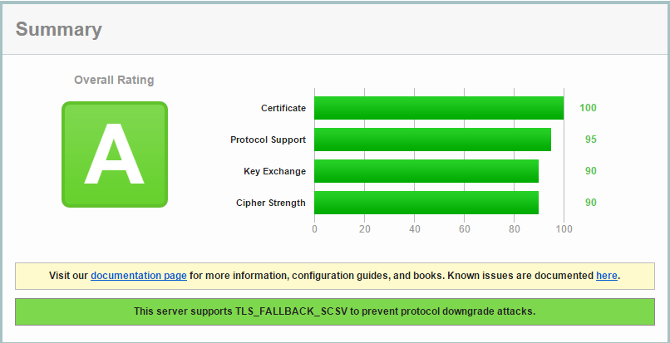
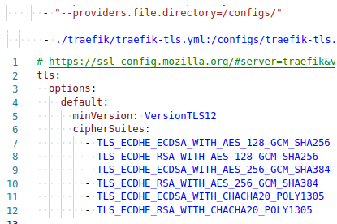
TLS config
Defaults in traefik allow too much
https://ssl-config.mozilla.org/
Needs extra config file sadly, not via docker-compose → mount config file into container, tell traefik to look for it. Also use ECDSA cert for better compat (golang is missing cipher suites for RSA...)
ssllabs.com/ssltest

Slide 21
“Deploy”
ssh into server
apt update && apt install git docker-compose
git clone <repo> && cd <repoName>
docker-compose up --detach
…..
profit

Slide 22
Updating things
“docker-compose pull” → pull new base images
Since our app is build and not provided as an image we have to “docker-compose build api” also
“docker-compose up” → rebuild+recreate+restart if something has changed

Slide 23
End
Questions?

