Slide 1
Strategic Analysis Peer Review Forum
Tesla
Executive Briefing
Unit 7: Comprehensive Strategic Management Analysis
Laznier Mederos Santos
University of Maryland Global Campus
MGMT 670 Strategic Management Capstone
Dr. R. Dool
March 11, 2026

Slide 2
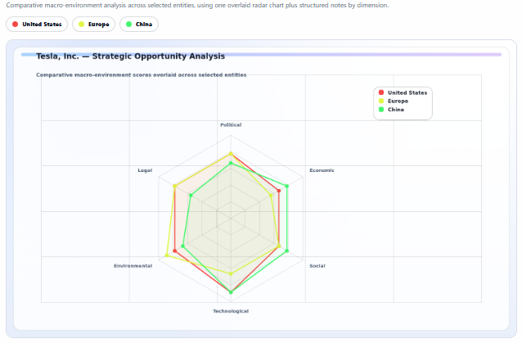
SITUATION ANALYSIS
1
External Environment Signals Growth Potential — and Execution Risk
Key insight from the environmental scan
EV adoption continues to grow globally, supported by decarbonization goals and policy incentives.
However, trade barriers, tax-credit eligibility rules, and affordability pressures make demand and margin realization uneven by region.
For Tesla, the strategic issue is not whether demand exists, but whether it can convert scale into durable, regulation-ready profit.
Takeaway: Favorable EV tailwinds remain real, but policy and cost conditions raise the bar for execution.
CPA-generated PESTEL overlay used to summarize cross-market macro pressure.
Notes:
Narration: For this slide, I’m using the PESTEL chart to show how Tesla’s external environment differs across the United States, Europe, and China. The numbers on this chart are not pulled from one single table. I built them as evidence-based comparative scores on a 1-to-10 scale using the sources from my Unit 4 analysis. For example, the political, legal, and environmental dimensions were informed by the IEA’s Global EV Outlook, IRS clean vehicle credit guidance, and the European Commission’s actions on Chinese EV imports. I also used Tesla’s 2024 10-K to ground the technology side of the analysis.
So this chart is meant to show relative pressure and opportunity by region. Europe scores higher on environmental and legal influence because regulation and emissions policy matter a lot there. China scores higher on economic and technological pressure because competition, battery scale, and cost discipline are strongest in that market. The U.S. scores high on political and legal influence because subsidy eligibility, sourcing rules, and regulatory oversight can directly affect demand and profitability. My main takeaway is that Tesla still operates in a favorable long-term market, but success depends on managing very different regional policy, cost, and compliance conditions.
Slide references: European Commission. (2024, December 12). EU Commission imposes countervailing duties on imports of battery electric vehicles (BEVs) from China. Internal Revenue Service. (2025, November 13). Credits for new clean vehicles purchased in 2023 or after. International Energy Agency. (2024). Global EV outlook 2024. Tesla, Inc. (2025). Form 10-K for the fiscal year ended December 31, 2024. U.S. Securities and Exchange Commission.

Slide 3
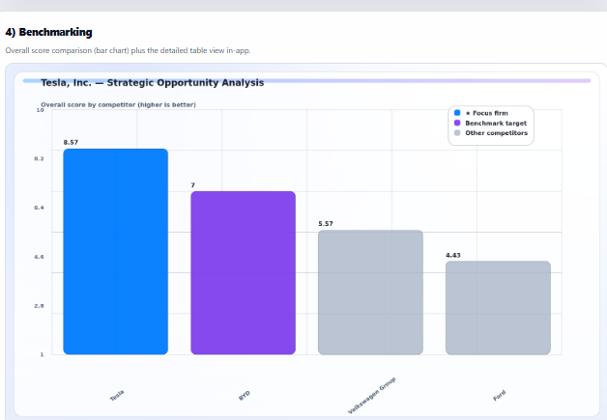
COMPETITIVE POSITION
2
Tesla Still Leads Overall — but Benchmark Gaps Are Narrowing
What the benchmark view suggests
Tesla remains the strongest overall peer in this scorecard relative to BYD, Volkswagen Group, and Ford.
Its most durable advantages sit in software integration, charging ecosystem reach, and brand-enabled EV scale.
The visible risk is that rivals are converging fastest where cost discipline and refresh cadence matter most in a price-sensitive market.
Takeaway: Tesla still leads, but leadership is increasingly contingent on defending cost and product momentum.
CPA benchmarking view: weighted score across scale, cost, profitability, software, charging, and market presence.
Notes:
Narration: This slide shows my benchmarking chart, which compares Tesla with BYD, Volkswagen Group, and Ford. This is a weighted strategic scorecard, not just a financial chart. I built it using seven factors: EV scale, cost efficiency, operating profitability, battery integration, software and ADAS capability, charging ecosystem strength, and market presence.
The scores came from a mix of reported company data and comparative strategic judgment. For example, EV scale was based on 2024 delivery and sales figures. Profitability came from company filings and reported results. Categories like software capability, charging ecosystem, and battery integration required informed judgment based on the firms’ actual business models and positioning. Then I weighted those categories to produce the overall comparison.
Tesla comes out on top because it performs strongly across several dimensions at once, especially software, charging, and pure-play EV scale. BYD is very close because of its scale and cost efficiency. Volkswagen and Ford remain major competitors, but their EV economics and ecosystem advantages are weaker in this model. The reason this chart matters is that it shows Tesla still leads overall, but the gap is getting tighter, especially where rivals are converging on cost and volume.
Slide references: Ford Motor Company. (2025). Form 10-K for the fiscal year ended December 31, 2024. International Energy Agency. (2024). Global EV outlook 2024. Tesla, Inc. (2025, January 2). Tesla fourth quarter 2024 production, deliveries & deployments. Tesla, Inc. (2025). Form 10-K for the fiscal year ended December 31, 2024. U.S. Securities and Exchange Commission. Volkswagen Group. (2025). Volkswagen Group annual results FY 2024 — key figures.

Slide 4
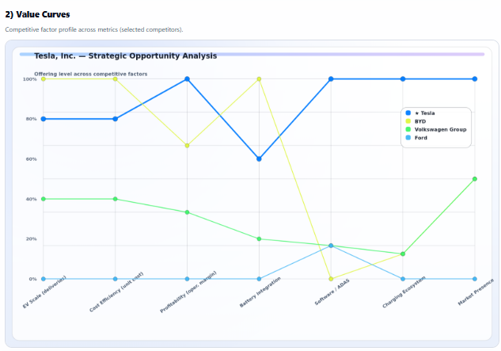
STRATEGIC RECOMMENDATION
3
How the Value Curve Identified Tesla's Strategic Opportunity
Why it mattered
1. It isolated Tesla's defensible strengths.
The curve shows Tesla leading most clearly in software / ADAS and charging ecosystem depth. Those factors are harder to copy than simple price cuts.
2. It exposed convergence risk.
BYD remains strong on scale, cost efficiency, and battery integration, which signals that Tesla cannot rely on volume alone to defend advantage.
3. It pointed to the opportunity.
The best strategic path is differentiation with scale: keep reducing cost, but expand monetization in software, charging access, and energy storage.
CPA SWOT synthesis highlighting the strategic opportunity and implementation risks.
Notes:
Narration: For this slide, I’m using the value curve to show where Tesla’s competitive advantage is strongest and where rivals are beginning to close the gap. Like the other charts, this visual was built in the CPA tool using a mix of company-reported data and structured strategic judgment. Metrics like EV scale and profitability were anchored to reported results, while areas like software capability, charging ecosystem strength, and battery integration were scored comparatively based on each firm’s positioning and business model.
What this chart helps reveal is not just who leads overall, but where Tesla’s strategic opportunity exists. Tesla appears strongest in software and ADAS, charging ecosystem strength, and overall market presence. At the same time, the value curve also shows where pressure is building, especially around cost efficiency, profitability under price competition, and the risk of convergence as rivals improve scale and execution.
That matters because it helps identify the strategic opportunity more clearly. Tesla should not try to compete only on price. Instead, this value curve supports a differentiation-with-scale strategy: continue lowering structural cost and improving localization, while also expanding the areas where Tesla still has harder-to-copy advantages, especially software, charging access, and ecosystem-based revenue streams. In that sense, this slide serves as the bridge between the competitive benchmarking and the SWOT-based recommendation that follows.
Slide references: Ford Motor Company. (2025). Form 10-K for the fiscal year ended December 31, 2024. International Energy Agency. (2024). Global EV outlook 2024. Tesla, Inc. (2025). Form 10-K for the fiscal year ended December 31, 2024. U.S. Securities and Exchange Commission. Volkswagen Group. (2025). Volkswagen Group annual results FY 2024 — key figures.

Slide 5
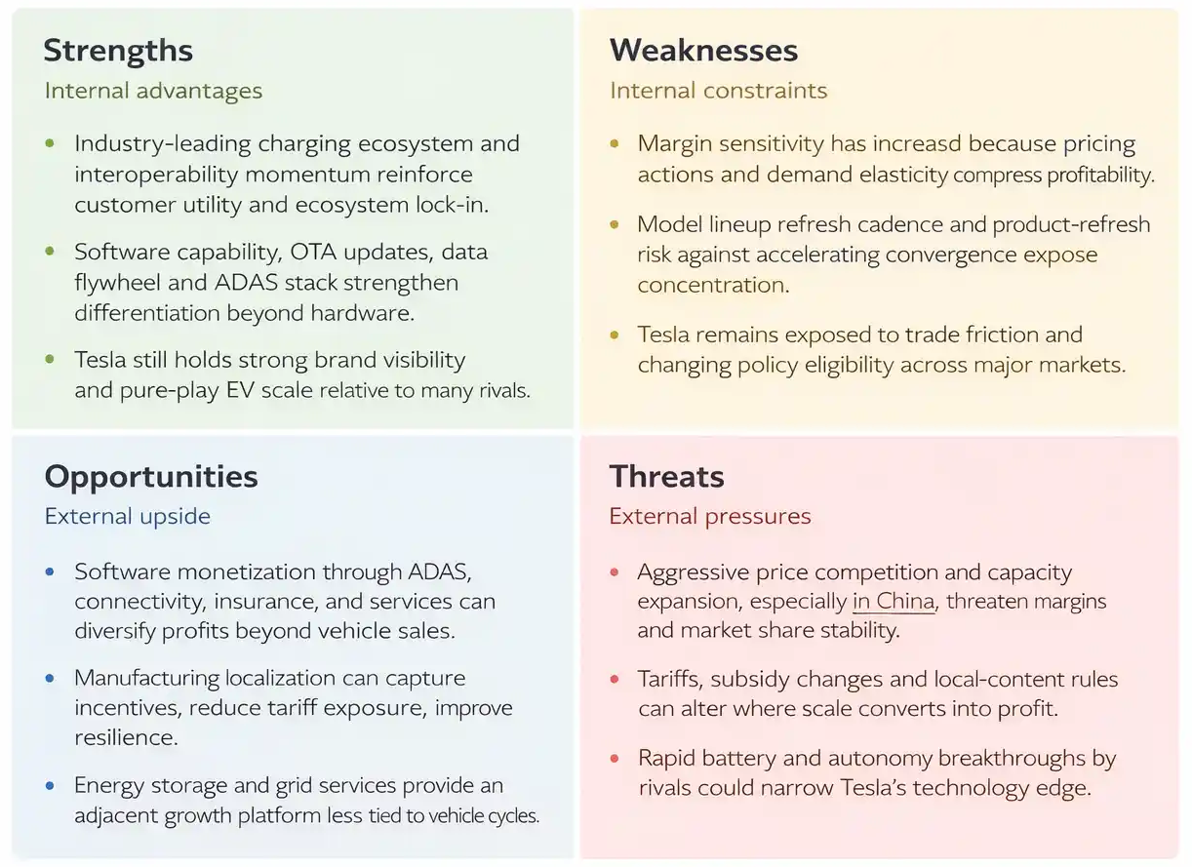
STRATEGIC RECOMMENDATION
3
Recommended Strategy: Differentiate With Scale
Recommendation and implementation challenge
Tesla should continue structural cost reduction and supply-chain localization while expanding recurring revenue from software, charging access, and energy storage.
This strategy fits the SWOT picture: strong ecosystem and software advantages, but rising exposure to rivalry, regulation, and margin pressure.
The biggest implementation challenge is scaling lower-cost growth without weakening quality, compliance discipline, or brand trust.
CPA SWOT synthesis highlighting the strategic opportunity and implementation risks.
Takeaway: The path forward is not just bigger scale — it is resilient, differentiated scale.
Notes:
Slide 4 – SWOT / Strategic Recommendation
Narration: For this slide, I’m using the SWOT synthesis to connect the earlier analysis to my recommendation. Like the other visuals, this SWOT was not copied from a published source. I built it by synthesizing the evidence from Tesla’s 2024 10-K, the IEA EV outlook, IRS policy guidance, European Commission trade developments, and the competitor analysis from the previous slides.
The strengths reflect where Tesla is still strongest, especially software capability, charging ecosystem strength, and brand visibility. The weaknesses reflect issues like margin sensitivity, product concentration, and exposure to trade and policy shifts. The opportunities come from areas such as software monetization, charging access, and energy storage growth. The threats come from price competition, especially in China, policy changes, and regulatory scrutiny around ADAS and safety.
This SWOT supports my recommendation that Tesla should pursue a differentiation-with-scale strategy. In other words, Tesla should keep driving down cost and localizing supply chains, but at the same time continue building the harder-to-copy parts of its advantage, especially software, charging, and energy-related revenue streams. The biggest implementation challenge is doing both at once without hurting quality, compliance, or brand trust.
Closing:
Thank you. Overall, my analysis shows that Tesla still holds meaningful strategic advantages, but sustaining them will require balancing cost discipline with continued investment in the differentiated capabilities that competitors will have the hardest time replicating.
Slide references: European Commission. (2024, December 12). EU Commission imposes countervailing duties on imports of battery electric vehicles (BEVs) from China. Internal Revenue Service. (2025, November 13). Credits for new clean vehicles purchased in 2023 or after. International Energy Agency. (2024). Global EV outlook 2024. Tesla, Inc. (2025). Form 10-K for the fiscal year ended December 31, 2024. U.S. Securities and Exchange Commission.

Slide 6
References
Barney, J. B. (1991). Firm resources and sustained competitive advantage. Journal of Management, 17(1), 99–120. https://doi.org/10.1177/014920639101700108
BYD Europe B.V. (2025). BYD reports its financial results in 2024: Revenue hits 777.1 billion yuan, up 29% year-on-year. https://bydukmedia.com/en/news-articles/byd-reports-its-financial-results-in-2024-revenue-hits-777.1-billion-yuan%2C-up-23-year-on-year.html
European Commission. (2024a, July 3). Commission imposes provisional countervailing duties on imports of battery electric vehicles from China while discussions with China continue. https://ec.europa.eu/commission/presscorner/detail/en/ip_24_3630
European Commission. (2024b, December 12). EU Commission imposes countervailing duties on imports of battery electric vehicles (BEVs) from China. https://trade.ec.europa.eu/access-to-markets/en/news/eu-commission-imposes-countervailing-duties-imports-battery-electric-vehicles-bevs-china
Ford Motor Company. (2025). Form 10-K for the fiscal year ended December 31, 2024. https://s205.q4cdn.com/882619693/files/doc_financials/2024/q4/Ford-Motor-Company-2024-10-K-Report.pdf
Hawkins, T. R., Singh, B., Majeau-Bettez, G., & Strømman, A. H. (2013). Comparative environmental life cycle assessment of conventional and electric vehicles. Journal of Industrial Ecology, 17(1), 53–64. https://doi.org/10.1111/j.1530-9290.2012.00532.x
Internal Revenue Service. (2025, November 13). Credits for new clean vehicles purchased in 2023 or after. https://www.irs.gov/credits-deductions/credits-for-new-clean-vehicles-purchased-in-2023-or-after
International Energy Agency. (2024). Global EV outlook 2024. https://iea.blob.core.windows.net/assets/a9e3544b-0b12-4e15-b407-65f5c8ce1b5f/GlobalEVOutlook2024.pdf
Nykvist, B., & Nilsson, M. (2015). Rapidly falling costs of battery packs for electric vehicles. Nature Climate Change, 5, 329–332. https://doi.org/10.1038/nclimate2564
Porter, M. E. (1980). Competitive strategy: Techniques for analyzing industries and competitors. Free Press.
ProjectManagerHelper. (2026). Competitive position analysis (CPA) tool. https://www.projectmanagerhelper.com/cpa/
Sierzchula, W., Bakker, S., Maat, K., & van Wee, B. (2014). The influence of financial incentives and other socio-economic factors on electric vehicle adoption. Energy Policy, 68, 183–194. https://doi.org/10.1016/j.enpol.2014.01.043
Tesla, Inc. (2023). Form 10-K for the fiscal year ended December 31, 2022. https://ir.tesla.com/_flysystem/s3/sec/000095017023001409/tsla-20221231-gen.pdf
Tesla, Inc. (2025a, January 2). Tesla fourth quarter 2024 production, deliveries & deployments. https://ir.tesla.com/press-release/tesla-fourth-quarter-2024-production-deliveries-and-deployments
Tesla, Inc. (2025b). Form 10-K for the fiscal year ended December 31, 2024. U.S. Securities and Exchange Commission. https://www.sec.gov/Archives/edgar/data/1318605/000162828025003063/tsla-20241231.htm
Teece, D. J., Pisano, G., & Shuen, A. (1997). Dynamic capabilities and strategic management. Strategic Management Journal, 18(7), 509–533. https://doi.org/10.1002/(SICI)1097-0266(199708)18:7<509::AID-SMJ882>3.0.CO;2-Z
Volkswagen Group. (2025). Volkswagen Group annual results FY 2024 — key figures. https://uploads.vw-mms.de/system/production/documents/cws/002/933/file_en/c185af7abefe2532043cd52d16cc4b02eaa874f4/2025-03-11_Volkswagen_Group_FY24_Website.pdf
Volkswagen Group. (2026, January 13). Volkswagen Group deliveries remain stable in 2025 (includes Jan–Dec 2024 BEV deliveries table). https://www.volkswagen-group.com/en/press-releases/volkswagen-group-deliveries-remain-stable-in-2025-20095

