Slide 1
storage
S3 LifeCycle Automation
Michael Reiber Storage SA
Presenter
Notes:
Hello my name is Abigail Reiber and I am a pre AWS Solutions Architect Storage Specialist and I want to share a solution that can help customers with a global presence manage and automate compliance with retention requirements across their S3 buckets.

Slide 2
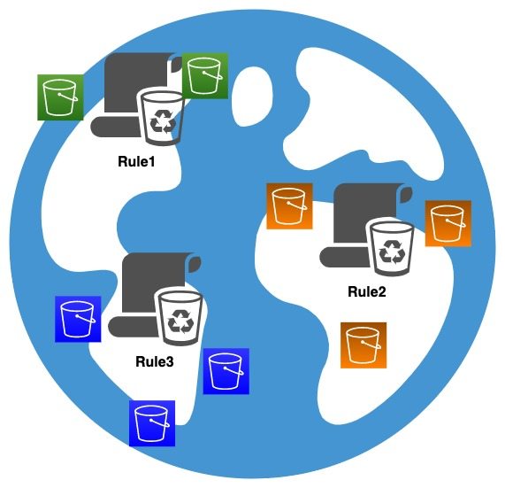
Compliance Rules by Geography:
Notes:
I have a customer who has infrastructure both in and out of the cloud deployed across the globe. Across their multiple geographical regions, they have different compliance requirements specifically around the retention of data. They came to us looking for help in managing these compliance requirements as they were applied to S3 buckets in the form of a S3 life cycle policy. These were data sets that would live in different AWS region and different AWS accounts and within multiple S3 buckets in those regions. They not only needed help in enforcing compliance, but also a solution that could be managed by a central organization. And a solution that would help them report on that compliance for auditing purposes. We developed the solution we are going to demo to you today in response to their request.

Slide 3
GeoArea: | USA
Description | "Governance mode for USA"
Version | 1
LastUpdate | "07/03/2022, 15:00:00"
awsRegions
 | "us-east-1"
 | "us-east-2"
 | "us-west-1"
 | "us-west-2"
Rules
 | "Type1"
Rule | Type1
minRetention | 299
Description | "Type1 Governance Rule"
Version | 1
LastUpdate | "07/03/2022, 15:00:00"
Notes:
The first part of the solution is a compliance framework. This framework allows the customer to define geographical regions which have unique compliance requireemtns, assign AWS regions to those geographical regions, set which compliance requirements applies to those regions, and finally set the specifics for those compliance requirements. Specifically, the retention time.
This is an example of that framework.
Here we have a geographical regions that encompasses the US. We have defined four AWS regions - us-east-1, us-east-2, us-west-1, and us-west-2. We have defined one compliance requirement rule called "Type1" that applies to the US.
Then in a different part of the framework we have defined retention time for the "Type1" rule seen here as 299 days.
This framework is then used by the automation of our solution when applying a S3 Life Cycle Policy.
The automation will enforce compliance with this framework and produce a record to show what Life Cycle Policy have been created.

Slide 4
Use Case:
Applying S3 Life Cycle Policies (LCP) on existing S3 Data Sets
Applying S3 LCP for new S3 Data Sets
Applying S3 LCP for data sets migrating to S3 (pre-Aged data)
Notes:
We see this tool being used across 3 different use cases.
The first is for data sets that already exist in S3 but dont have an S3 Life Cycle Policy (or dont have a correct life cycle policy set). This tool could be run manually to set these policies or as part of some larger automation tool that is evaluating S3 data. If you are interested in this use case, let me know because we have other automation that might be useful here as well.
The second use case is for new data sets potentially going into new S3 buckets. This automation could be deployed as part of a deployment script.
The third use case, which is also the use case for our original customer, were data sets that were already part of an archive system that was not in the cloud. Think data on tapes. They wanted to move this data to S3 and apply the appropriate retention polices, but they wanted those retention polices to reflect the current age of the data.
For example if the retention requirement was 7 years, but the data had been sitting on tape for 2 years, they wanted the S3 life cycle policy to accommodate the pre-aging of the data.
The automation we are going to show you can accommodate all three use cases.
I will now run the demo.

