Slide 1

Loan Approval Prediction
Members: Bhushan Gunjal, Jaydutt Desai, Uzair Shahid Kazi, Dikshant Phulpagar, Sanju Vikasini V

Slide 2
Problem Statement
Loan approval is a critical task for financial institutions. With the growing number of loan applications, it becomes essential to automate the loan approval process to ensure efficiency and accuracy.
This project aims to build machine learning models to predict whether a loan application will be approved or not based on various applicant information and loan details.

Slide 3
Approach
1. DATA ACQUISTION 2. DATA PREPROCESSING 3. EXPLORATORY DATA ANALYSIS 4. DATA MODELLING 5. MODEL HYPER PARAMETER TUNING

Slide 4
DATA PREPROCESSING
1. Label Encoding:
Encoded categorical columns i.e. Education, self_employed, Loan status in the loan dataset using LabelEncoder.
2. Scaling:
Scaled the loan dataset numerical columns to values between 0 and 1 using MinMaxScaler.
3. Resampling:
Randomly down sapling the majortiy data to match the minority class in the dataset.

Slide 5
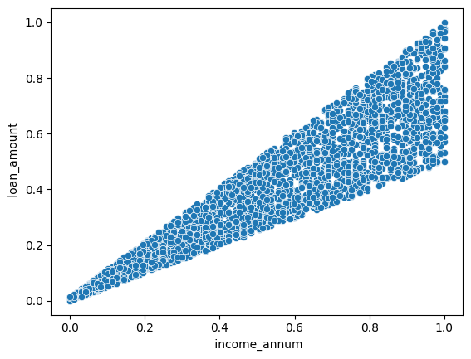
EDA
Visualize the relationship between annual income and loan amount using a scatter plot to identify trends and correlations.

Slide 6
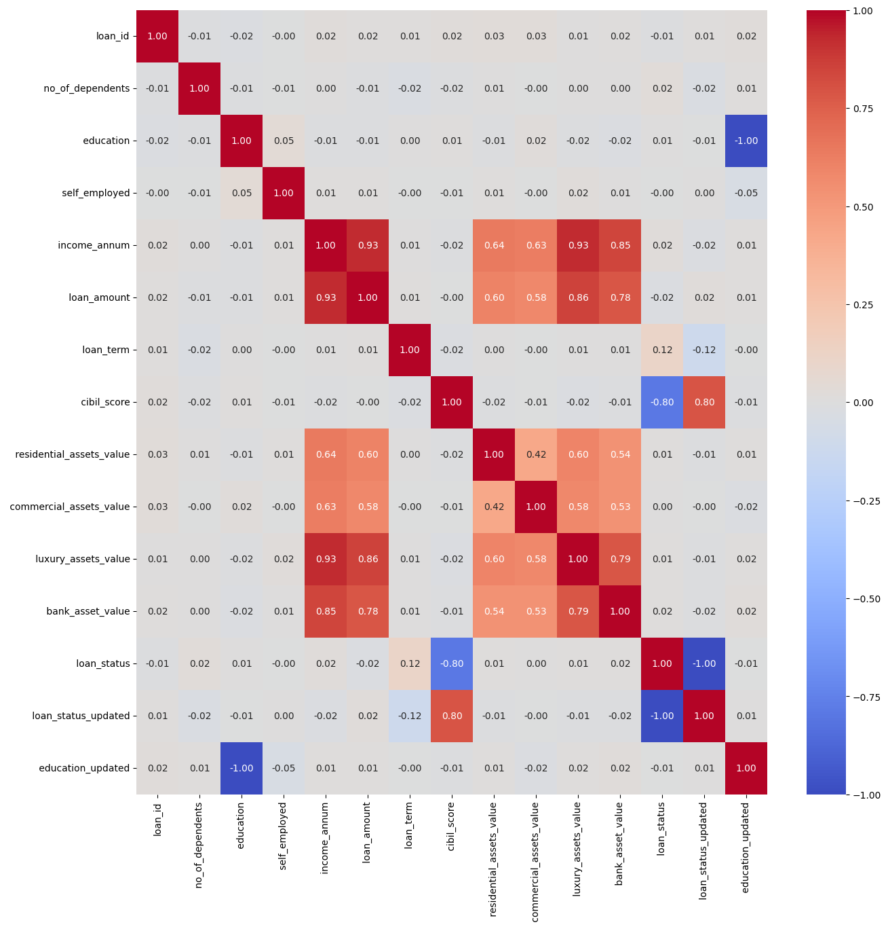
EDA
Correlation matrix heatmap to visualize the relationships between different features in the loan dataset.

Slide 7
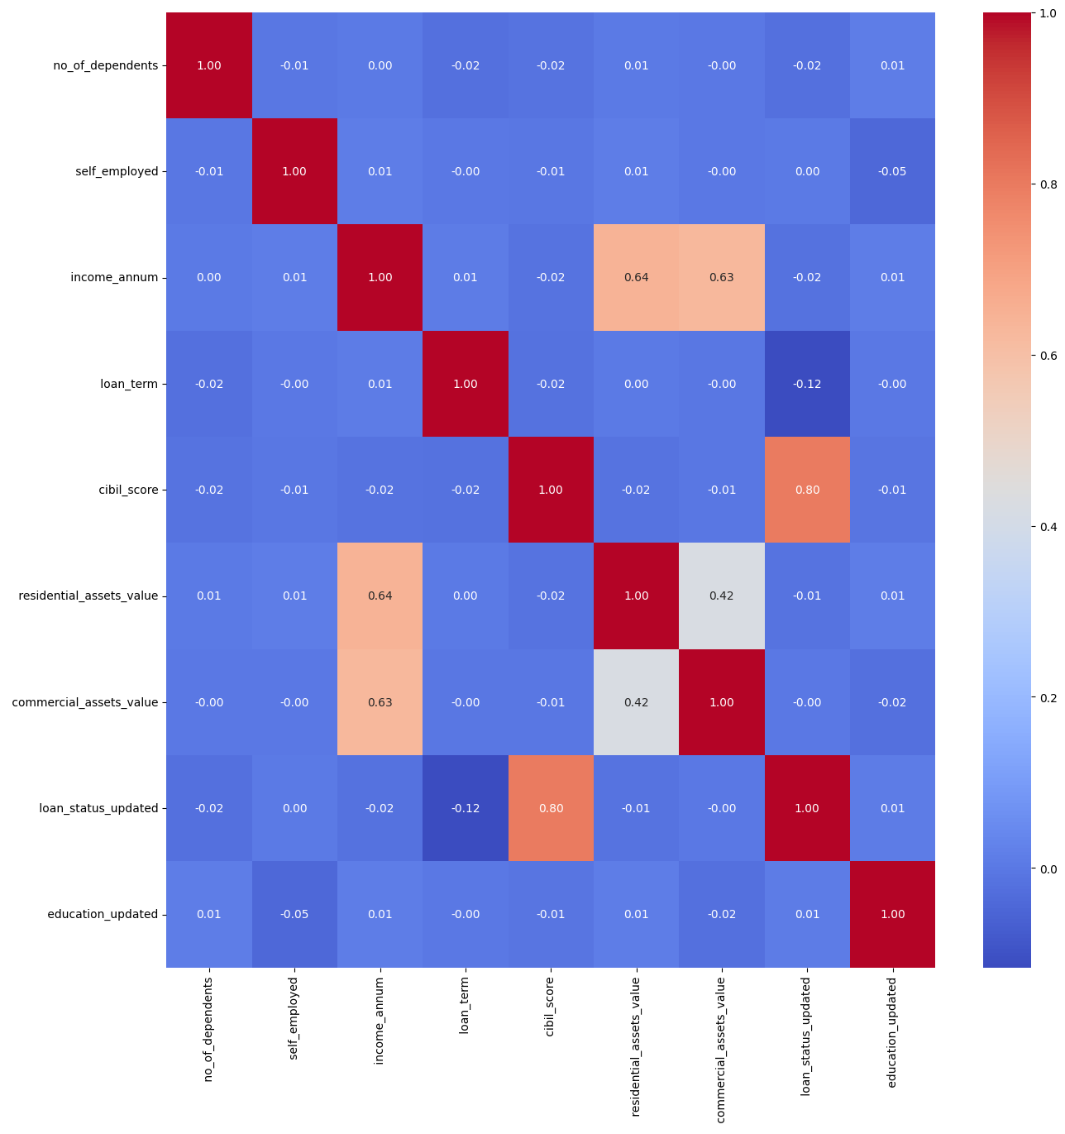
EDA
Dropping highly correlated features to prevent multicollinearity and reducing redundanc.
luxury_assets_value
bank_asset_value
Along with that, loan_id and categorical columns having textual data are dropped.

Slide 8
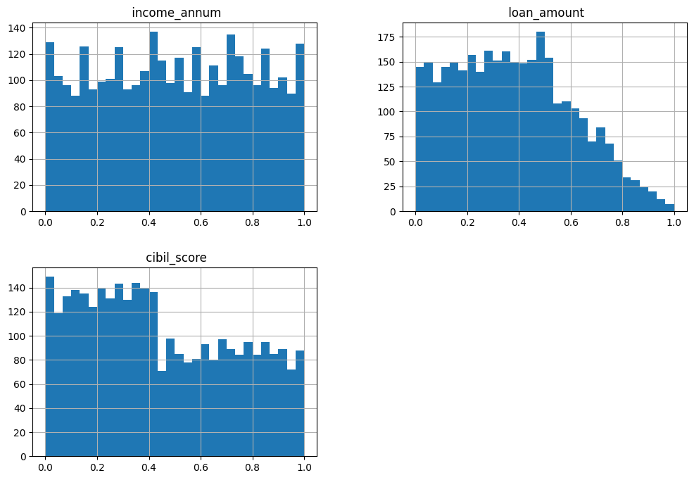
EDA

Slide 9
DATA MODELLING
1. Data Splitting:
The dataset was split into 8:2 ratio. This split ensures that the majority 80% of the data is used for training the models, while the 20% unseen subset is reserved for testing and evaluating the models' performance.
2. Model Used:
Naive Bayes (GaussianNB) Logistic Regression
Decision Tree Random Forest
K-Nearest Neighbors Support Vector Machine
Gradient Boosting
3. Evaluation:
Each model was evaluated using several metrics to ensure comprehensive performance assessment. These metrics include accuracy, confusion matrix, and classification report.

Slide 10
HYPER-PARAMETER TUNING
We performed hyperparameter tuning for various classification models using ‘GridSearchCV’.
For each model, ‘GridSearchCV’ was used to find the best hyperparameters through cross-validation.
We defined hyperparameter grids for models like Logistic Regression, Decision Tree, Random Forest, K-Nearest Neighbors, Support Vector Machine, and Gradient Boosting.
The tuned models were then evaluated on the test set, and the best parameters along with performance metrics such as accuracy, confusion matrix, and classification report were printed.

Slide 11
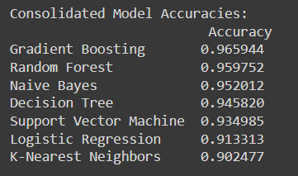
RESULTS:
The results show that Gradient Boosting achieved the highest accuracy at 96.59%, followed closely by Random Forest with 95.98%. Naive Bayes and Decision Tree also performed well, with accuracies of 95.20% and 94.58% respectively. Support Vector Machine, Logistic Regression, and K-Nearest Neighbors had lower accuracies, with K-Nearest Neighbors being the lowest at 90.25%.

Slide 12
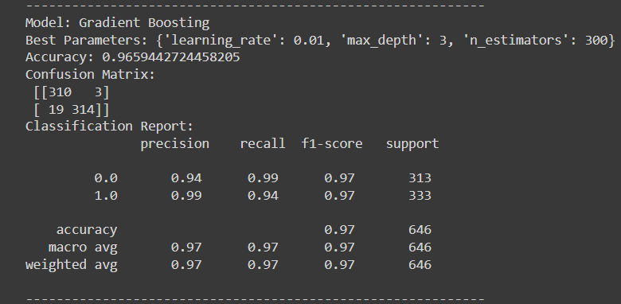
BEST MODEL

Slide 13
Thank You!

