Slide 1
Smog Forecast Pakistan
Team XYZ | Air Quality: next-day PM2.5 forecast and smog advisory

Slide 2
Problem Statement
THE PROBLEM
1
Who is affected?
Every winter, smog in Pakistan’s cities reaches many times the safe limit (Lahore: 539 µg/m³ in Nov 2024; Pakistan’s 24-hour limit is 35). Schools, hospitals and traffic plans must be decided the evening before, but officials only see today’s reading.
District environment officers, schools and hospitals in 4 cities
2
Why does it matter?
Children, the elderly and asthma patients are hit hardest
3
Our goal
Tomorrow’s PM2.5 and a clear advisory by 8 PM, in Urdu too

Slide 3
Dataset Declaration
Dataset name | OpenAQ PM2.5 sensors + NASA FIRMS fires + Open-Meteo weather + Copernicus CAMS
Source / link | Public APIs: openaq.org, firms.modaps.eosdis.nasa.gov, open-meteo.com
Size | ~905K hourly PM2.5 rows (202 sensors), ~285K fire detections, ~49K weather hours
Time period | June 2025 to now (Oct 2026), updated every hour
Format & license | JSON/CSV into DuckDB; CC BY 4.0 and NASA open data
Key features / target | Target: tomorrow’s mean PM2.5 per city. Inputs: PM2.5 history, weather forecast, fires, CAMS, season
905K
Hourly PM2.5 readings
202
Sensors in 4 cities
2,500+
Raw files, SHA-256 fingerprinted

Slide 4
Pipeline Used
1
2
3
4
5
Data Collection
Data Cleaning
Analysis / EDA
Modeling
Dashboard / App
OpenAQ, NASA FIRMS, Open-Meteo APIs; hourly
Quality Agent: flag, fill 1–2 h gaps, 2 gates
Profiling, 8 PM features, drift, EPA check
Gradient boosting + calibrated 80% range
HF dashboard, Urdu, cited Insight Agent
Hourly sensor, fire and weather data in → tomorrow’s PM2.5, chance of an unhealthy day and an advisory at 8 PM

Slide 5
Pipeline Details & Tools
Stage | Tools / Libraries | What we did
Collection | Python, requests, SHA-256 manifest | Hourly API downloads; every raw file fingerprinted so data can’t change unnoticed
Preprocessing | DuckDB, pandas, pandera | Raw → cleaned → gold in UTC; flag stuck/spike/zero readings, fill only 1–2 h gaps, log every decision
Analysis / EDA | pandas, DuckDB SQL | Profiling set the quality thresholds; PSI drift monitor; Punjab EPA spot check
Modeling | scikit-learn (gradient boosting) | Only inputs known at 8 PM; rolling-origin validation; calibrated 80% range; 17.7% better than baseline
Dashboard / App | Prefect, Hugging Face, Plotly, Groq/Gemini, Render | Runs every hour (24/24); live dashboard in English and Urdu; agent with checked citations

Slide 6
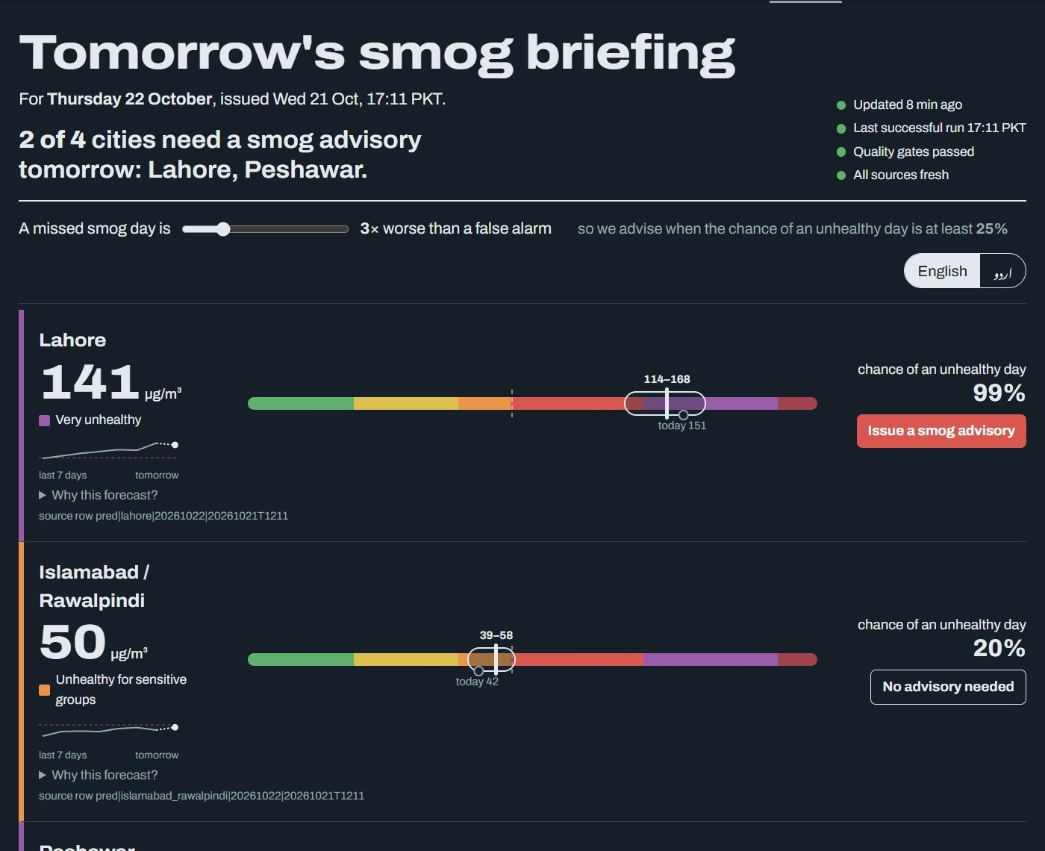
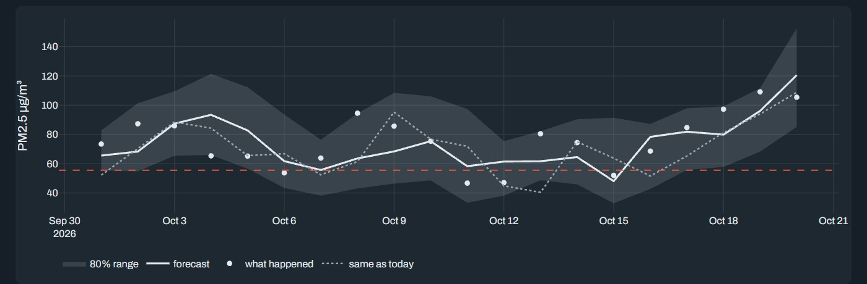
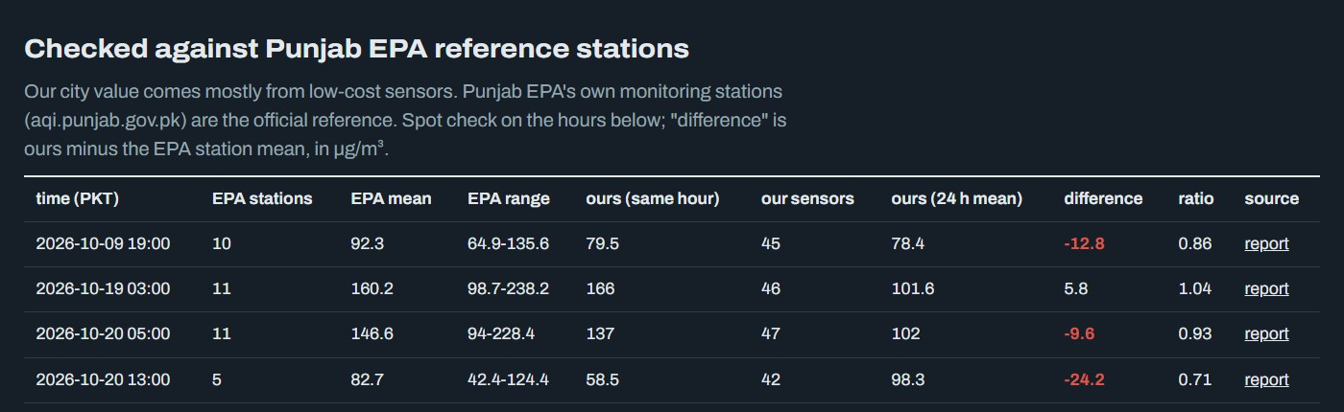
Dashboard / App Views
Page 2 – Were we right? Back-test
Page 1 – Tomorrow’s smog briefing (live)
Page 3 – Punjab EPA check
Live demo: huggingface.co/spaces/lazypanda21/smog-forecast-pakistan

Slide 7
Conclusion
17.7% lower error than “tomorrow = today”
IMPACT
1
Locked Oct 2026 test (80 city-days): MAE 8.94 vs 10.86 µg/m³. Lahore 8.7%, Karachi worse: reported openly
Officers act the evening before; schools, hospitals and the public get warnings, in Urdu too
2
Missed smog days: 11 → 1
Our advisory rule caught 39 of 40 unhealthy test days (simple rule: 29), with 17 false alarms vs 7
FUTURE WORK
Calibrate sensors with Punjab EPA, more cities, SMS alerts, cloud hosting, a district pilot
3
Honest uncertainty and cited answers
80% range held the real value 91% of the time; the Insight Agent passed 22/22 test questions

Slide 8
Team & Credits
TEAM XYZ
LK
SM
NF
AI
Laksh Kumar
Syed Mustehsan Akhtar Kazmi
Noor Fatima
Amna Iqbal
Lead dev | DT-23035
Problem & impact
Model and results
Agent and responsible AI
Contact: github.com/lazy-laksh/hackinsight-smog-forecast
Thank you!

