Slide 1
ENGSTROM WOOD PRODUCTS · CASE STUDY & PROPOSAL
Custom Quote App
for Trade Businesses
Stop estimating in spreadsheets. Start closing in minutes.
Built for craftspeople, by a developer who works with them.

Slide 2
THE PROBLEM
Custom quoting is eating your week.
01
02
03
Hours per quote
Pricing drift
Slow follow-up
Spreadsheets, scratch pads, and "let me get back to you tomorrow." Every quote is a custom build from scratch.
Different jobs, different numbers. A small mistake in a spreadsheet costs real margin you'll never see.
By the time the proposal goes out, the customer's already talking to someone else. Speed wins jobs.
Quote App for Trade Businesses
2 / 11

Slide 3
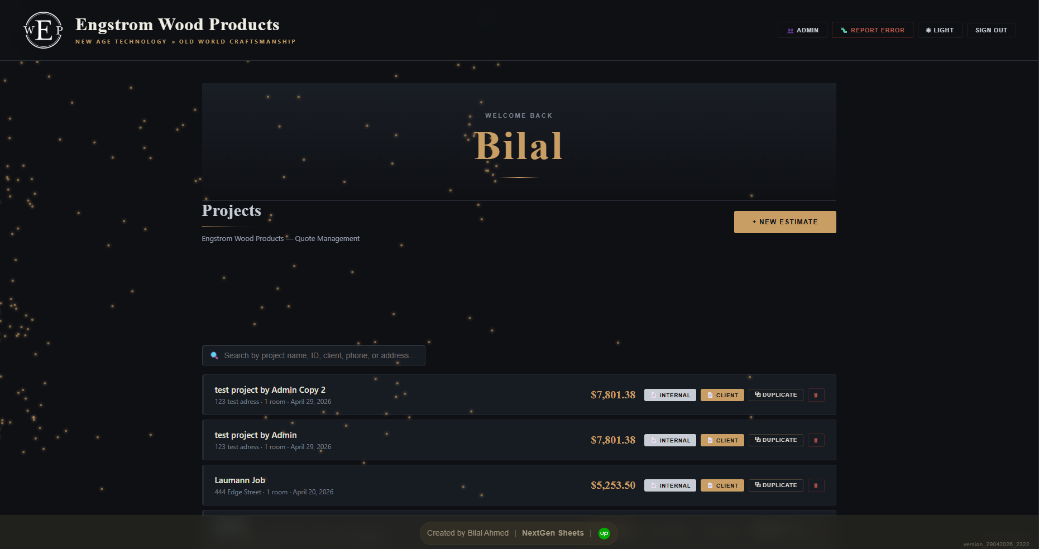
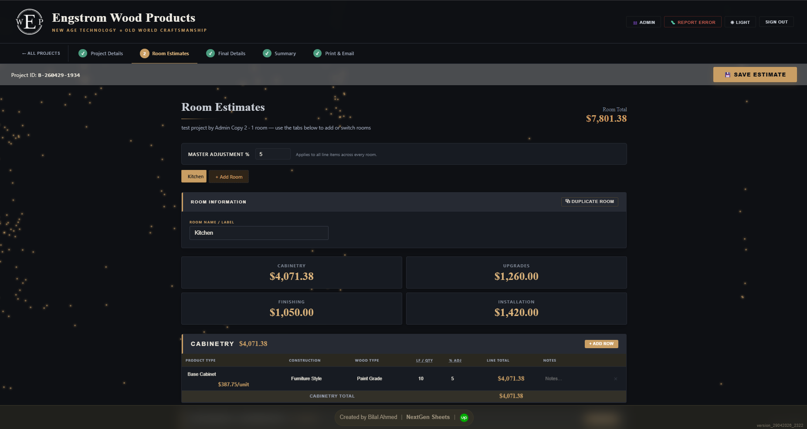
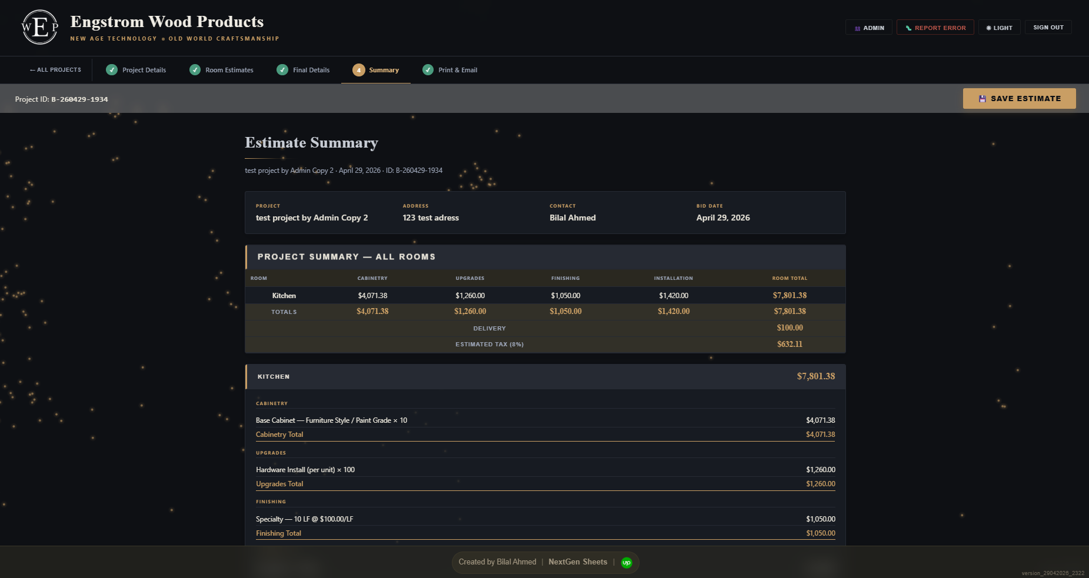
THE SOLUTION
A custom-branded estimating app
that turns your pricing rules into instant, professional quotes.
Dashboard
Room Estimator
Quote PDF
All projects, statuses, and client info — at a glance.
Drop in items, watch the total update live.
Your branding. Your logo. Sent in one click.
Quote App for Trade Businesses
3 / 11

Slide 4
KEY FEATURES — PART 1 OF 2
Built around how you actually quote.
01
Multi-step workflow
02
Itemized line by line
Project → Rooms → Final Details → Summary → Send. Each step validates the last so nothing slips through.
Cabinetry, upgrades, finishing, install — every component priced from your tables, never guessed.
03
Live totals
04
Master adjustment %
Change a quantity, swap a finish, toggle tax — the grand total recalculates instantly.
Dial a discount or markup across every line at once. Great for repeat customers or rush jobs.
Quote App for Trade Businesses
4 / 11

Slide 5
KEY FEATURES — PART 2 OF 2
From estimate to inbox.
05
Branded PDF quotes
06
Email from the app
Auto-generated, two-page templates with your logo and your colors. Customer-facing and internal versions, side by side.
Send the quote to a client without leaving the screen. Replies come back to your inbox.
07
Admin panel
08
Cloud-synced
Manage pricing tables, contractors, users, and bug reports. No developer needed for day-to-day changes.
Quote from the office, the truck, or the job site. Same data, any device, real-time.
Quote App for Trade Businesses
5 / 11

Slide 6
BUILT FOR YOUR WORKFLOW
Your quoting logic, not someone else's template.
INDUSTRY
HOW IT ADAPTS
Cabinet Makers
Rooms → cabinets, finishes, installation
Countertop Fabricators
Areas → slabs, edges, sinks, install
Landscapers
Zones → materials, equipment, labor
Painters
Rooms → surfaces, prep, paint type, coats
Custom Metal / Fab
Pieces → material, fabrication, finishing
If you can describe how you quote, I can build it.
Quote App for Trade Businesses
6 / 11

Slide 7
LIVE IN PRODUCTION
Engstrom Wood Products
engstromwoodproducts.com · Rogers, MN
Hours → minutes
Zero pricing drift
Quotes that took an afternoon now go out before the customer leaves the lot.
Every line item from a single source of truth, every time.
One-click duplicate
Quote from anywhere
Clone last year's quote, tweak two lines, send.
Phone, tablet, laptop. Same data, real-time, no install.
Used daily, by the people who quote.
Quote App for Trade Businesses
7 / 11

Slide 8
WHAT YOU GET
A finished tool. Yours.
Custom-built app
Cloud database
Designed around your branding, your logo, your colors, and your pricing logic.
Your project data, only yours — never shared, never resold, with daily backups.
Admin panel
PDF templates
Self-service for pricing tables, contractors, and team access. No developer round-trips.
Two layouts ready to send: a clean customer-facing quote and a detailed internal sheet.
Email integration
30 days free tweaks
Quotes go out from your domain, replies come back to your inbox.
Real shops surface real edge cases. The first month after launch, I keep refining at no charge.
Quote App for Trade Businesses
8 / 11

Slide 9
THE PROCESS
Four steps. About six weeks, end to end.
1
Discovery call
30 minutes. Show me how you quote today — even the messy parts. I'll ask the awkward questions now so we don't hit them later.
2
Working prototype
Two weeks to a real, clickable app with your pricing logic loaded in. Not mockups — actual software you can break.
3
Test and refine
You quote a few real jobs through it. I fix friction. We iterate until it fits your shop, not the other way around.
4
Launch
We go live. Your team gets a short walkthrough. You stop opening the spreadsheet for new quotes.
Quote App for Trade Businesses
9 / 11

Slide 10
INVESTMENT
Priced for a small shop. Built like an enterprise tool.
ONE-TIME BUILD
OPTIONAL ONGOING
A flat fee per project
Monthly hosting + tweaks
Scope based on how many product types and pricing rules you have
Cloud hosting, daily backups, security patches
Typical small-shop range fits within an annual tooling or marketing budget
A pool of monthly hours for new fields, reports, or tweaks
Fixed price after the discovery call — no hourly surprises
Cancel anytime — your data stays yours
"Quote me back. I'll send a real number after our call."
Quote App for Trade Businesses
10 / 11

Slide 11
LET'S TALK
If your quoting process
is slowing you down,
it doesn't have to.
Reply to my email or contact on WhatsApp.
[ Bilal Ahmed] · [11bilalahmed@gmail.com] · [ +92-321-2665520]
11 / 11

