Slide 1



Slide 2

Crop Identification And Disease Detection Using AI
Problem Statement :–
Open Innovation:
Develop a desktop application that can identify crops and their diseases using just a photo or video of crops. Also develop a recommendation system for the same. The feed may be taken from drone or mobile phone as a video or as images. Suitable hardware may be used for the same.
Team Name- Kernel-Krakerz
Team Leader- Binod Thapa

Slide 3
Solutions we propose:
We Don’t Look At It…We Look In It.
We have made an application that identifies the crop based on the various parameters ranging from HSI color model, shape of the leaves and the texture of leaves.
The accuracy of this deep learning model is upto 99% and is achieved by using neural networks with around 3-4 hidden layers.
The TensorFlow library being quite fast recognizes with around a speed of 200 ms /picture and thus is a perfect tool for fast, low latency detection.
The disease is detected and a corresponding recommendations are displayed on the screen.

Slide 4
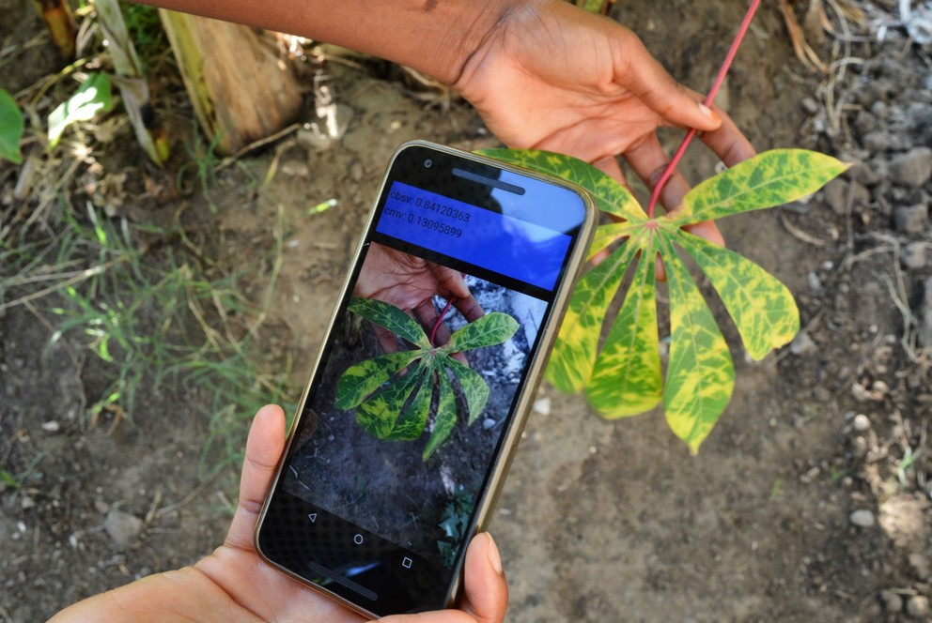
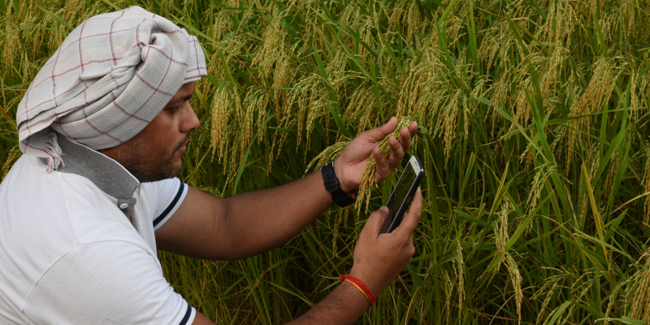
Mode 1: Crop Identification
Crop is identified as follows:
Name
Scientific Name
Temperature, humidity, texture of soil and water requirements.

Slide 5
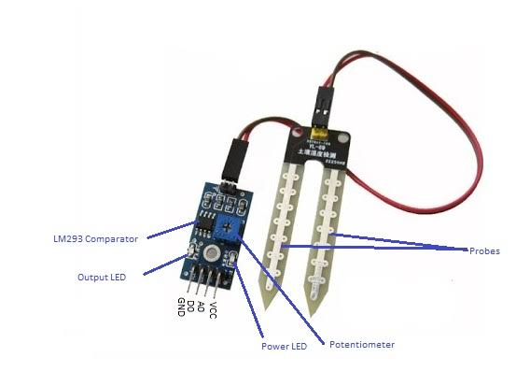
Hygroscopic sensor
Description:
The hygroscopic sensor basically detects
the moisture content of the soil by the change in
resistance that takes place.
The resistance is
measured by a circuit which then displays the
result as a reading of humidity.

Slide 6


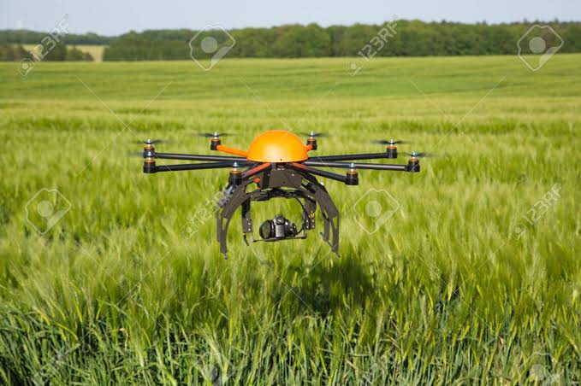
Mode 2: Disease Identification
Any of the two methods of input may be used to detect the disease, either the feed from camera or video.
The drone sends the live feed to the server where data is stored.
The application then compares the feed with the model and detects the disease.

Slide 7
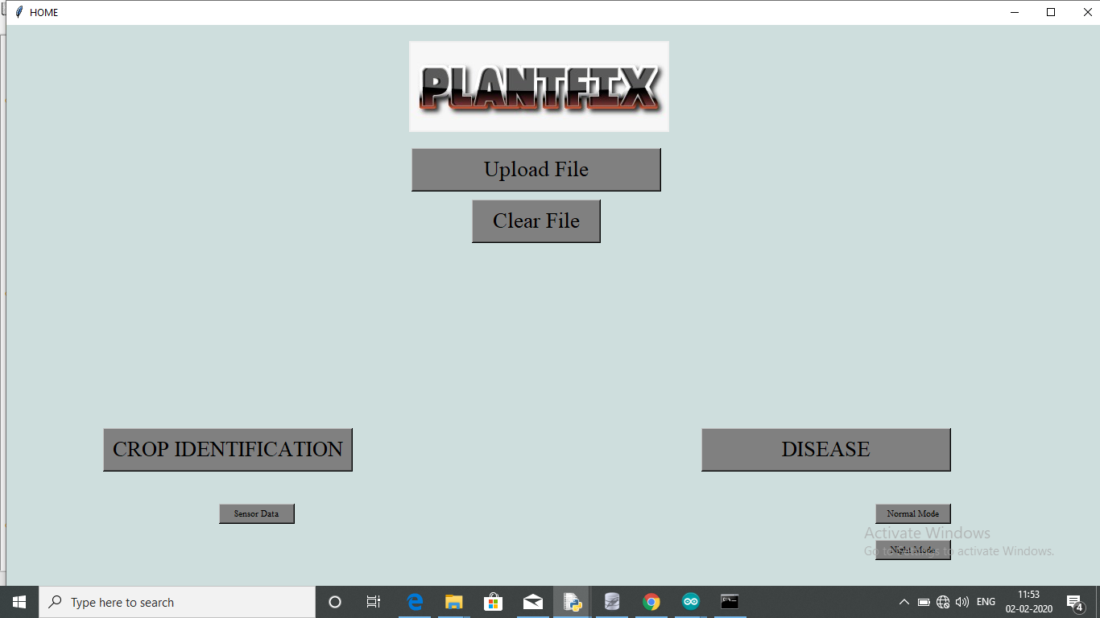

Slide 8

So this is how we do it….

Slide 9
A short demo

Slide 10
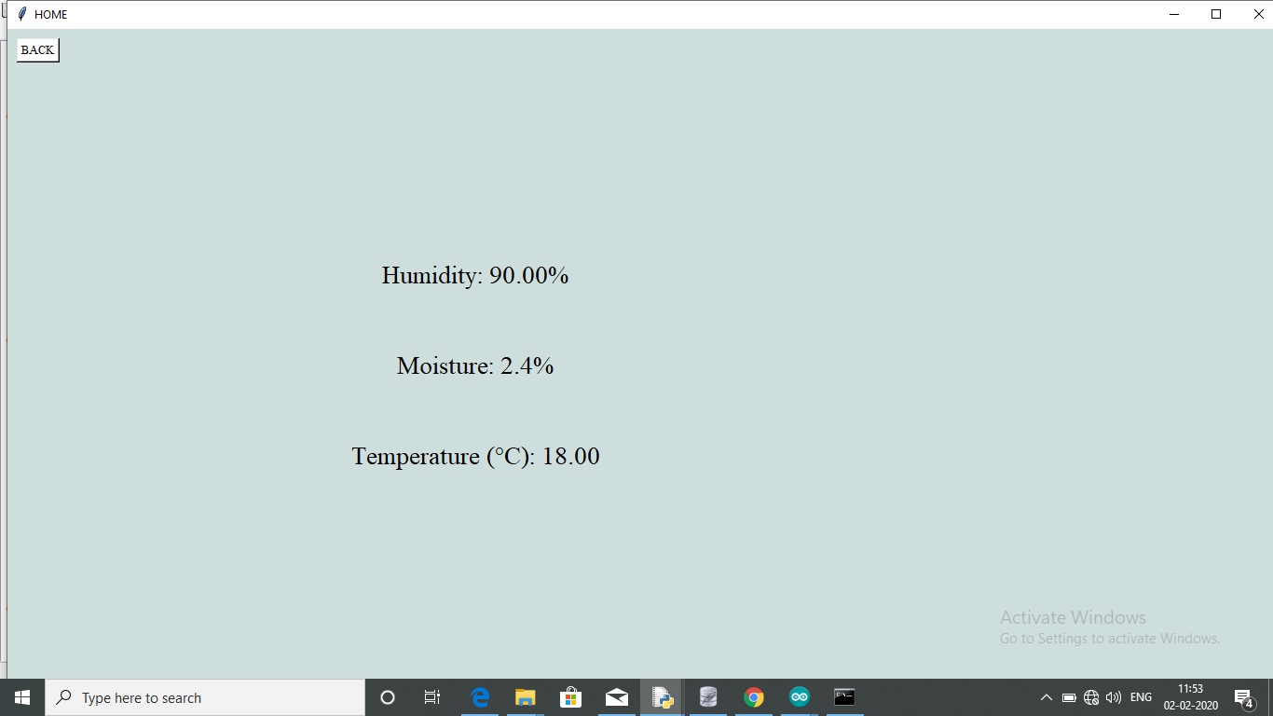
Soil moisture detection

Slide 11
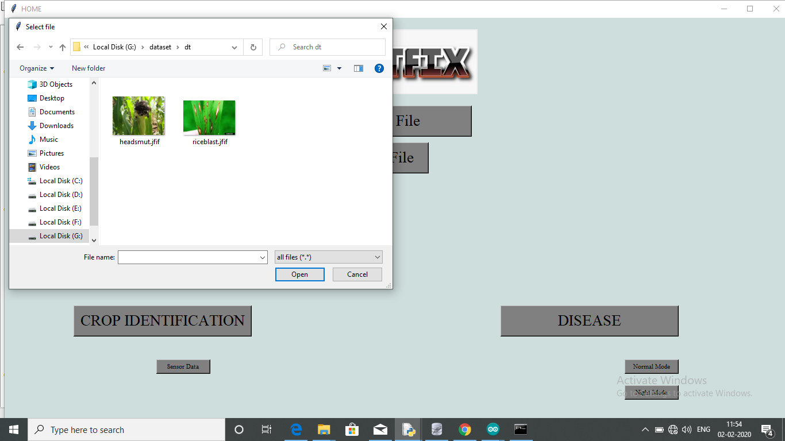

Slide 12
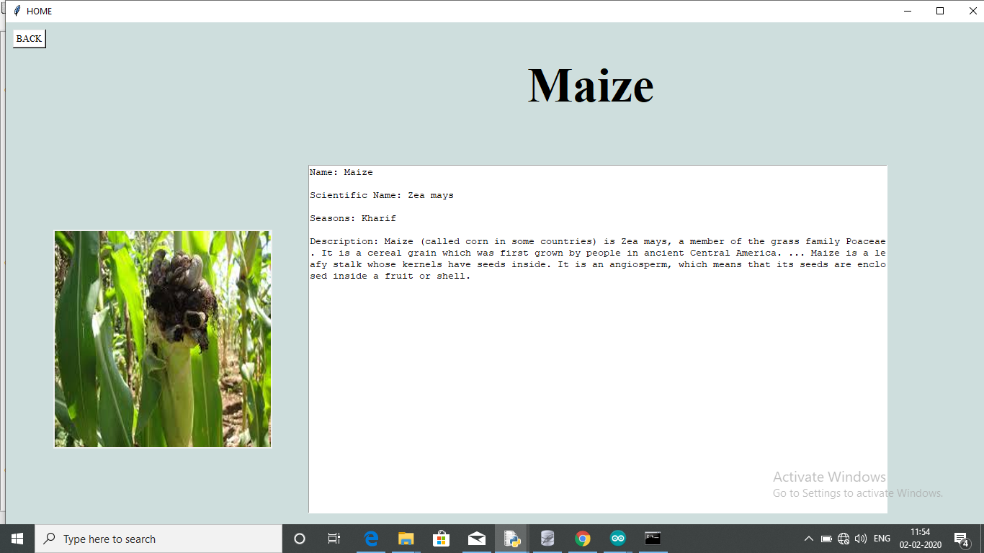

Slide 13
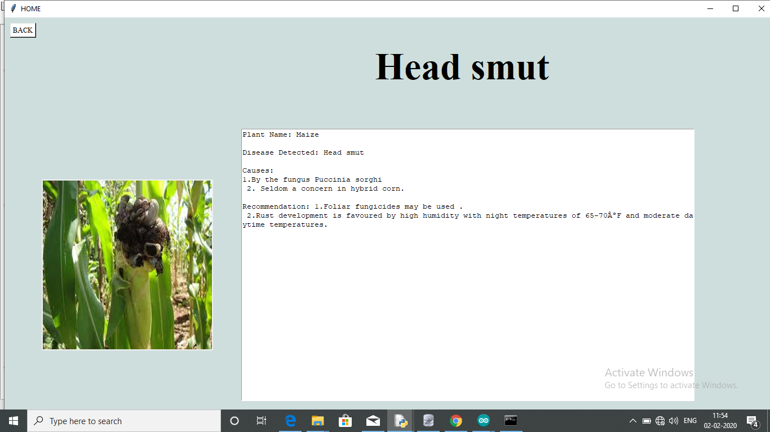

Slide 14

CONCLUSION
Digitalization of the agriculture sector.
Better crop quality, hence increased yield.
May be used to detect plants having medicinal values.
Simple to use interface with just 2 click disease identification.
Zero or no latency, so no buffering up

Slide 15
Thank You

