Slide 1

Designing a Car Alarm System Using
Verilog HDL
Presentation by : Mallikarjun Kumbar

Slide 2
Introduction to Car Alarm Systems :
Car alarm systems are designed to enhance vehicle
security and protect against theft and vandalism.
Components of a car alarm system include sensors,
control units, and sirens.
Common features of car alarm systems include remote
keyless entry, immobilization, and intrusion detection.

Slide 3
Methodology:
D = 1 - The door is closed.
0 - The door is not closed.
K = 1 - The key is in.
0 - The key is not in.
L = 1 - The Driver has the License.
0 - The Driver doesn’t have the License.
B = 1 - The Seat belt is closed.
0 - The Seat belt is not closed
DR = 1 - The Driver is not drunk
0 - The Driver is drunk
V= 1 - Vehicle condition is good
0 - Vehicle condition is not god
I = 1 - Driver is not on call
0 - Driver is on call

Slide 4
TRUTH TABLE :
k | d | l | b | dr | v | i | a
0 | x | x | X | X | X | X | 0
1 | 0 | X | X | X | X | X | 1
1 | 0 | 0 | X | X | X | X | 1
1 | 1 | 0 | X | X | X | X | 1
1 | X | X | X | 0 | X | X | 1
1 | X | X | X | X | 0 | 1 | 1
1 | X | X | X | 1 | 1 | 0 | 1
1 | X | X | 0 | 1 | 1 | X | 1
1 | X | 0 | X | 1 | 1 | X | 1
1 | 0 | X | X | 1 | 1 | X | 1
1 | 1 | 1 | 1 | 1 | 1 | 1 | 0

Slide 5
VERILOG CODE:
module car_alarm (input d, k, l, b, dr, i, v, output reg a);
always @* begin
if (k == 1) begin
if (dr == 0 || v == 0)
a = 1;
else begin
case ({d, l, b, i})
4'b0xxx: a = 1;
4’bx0xx: a = 1;
4’bxx0x: a = 1;
4’bxxx0: a = 1
default: a = 0;
endcase
end
end
else
a = 0;
end
endmodule

Slide 6
RESULT AND ANALYSIS :
The alarm will trigger under the following conditions:
Door Closed: If the door is opened without the proper key.
Key In: If the vehicle is started without the correct key.
Driver's License Present: If the vehicle is operated without a valid driver's license.
Seat Belt Closed: If the driver is not wearing the seatbelt while driving.
Driver Not On Call: If attempting to drive while distracted by a phone call.
Vehicle Condition Is Good: If anomalies in the vehicle's condition are detected.
Driver Is Not Drunk: If the driver is under the influence of alcohol.
.

Slide 7
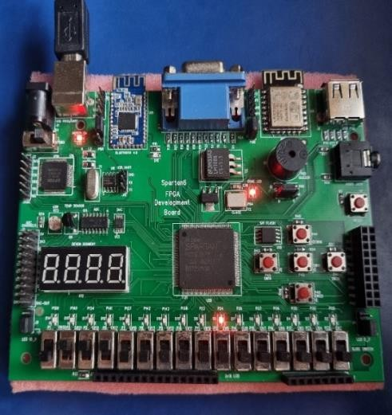
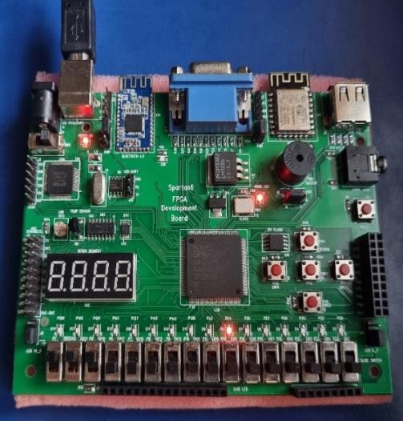
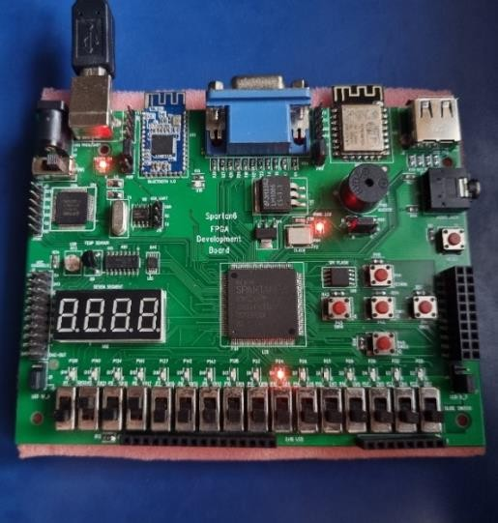
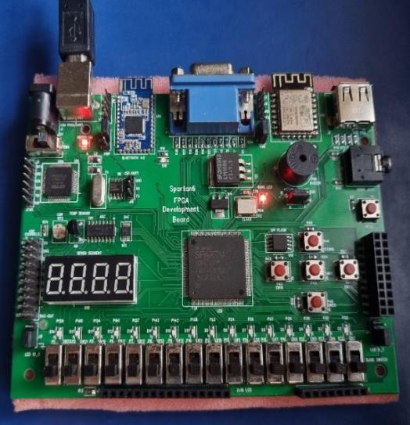
When the input is 0111000
When the input is 1110000
When the input is 0101000
When the input is 0000000

Slide 8
OUTCOME;
A car alarm system can be designed using an FPGA board, which can
process multiple inputs and generate appropriate outputs based on the
programmed logic.[L3]
The system can be designed to trigger an alarm when any one of the
inputs,such as the door being opened,the key is removed,or the seat
being unbuckled,is detected while the car is in a stationary state.[L3]
The system can be designed to perform additional functions, such as
disabling the engine,locking the doors,or sending an alert message to
the owner's mobile device, based on the severity of the situation.[L4]
To increase the accuracy and reliability of the system,the inputs can be
monitored using sensors or switches that provide digital signals to the
FPGA board,which can then process the signals using logical
operators.[L4]
The system can be designed to be customizable, allowing the user to set
specific thresholds or conditions for triggering the alarm or other
functions based on personal preferences or security requirements.[L4]

Slide 9


