Slide 1
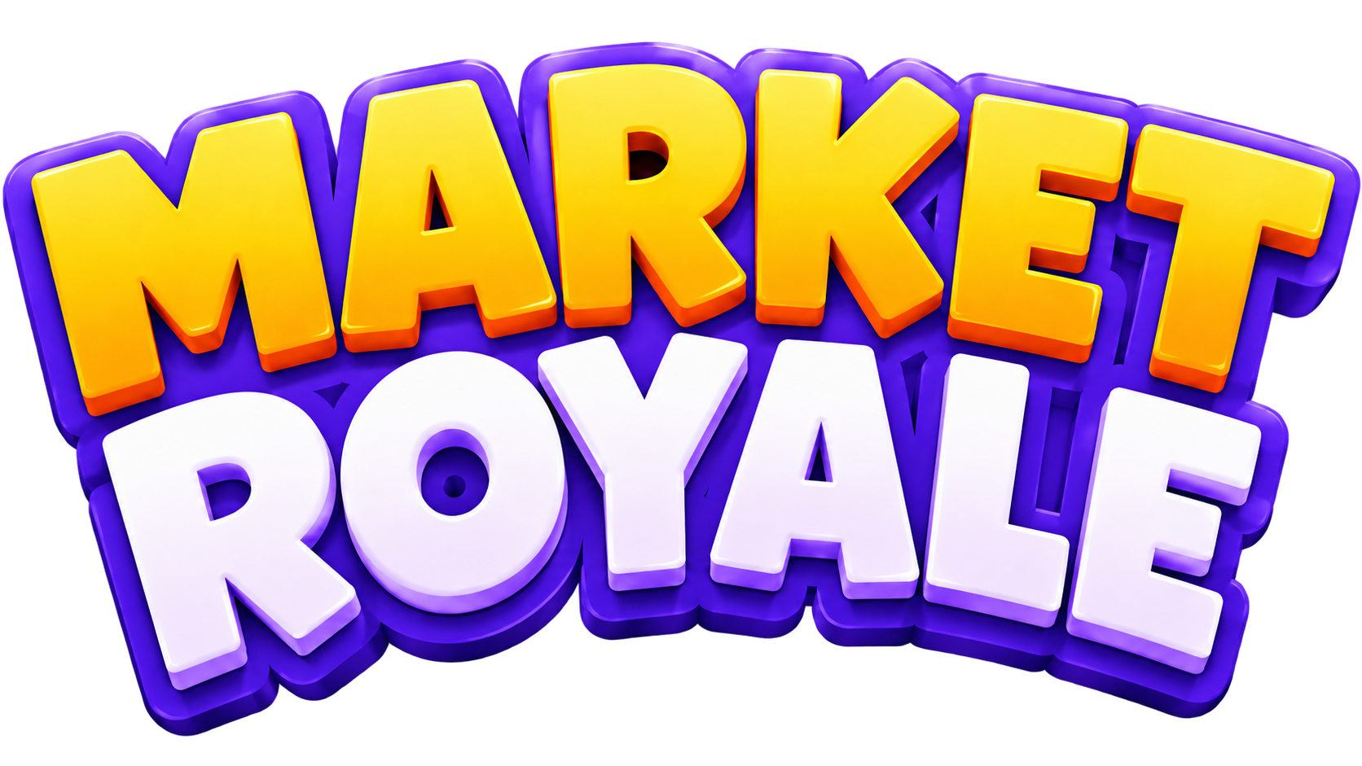

A TRADING BATTLE ROYALE ON DREAMDEX
Equal starting vaults. Live UP/DOWN markets.
The bottom half gets cut.
Somnia × DreamDEX Event Contracts Hackathon
Notes:
Open with the product in one sentence: Market Royale turns DreamDEX Event Contracts into a multiplayer survival game.
Source: repository README and deployed Shannon prototype.

Slide 2

Prediction markets end too early
A position settles, but the user has no shared contest or lasting progression.
Most sessions stop at one trade
The market closes and the experience disappears. Trading stays solitary, while discovery and retention depend on users finding another reason to return.
Market Royale adds a visible field, repeat rounds, and entry-funded stakes around the same DreamDEX liquidity.
THE OPPORTUNITY
Turn market settlement into a social game loop
02
Notes:
Product thesis based on the Market Royale concept and user flow. No external market-size claims are used.

Slide 3

One market becomes a tournament
Every round uses a real rolling DreamDEX Event Contract.
1
2
3
4
5
JOIN
TRADE
SETTLE
SURVIVE
WIN
Equal entry and vault
Buy or sell UP / DOWN
Oracle redeems shares
Bottom half is cut
Prize pool pays out
Survivors advance to a fresh market until one player remains or the round limit is reached.
03
Notes:
Source: contracts/MarketRoyale.sol and README gameplay loop.

Slide 4
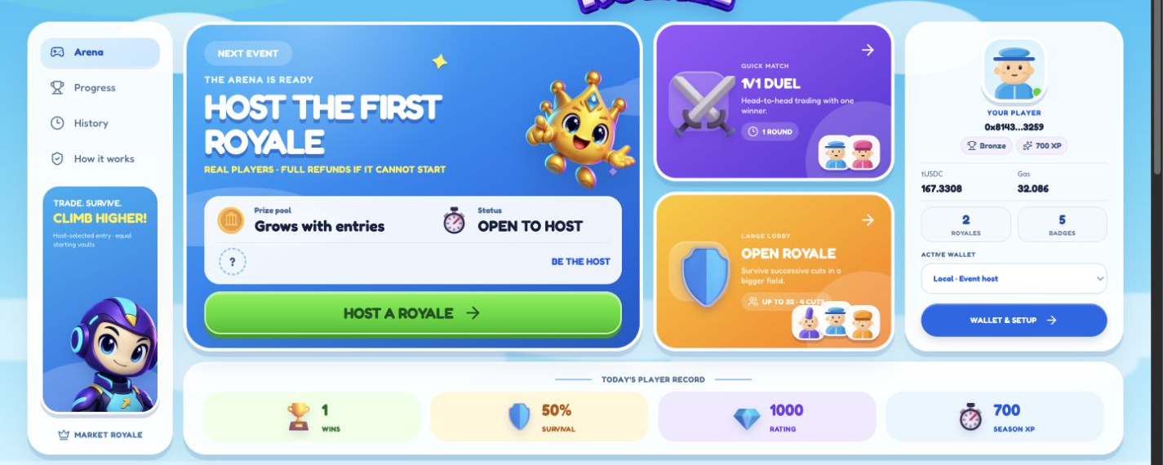
A game-first entry point
The arena makes hosting, wallet state, player progress, and active events visible at a glance.
HOST CONFIGURES THE RULES
04
Notes:
Source image: current local Market Royale Shannon arena, captured 2026-09-06.

Slide 5

Fair competition starts with equal vaults
Ranking follows settled bankroll performance rather than trade count or wallet wealth.
FINAL BANKROLL
cash + redeemed outcome value
RANK
Highest settled bankroll leads the field.
CUT
The bottom half leaves after each round.
TIES
Earlier on-chain entry wins an exact tie.
EQUAL
0%
PRIZES
A duel pays first. Larger fields pay the top three.
starting bankroll for every entrant
arena cut from the entry pool
05
Notes:
Source: contracts/MarketRoyale.sol. Prize weights are 80/128, 30/128, and 18/128 for fields with at least three entrants.

Slide 6

Contracts enforce the tournament
The operator advances public state. Player vaults keep custody boundaries on-chain.
PLAYER
WALLET
MARKET
ROYALE
TRADER
VAULT
DREAMDEX
CLOB
ORACLE
CLOUDFLARE KEEPER
liquidity, settlement, recovery
PROGRESSION
rating, XP, badges
Payouts can only return to the original player
06
Notes:
Sources: contracts/MarketRoyale.sol, contracts/MarketRoyaleProgression.sol, workers/keeper.ts, and README architecture section.

Slide 7

DreamDEX stays at the center
Market Royale changes the experience around Event Contracts while preserving real market execution.
LIVE BOOK
UP and DOWN prices come from the public CLOB.
IOC EXECUTION
Orders can fill partially without locking stale intent.
DEPTH PREVIEW
The ticket estimates fill, average price, and proceeds.
REALIZED P&L
Closing a position shows the confirmed vault result.
BTC + ETH
Rolling public Event Contracts
ORACLE PAYOUT
Settlement redeems the actual on-chain payout vector.
07
Notes:
Sources: lib/testnet/server.ts, app trading ticket, and @somnia-chain/markets-sdk 0.28.1 integration.
Official developer documentation: https://docs.dreamdex.io/developers/event-contracts

Slide 8

Failure paths preserve player funds
The contract defines what happens when participation, markets, or automation fail.
NO QUORUM
Cancel after entry closes and return eligible deposits.
NO FILLED TRADES
Cancel at expiry instead of awarding an idle winner.
ORACLE OR MARKET STALL
Unlock timeout recovery after the defined grace period.
KEEPER RESTART
Reuse the journaled transaction, hash, and nonce.
Recovery always pays the original player
08
Notes:
Sources: contracts/MarketRoyale.sol, workers/keeper.ts, and docs/OPERATIONS.md failure safeguard table.

Slide 9
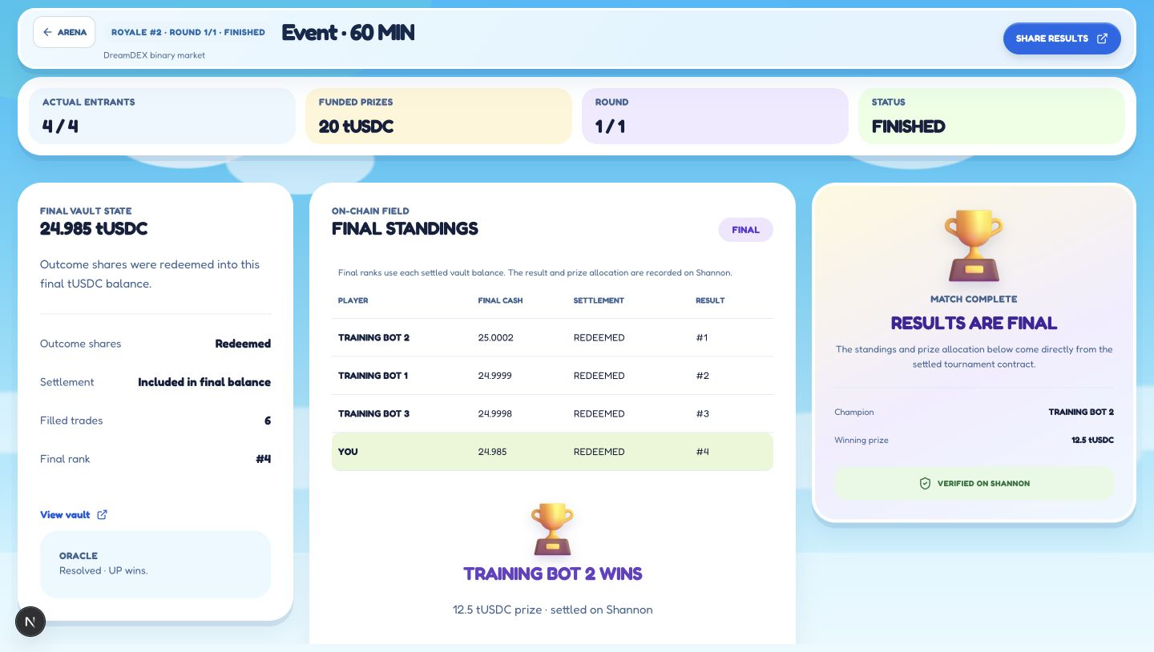
Public Shannon proof
The working prototype settles real DreamDEX positions and records final ranks on chain.
64
8
players in the full settlement test
soulbound achievement badges
4
0%
labeled bots trading on testnet
entry-pool cut taken by the arena
ARENA V5
0x4a17…80cd
09
Notes:
Sources: deployments/shannon-v5.json, deployments/shannon-progression-v4.json, deployments/shannon-training-bots.json, and tests/testnet.test.mjs.
Shannon explorer: https://shannon-explorer.somnia.network/address/0x4a17dc5e798e68060e6e8cadbf795531557880cd

Slide 10

Why DreamDEX benefits
Tournament play creates repeat Event Contract order flow.
DISCOVERY
A familiar game format brings new users into Event Contracts.
ACTIVITY
Every entrant trades against the real DreamDEX book.
NEXT
RETENTION
Rounds, rating, seasons, and badges reward returning players.
Public Cloudflare launch
Human verification
Independent contract audit
Community seasons
TRADE REAL MARKETS. SURVIVE THE CUT.
Notes:
Close on ecosystem impact and the concrete next steps.
Hackathon criteria source: https://dorahacks.io/hackathon/event-contracts/detail

