Slide 1
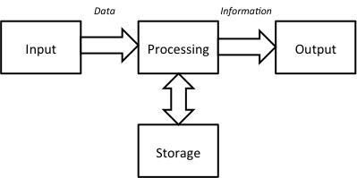
Data
Information
Input
Processing
Output
Storage
Communication
Subsystem A
Subsystem B

