Slide 1
Module 4 Basic Query Formulation with SQL
Lesson 3: Join Operator
Notes:
Welcome to lesson 3 of Module 4 on basic query formulation with SQL
Query formulation is an important skill in application development.
Everyone involved in the application development must be competent in query formulation.
Most students will be involved (at least initially) in application development rather than in a role as a database specialist. Database specialists must also understand query formulation and SQL.
Opening question:
- Why is the join operator so important in query formulation?

Slide 2
Lesson Objectives
Create the result of a join operation on sample tables
Briefly explain the components of the natural join operator
Notes:
Join result: see example in later slides of this lesson

Slide 3
Natural Join Example I
Offering
OfferNo | FacNo
1111 | 111-11-1111
2222 | 222-22-2222
3333 | 111-11-1111
Faculty
FacNo | FacName
111-11-1111 | JOE
222-22-2222 | SUE
333-33-3333 | SARA
Notes:
To begin the animation, let's use small input tables:
- Small version of the Offering and Faculty tables
- Use small versions because of screen limitations and focus attention on essential ideas
- Same ideas apply to tables with more rows and columns
- Using small tables can help you to understand the natural join operation
- Useful for difficult problems
Join condition: Faculty.Facno = Offering.FacNo (highlight columns)
- Natural join requires same unqualified names and equality as comparison operator
Matching rows:
- First Faculty row matches with rows 1 and 3 of Offering (point)
- Second Faculty row matches with row 2 of Offering (point)
- Third Faculty row does not match any Offering rows
- Natural join: discard one of the join columns (one column is duplicate)
- Column discarded does not matter here

Slide 4
Natural Join Example II
Offering
OfferNo | FacNo
1111 | 111-11-1111
2222 | 222-22-2222
3333 | 111-11-1111
Faculty
FacNo | FacName
111-11-1111 | JOE
222-22-2222 | SUE
333-33-3333 | SARA
Faculty Natural Join Offering
OfferNo
FacNo
FacName
1111
111-11-1111
JOE
Notes:
First Offering row combines with the first Faculty row
Notice that the OfferNo column comes from the Offering table
The FacNo and FacName columns come from the Faculty table.

Slide 5
Natural Join Example III
Offering
OfferNo | FacNo
1111 | 111-11-1111
2222 | 222-22-2222
3333 | 111-11-1111
Faculty Natural Join Offering
OfferNo
FacNo
FacName
Faculty
FacNo | FacName
111-11-1111 | JOE
222-22-2222 | SUE
333-33-3333 | SARA
1111
111-11-1111
JOE
2222
222-22-2222
SUE
Notes:
Second Offering row combines with the second Faculty row

Slide 6
Natural Join Example IV
Offering
OfferNo | FacNo
1111 | 111-11-1111
2222 | 222-22-2222
3333 | 111-11-1111
Faculty Natural Join Offering
OfferNo
FacNo
FacName
1111
111-11-1111
JOE
Faculty
FacNo | FacName
111-11-1111 | JOE
222-22-2222 | SUE
333-33-3333 | SARA
2222
222-22-2222
SUE
3333
111-11-1111
JOE
Notes:
Third Offering row combines with the first Faculty row
Third Faculty (SARA) row does not participate in the result (faculty not teaching perhaps a research faculty).
Repeat this exercise yourself using your own small tables

Slide 7
Join Operator
Most databases have many tables
Combine tables using the join operator
Specify matching condition
Can be any comparison but usually =
PK = FK most common join condition
Relationship diagram useful when combining tables
Notes:
Most joins follow relationship diagram
- PK-FK comparisons
- What tables can be combined directly versus indirectly
Examples:
Combine course and offering: compare on Course.CourseNo to Offering. CourseNo
Combine Course and Faculty: compare on Course.CourseNo to Offering. CourseNo and Offering.FacNo to Faculty.FacNo

Slide 8
Natural Join Operator
Most common join operator
Requirements
Equality matching condition
Matching columns with the same unqualified names
Remove one join column in the result
Usually performed on PK-FK join columns
Notes:
You should understand a common variation of the join operator.
SQL has a natural join operator but will not use it in examples (later lessons) because natural join operator omits specification of join columns making a statement more difficult to read.

Slide 9
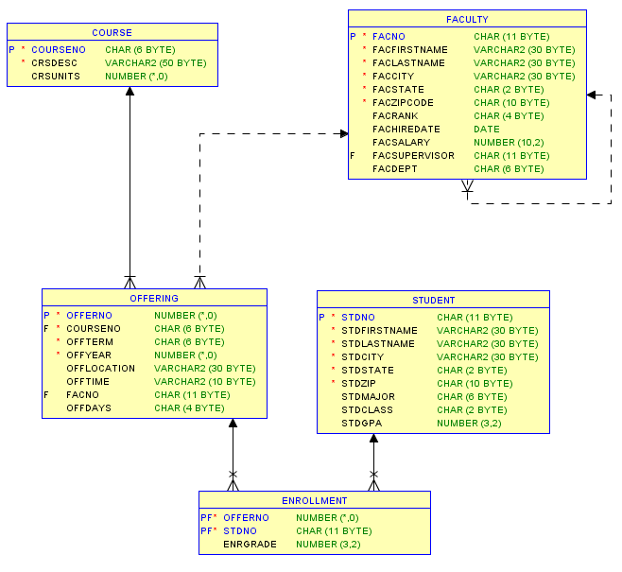
University Database Diagram
Notes:
Use university database for examples
University database was covered in previous modules so you should be familiar with it.
When formulating problems involving the join operator (typically used to combine tables), you should know the relationships in a database diagram.
Natural join example:
Student Natural Join Enrollment (circle tables)
Join using Student.StdNo = Enrollment.StdNo (underline columns)
All columns from both tables in the result except either Student.StdNo or Enrollment.StdNo

Slide 10
Summary
Essential operator in query formulation
Use sample tables to learn the join operator
Explicit join specification in the SELECT statement
Notes:
Join operator is essential because business databases typically have many tables. Extracting useful information typically requires more than one table, sometimes many tables.
You should try the simple exercise in this lesson on your sample tables. You can use the same tables and create new rows.
Other lessons in this module and the next module will give you lots of practice with join operations in SQL.
Will not use natural join as explicit specification is easier to read

