Slide 1
Module 5 Extended Query Formulation with SQL
Lesson 1: Query Formulation Guidelines
Notes:
Welcome to lesson 1 of Module 5 on extended query formulation with SQL
Query formulation is an important skill in application development.
Everyone involved in the application development must be competent in query formulation.
Most students will be involved (at least initially) in application development rather than in a role as a database specialist. Database specialists must also understand query formulation and SQL.
Opening question:
- What are the critical questions that you should articulate before writing a SELECT statement?

Slide 2
Lesson Objectives
Convert a problem statement into a database representation using the critical questions
Identify extra tables in a SELECT statement
Notes:
Convert a problem statement into a database representation
Use critical questions
Before writing SELECT statement
Recognize inefficient elements
Extra tables
Row conditions in HAVING

Slide 3
Query Formulation Process
Problem Statement
Database
Representation
SELECT
Statement
Notes:
Problem statement:
- Ill formed (without structure)
- Most difficult part is to structure the problem statement (convert to db representation)
- Convert problem vocabulary into database vocabulary
- Problem statement is often ambiguous and incomplete
Database representation: answers to query formulation questions
- Tables
- Columns
- Conditions
DB Language statement:
- SQL or other language
- Easy part after some practice

Slide 4
Critical Questions
What tables?
Columns in result
Conditions to test (including join conditions)
How to combine the tables?
Usually join of PK to FK
More complex ways to combine
Individual rows or groups of rows?
Aggregate functions in result
Conditions with aggregate functions
Notes:
Answer questions explicitly or implicitly
- Initially answer explicitly
- As you gain skill, implicitly answer

Slide 5
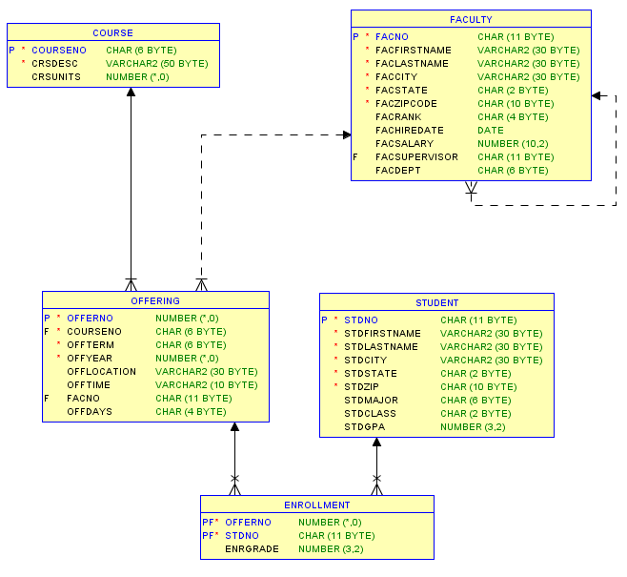
University Database Diagram
Notes:
Use database diagram to answer critical questions
Try to identify the tables using the database diagram in the following examples.

Slide 6
Summarization and Joins I
Example 1: List the number of students enrolled in each 2017 course offering showing the offer number and number of students in the result.
SELECT Offering.OfferNo,
COUNT(*) AS NumStudents
FROM Enrollment, Offering
WHERE Offering.OfferNo = Enrollment.OfferNo
AND OffYear = 2017
GROUP BY Offering.OfferNo;
Notes:
What tables?
Enrollment table because counting enrollment rows
Offering table because of condition on OffYear
Student table is not required because the enrollment rows are counted for each offering
How are tables connected?
- Join Offering and Enrollment on OfferNo
Individual rows versus row summaries
- Row summaries as result includes the count of enrollment rows (number of students)
Can also use the join operator style

Slide 7
Summarization and Joins II
Example 2: List the offering number, course number, and average GPA. Only include courses offered in fall 2016 in which the average GPA is greater than 3.0.
SELECT Enrollment.OfferNo, CourseNo,
AVG(StdGPA) AS AvgGPA
FROM Offering, Enrollment, Student
WHERE Offering.OfferNo = Enrollment.OfferNo
AND Student.StdNo = Enrollment.StdNo
AND OffYear = 2016 AND OffTerm = 'FALL'
GROUP BY Enrollment.OfferNo, CourseNo
HAVING AVG(StdGPA) > 3.0;
Notes:
Example 2 demonstrates a problem involving joins and grouping.
Critical questions:
What tables?
Student because student GPA column used
Offering because course number in the result
Enrollment: connecting Student and Offering
How connected? PK-FK
Individual rows versus row summaries: row summaries because of average GPA in the result and condition on average GPA so a HAVING clause is needed.
Other observations
Join style (cross product versus join operator) is a matter of preference.
See Module 5 examples for an equivalent statement using the join operator style

Slide 8
Efficiency Considerations
Little concern for efficiency
Intelligent SQL compilers
Correct and non redundant solution
No extra tables
No unnecessary grouping
No missing join conditions
Notes:
Ideally little concern for efficiency
SQL compilers:
- Consider thousands of alternative plans to evaluate the query
- Should not be sensitive to the order of joins or join style
- Complex queries do require efficiency concern: advanced db course topic
Eliminate redundancy:
- Slows performance
- Avoid extra tables: performance most sensitive to the number of joins
- Grouping is also expensive: avoid if not necessary
- Slow performance if row conditions in HAVING
- Improve performance by reducing the size of intermediate tables through WHERE conditions

Slide 9
Extra Table Redundancy
Example 3: List the offering number, course number, and average GPA. Only include courses offered in fall 2016 in which the average GPA is greater than 3.0.
SELECT Enrollment.OfferNo, Offering.CourseNo,
AVG(StdGPA) AS AvgGPA
FROM Offering, Enrollment, Student, Course
WHERE Offering.OfferNo = Enrollment.OfferNo
AND Student.StdNo = Enrollment.StdNo
AND Course.CourseNo = Offering.CourseNo
AND OffYear = 2016 AND OffTerm = 'FALL'
GROUP BY Enrollment.OfferNo, Offering.CourseNo
HAVING AVG(StdGPA) > 3.0;
Notes:
Example 3 demonstrates a redundant table for the same problem statement as Example 2.
Redundancy
Course table is not needed because CourseNo column can be taken from the Offering table.
Course is required for an offering.
SELECT statement will execute more slowly because an extra table (Course) must be retrieved.
See Module 5 examples for an equivalent statement using the join operator style

Slide 10
Summary
Remember the query formulation process
Use critical questions to convert a problem statement into a database representation
Check for unnecessary tables and missing join conditions
Much practice with more difficult problems involving joins and grouping
Notes:
Query formulation process
Transform problem statement into a database representation using the critical questions
Convert database representation into a SELECT statement using similar examples.
The critical questions are the most important problem solving aid.

Slide 11
Database Representation to SQL Statement

