Slide 1

Credit Card Fraud Detection
End-to-End Analytics, Machine Learning & Explainable AI
Consulting Case Study

Slide 2
Executive Summary
Designed an enterprise-grade fraud detection solution for financial services
Balanced fraud detection accuracy with customer experience
Implemented Explainable AI to support trust and regulatory compliance
Delivered executive and operational dashboards using Power BI Service

Slide 3
Business Problem
Credit card fraud causes direct financial losses and reputational damage
High false positives lead to poor customer experience
Regulators require transparency in automated decision-making
Need for scalable, explainable, and actionable fraud analytics

Slide 4
Project Objectives
Accurately identify fraudulent transactions
Prioritize high-risk cases for investigation
Explain model decisions to non-technical stakeholders
Enable executive and operational decision-making

Slide 5
Data Overview
Highly imbalanced credit card transaction dataset (<1% fraud)
Anonymized behavioral features (PCA components)
Transaction amount and time features
Binary fraud classification target

Slide 6
Analytics & ML Approach
Baseline model: Logistic Regression
Advanced models: Random Forest, XGBoost
Evaluation focused on Recall, Precision, F1, ROC-AUC
Random Forest selected for optimal balance of performance and explainability

Slide 7
Explainable AI (SHAP)
Applied SHAP to interpret model predictions
Identified key drivers influencing fraud risk
Enabled transparency and auditability
Aligned with Responsible AI principles

Slide 8
Dashboard Strategy
Built entirely using Power BI Service (Web)
All KPIs and risk logic pre-computed in Python
Designed separate views for executives, operations, and compliance
Interactive drill-down for investigation

Slide 9
Operational Dashboard Highlights
Executive overview of fraud exposure
High-risk transaction analysis with conditional formatting
Customer-level drill-down for root-cause analysis
Merchant and risk-segment prioritization

Slide 10
Model Explainability Dashboard
Top fraud drivers ranked using SHAP
Clear business interpretation of model behavior
Supports compliance and governance requirements
Builds stakeholder trust in automated decisions

Slide 11
Business Impact
Improved prioritization of high-risk fraud cases
Reduced analyst effort through visual triage
Enhanced transparency and regulatory readiness
Enterprise-ready analytics deployment

Slide 12
Key Takeaways
Fraud analytics must balance accuracy, explainability, and actionability
Explainable AI is critical for financial services adoption
Tool constraints can be addressed with thoughtful design
End-to-end ownership drives real business value

Slide 13
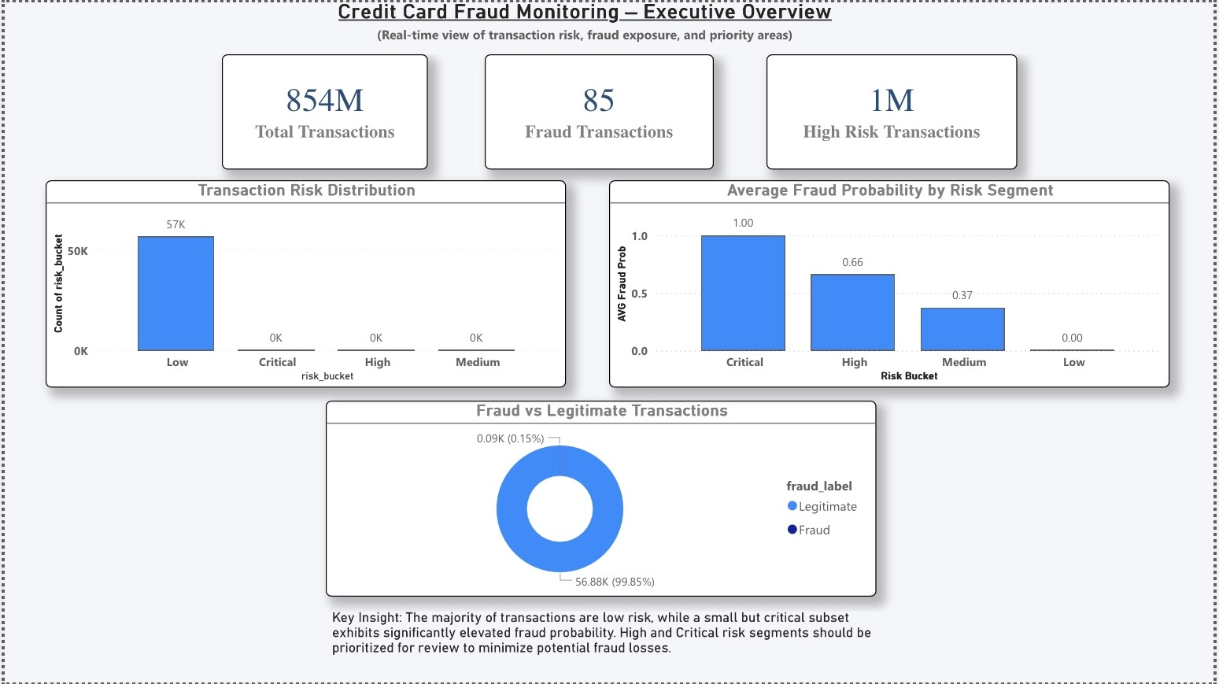
Fraud Monitoring Dashboard – Executive Overview
(Page 1: KPIs, Risk Distribution, Fraud Overview)

Slide 14
Fraud Monitoring Dashboard – Risk Analysis
(Page 2: High-Risk Transactions, Conditional Formatting, Slicers)

Slide 15
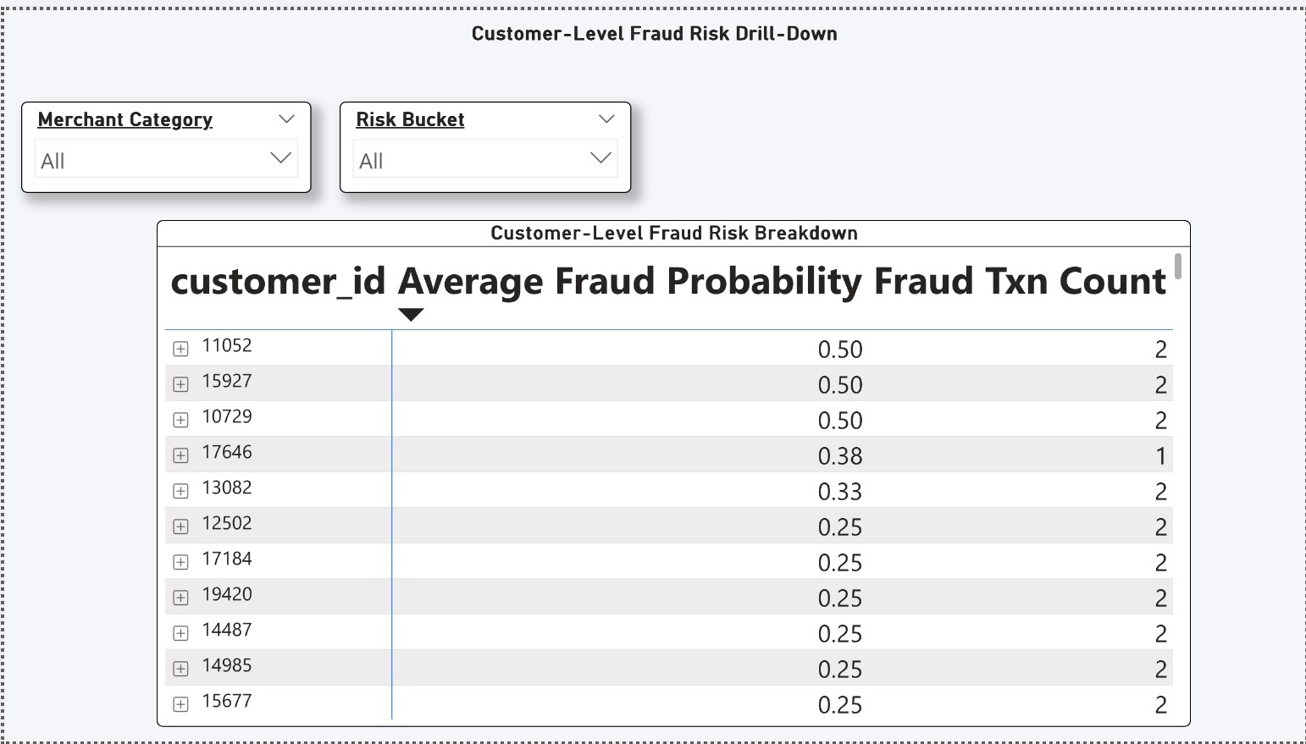
Fraud Monitoring Dashboard – Customer Drill-Down
(Page 3: Customer → Risk → Merchant Drill-Down)

Slide 16
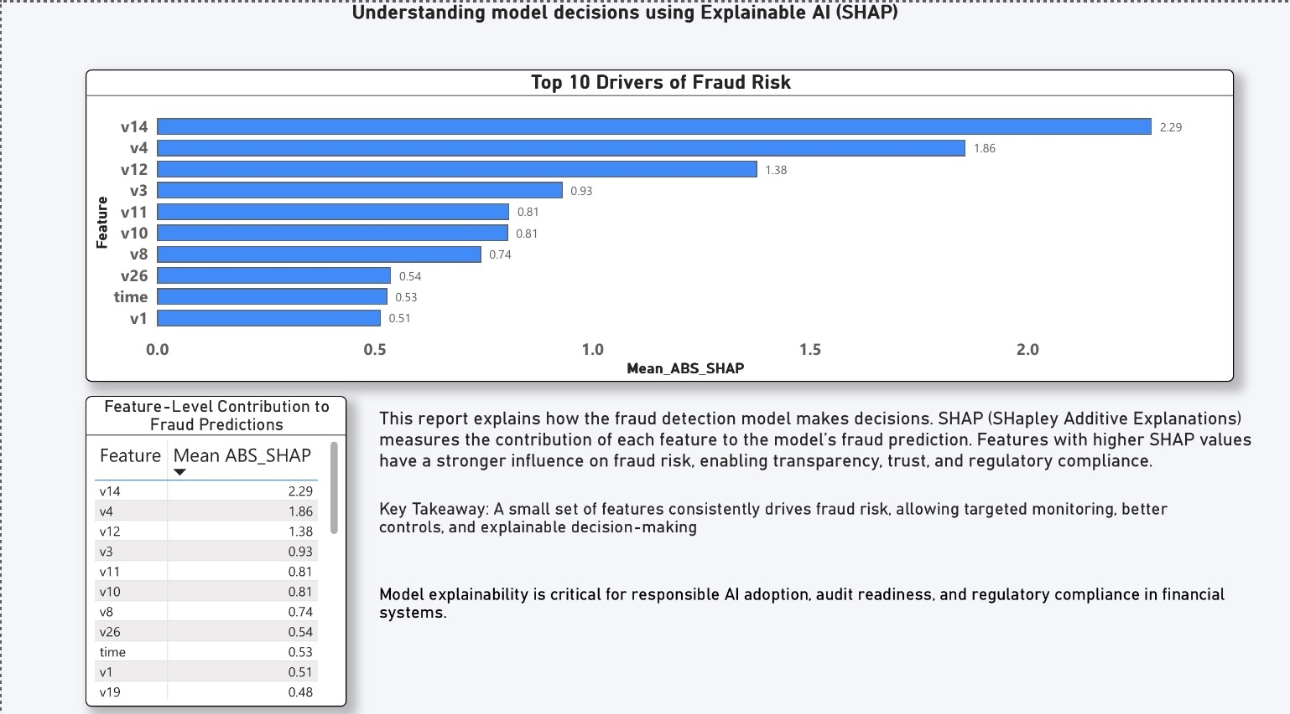
Model Explainability Dashboard (SHAP)
(Top Fraud Drivers, SHAP Feature Importance)

